Slide 1
The classified (r)evolution How Carsnip is using dynamic data to power search. Alastair Campbell

Slide 2


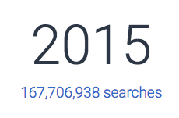
Who Am I
Founder of Carsnip.com
Previously CompanyCheck.co.uk
Notes:
Carsnip is a PPC car listing website has gone from an idea at a kitchen table to partnering with Halfords, Yell and 20 more Q4.
4 background, Company Check and strategies we use today are from lessons learned in how to make a dent into a crowded marketplace where the Goliaths ‘own’ the space.
when I left CC it doing 170m company searches / year.

Slide 3
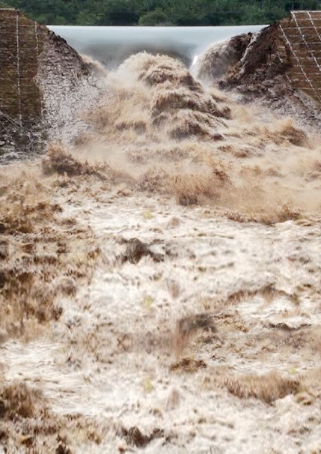
What has changed?
Listings data is now a commodity
Paying to list will cease to be sustainable
Change was slow but now faster
I think, the dam has burst, and…
Consumer data and personalisation is the key for future growth and revenue.
Notes:
Listings are a commodity –
Paying to list is dead
Slow slow but get a grip
Dam has burst
Consumer data – IS FUTURE
What is replacing it? Data driven insight and actionable information to help better match consumer and sellers,.

Slide 4
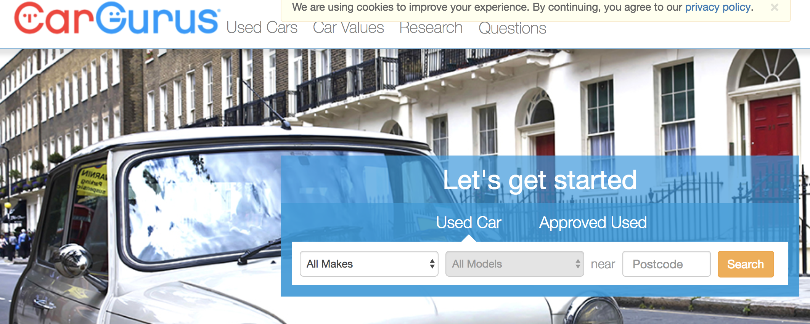
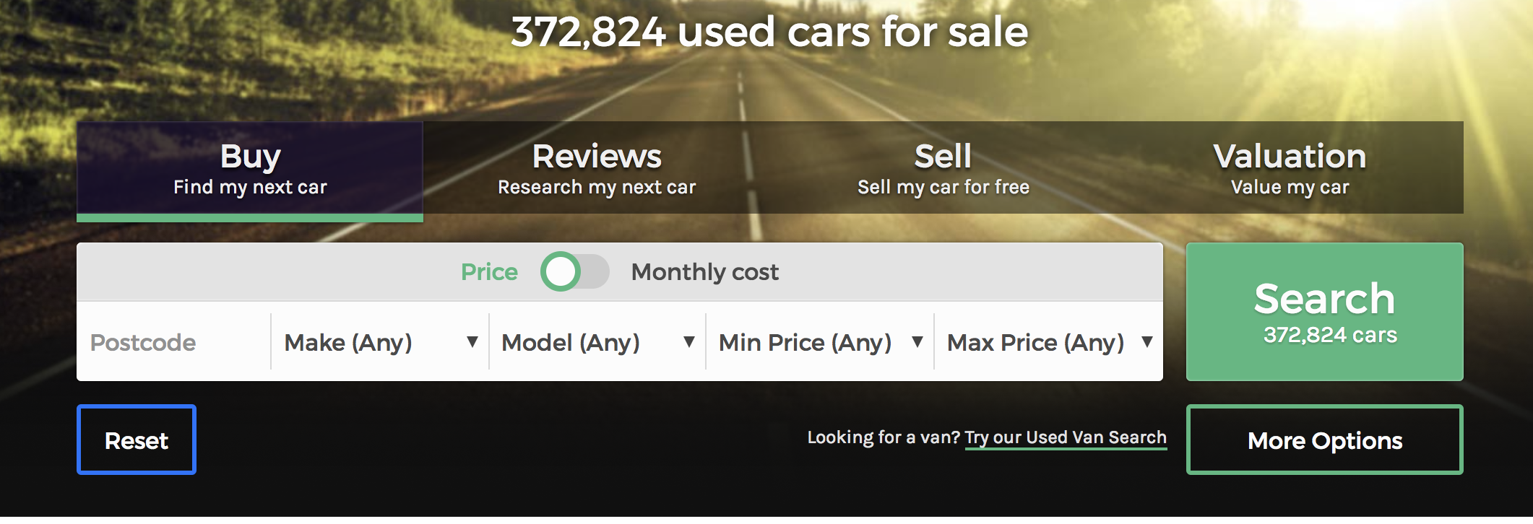
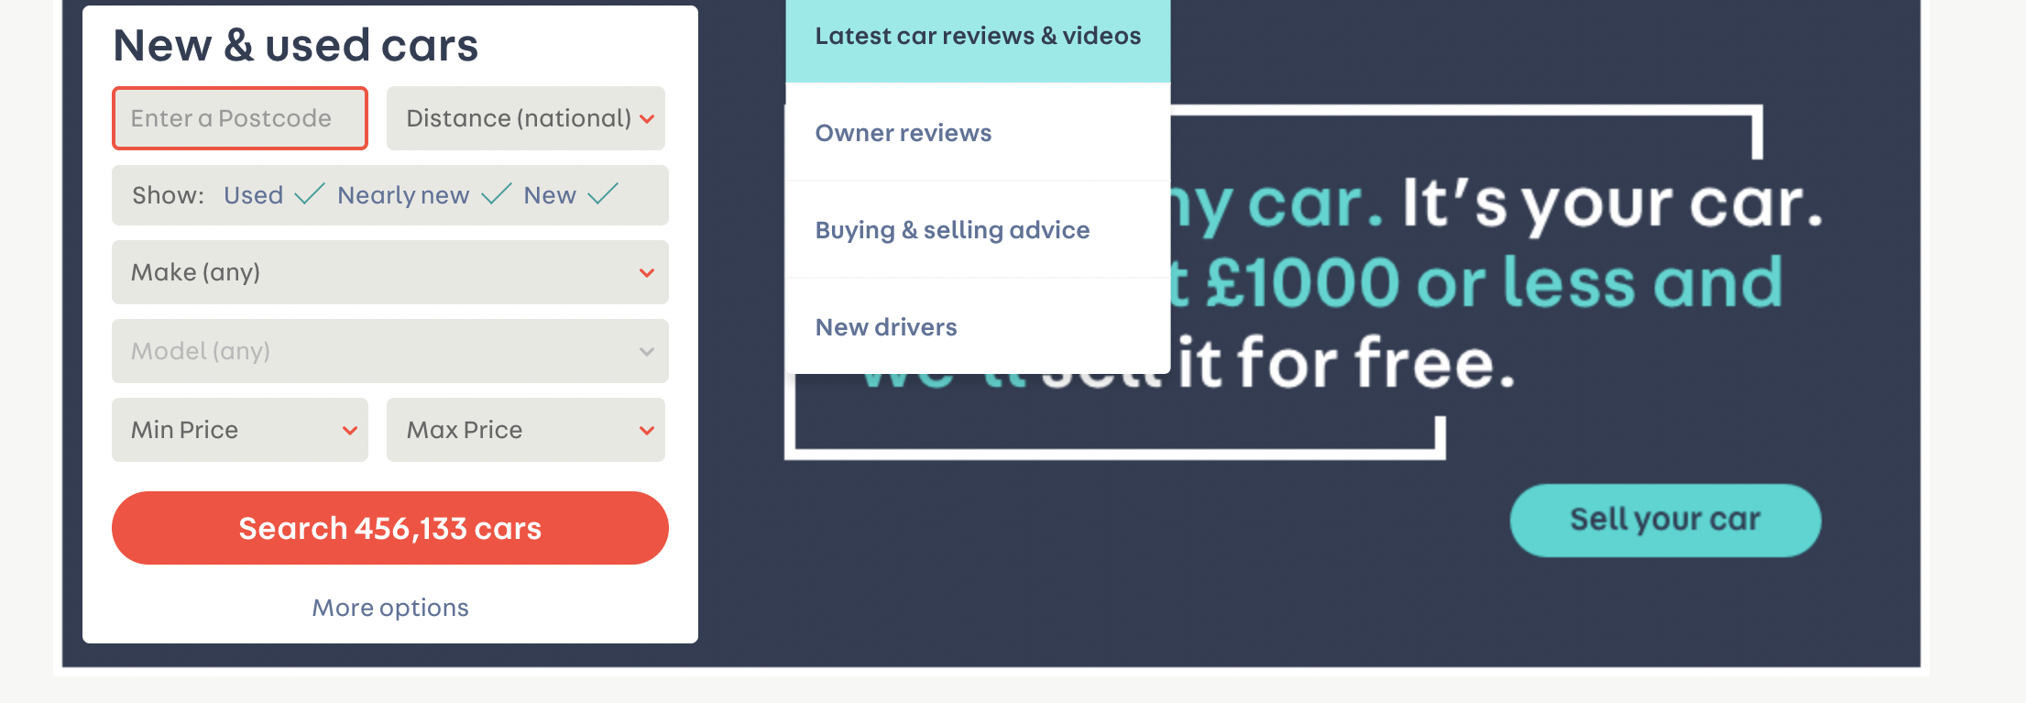
How it works now…
Notes:
Is that the best search we can do?
Not much data here?

Slide 5
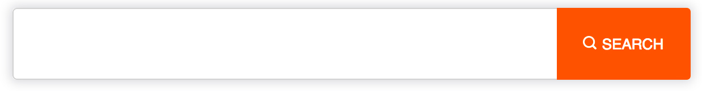
Let’s build natural search
Suzuki grand vitara 3dr
tesla london
toyota avensis excel auto
7 seats, London, £20,000
bmw x5 2008
mercedes C300H hybrid
Mercedes E63 MG or Audi RS6
vauxhall viva melton mowbray
BMW 3 series m sport
bmw 3 series london
“Carsnip has huge potential, why wouldn’t dealers want clicks from a niche vertical search engine.” Google Exec.
Notes:
Everyone knows this - it might take a while but for most consumers this is not the step change that the sector thinks .

Slide 6
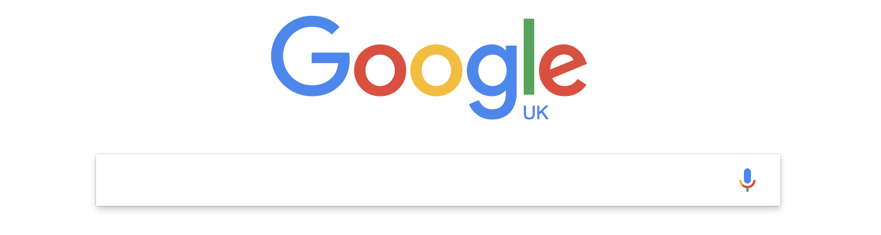
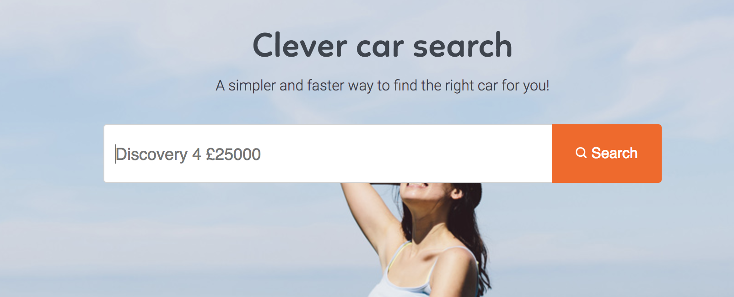
It’s not rocket science!
Carsnip ☺

Slide 7
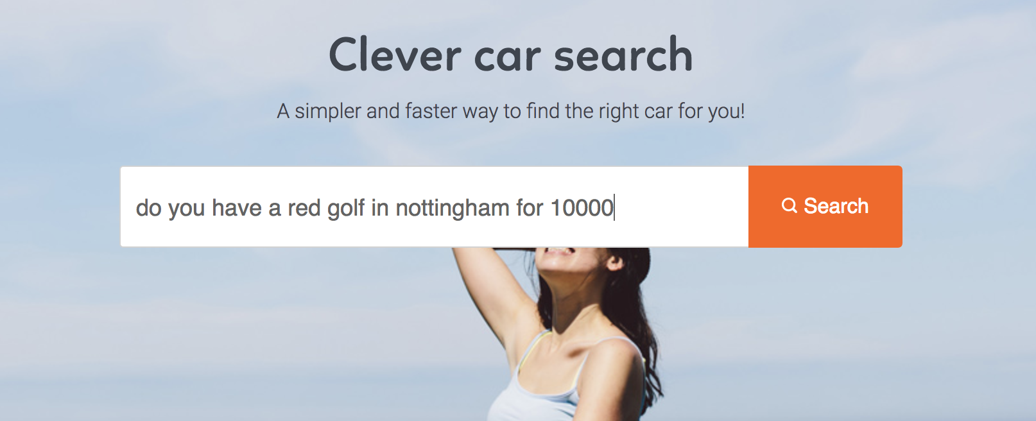
Search like a human

Slide 8
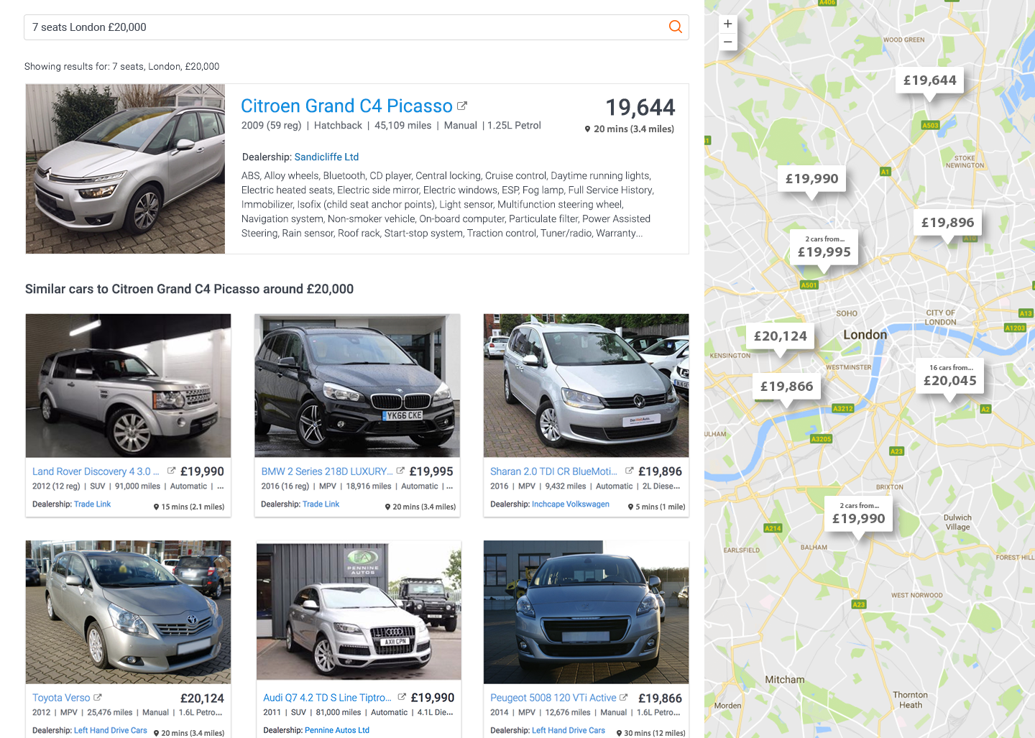
Get results like you are used to in modern web apps.

Slide 9
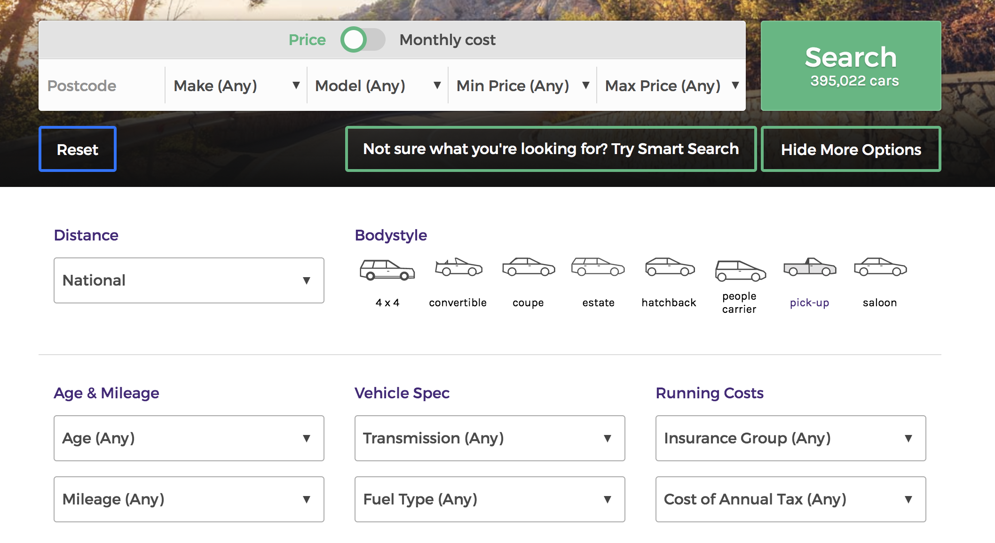
Not this…

Slide 10
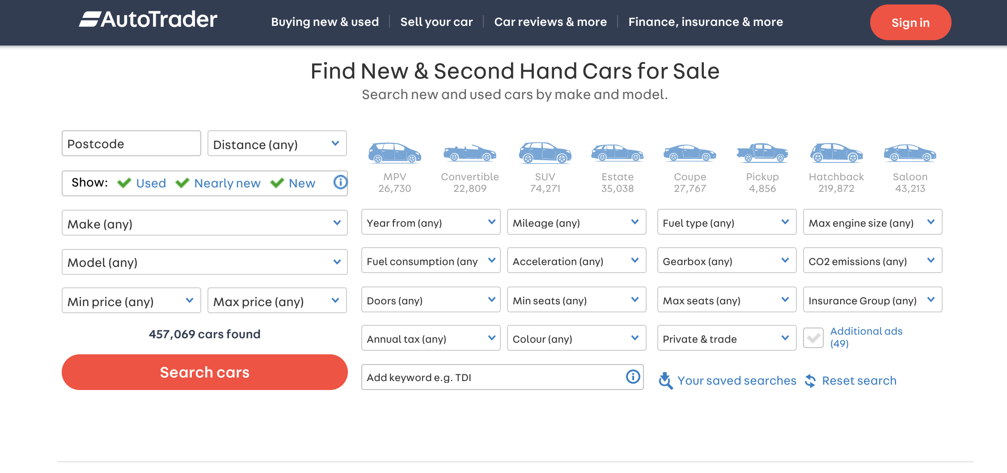
Or worse, this!

Slide 11
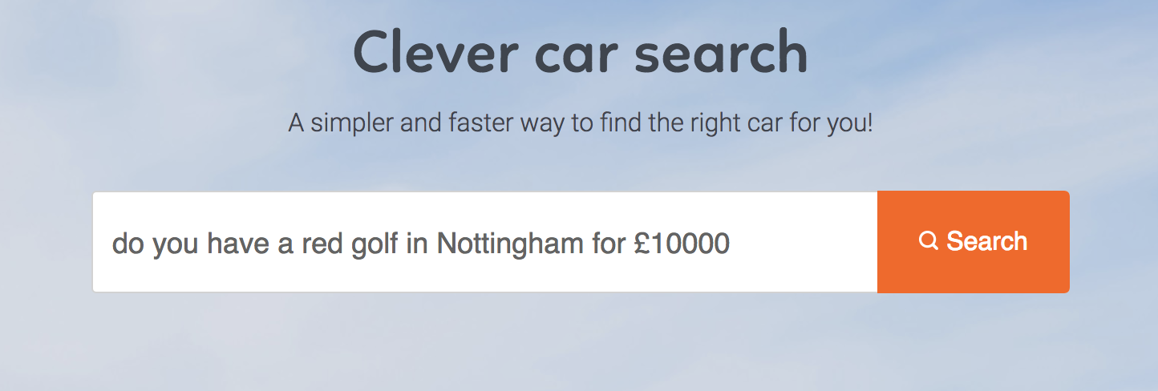
The way people search for everything else

Slide 12

So, what’s the big deal?

Slide 13
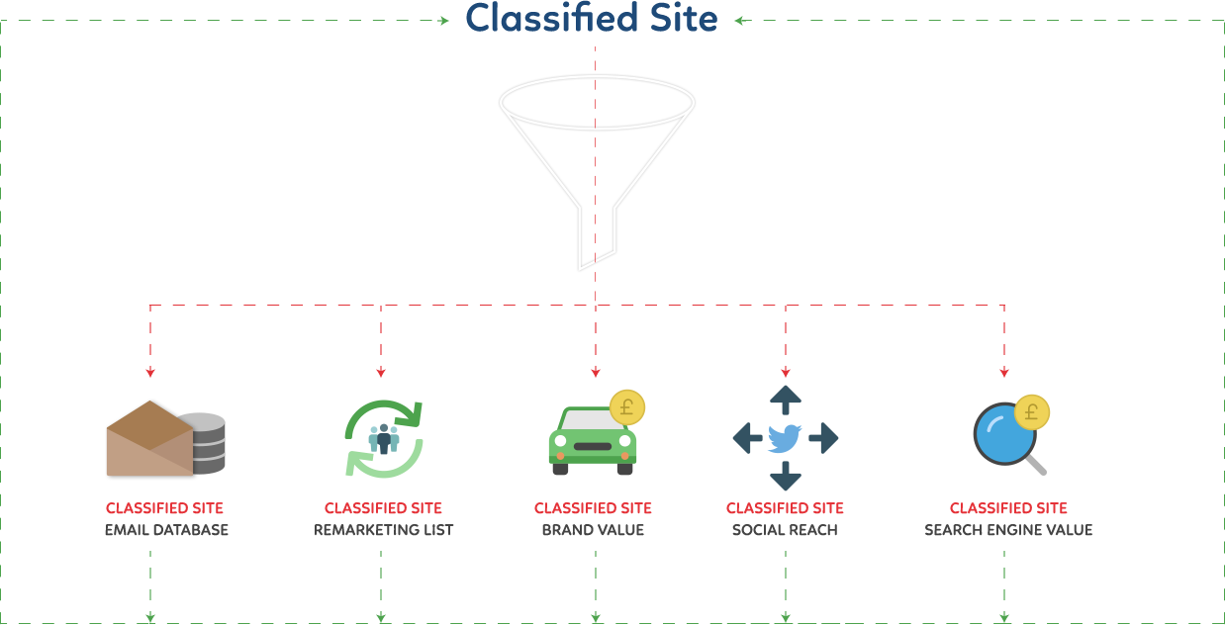
How it works now…
Notes:
Well, before we dive deeper into this , lets start with existing portals, historically this is how it works..

Slide 14
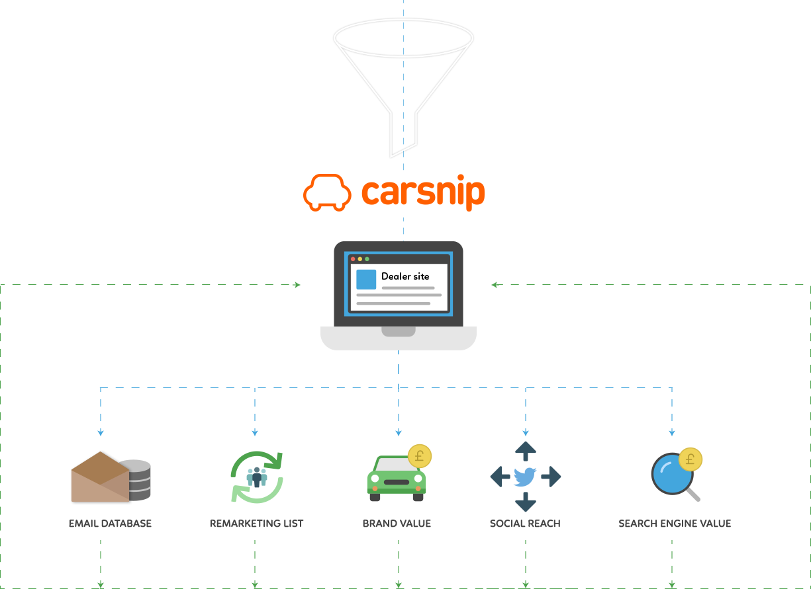
How the future looks
Notes:
We fundamentally shift the bigger opportunity back to the dealers, our customers
And only on performance where the market sets the price – 2 huge fundamental shifts
Giving dealers ability to play in the same game – something the current portals/classified construct is not efficient at

Slide 15













Notes:
Our traffic partners send us consumers and data , we assist with the search, gather more data and pass the clicks directly to the dealer site
This has many advantages…

Slide 16
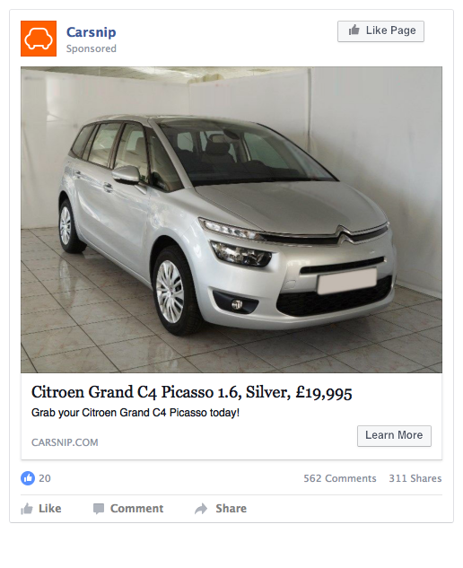
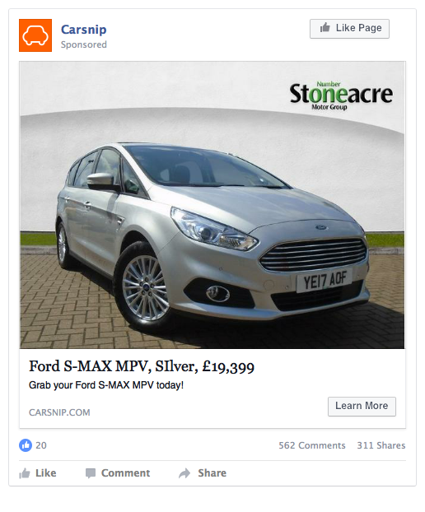
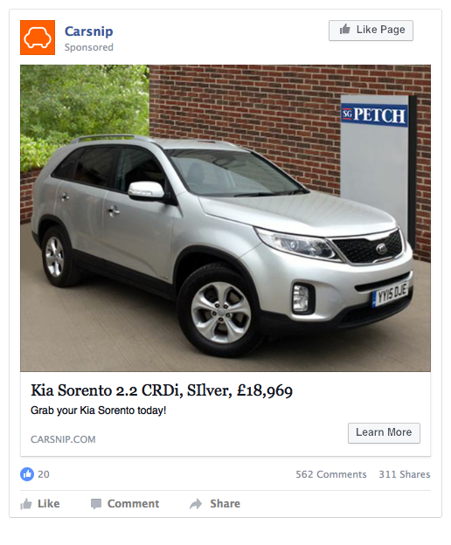
Focussed Remarketing
Notes:
remarking advertising targeted at the consumers intent with 7 seaters in correct colours and price bands.
And if they cannot do that yet – they can pay us and we will do it for them. - still olyu charging per click

Slide 17
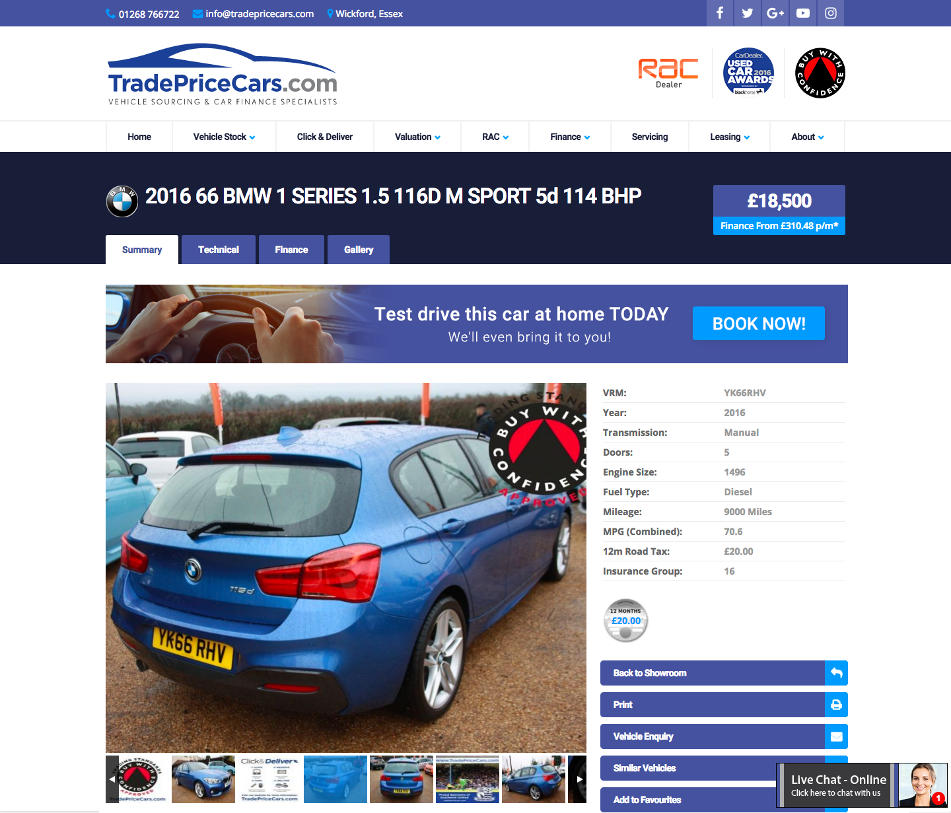
Localisation
Notes:
Localization – here it’s a test drive because we know the uses is within 20 miles of the dealership

Slide 18
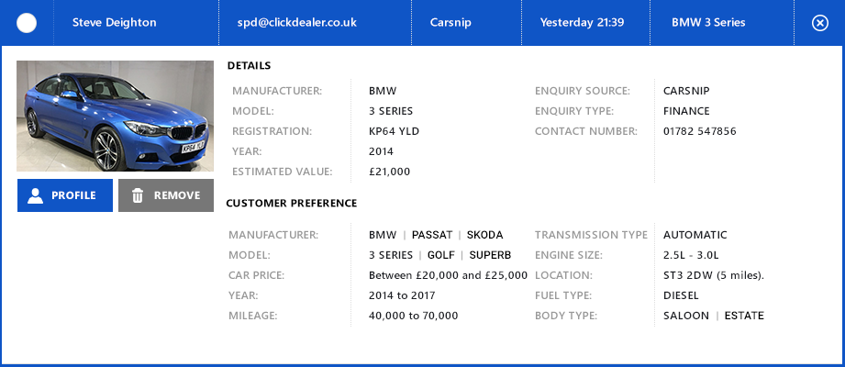
Intelligence
Know Your Customer for dealers
Click dealer CRM image from CDX
Notes:
Awesome engagement with consumer

Slide 19
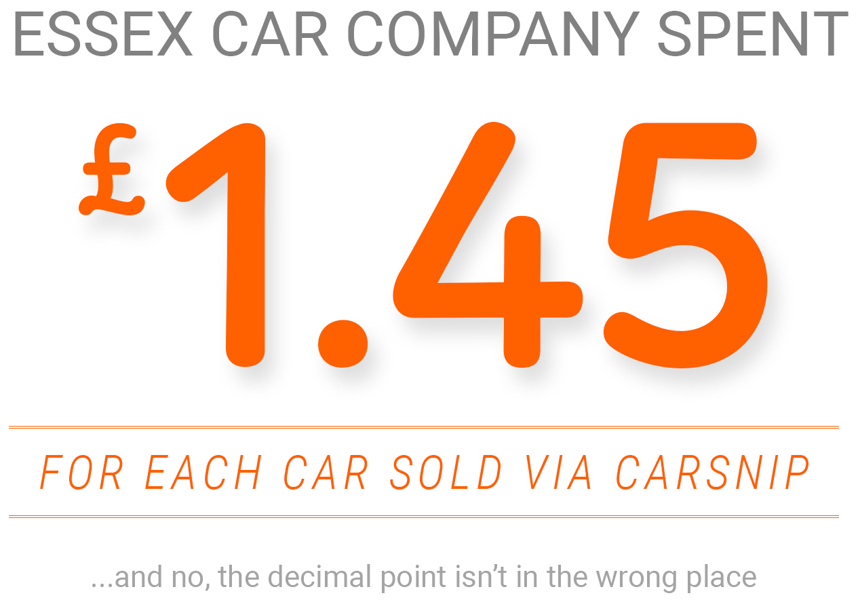
The result?

Slide 20


Keeping Everybody Happy ☺
Consumers
Car Dealers
Natural Search and choice
Personalisation and higher value proposition
Notes:
We fundamentally shift the bigger opportunity back to the dealers, our customers
And only on performance where the market sets the price – 2 huge fundamental shifts
Giving dealers ability to play in the same game – something the current portals/classified construct is not efficient at

Slide 21
Data and Insights
Dealer gets first chance at:
Carsnip gets:
sell car
value car
finance quote
insurance quote
vehicle check
car warranty
GAP insurance
Consumer data
360 vision on consumer activity
Car and Stock data
Access to partner data
Build Audience profiles
Propensity modelling
Where is the value now. In the clicks, not the leads.
Notes:
the result of this is better consumer modelling for dealers, better engagement, better understanding, better targeting and being able to own the funnel, not wait for a lead to ‘arrive’

Slide 22

Summary
Consumer queries drive better search results and learnings.
Data & analysis = propensity of buying signals.
Share this with our customers, become more like partners.
Real value to their own digital marketing and sales funnels.
Notes:
Consumer queries drice better search results
Data analysis
Share this with our customers to make us partner
ADD real value to their datasets

Slide 23


