Slide 1

The future of multi-platform mobile development
Guilhem Ensuque, Director OpenPlug Products
guilhem.ensuque@alcatel-lucent.com
Twitter: @gensuque_op
Hashtags: #openplug, #icmanice
Slides: http://slideshare.net/gensuque
Notes:
ELIPS Studio is the next generation of cross-platform mobile application development tool by OpenPlug

Slide 2
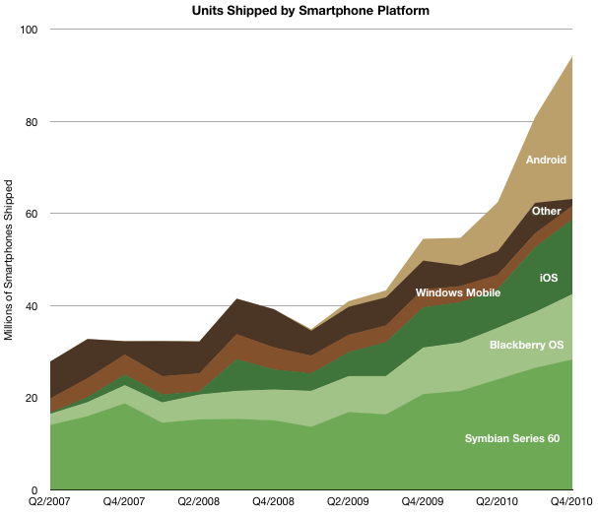
Why Multi Platform ? – Past smartphone landscape

Slide 3
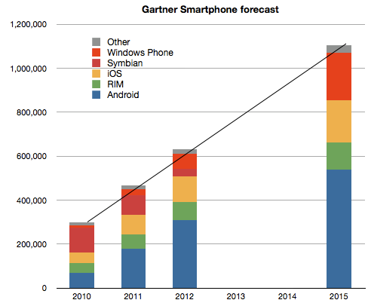
Why Multi Platform ? – Future smartphone landscape
Source: Gartner / Asymco

Slide 4


How can you go multi platform ? – traditional approach
  Boss: “I need an iPhone app !”
  Engineer: “OK I go learn Objective-C and do it …”
  Engineer (3 months later) : “Done !”
  Boss: “Ah but… how about Android ?”
  Engineer: “I need to learn Java !”
  Boss: “I don’t have the money nor the time for that!”

Slide 5
How can you go multi platform ? – new approach
Cross-Platform mobile development technologies
  “Write-Once Run-Everywhere”
    Same code is written for all devices
    Same app package across app stores
    Same code runs on all devices
  “One Code to Rule Them All”
    80% same code written for all / 20% adapted (esp. UI)
    One app package for each app store
    Code that runs on each device is different

Slide 6
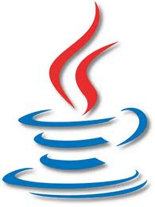


Write-Once Run-Everywhere - #FAIL
  Technologies: Java, Web/HTML5/PhoneGap, Flash/AIR, Silverlight
  Advantages:
    Single dev
    Same user experience on all devices
  Drawbacks:
    Poor performance
    UI not consistent with rest of platform
    “Uncanny Valley” effect
    Cannot be distributed on all platforms/app stores (notably Apple)

Slide 7



One Code To Rule Them All - #FTW
  Technologies: Alcatel-Lucent OpenPlug, Appcelerator Titanium , ANSCA Corona
  Advantages:
    Single code base / dev skill set
    User experience adapted to platform
    Very good performance
  Drawbacks:
    None ?
    Depends on which you consider

Slide 8


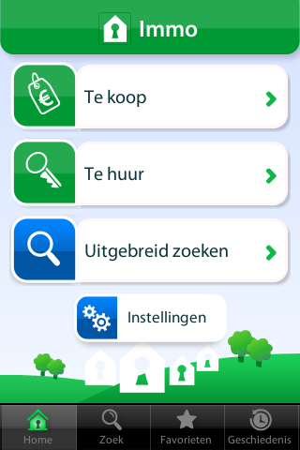

Example: Hebbes Immo - #2 Free App in Belgium
(as of July 1 2010)
Created by Exuvis with OpenPlug Studio
Copyright OpenPlug 2010
Notes:
Almanaque Anos 80
#1 paid app in Brazil
tweetMWC
-> all app stores

Slide 9

OpenPlug Studio
The fastest cross-platform native mobile applications development environment
http://developer.openplug.com
9
Notes:
ELIPS Studio brings to mobile and web developers the best of their 2 worlds:
It produces native apps for all smartphones
Out of a single web oriented code base (ActionScript, CSS, XML)
ELIPS Studio brings competitive advantages to its users:
They can reuse their web development skills for addressing the booming mobile market
They get a fast access to mobile development without the pain of learning complex and heterogeneous native languages
They get a fast return on investment by writing one single app to target all the smartphones and app stores

