Slide 1
GO LEAN AND
DELIGHT YOUR USERS
October 2016

Slide 2









DAVE MARTIN
Digital Director, Classifieds, Bauer Xcel (UK)
Blog: www.productwarrior.com
Background - product leadership, consultancy, tech start up.

Slide 3

SOFTWARE IS COMPLEX

Slide 4


Slide 5

AGILE WEAKNESS IS “PRODUCT OWNERS”

Slide 6


Slide 7
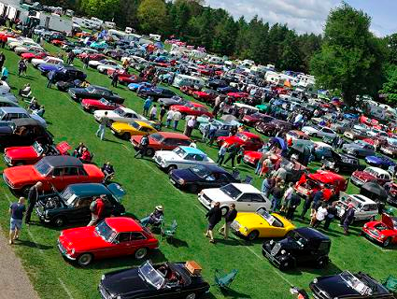
MIDDLE AGED MEN
& OLD CARS

Slide 8

CAR DEALERS NOT GETTING ENOUGH ENQUIRIES

Slide 9

DIFFICULT TO
EXPLORE & ENQUIRE

Slide 10
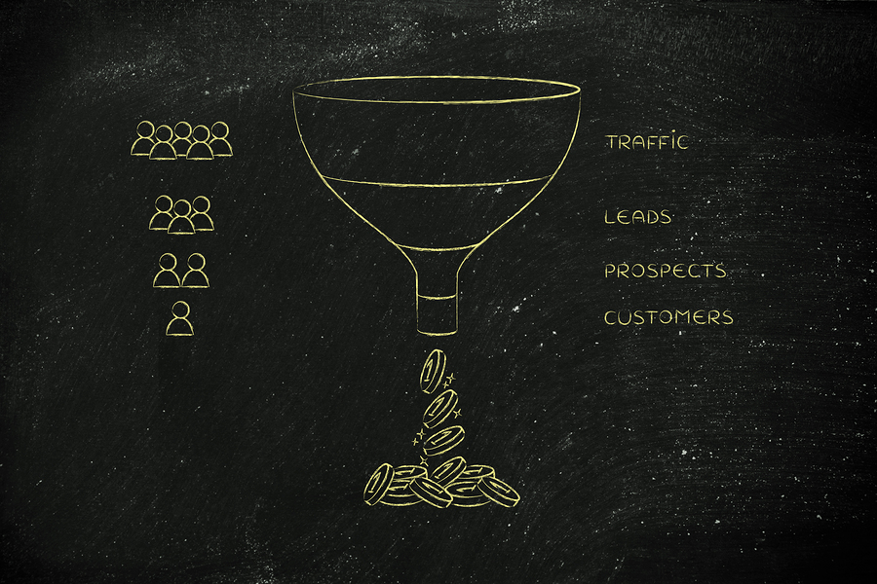
NEEDED BETTER CONVERSION

Slide 11
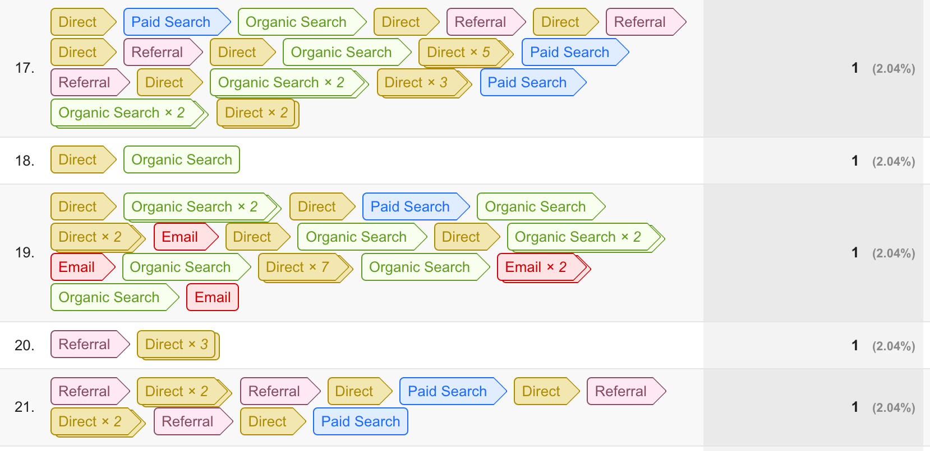
BUYERS DO NOT ENQUIRE ON IMPULSE

Slide 12
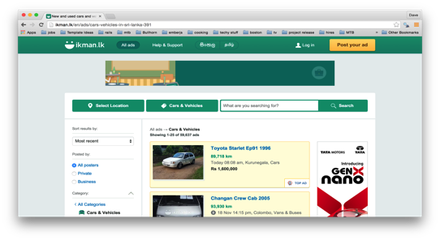
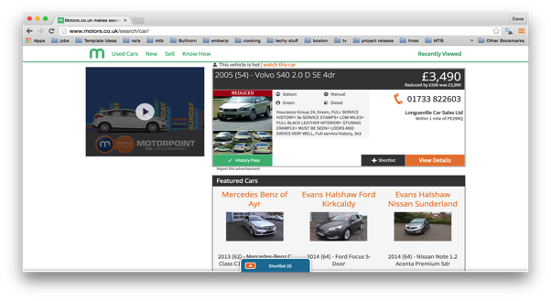
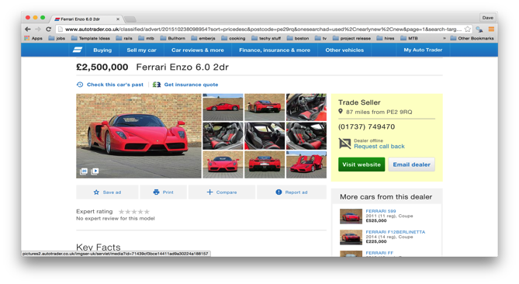
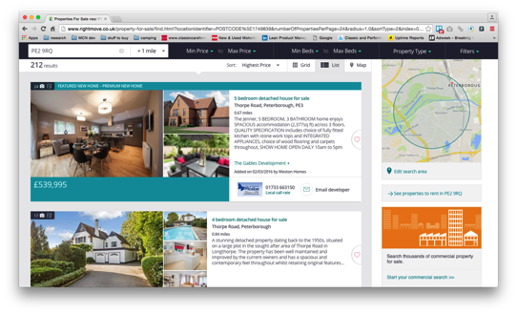
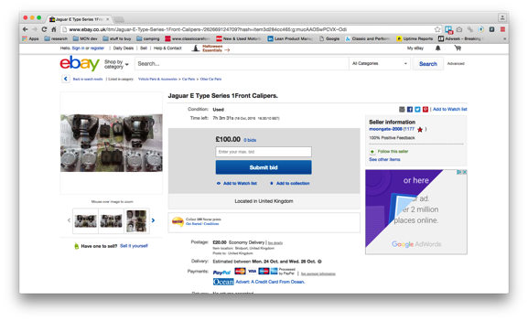
RESEARCHED CLASSIFIEDS LANDSCAPE
NEEDED BETTER CONVERSION

Slide 13

CROSS FUNCTIONAL IDEAS WORKSHOP

Slide 14
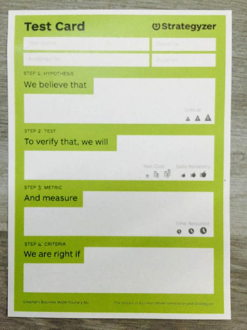
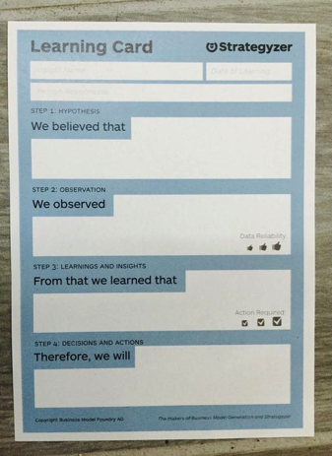
TEST CARDS AND LEARNING CARDS

Slide 15

6 WEEKS 16 EXPERIMENTS
LOTS OF LEARNINGS
ENQUIRY CONVERSION IMPROVED

Slide 16

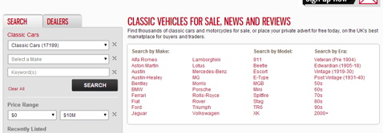
EXAMPLE EXPERIMENT
WE BELIEVE THAT:
WE OBSERVED:
FROM THAT WE LEARNED:
THEREFORE WE WILL:
Users prefer to click / tap instead of search.
19% of users clicks one of these links.
Makes received most clicks (80%).
Bounce rate dropped by 18%
Listing results page increased by 12%
Vehicle page views increased by 8%
Enquiries went up.
Prompted search is important to users.
Review search paradigm to promote prompts.

Slide 17
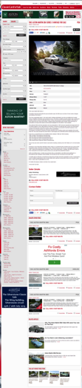
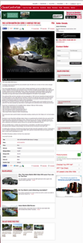
EXAMPLE EXPERIMENT
WE BELIEVE THAT:
WE OBSERVED:
FROM THAT WE LEARNED:
THEREFORE WE WILL:
Using a layout favoured by other classifieds sites (defacto standard) will convert response higher.
Email enquiries improved by over 50%.
Website clicks went down.
Related content clicks went up.
A more familiar vehicle details layout should be adopted - no search column, CTA top right.
Redesign this page to improve user value and adopt “defacto” standards.

Slide 18
SOME OTHER EXPERIMENTS...
RESULTS IN GRID OR LIST
RESULTS LAYOUT
RESULTS ORDERING
FLAT SITE DESIGN
CAR FACTS
RELATED CARS POSITION & LAYOUT
ETC…..

Slide 19

78% CONVERSION INCREASE

Slide 20
INFORMING A REDESIGN
EXPERIMENT LEARNING
AVOID HIPPO EFFECT
KILL FEATURES NOT USED
FOCUS JUST ON SELLING CARS
ANALYTIC TRACKING

Slide 21
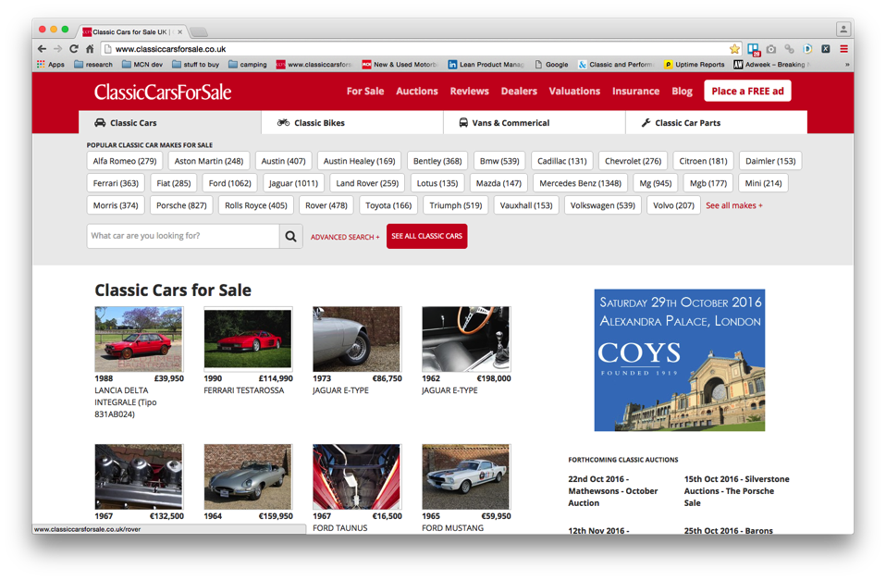
SOME OTHER EXPERIMENTS...

Slide 22
LEAN REDESIGN YoY PERFORMANCE
Up 43%
PAGE VIEWS
Down 19%
BOUNCE RATE
Up 29%
ORGANIC SEARCH
Up 52%
EMAIL ENQUIRIES

