Slide 1
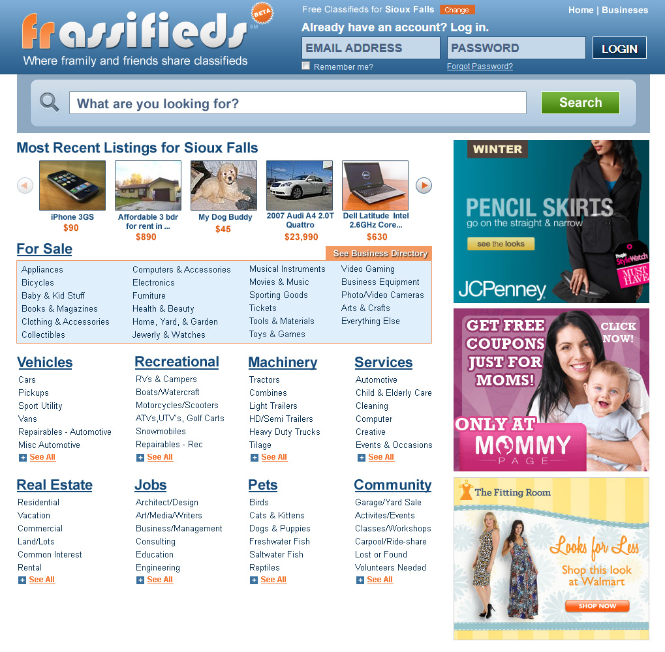

Public-facing, Category Browsing Page
Log in to access your own,
local, private, social
ad network:
Display Ad Networks
Framily (your inner circle)
Friends & Acquaintances
Friends of Friends
Unknown Members

Slide 2
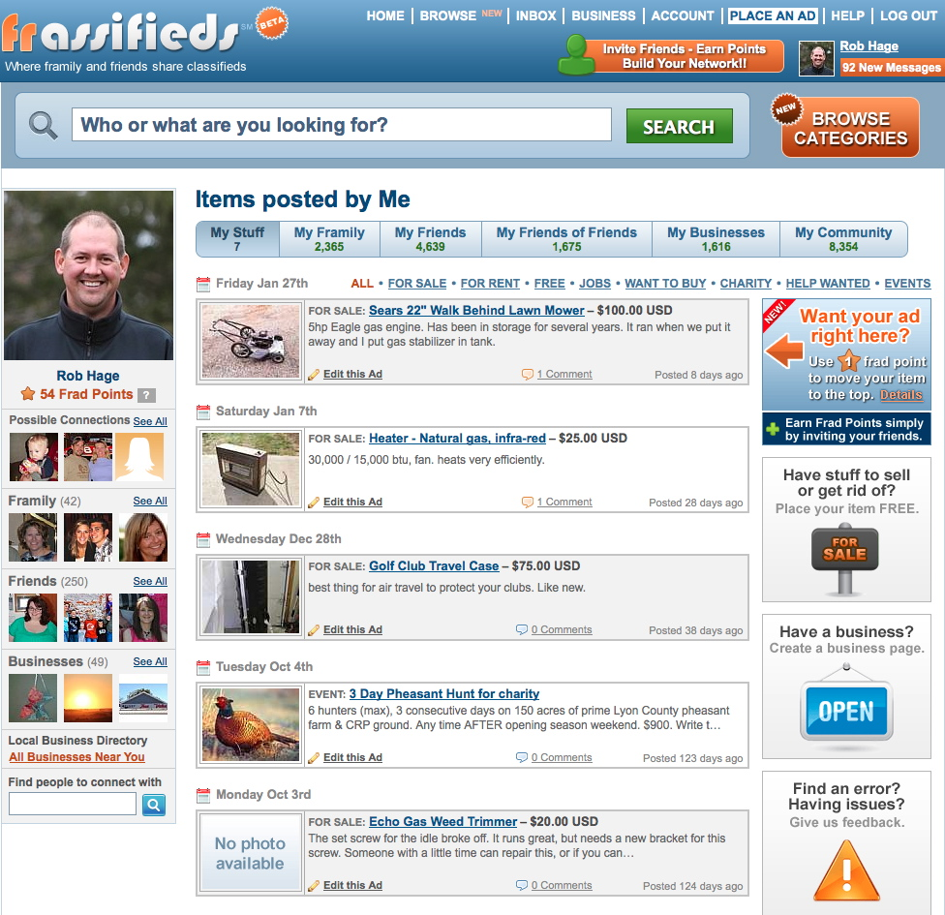
Personal Home Page
Social
Ad
Display
Filters
Personal Social
Connections
Display
Ads

Slide 3
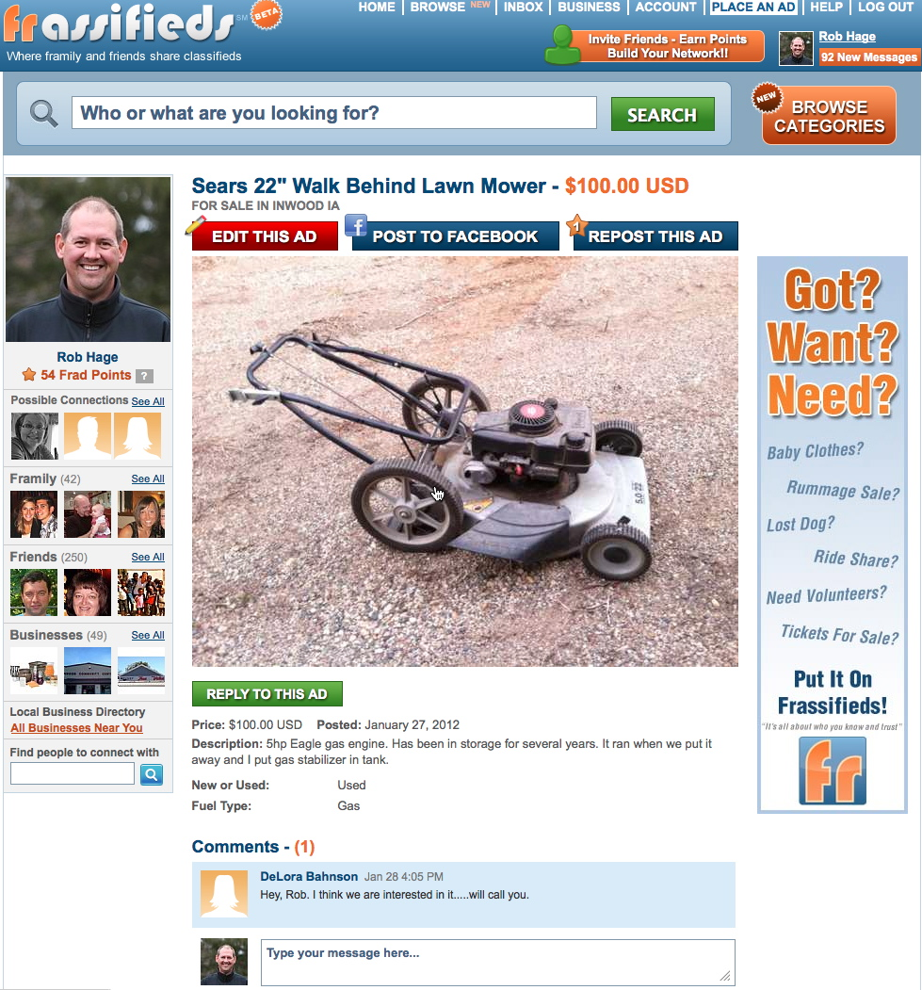
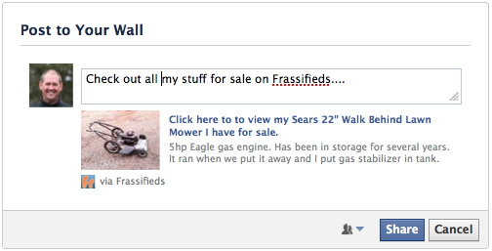
Ad Item Details Page
Invite friends and
earn frad Points!
Communicate publicly or privately.

Slide 4
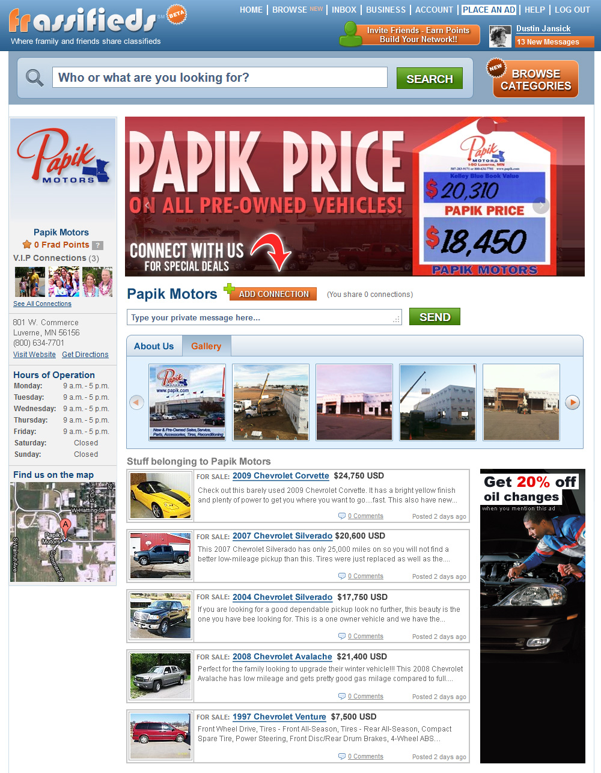
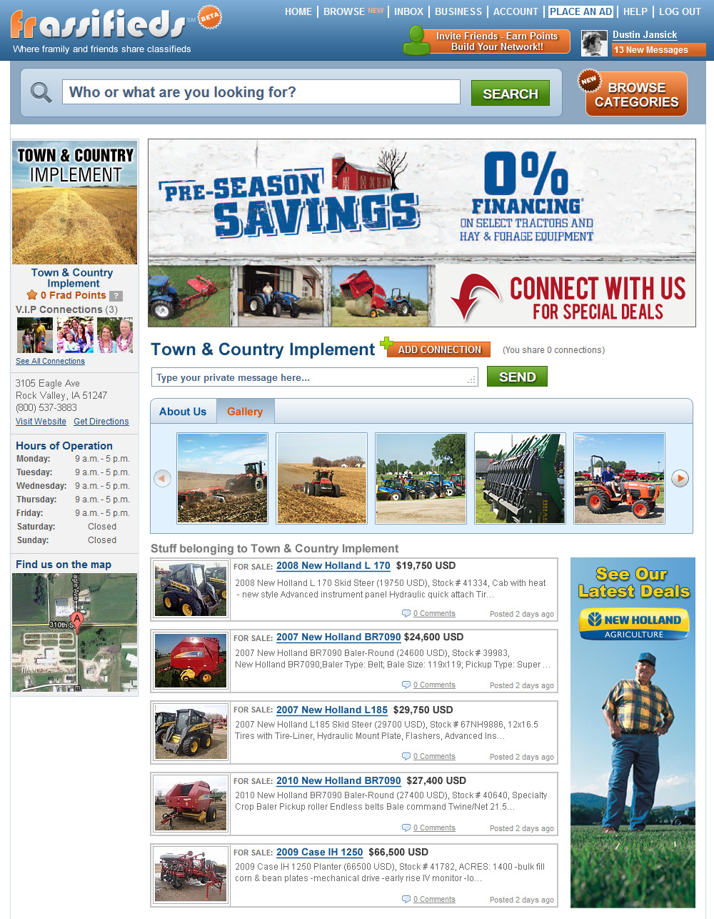

Business Directory Page with inventory powered automatically by AutoConX®
Name, address, hours, location, VIP connections
Self-serve business display ads

