Slide 1
Data-driven marketing science for classifieds advertisers.
http://dominioninsights.com

Slide 2

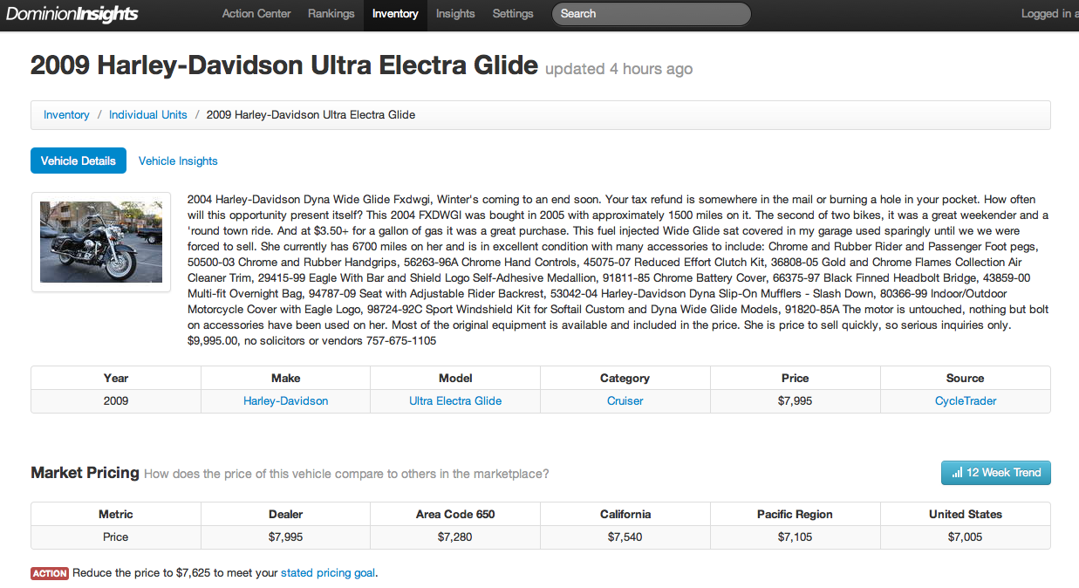
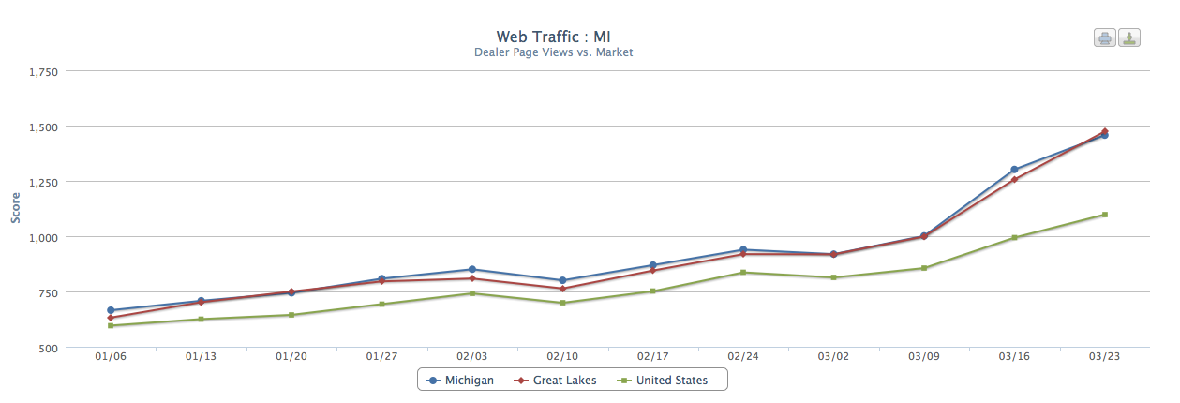
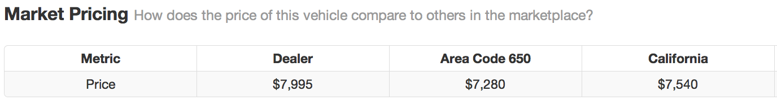
Classifieds and… Data?
Data-Driven
Competitive Benchmarks

Slide 3
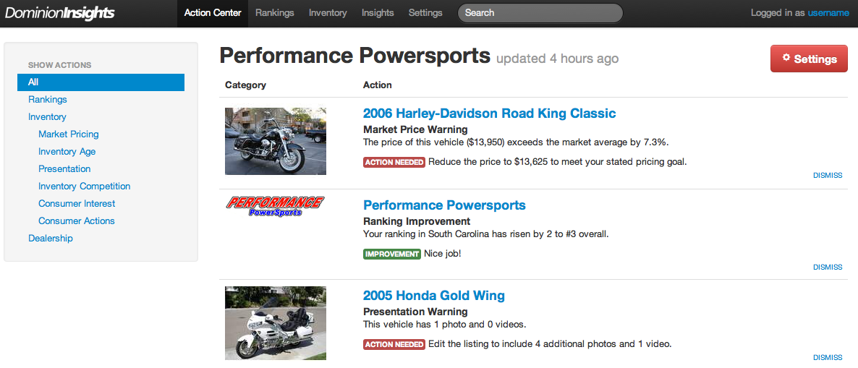
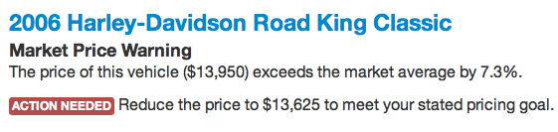
Now What?
Specific, Market-Derived
Action Items

Slide 4
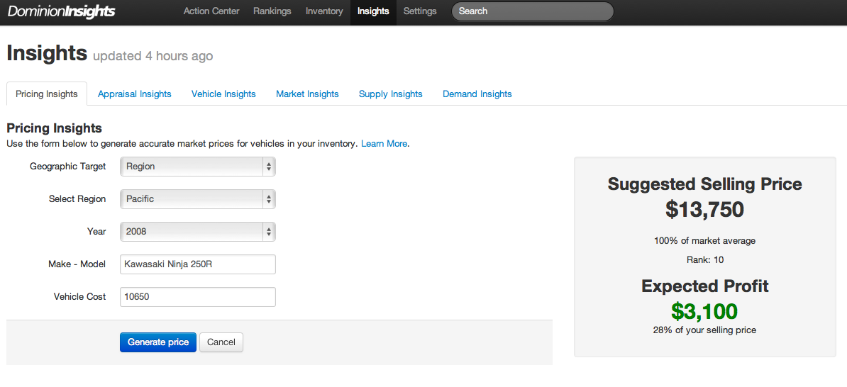
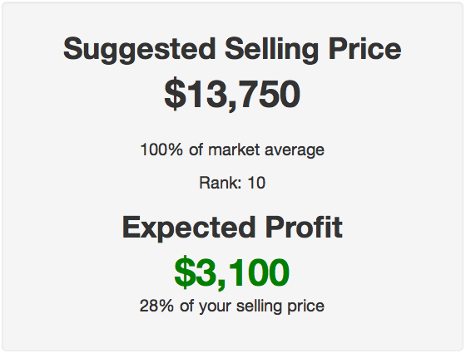
New Insights
Real-Time Market Intelligence
Pricing – Supply - Demand

Slide 5
Thank you for considering us for the 2012 ICMA Innovation Award!
http://dominioninsights.com

