Slide 1

Local advertising made simple

Slide 2
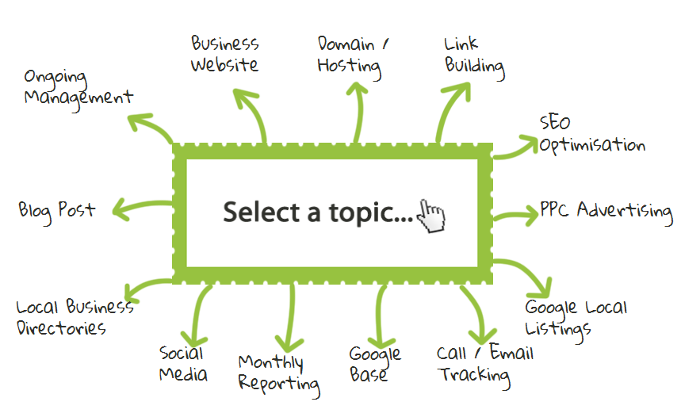
WHAT?

Slide 3
WHY?
The web is confusing
To save time
Expense
Pace of the Market

Slide 4
BENEFITS
Transparency
Fast Setup
New
Affordable
Response

Slide 5

RESULTS
200 Happy Customers - Yr 1
95% retention rate

Slide 6
The FUTURE
E COMMERCE
Mobile
Email
White Label

Slide 7
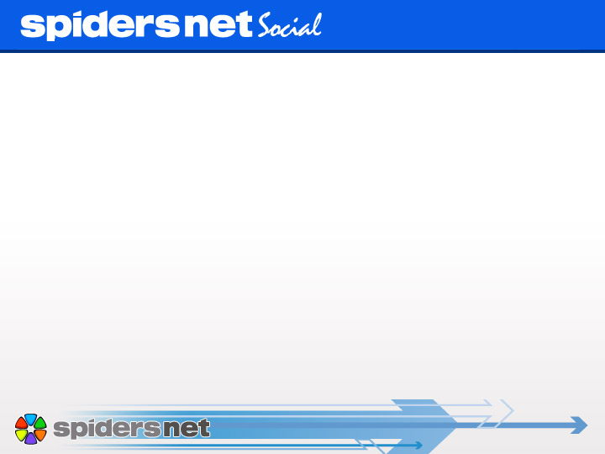

The UK’s first Automated Social Media product for Automotive dealers

Slide 8
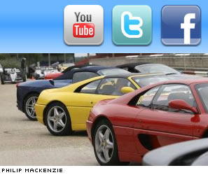
The Opportunity
Social media has become an essential tool within any advertising strategy, with this in mind we needed to create a simple product to enable our dealers to be part of the social media revolution.
Requirements of Spidersnet Social;
Developed quickly
Easy to replicate & maintain
User friendly
No effort for the customer
Simple to sell
Profitable

Slide 9


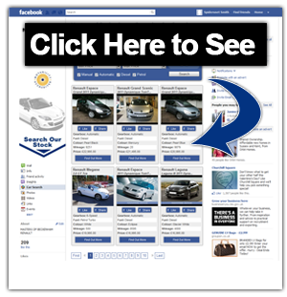
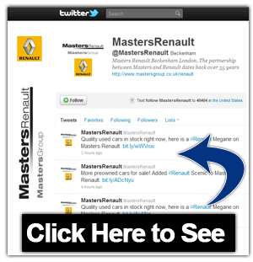
The Solution
For one fixed monthly fee, we provide the dealer with;
A tailored profile page for the dealership on both &
These pages created by us, are updated automatically when a new car is added by the dealer in our vehicle uploading tool.
Vehicles are displayed within a custom built application on their Facebook business page. Every time a vehicle is added that vehicle is updated automatically on both applications, exposing each and every vehicle to the largest social audience.
This process is completely automated saving the dealer time & effort.

Slide 10
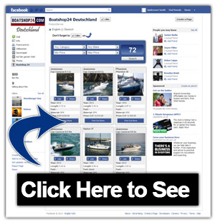
The Implementation
Development
In-house keeping costs & time down to a minimum.
The project was completed from specification to delivery within 3 weeks.
Set-Up
Each new customer could be up and running with Spidersnet Social within 30 minutes.
Marketing
Video
Promotional email detailing the product and a limited offer.
Sales Process
Promotion Follow up

Slide 11
The Success (to date)
The Spidersnet Social product has seen us;
Improve our offering to our existing & potential customers
Increase our revenue base
Build on our brand through the exclusivity of the product
Improve customer retention
Sell quickly & relatively easily
Maximise profit margins due to the low maintenance cost
What Next?
In the last month we have used the framework of the Spidersnet Social product to replicate this success for our Boat’s business and within the coming months the plan is to make the product available to other businesses within the Friday Media Group such as Caravan & Horse dealers and a further campaign to our existing customer base.

Slide 12
Thankyou!

