Slide 1
Dynamic Personalization of a Classified Ads Site to Boost User Engagement
using a recommendation system
ICMA Classified Media Innovation Award, 10/02/2012

Slide 2
Schibsted Classified Media Hungary Kft., Hungary, Budapest – www.jofogas.hu
Gravity R&D Kft., Hungary, Budapest – www.gravityrd.com
Contact person: Laszlo Budai Product Manager, email: laszlo.budai@schibsted.hu phone: +36 30 4604059
Contact person: Balazs Nedli Business Development Manager, email: nedli@gravityrd.com phone: +36 70 2025828
Team: Zoltan Peresztegi, Laszlo Budai , Gyorgy Dozsa, Balazs Nedli
Executive Summary
To improve website efficiency and enhance user experience, Jofogás.hu wanted to personalize the site by showing relevant content to each and every visitor.
To achieve these goals, Jófogás and Gravity – Rock Solid Recommendations jointly developed a new recommendation system which learns the visitors’ taste in real time and displays the most interesting content to them.
The expectation was to generate a content discovery effect and ease navigation.
Results
Significant and sustainable improvement has been achieved in efficiency and user experience:
Ad (item) page views/visit: 10.57% increase;
Improvement by self learning: at launch, 19.8% of visitors clicked on recommended ads - 2.5 months later, accuracy of recommendations increased by 75%; 35% of visitors now click on a recommended ad;
number of contact requests among users (visitors and advertisers) – has risen by over 33%

Slide 3
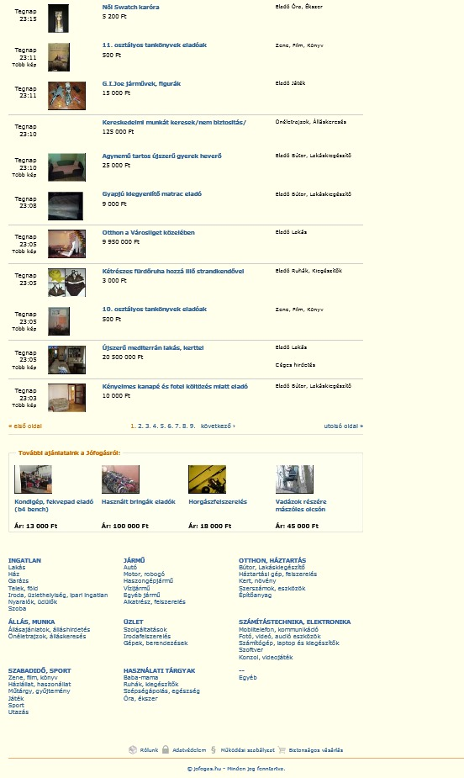
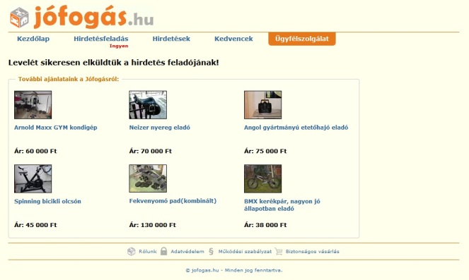
Recommendations appear
Item2Item recommendation logic: the ad’s profile will be matched to the profile model of available ads
Personalized recommendation logic: the visitor’s profile will be matched to the profile model of available ads
www.jofogas.hu/budapest
www.gravityrd.com

Slide 4
Higher User Engagement
Figures show weekly moving average of Ad Detail views per user among those exposed to personalized recommendations, in comparison to visitors who weren’t, in an A/B test

Slide 5
Accuracy improved by 75%
Self learning system - figures show the percentage of all website visitors who clicked on a personally recommended ad on any page of the site

Slide 6
33.7% Increase of Contacts
Figures showing increase of contact requests among visitors exposed to personalized recommendations in comparison to users who weren’t, in an A/B test

