Slide 1
Delivering the World’s Information

Slide 2











































Delivering the World’s Information
Connecting publishers and businesses to consumers across 2,200 device profiles
Notes:
Platform as Service for creating, deploying, and managing mobile websites, apps and messaging programs
Gumiyo was founded in 2006
Classified Media is in our DNA
1 Billion mobile page views in 2011
35,000 messaging campaigns

Slide 3











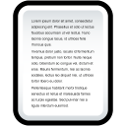
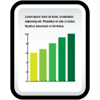

Delivering the World’s Information
Innovating for scalability
Provisioning/Deployment
Mobile Web
Automotive
Gumiyo Studio (author, manage)
Real Estate
Native Apps
API’s
Digital Publishing/ Media
App Configuration
Directories/Classifieds
Messaging
QR codes
SMS Gateways
QR Codes
SMB/Retail

Slide 4

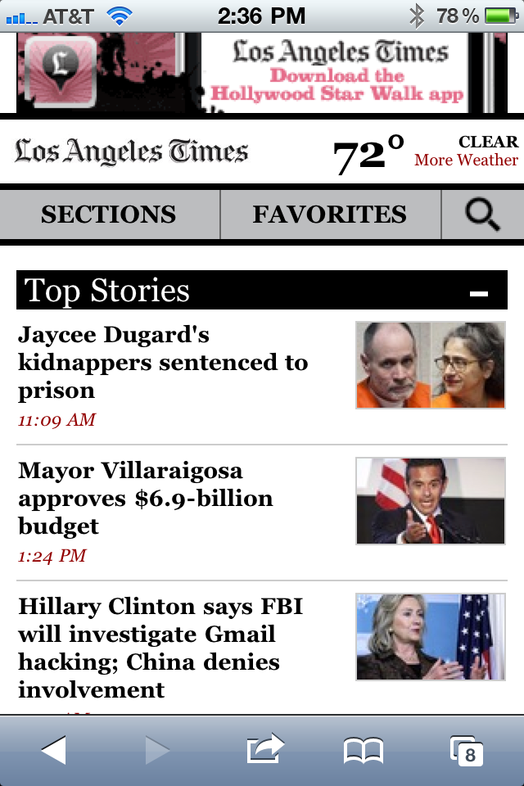
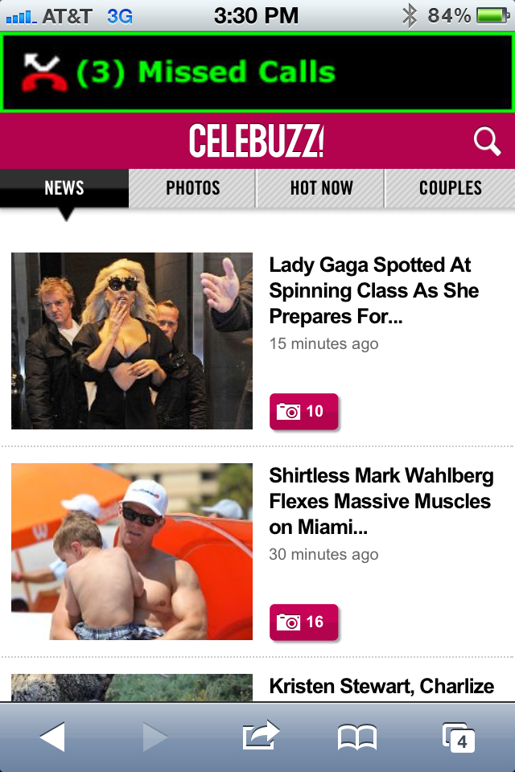
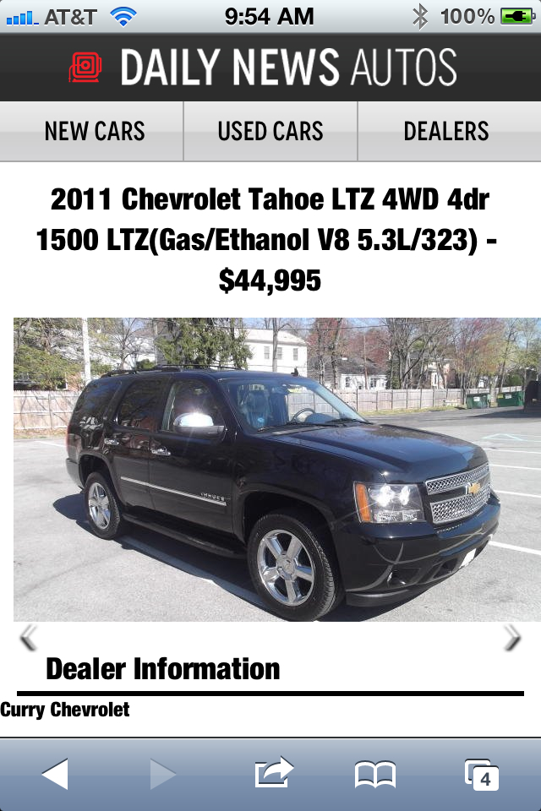


Deliver the World’s Information
Innovation for quality and usability

Slide 5

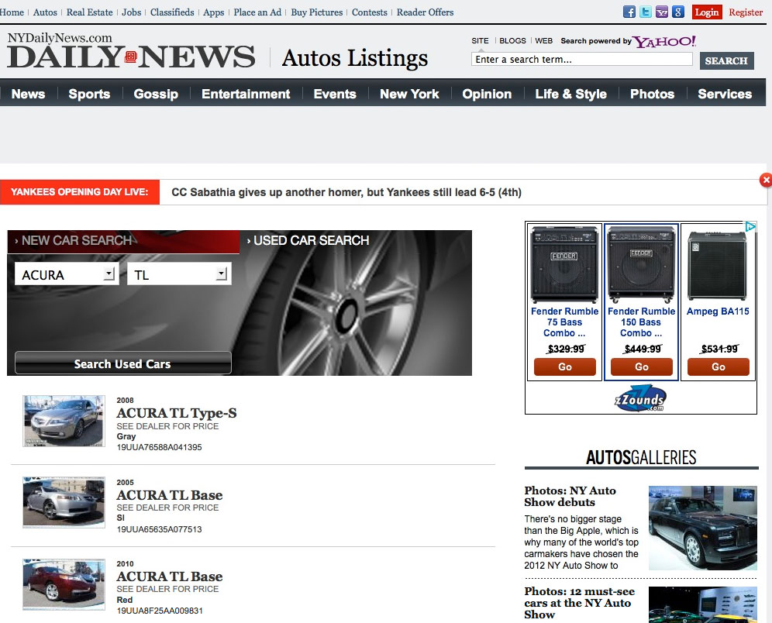
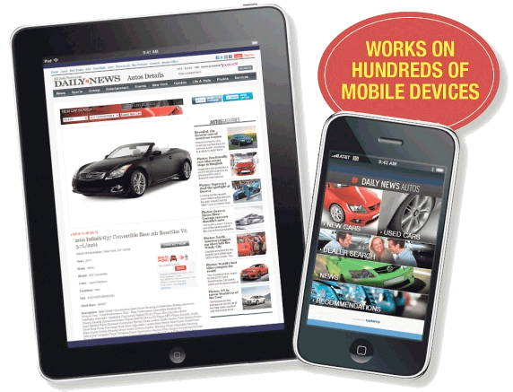
Delivering the World’s Information
One Platform to all Devices
dailynewsautos.com
Notes:
LATRE http://l1nk.me//s.p?m=b&p=l9YaqH6dgBJs
http://www.nydailynews.com/autos/mobile-solution-local-auto-dealers-york-dma-article-1.1056900

Slide 6
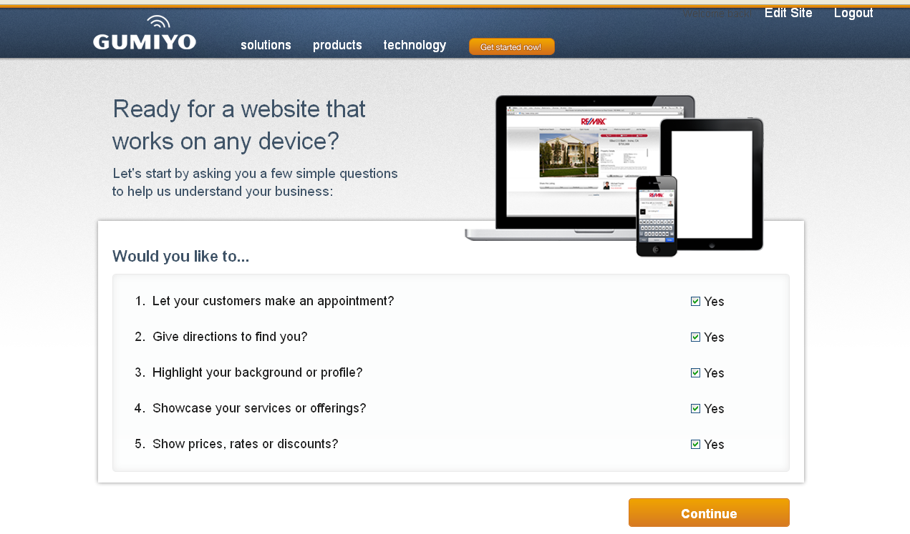
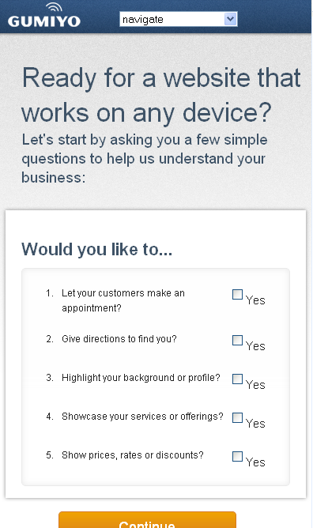

Delivering the World’s Information
Innovating toward simplicity
Turning technical decisions into business decisions

Slide 7
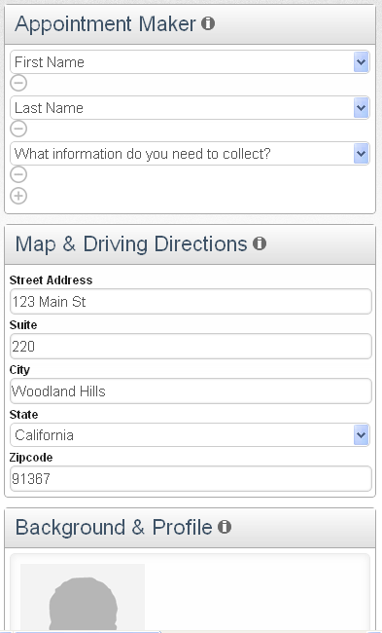
Delivering the World’s Information
Innovation is about disruption
Rethinking and simplifying the fulfillment process

Slide 8
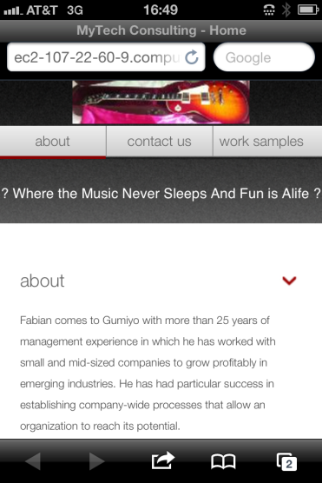
Delivering the World’s Information

Slide 9


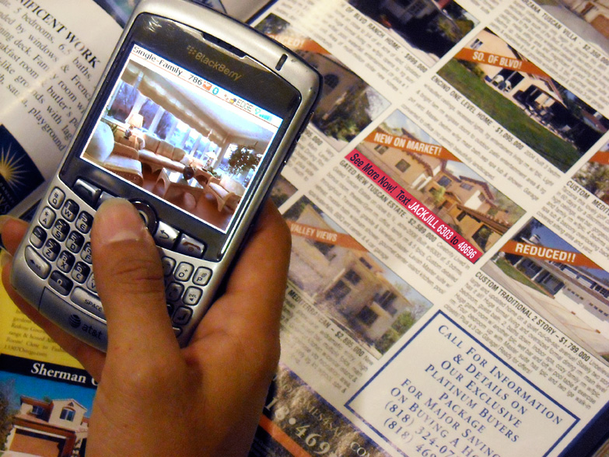


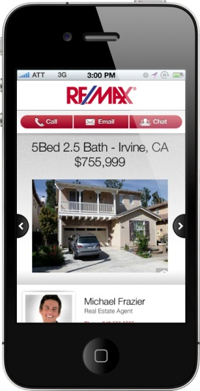


Delivering the World’s Information
Innovation to create value
Text LATHOMES to 12345

Slide 10
Thank you!
Rich Abronson
rich@gumiyo.com
818 458 2025

