Slide 1

How to become market leader in the Hungarian online job market
by integrating a national
and 20 local job boards
Inform Media Tech SRL,
Romania, Oradea
Gerhard Koehle
Email: gerhard.koehle@im-tech.ro,
Tel.: 0036 204 801 623
Innovators:
Josef Kogler, Gerhard Koehle,
Adrian Ghender, Laura Serdult,
Zoltan Balla, Maria Vince
Inform Media – ICMA Awards 2012

Slide 2


The Problem
Inform Media had two national job portals in the market, with cvonline.hu and topjob.hu
With two national portals Inform Media couldn’t challenge the dominant player on the market
Heavy national competition with 6 players in a small market
One dominant number one with 10 years experience
(acquired in 2010)
12 years in the Hungarian market
Number 2 position with focus on capital Budapest
Outdated, 10 years technology with huge SEO problems
Countryside not covered
cvonline.hu was not integrated in the topjob.hu platform
(founded in 2008)
Only 2 years on the market
Number 3 position with focus on eastern Hungary
New, scalable technology with high SEO ratings
Local sales force
No regional portals existed
Integrate cvonline.hu in topjob.hu platform
topjob.hu goes local

Slide 3
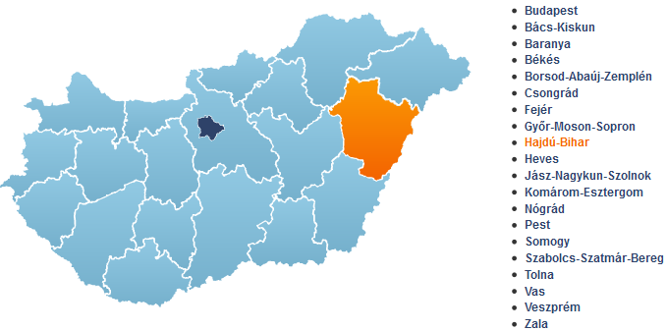
The Strategy
Migrate topjob.hu into 20 regional portals
Integrate cvonline.hu into the same platform
One SaaS platform hosts all portals
Develop a clever SEO strategy (avoid duplicate content and smart indexing of content)
Develop a sophisticated content sharing strategy between local-, national- and category levels
Develop a clear sales strategy for regional portals and the national cvonline.hu
Topjob.hu goes local

Slide 4
The Solution
SEO and Content Solution
A Content Strategy which is avoiding duplicate content
A Carefully handled indexation of content within the portals
A Smart client- and job synchronization between the national cvonline.hu and the regional topjob.hu portals
Sales and Marketing Solution
One national sales team for cvonline.hu, selling national and regional portals
Sales teams on regional level, selling only local branded niche portals
Selling from national to local level is obligatory
Selling from local to national is not allowed
Cvonline.hu as national brand is powered by 20 local job niche portals
Technology Solution
All regional domains and the national portal is hosted in one SaaS platform technology
A scalable technology to easily rollout regional portals with a view clicks
accounts and data synchronization within the portals
A flexible HTML structure on the frontend to support SEO strategy

Slide 5
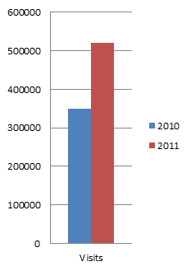
The Results
The job network is now the number One marketplace for jobs in Hungary → Market leader
The number of applicants on a weekly basis doubled
Traffic increased by 49% in the first year
The number of job alerts grew 800%
The number of registrations increased 20%
Revenue grew by 20%

Slide 6
Is this innovative?
Yes because:
We challenge the competition
We tried something new with a local and national ultra niches considering SEO, Content, Technology and sales – that’s novelty.
The concept how we manage SEO, content, technology and sales was quite hard work, that’s creativity
All important numbers went up within 8 months and the customers appreciate the response we deliver – that are results
Sustainability is guaranteed as we see that jobs are fragmented markets which demand niches that’s sustainability

