Slide 1

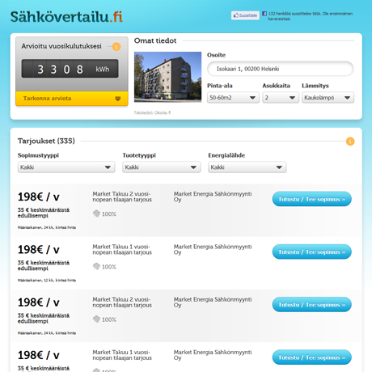
Consumer focus
Make an electricity contract online
A comprehensive site that represents 100 % of Finnish electricity offers
Transparent and neutral
Very simple to use: Approximation of costs based on the street address only!
Household basic data and picture retrieved from Sanoma’s Oikotie.fi classified service
Approximation of yearly costs of electricity contracts, based on stock exchange data
Makes it very simple to use the service and find a suitable offer
Price is important but…
Compare visually, filter, choose yours!
Consumer study revealed important aspects

Slide 2
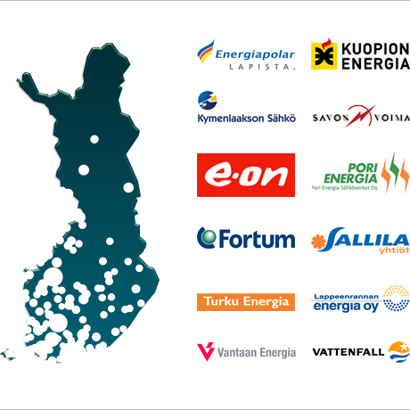
Supplier focus
Focus also heavily on the power companies who pay for the service
Get new sales!
Save costs and effort!
New kind of sales and marketing tools for electricity companies
Create campaign offers based on geographical area, period of time, source of energy, type of contract etc.
Limit sales based on the volume sold (pricing experiments etc.)
Stand out: Sales slogans on the comparison list
Integration to customers’ billing systems made easy - save effort!

Slide 3
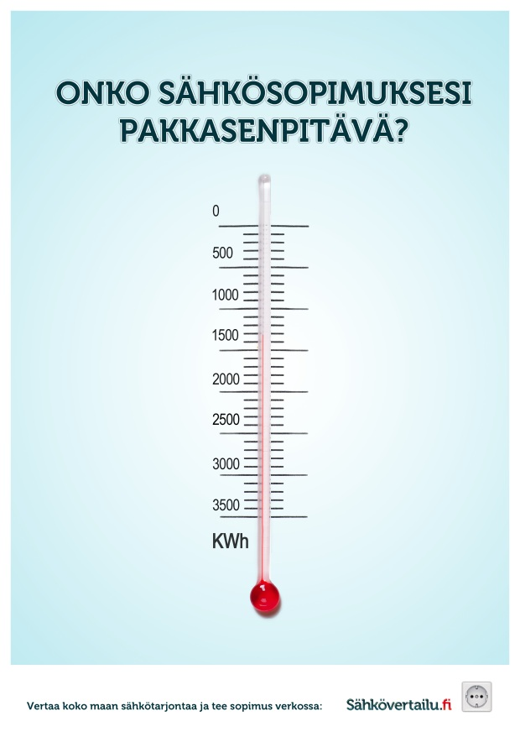

Brand and features
Two thorough prestudies
Finding out companies’ and consumers’ needs helped match the service, brand and visualisation to actual needs
Studies revealed what consumers wanted
Comprehensiveness
Transparency
Ease-of-use
Innovative and successful marketing campaign on a difficult topic provided the necessary attention

Slide 4
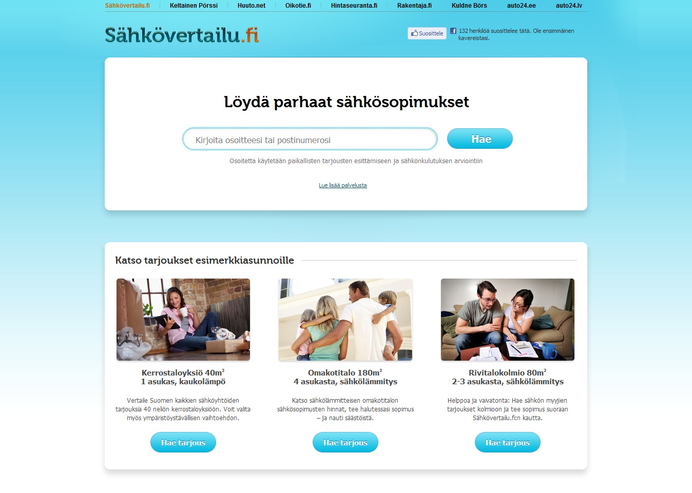
Results
Comprehensiveness, transparency and ease-of-use were a success!
Electricity worth the production of a medium sized energy company sold already within the first month!
100 % of Finnish electricity products shown on the site!
All major Finnish energy companies pay for the service!
Very effective pre-sales campaign
Companies’ customers use 60 % of electrical household energy in Finland
More than 2 % of Finnish household energy consumers have used the service within the first month!

