Slide 1
SEO Tools
Tools, Tools, Tools!

Slide 2
Technical tools
Tools to grind your HTML

Slide 3
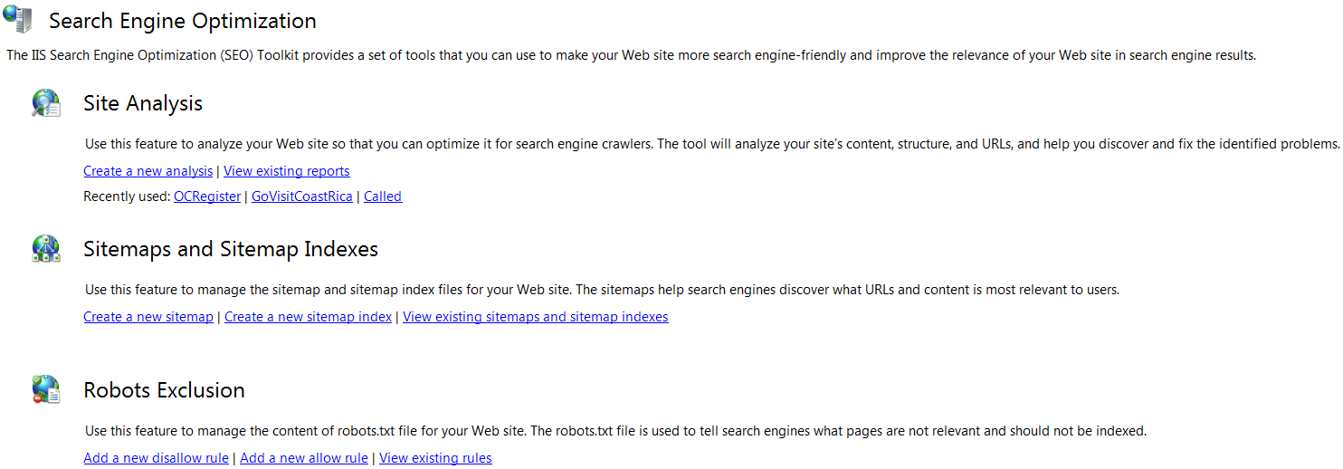
Search Engine Optimization Toolkit

Slide 4
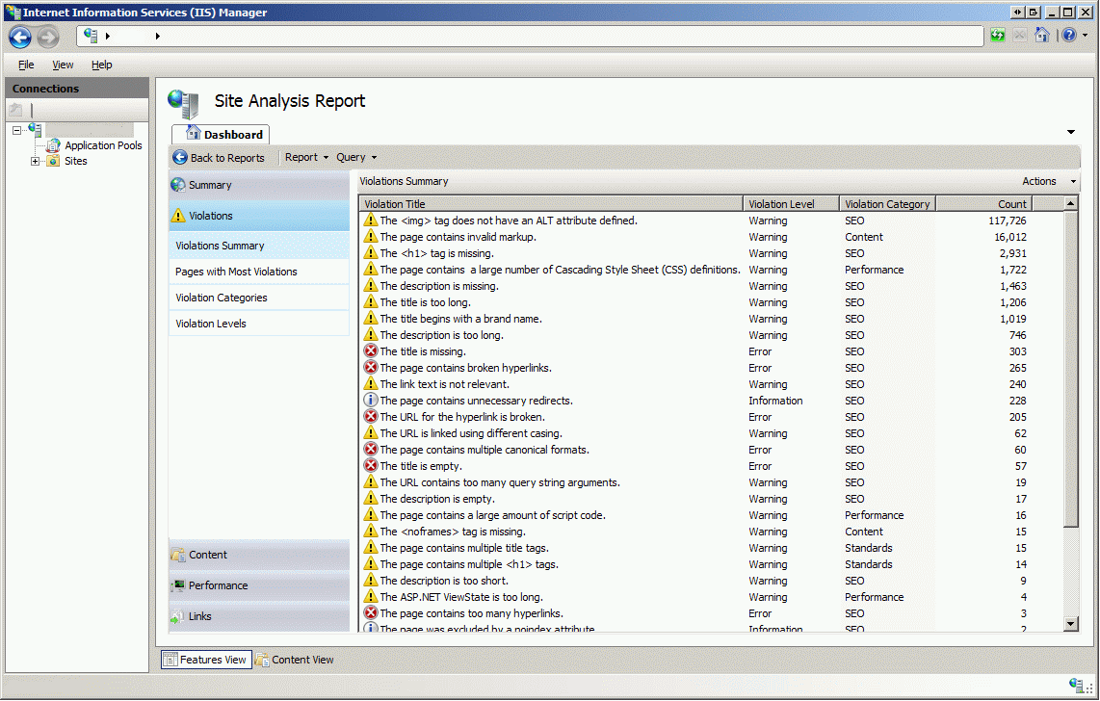
Search Engine Optimization Toolkit

Slide 5
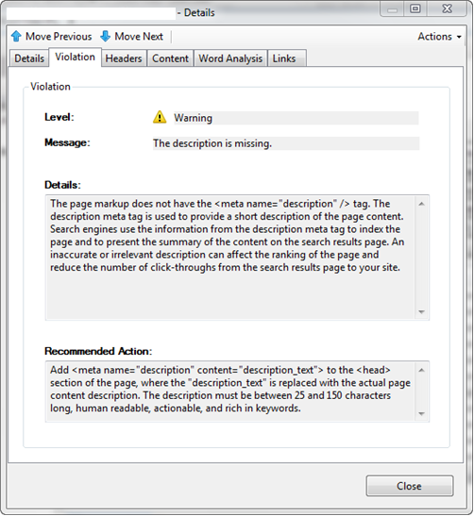
Search Engine Optimization Toolkit

Slide 6
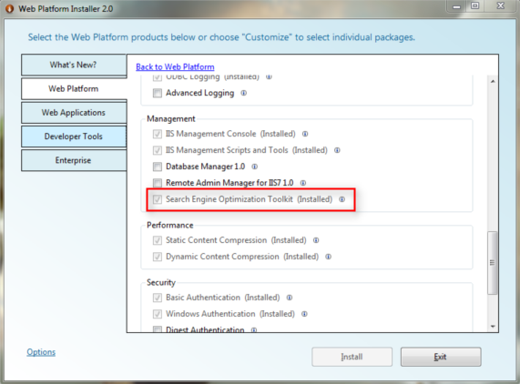
SEO Toolkit – How To Get It
www.microsoft.com/web/downloads/platform.aspx

Slide 7

Google Chrome

Slide 8
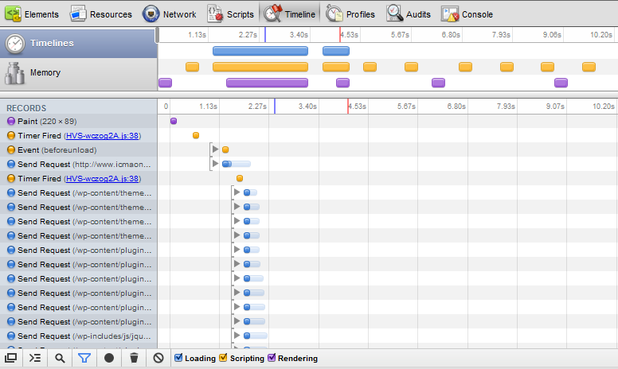
Google Chrome

Slide 9
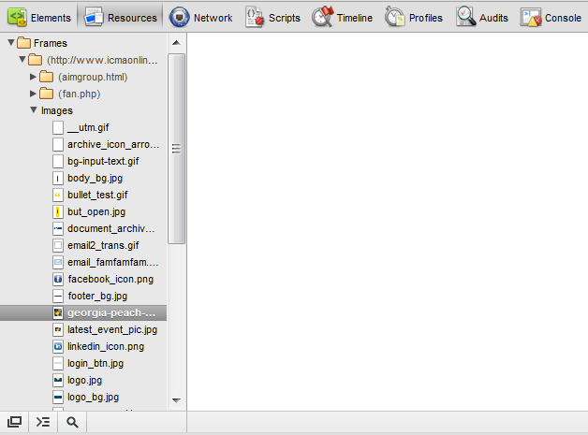
Google Chrome

Slide 10

SEO Site Tools Chrome Extension
chrome.google.com/webstore/detail/diahigjngdnkdgajdbpjdeomopbpkjjc

Slide 11
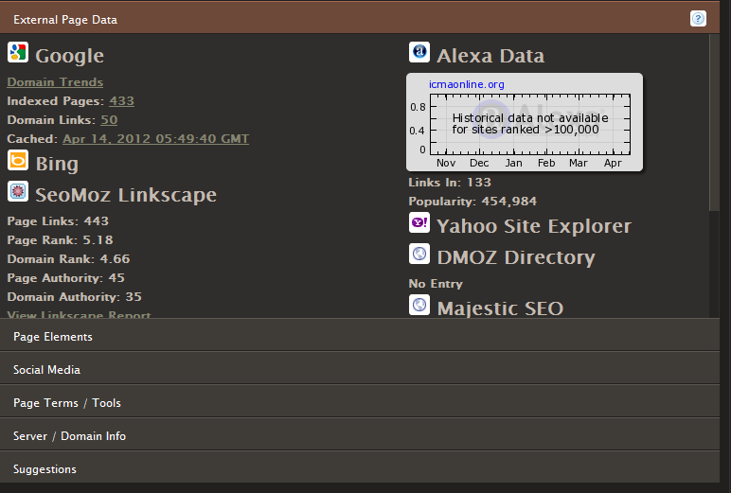
SEO Site Tools Chrome Extension

Slide 12
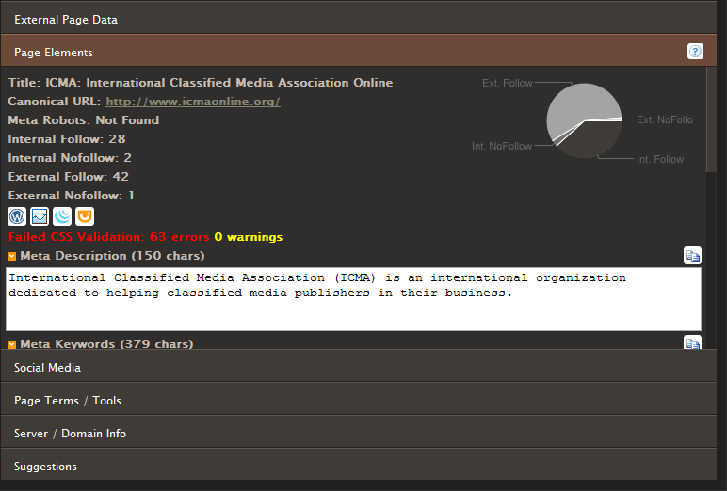
SEO Site Tools Chrome Extension

Slide 13
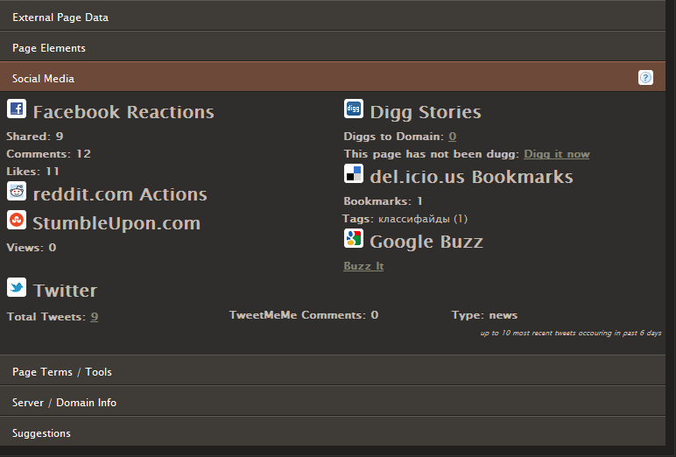
SEO Site Tools Chrome Extension

Slide 14
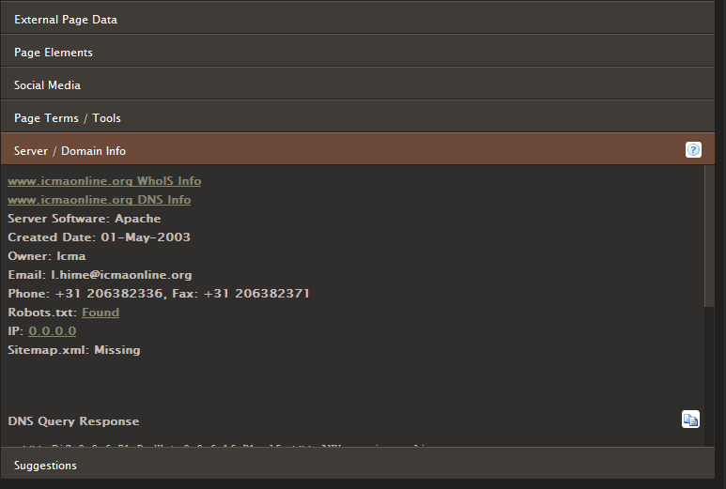
SEO Site Tools Chrome Extension

Slide 15
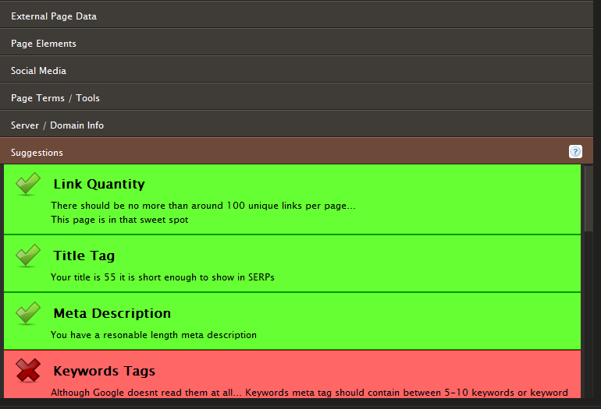
SEO Site Tools Chrome Extension

Slide 16
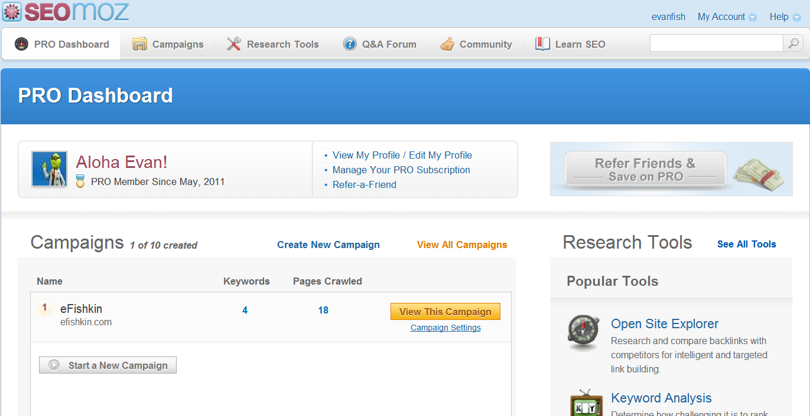
SEOmoz Pro Tools & Campaign Manager

Slide 17

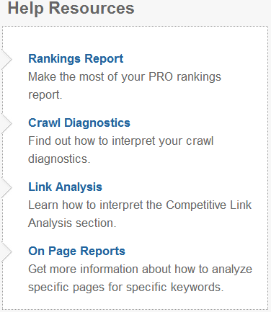
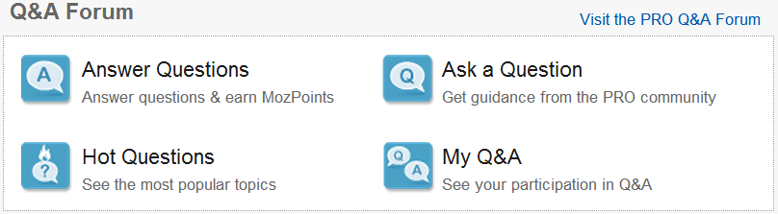
SEOmoz Pro Tools & Campaign Manager

Slide 18
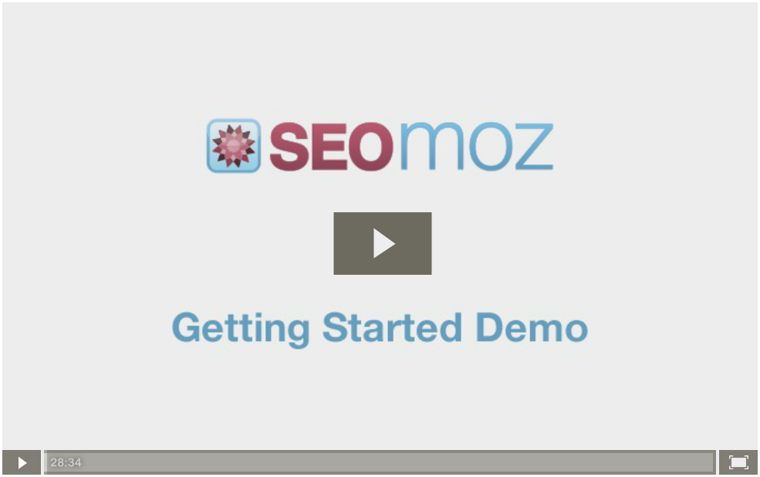
SEOmoz Pro Tools & Campaign Manager

Slide 19

Web Developer Chrome Extension
chrome.google.com/webstore/detail/bfbameneiokkgbdmiekhjnmfkcnldhhm

Slide 20
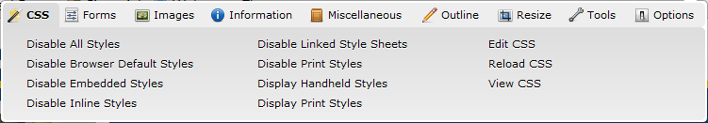
Web Developer Chrome Extension

Slide 21
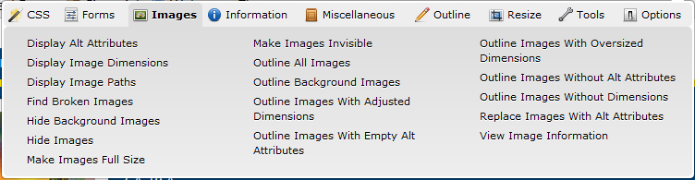
Web Developer Chrome Extension

Slide 22
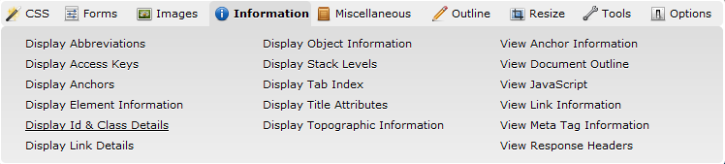
Web Developer Chrome Extension

Slide 23
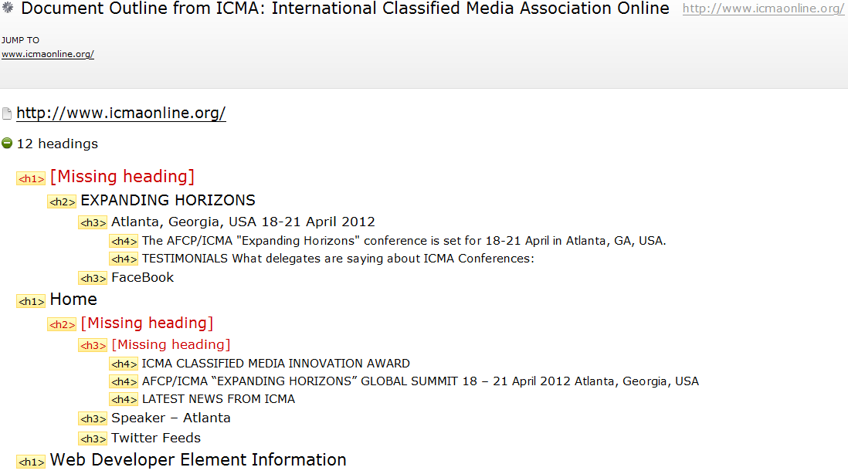
Web Developer Chrome Extension

Slide 24
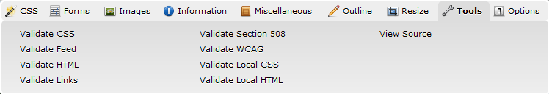
Web Developer Chrome Extension

Slide 25

HTTP Headers Chrome Extension
chrome.google.com/webstore/detail/hplfkkmefamockhligfdcfgfnbcdddbg

Slide 26
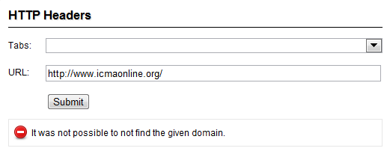
Live HTTP Headers

Slide 27
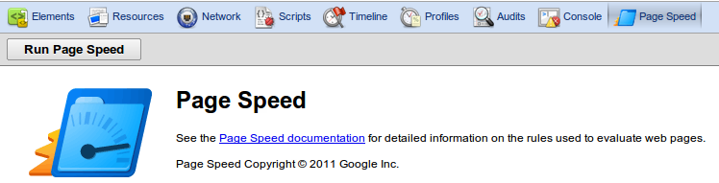
Google PageSpeed Chrome Extension

Slide 28
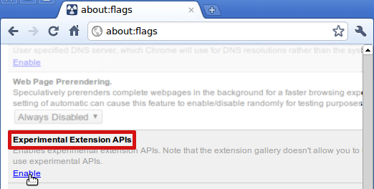
Google PageSpeed – How To Get It
developers.google.com/speed/docs/insights/using_chrome

Slide 29
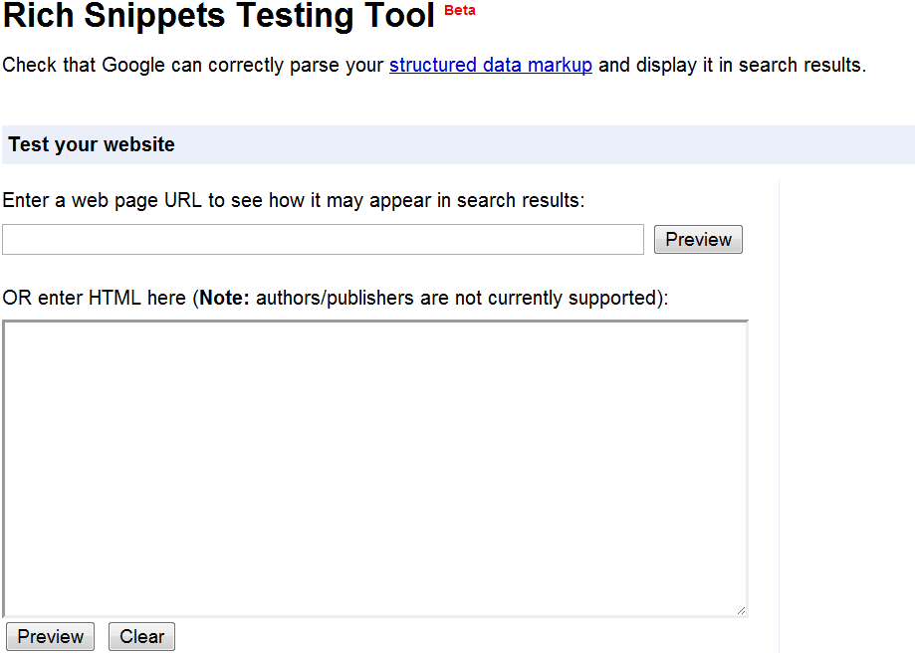
Google Rich Snippets Testing Tool
www.google.com/webmasters/tools/richsnippets

Slide 30
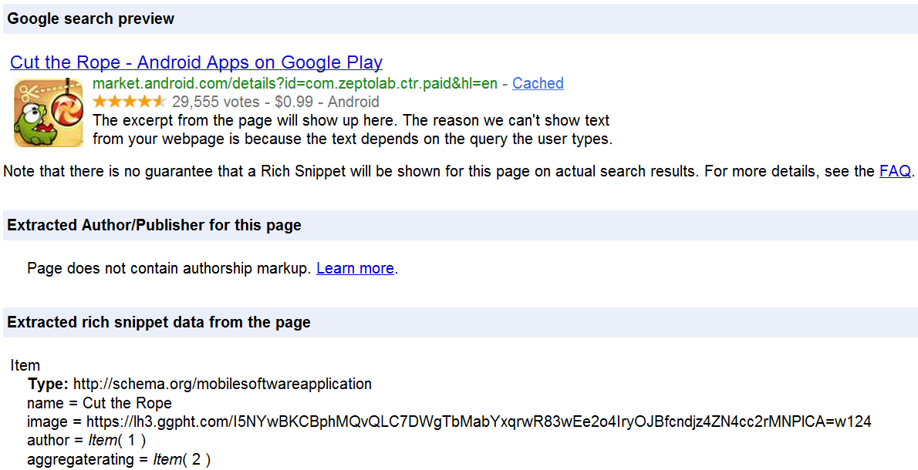
Google Rich Snippets Testing Tool

Slide 31
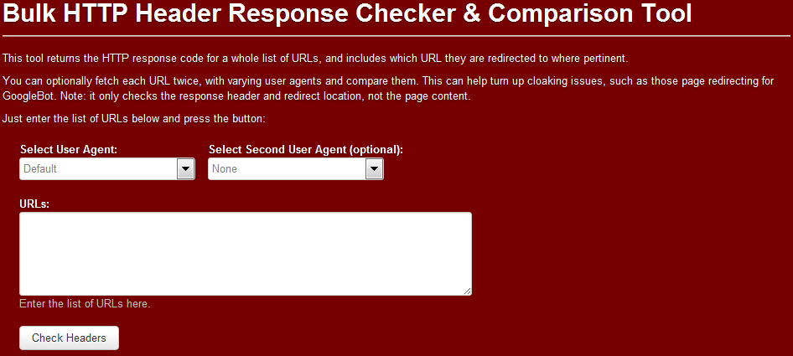
Bulk HTTP Header Tool
www.tomanthony.co.uk/tools/bulk-http-header-compare/

Slide 32
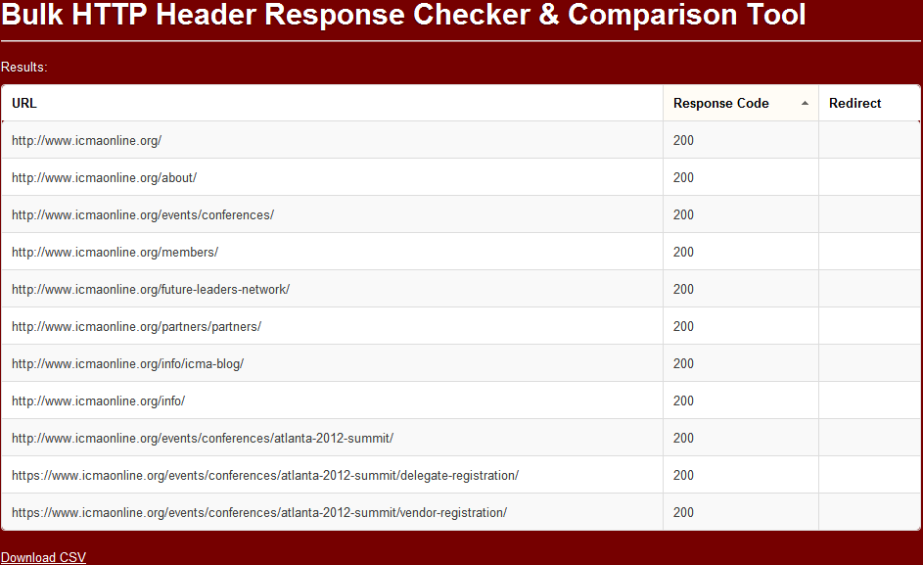
Bulk HTTP Header Tool

Slide 33

SEO Tools for Excel
nielsbosma.se/projects/seotools/download/
nielsbosma.se/projects/seotools/functions/

Slide 34
Intelligence tools

Slide 35

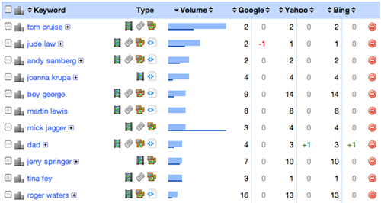
AuthorityLabs
authoritylabs.com/

Slide 36
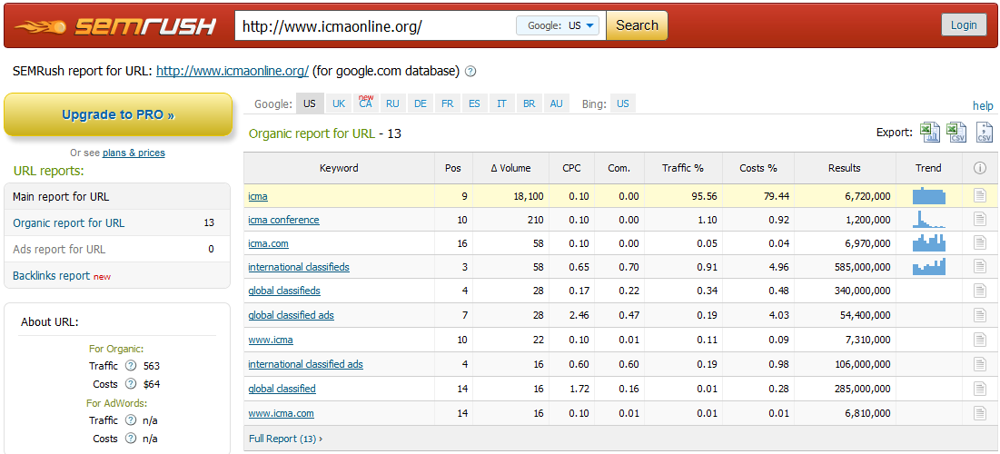
SEMRush
www.semrush.com/

Slide 37

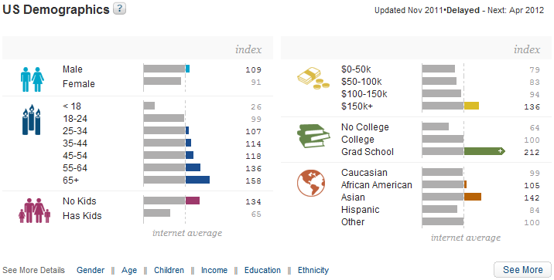
Quantcast
www.quantcast.com

Slide 38

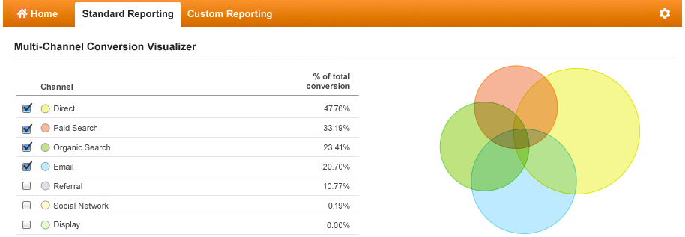
Google Analytics

Slide 39
Demo Time
Thanks for Attending!
evan.fishkin@digitas.com
212-610-5300
@efishkin

