Slide 1

Jellyfish
Paid search best practice
By Rob Pierre, MD at Jellyfish
The UK’s leading agency dedicated to paid search
Notes:
How paid search can benefit the classified ad industry to gain market share and generate advertisers

Slide 2


It is ideal to start the set up process by building a campaign and ad group structure using a very specific naming convention.
Notes:
Search is a barometer for consumer interest and opinion
Search data can be invaluable to all channels of marketing
With search marketing you are responding to a request as opposed to speculatively presenting a service / product proposition

Slide 3


Searchers make
very specific requests
Notes:
Searchers make very specific requests

Slide 4

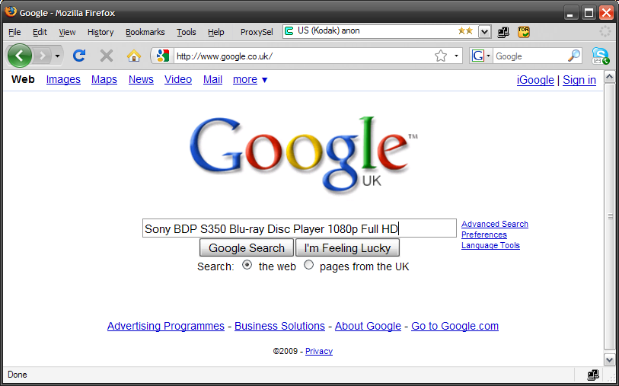

Slide 5
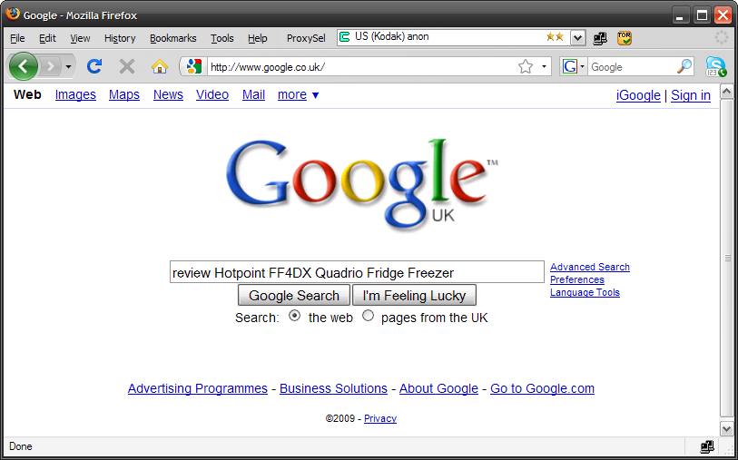

Slide 6
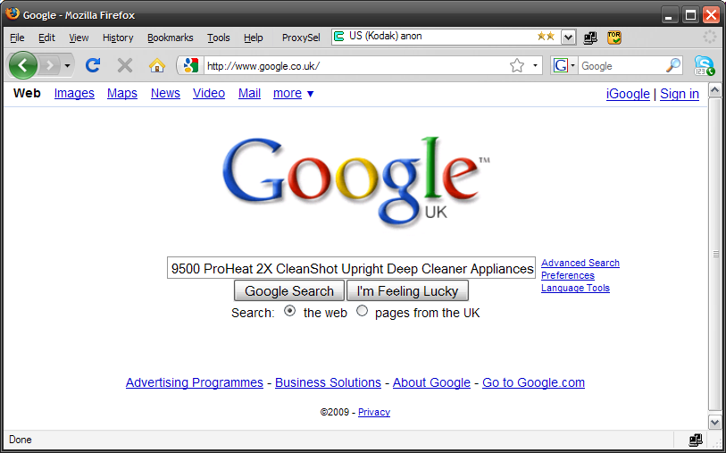

Slide 7

Searchers actually
ask questions
Notes:
Searchers ask you questions

Slide 8
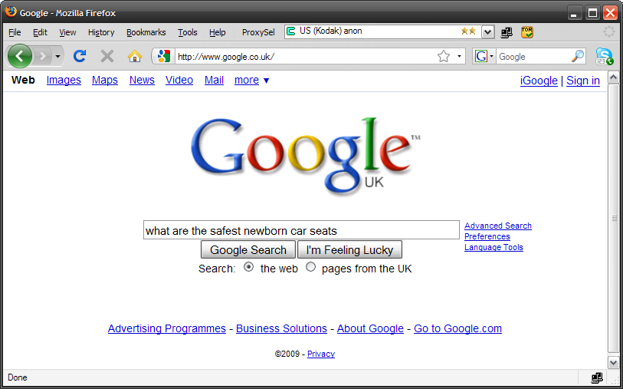

Slide 9


Slide 10
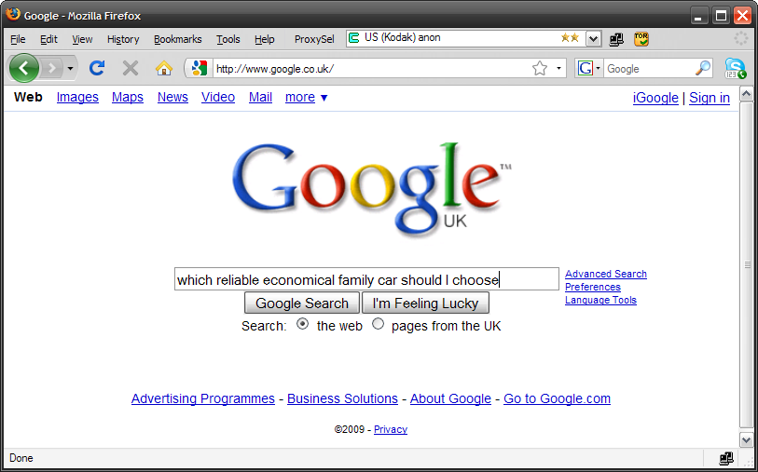

Slide 11

Searchers tell you
about themselves
Notes:
Searchers even tell you about themselves

Slide 12
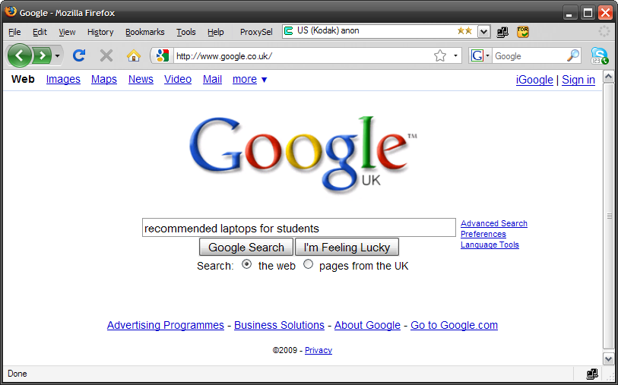

Slide 13


Slide 14


Slide 15
Searchers are also
funny, unpredictable &
notoriously bad spellers
Notes:
Searchers are also funny, unpredictable and notoriously bad spellers...Here are some real examples of searches which have actually resulted in a transaction...
To illustrate this point, I’m going to tell you what they bought then what the search term was...

Slide 16
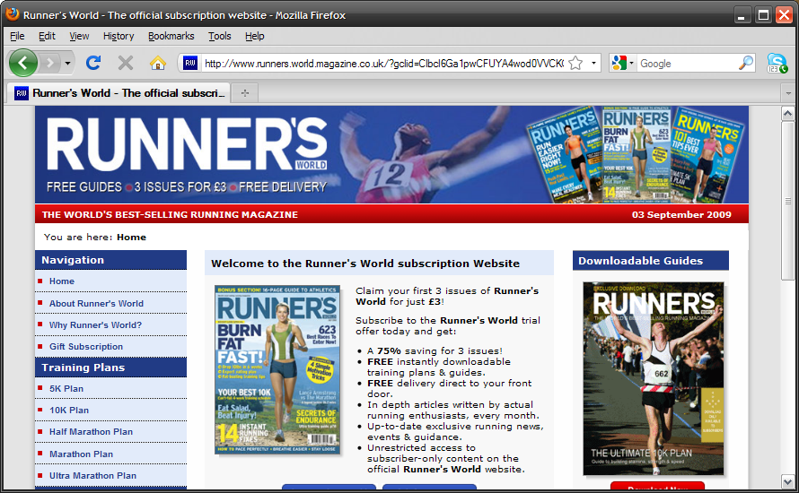
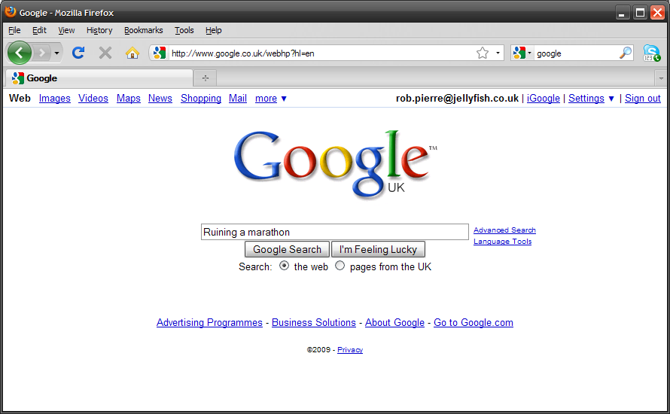

Slide 17
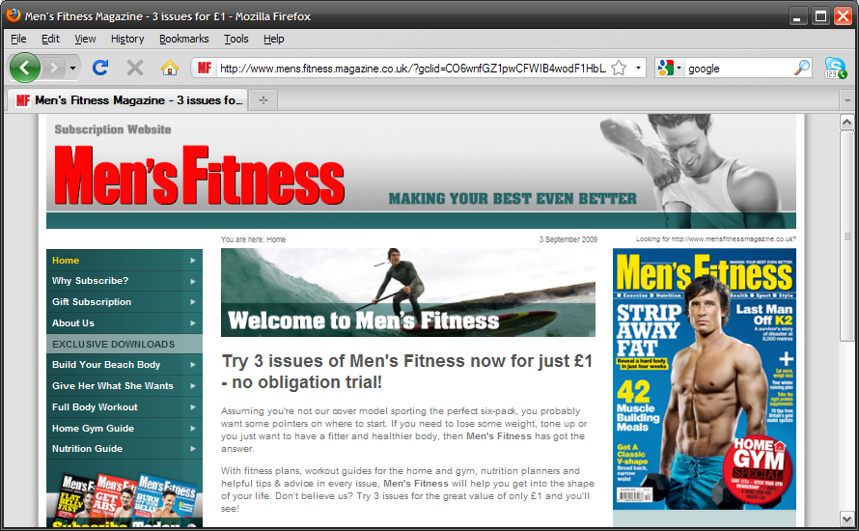


Slide 18
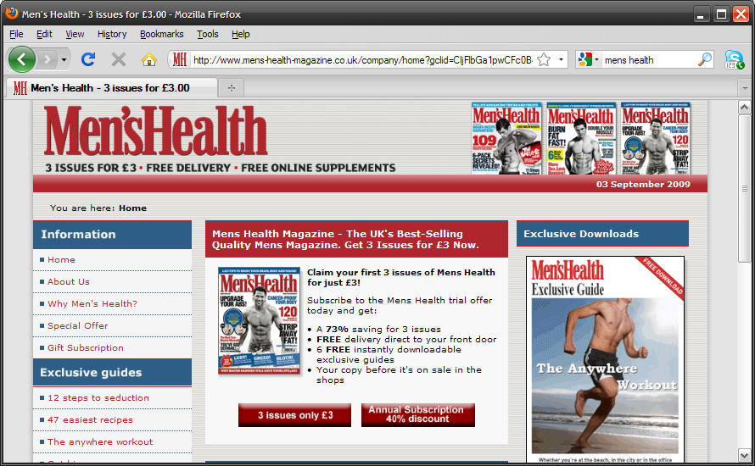


Slide 19
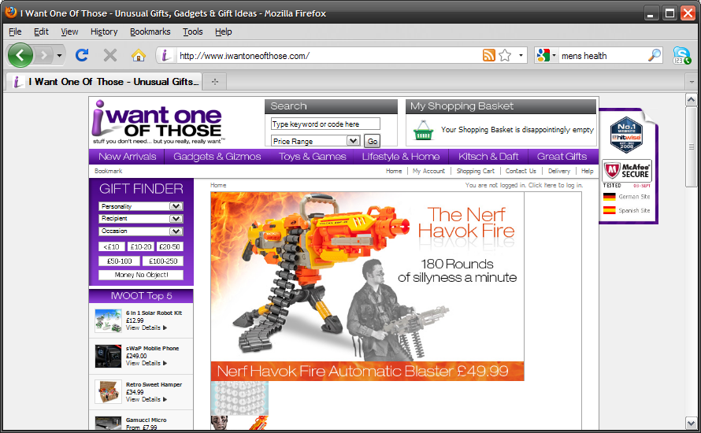


Slide 20


Slide 21

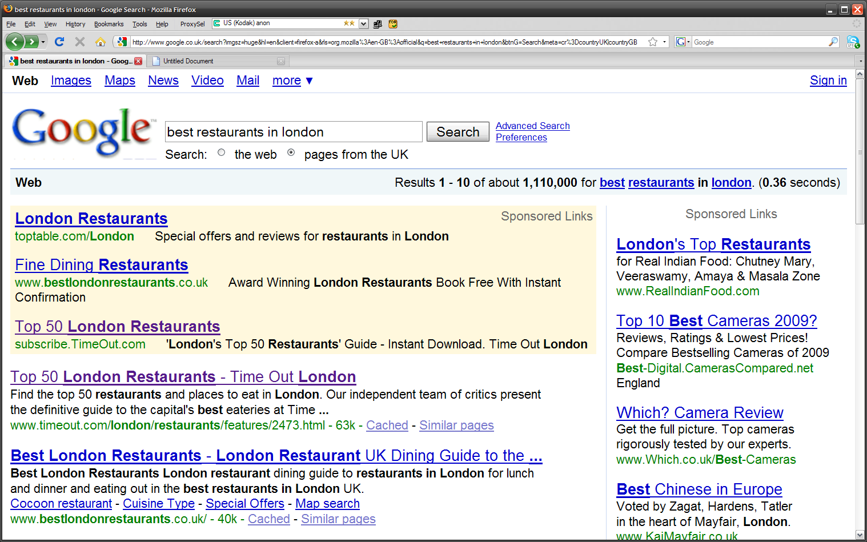
SEO
vs.
PPC
Notes:
So PPC or SEO?

Slide 22

We believe it
shouldn’t be a choice
Notes:
We Believe It Shouldn’t Be A Choice
PPC & SEO Strategies should co-exist. Most marketers agree that that both forms of search marketing are important; however, on many occasions there seems to be a tendency to choose one or the other.
Although they are completely different disciplines, and require totally different processes to optimise their performance, we strongly recommend that they are both be present in your online marketing strategy.
Here’s why...

Slide 23

1. There are environments where PPC ads are
served where there are
no organic listings
Notes:
1. There are environments where PPC ads are served where there are no organic listings

Slide 24
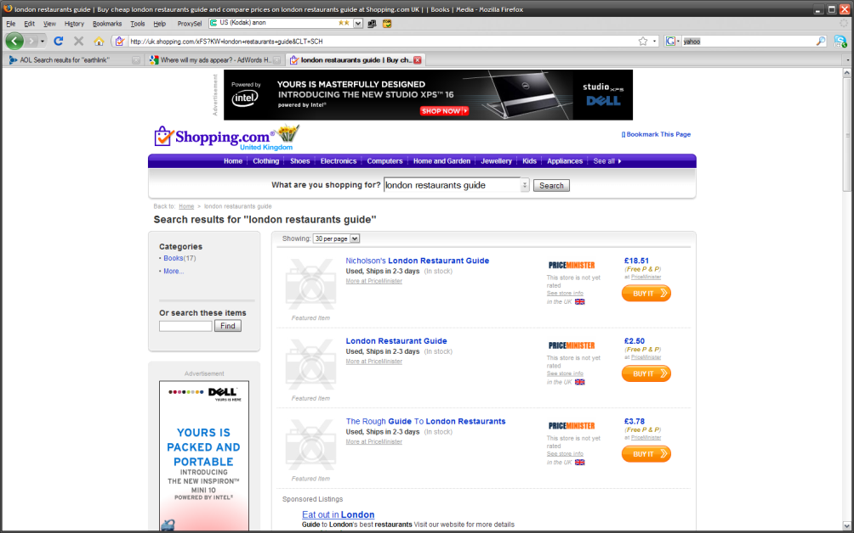



Notes:
Other Google owned sites

Slide 25

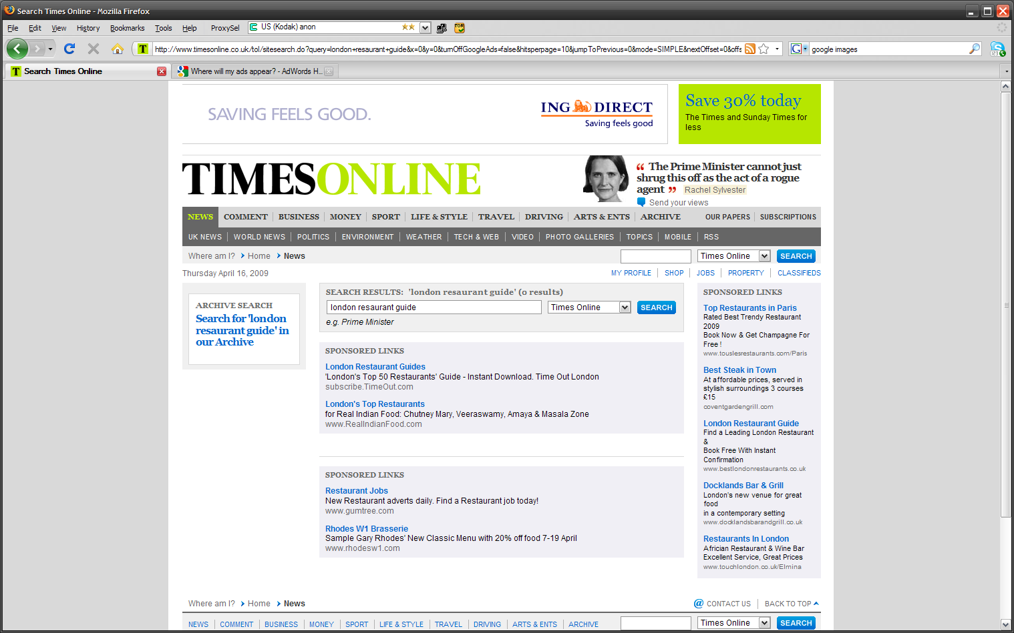

Notes:
Search partner sites

Slide 26

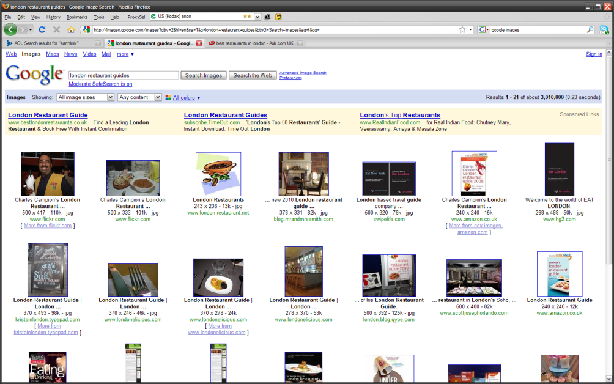

Notes:
And even different Google environments where SEO optimised natural listing are not present. E.g. Google images, etc...

Slide 27

2. PPC traffic can be directed to a specific sales environment which can be quickly tested and optimised
Notes:
2. PPC traffic can be directed to a specific sales environment which can be quickly tested and optimised

Slide 28

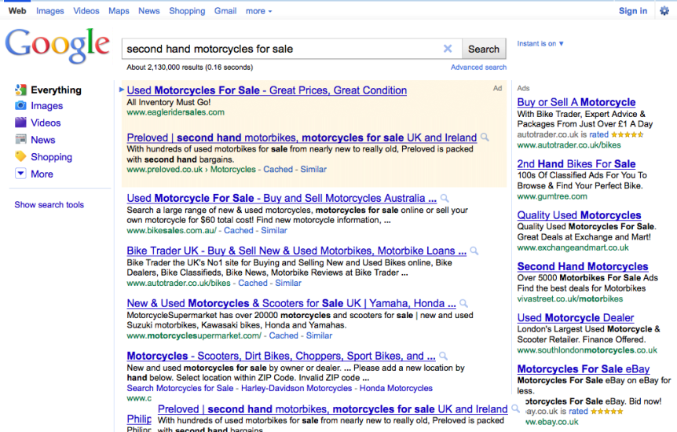
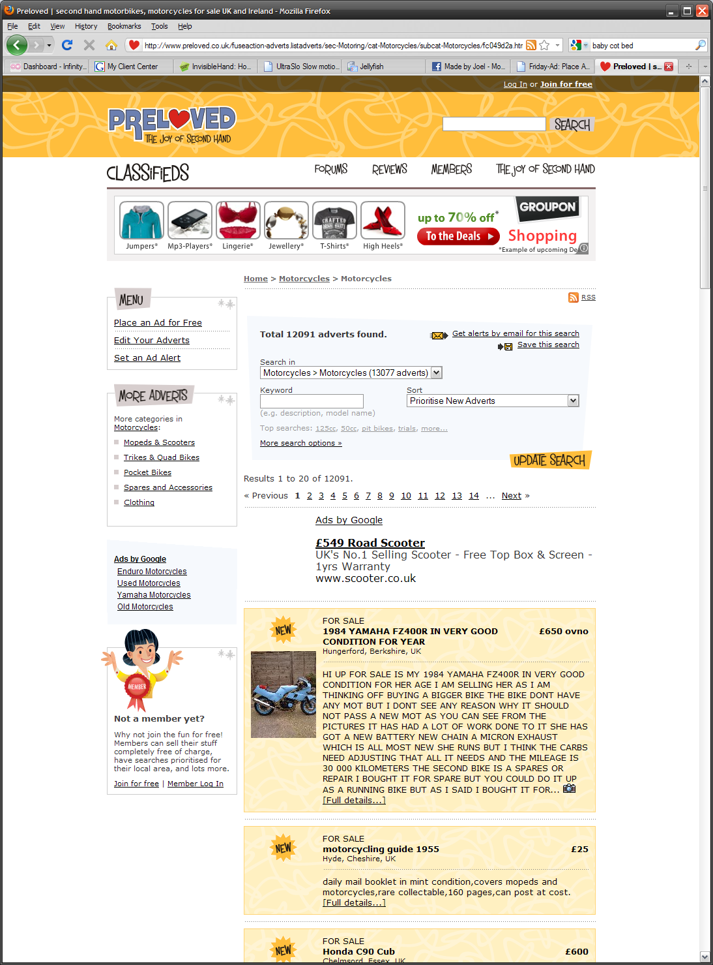
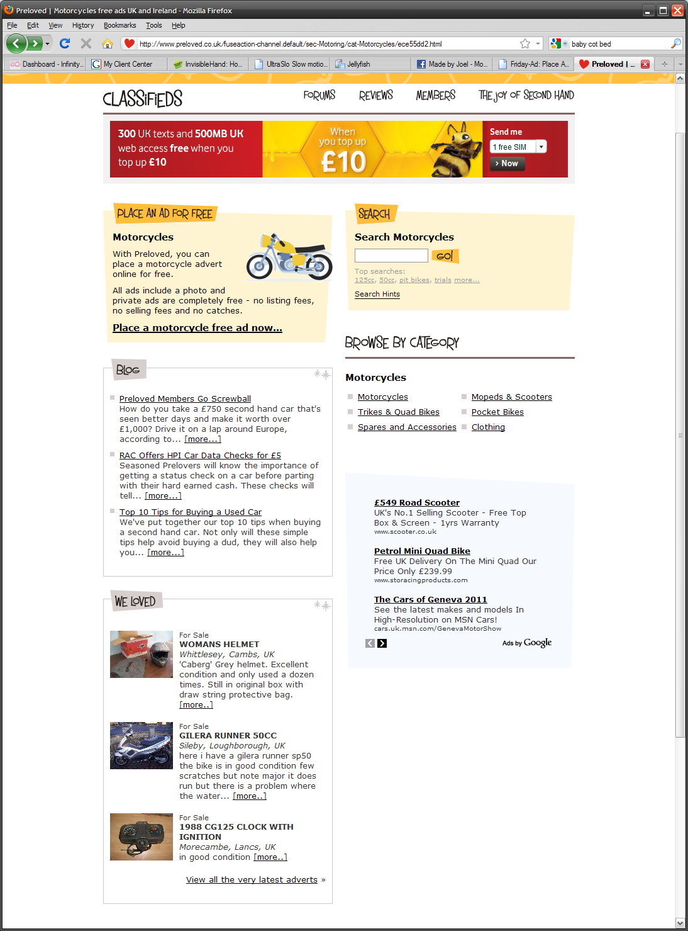
SEO
PPC
Notes:
With PPC you can land traffic to a specific sales environment, multi-variant test different landing pages, test different product or service offers...all without disrupting the SEO strategy and main site structure.
With PPC you can produce numerous pages (blocked from search spiders) with subtle title / copy changes without worrying about duplicate content affecting SEO. This increases quality score, conversion etc...
Of course all learning can be applied to the SEO strategy; however, it is also worth noting that optimisation for PPC differs from SEO. Some of the requirements for SEO fundamentally conflict with what is required for a PPC landing environment. E.g. Outbound links, user generated content via blogs forums etc..., heavy content.

Slide 29

3. PPC can be used to identify and prioritise keywords for SEO optimisation
Notes:
3. PPC can be used to identify and prioritise keywords for SEO optimisation

Slide 30

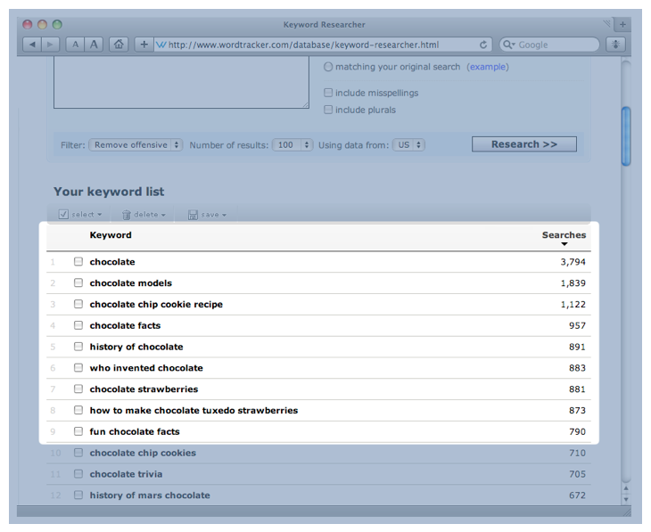
Notes:
In our experience, even the best keyword tools are not always accurate.
It is not uncommon to have looked up numerous keyword tools, identify a list of killer high volume keywords, optimise your site to these keywords, only to find when you achieve that no. 1 spot for the keyword at the top of your list, you are getting more traffic from the 4th or 5th most popular search term in your hit list? With PPC you can get the raw data. Through broad and phrase match keywords, you can mine the most popular raw search terms from your server logs.

Slide 31
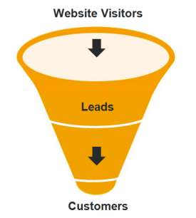
Notes:
Of course, we also have to consider that not all keywords convert!
Unless the sole purpose of the campaign is brand building, then there is little or no point in spending the time and effort optimising the site for high traffic keywords if they don’t convert. Again PPC can be used to identify those converting keywords before the speculative investment is put into an SEO campaign.

Slide 32
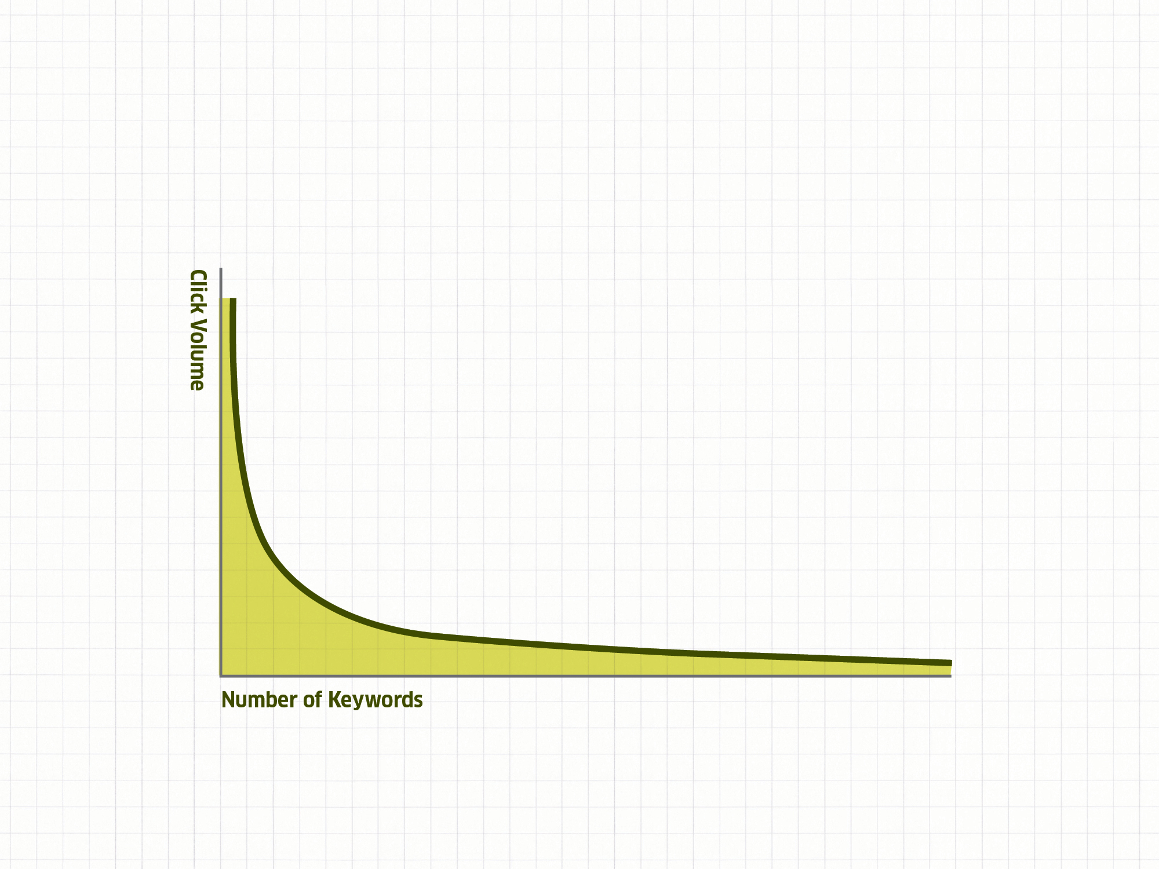
Target
converting
tail
keywords
Notes:
Lastly, by mining the long tail keywords THAT CONVERTED you end up with invaluable information which can be used to get quick wins from your SEO campaign. For example; you can obtain a number one organic position for many, MANY long tail keywords by simply getting a SINGLE back link with that anchor text or writing an article on that exact topic. You can also create a relevant new page on your site.

Slide 33

4. PPC can be used to
test ad copies and learnings can be used to optimise
meta descriptions
Notes:
4. PPC can be used to test ad copies and learnings can be used to optimise meta descriptions

Slide 34
Ad copy
Meta
description
Notes:
Meta descriptions are the little snippets shown from your site in the search results. Like PPC ad copy, these snippets are essential to getting users to click through to your site in organic listings.
With PPC, you can optimise your call to action and description to maximise your CTR on organic listings. It may even be possible to get a higher click through rate in the second or third organic position if you have the perfect meta description. With PPC you can split test many different descriptions and see which performs best. Then add the best performing PPC creative to your meta description tags.

Slide 35

5. PPC will give insight beyond page rank and
will identify keywords
which the search engines
think are relevant to the site
Notes:
PPC will give insight beyond page rank and will identify keywords which the search engines thinks are relevant to the site

Slide 36
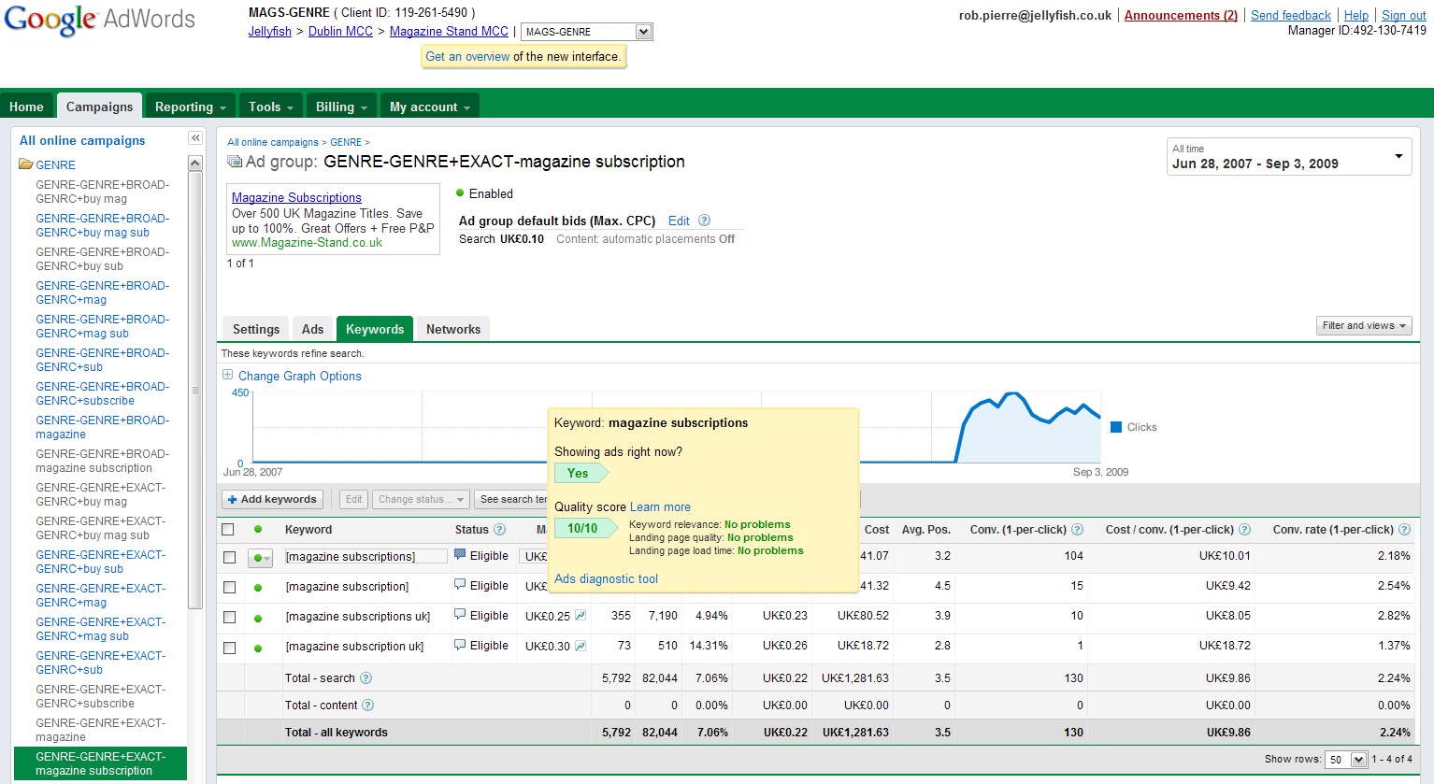
Quality score
Notes:
Google, MSN & Yahoo! wants to provide relevant results in the organic search results. Knowing and improving your quality score for certain keywords in your PPC campaign can reveal how relevant Google thinks your site is for any given keyword. Although this quality score is fairly subjective, it offers a good indication. With PPC you can find what keywords work and what keywords don’t and optimize your organic listings according to that data.

Slide 37

6. The more real estate your brand occupies on any given SERP the more trust and recognition you will receive
Notes:
6. The more real estate your brand occupies on any given SERP the more trust and recognition you will receive.

Slide 38
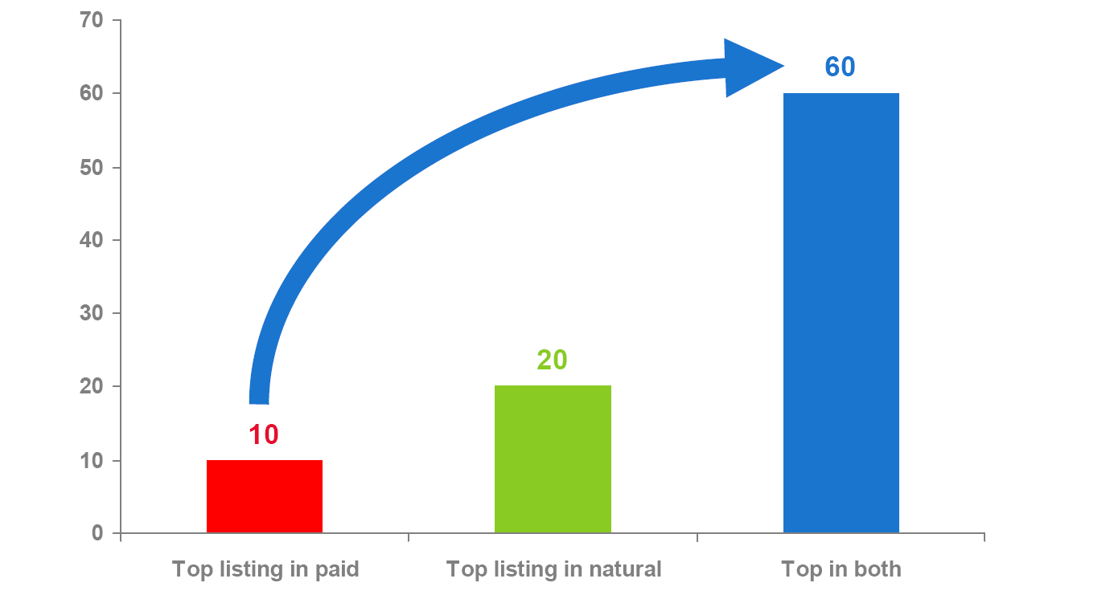

Affect of top listings in both paid and organics:
Out of 1,000 impressions number of expected clicks to the page
By being both paid and natural listings you dramatically increase
the number of clicks to your page (1-2% to 6%)
Notes:
According to Google, in the scenario where you have both an organic and PPC listing – from a CTR and subsequent click volume standpoint...1+1 makes 3.
Not to mention...if you are not there, your competitors will be...and their sponsored link will be above your ad even if you are no. 1 in the organic listings.

Slide 39
Managing PPC
to a fixed CPA
Notes:
Okay...I’m going to give a top line view of how this can be achieved...

Slide 40

Define the acquisition
Notes:
Within this industry an acquisition can be in the form of an advertiser (creating inventory for the site) or a shopper (driving market share)

Slide 41
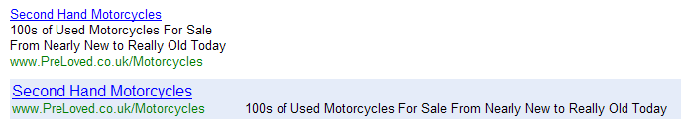

Use PPC to
gain market
share…
…and create
inventory.
Notes:
Within this industry an acquisition can be in the form of an advertiser (creating inventory for the site) or a shopper (driving market share)

Slide 42
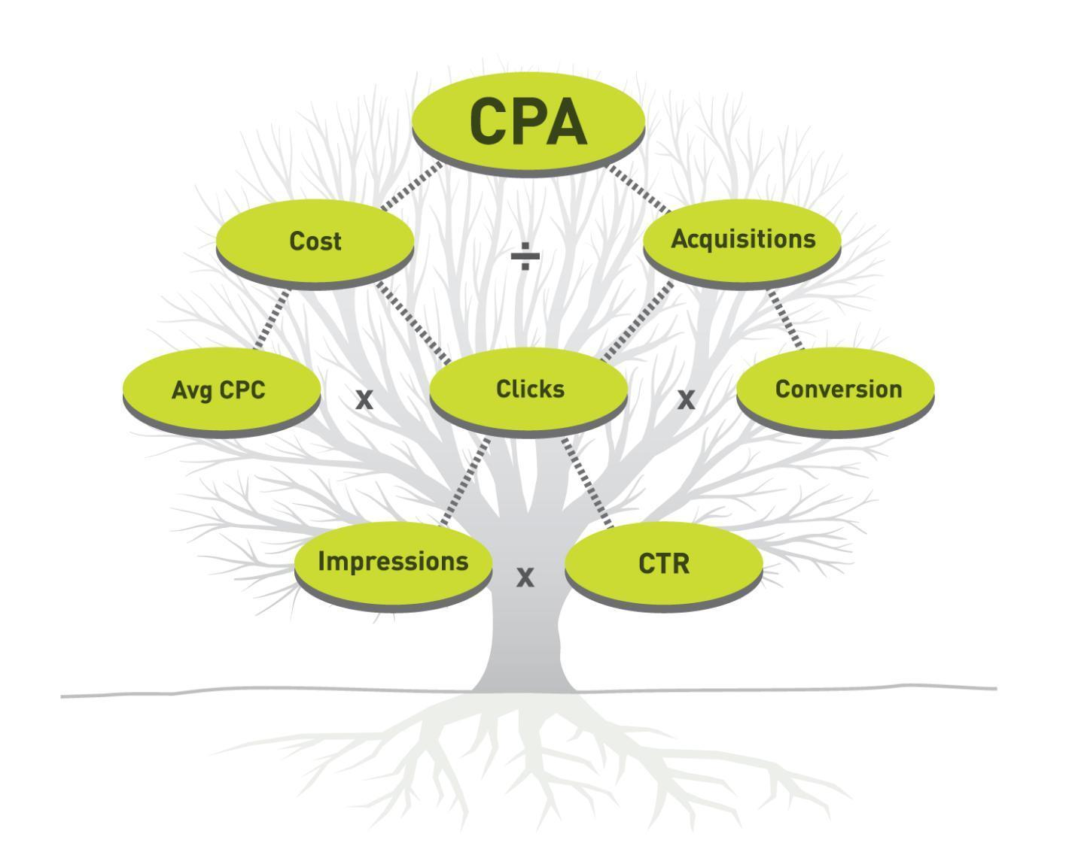
Notes:
The tangible nature of Pay per Click (PPC) campaigns provide the opportunity to generate acquisitions (sales, leads, enquiries etc...), in volume, at a fixed Cost per Acquisition (CPA).
This essentially turns your marketing activity into a fixed cost of sale, making it self-financing and subsequently much more scalable.

Slide 43
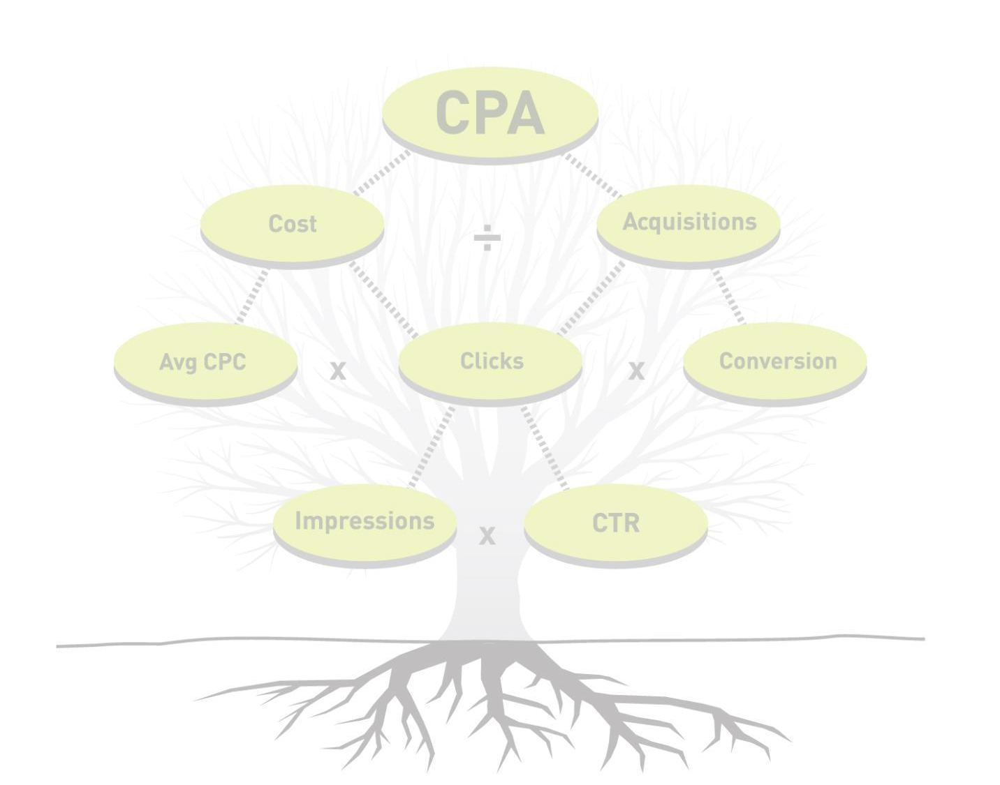
Campaign structure
Keyword generation
Ad copy writing
Landing page development
Destination URL allocation
Launch bid strategy
Notes:
Before we can manage the campaign, we need to look at the set-up and foundations needed to run a proficient campaign.
We have:
Campaign Structure
Keyword Generation
Ad copy Writing
Landing page development – where bespoke landing environments are required
Destination URL Allocation – using existing landing pages / website etc...
Launch Bid Strategy – How we attribute launch bid caps on Brand terms, Generic terms, Specific tail terms etc...

Slide 44
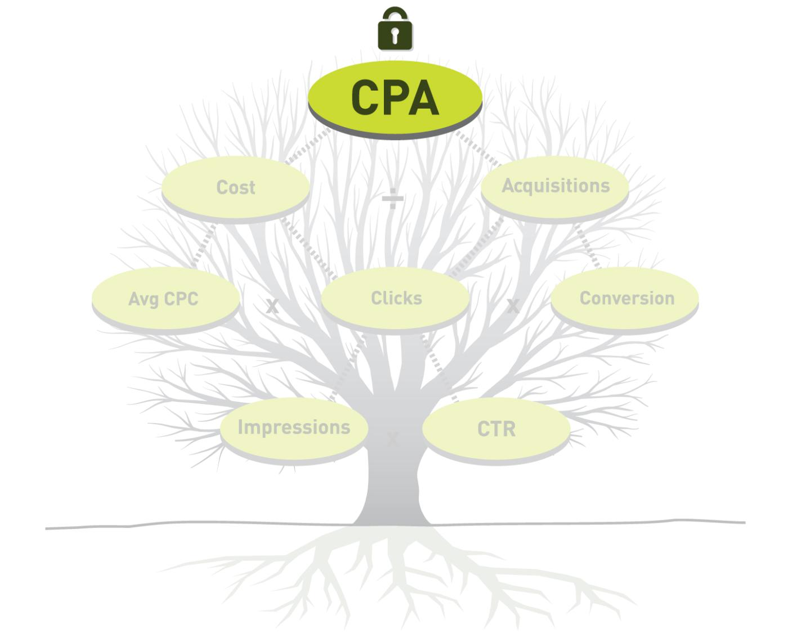
Notes:
With PPC campaigns...in order to manage them well...you ideally need to lock or anchor one aspect of the campaign.
For example, our preferred method is to lock the CPA making both acquisition volume and campaign cost the potential variables (never the ROI!).
It is also possible to fix the cost with a specific budget which will allow the CPA or number of acquisitions to vary. Or even fix the number of acquisitions which of course allows the cost and CPA to vary.
It gets extremely tricky to manage when everything is variable. As you can imagine, if you do not have a specific target for any of the top 3 metrics, it is difficult to adopt an effective campaign management strategy.

Slide 45
Affecting the
CPA cost curve
Notes:
Lets look at the CPA Cost Curve...

Slide 46
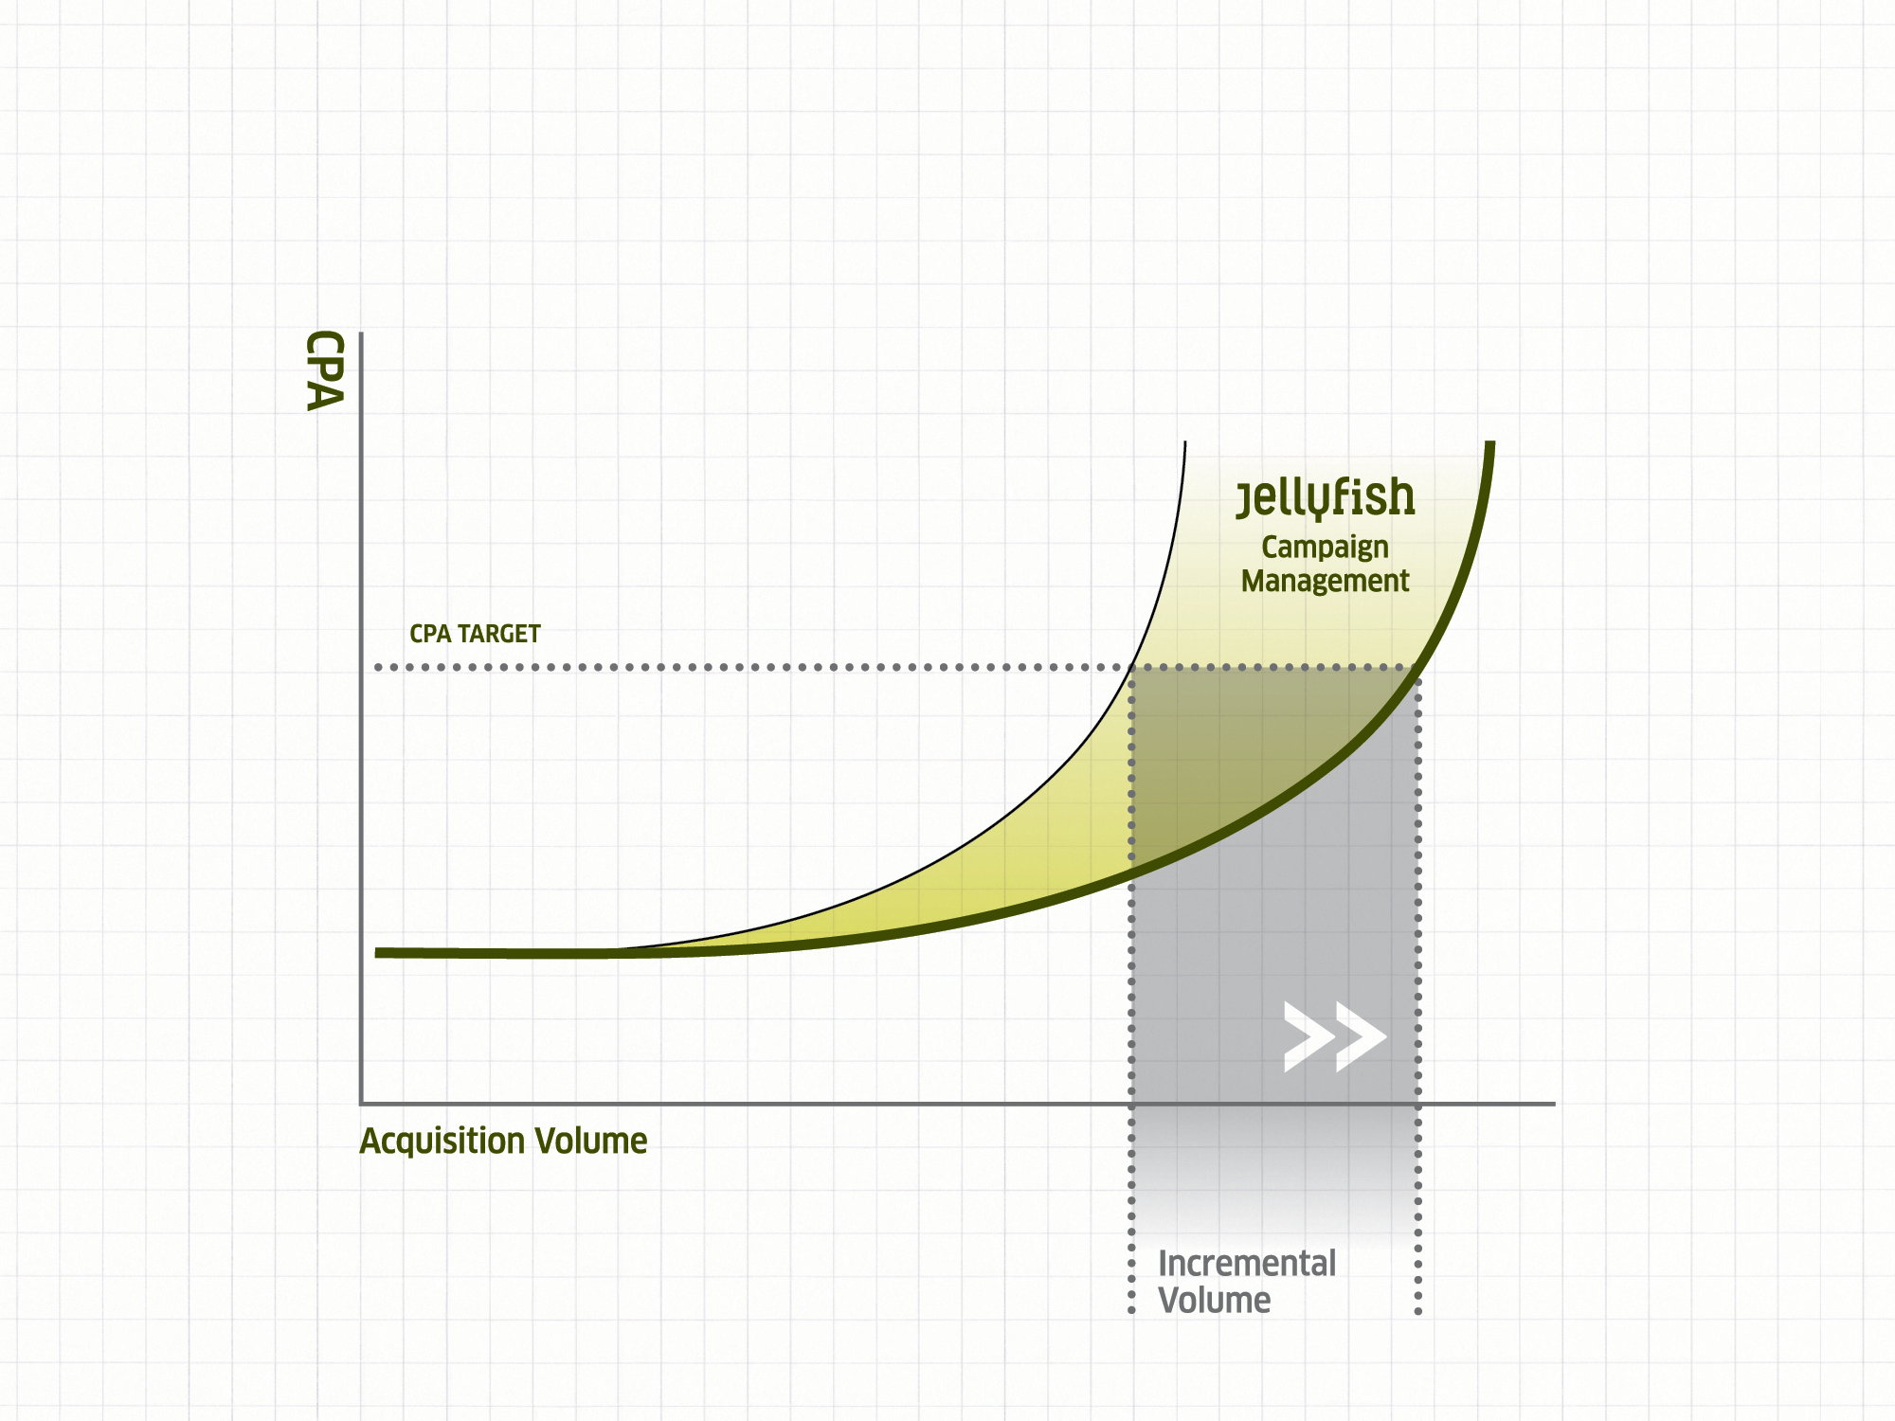
Cost curve with
proficient campaign
management
Natural cost curve
Notes:
Here you have an example of the natural cost curve based on the search landscape. As you can see, unlike manufacturing, or printing, there is no economy of scale!
The further you cast the net out, and target less specific or less related search terms, the more expensive the average acquisition cost becomes.
Through the introduction of quality score, it is possible for us to influence this cost curve through proficient campaign management.
The original cost curve is what will be followed using bid management technologies; however, through advanced campaign management methodologies and workflow, specific technology and a considerable amount of human resource the cost curve can be manipulated to deliver more volume of acquisition at the same CPA.

Slide 47
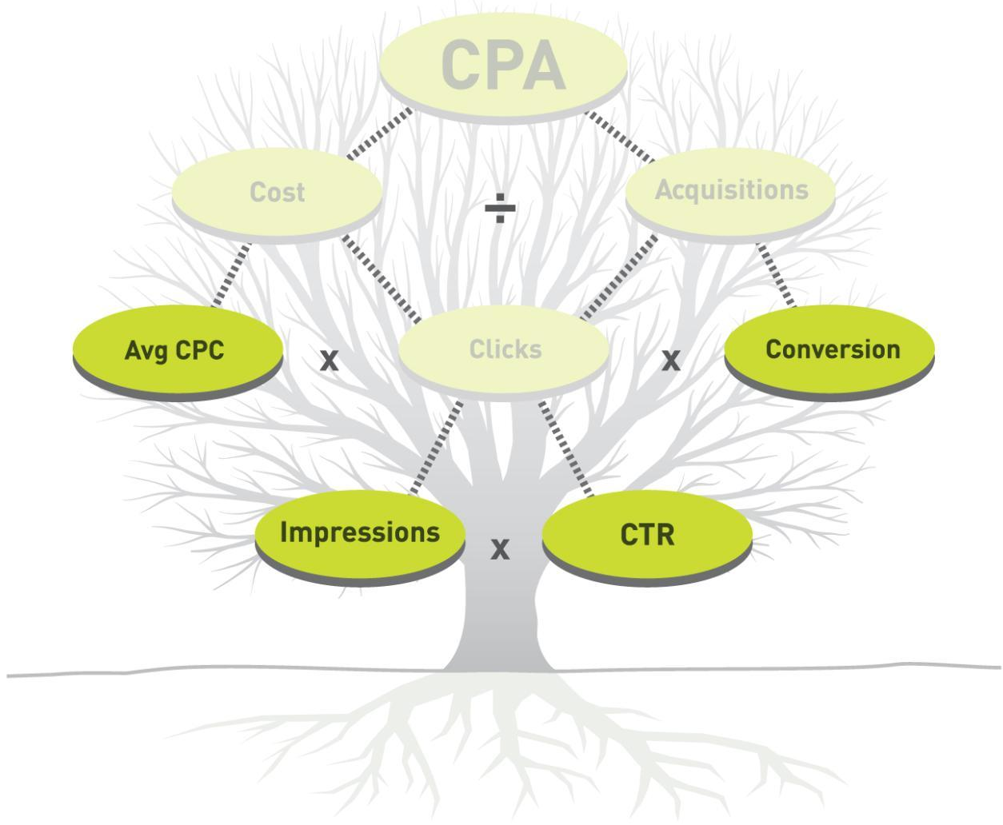
Notes:
If we look at the metrics tree again, there are actually only 4 metrics we can actually directly affect. The other metrics are simply a symptom of the affect we have on the metrics we can affect.

Slide 48
^{22 unique ways we positively}
^{affect our PPC campaigns}
Increase/decrease keyword count
Increase/decrease number of search networks
^{Manage content network}
^{Manage placement targeting}
^{Manage match types}
Increase/decrease campaign budgets
Introduce negative keywords (keyword mining)
Generate more tail keywords (keyword mining)
^{Increase/decrease bid caps}
^{Qualify/de-qualify ad copy}
^{Introduce network extensions}
(product extensions, video extensions & site links)
^{Improve ad copy relevancy}
^{Improve landing page relevancy}
^{Improve landing page load time}
Delete zero impression keywords
Delete keywords with 500+ impressions and no clicks
Define affiliate PPC rules & police activity
Improve website/landing page usability
Improve product offer/reduce commitment
Email follow-up (funnel drop-off)
^{Introduce retargeting}
^{Call tracking}

Slide 49
Keyword count
Network count
Content
Placement
Match type
Budgets
Negative keywords
Tail keywords
Bid cap
Ad copy relevancy
Landing page relevancy
Ad copy qualification
Site management
Product offer
Email follow-up
Negative keywords
Tail keywords
Page load time
Remarketing
Call tracking
External factors
Bid cap
Tail keywords
Negative keywords
Ad copy relevancy
Landing page relevancy
Page load time
0 Impression keywords
0 Click keywords
Affiliate management
Ad copy qualification
Keyword insertion
Negative keywords
Ad copy relevancy
Tail keywords
Ad extensions
Remarketing
Notes:
Here we see which metrics are affected by which change...

Slide 50

Non-search
PPC opportunities
Notes:
Before I quickly overview the technology required to proficiently fun PPC campaigns; thought I’d mention remarketing.
It is possible to use GDN remarketing to target users who have already visited your site and increase conversion rates.

Slide 51


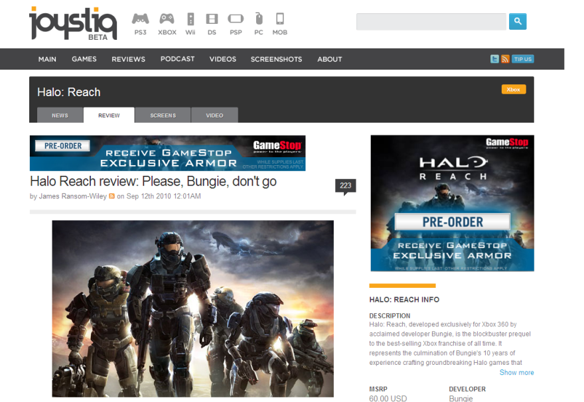


2. Google saves user info on user list.
3. User is recognized across GDN, and is shown relevant display or text ads.
1. User visits the Halo: Reach bonus content GameStop campaign site.
4. User has quick and easy access to the Halo Reach campaign site - enabling the user to convert easily when ready to complete purchase.
Notes:
What is remarketing?
Remarketing allows you to show ads to users who've previously visited your website as they browse the Web.
When you use remarketing, you'll tag pages of your site that correspond to certain categories you want to promote. For example, you could add a “LCD TV" tag on all of the pages where you comparing LCD TVs. You can then create an AdWords campaign to show highly relevant messages to people who've visited these pages as they browse sites across the Google Content Network.
Why you'd use it ?
Remarketing allows you to communicate with people who've previously visited key pages on your website, giving you a powerful new way to match the right people with the right message.
When you combine your keyword campaigns with remarketing, you might see higher
conversions for your campaigns overall. For example, if you have keywords that you don't use because you haven't seen conversions in the past, you can use these keywords to drive traffic to your site, then use remarketing on the Google Content Network to capture incremental conversions from a more qualified set of potential customers.

Slide 52

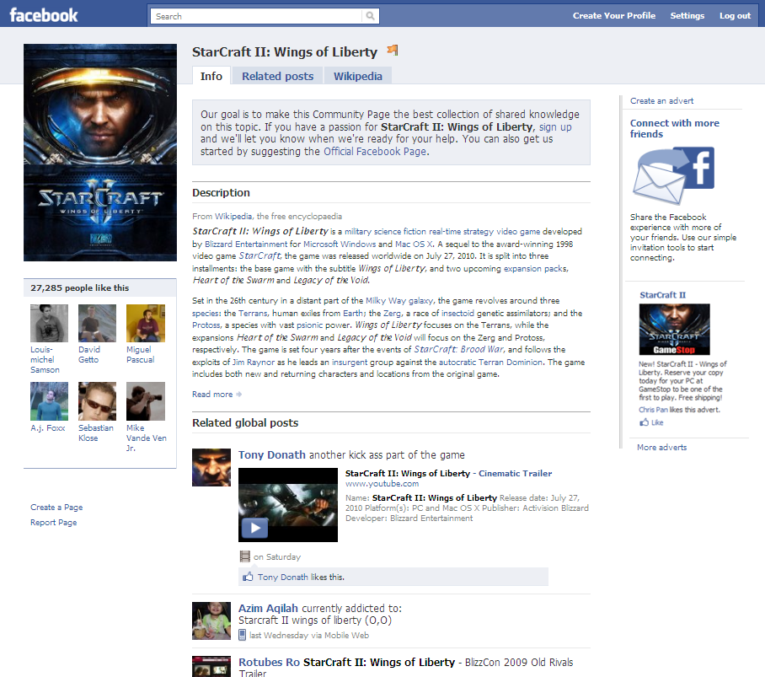
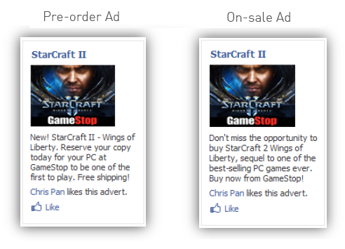
Targeted placement:
Extremely low CPMs makes Facebook a great channel for brand awareness.
Multiple interest (sport, music, films, entertainment etc.) targeting variants.
Multiple image variants – relevant to targeting and game being promoted.

Slide 53
The technology
Notes:
Conceptually understanding the numerous ways in which we can positively affect the performance of a campaign is extremely important; however, the ongoing analysis of the campaign metrics, identification of opportunities and facilitation of changes is just as important, if not more important.
How can you possible apply all those changes to 1000s of keywords on a weekly basis...I hear you ask!

Slide 54
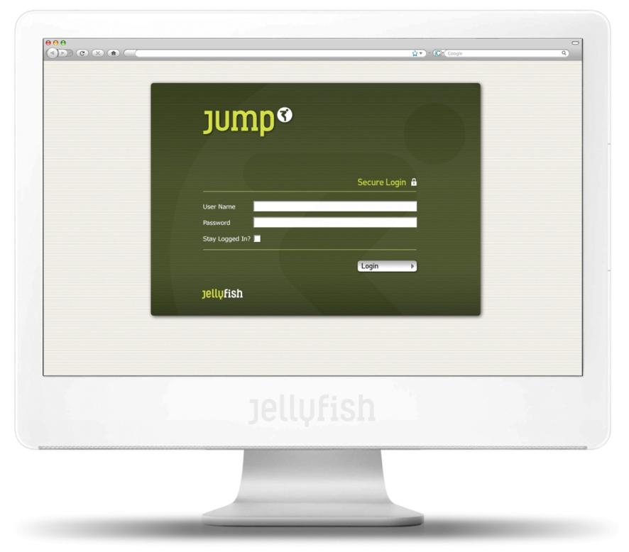
We use our proprietary platform JUMP...
Notes:
Well we use a bespoke workflow and analytics platform to help us...called JUMP

Slide 55
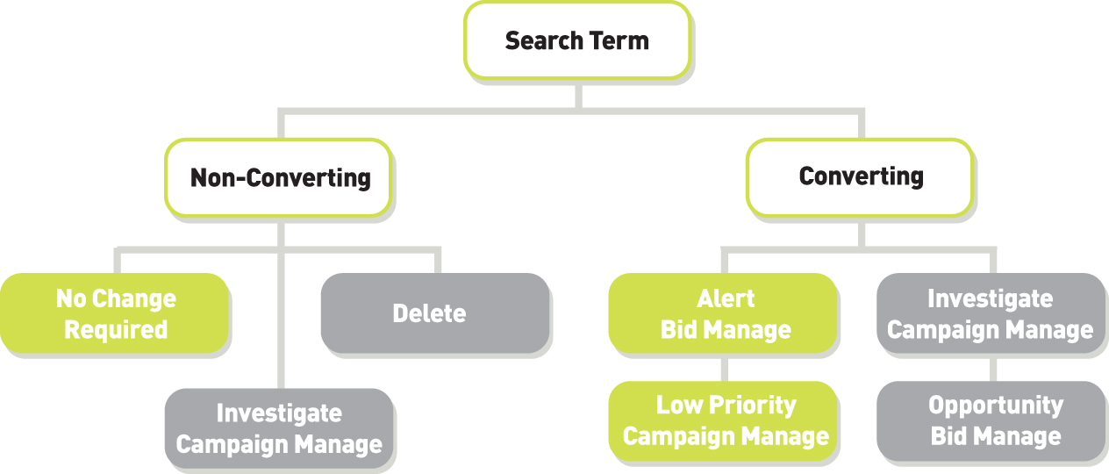
Notes:
JUMP puts the keywords into the following categories...

Slide 56
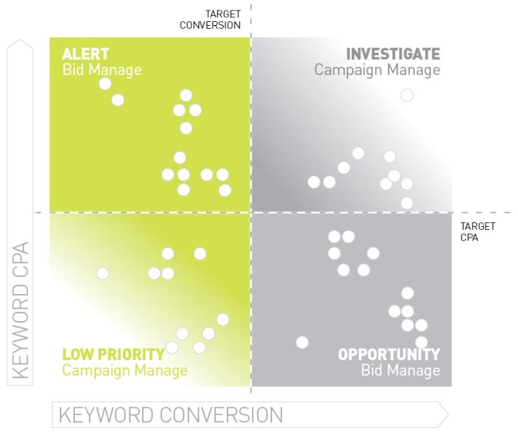
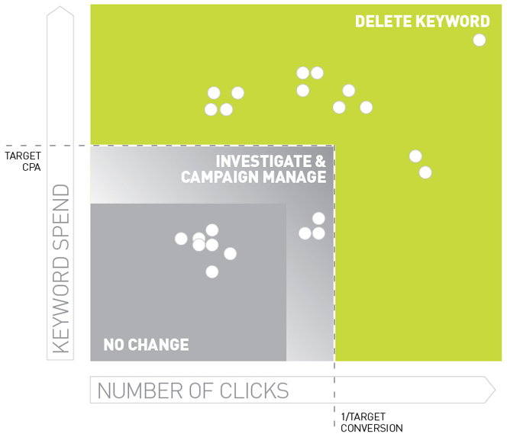
Non-converting
keywords
Converting
keywords
Notes:
All non-converting keywords are plotted on this matrix.
Where they fall on the matrix determines what action the JUMP system will recommend.

Slide 57
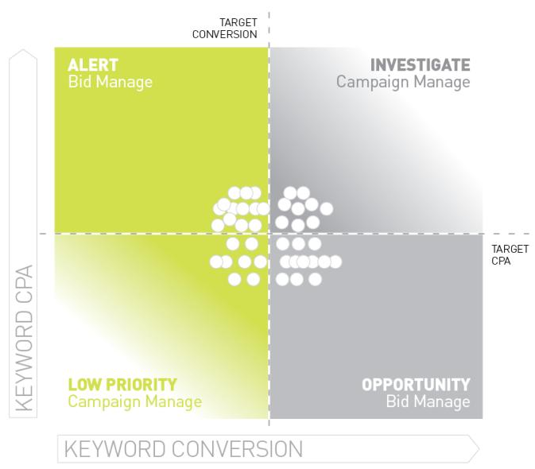
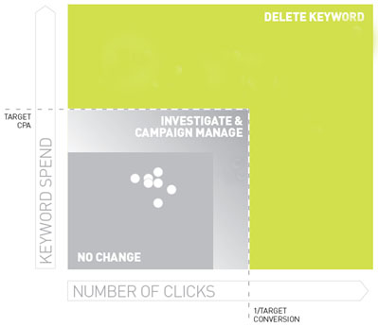
Non-converting
keywords
converting
keywords
Notes:
All non-converting keywords are plotted on this matrix.
Where they fall on the matrix determines what action the JUMP system will recommend.

Slide 58
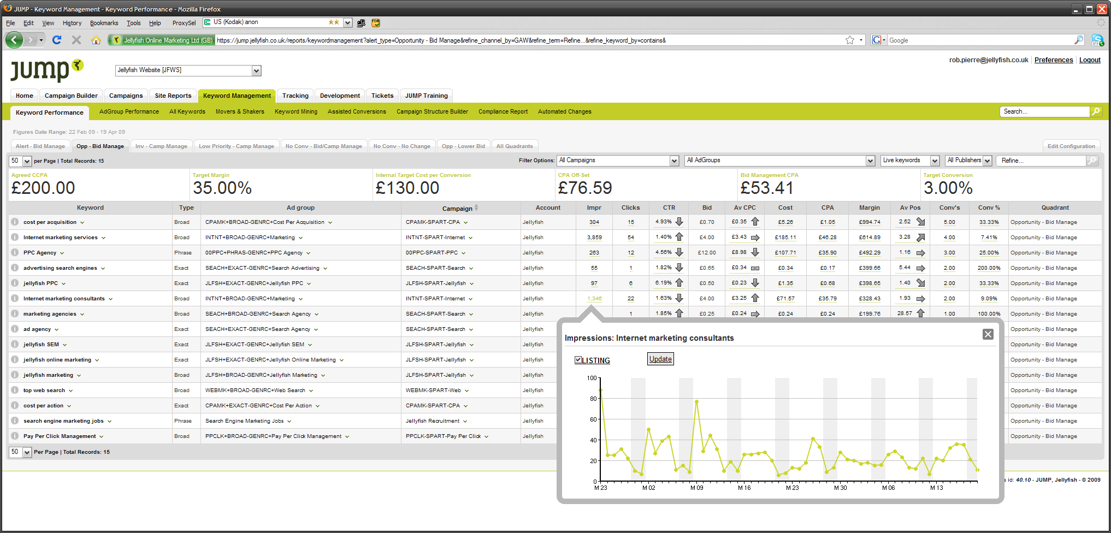
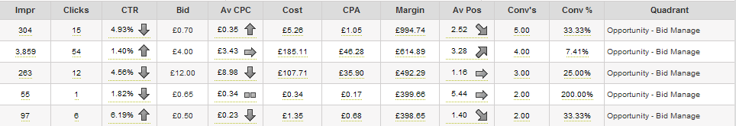
Notes:
We manage the keywords through an interface which provides quick and easy access to relevant performance metrics, campaign information and the facility to log and make changes, at each point in the campaign management workflow.

Slide 59
The tangible nature of Pay per Click (PPC) campaigns provide the opportunity to generate acquisitions (sales, leads, enquiries etc...), in volume, at a fixed Cost per Acquisition (CPA)!
Notes:
So in conclusion...

Slide 60
Thank you
jellyfish.co.uk

