Slide 1


Slide 2
Own the mobile space
50% of internet traffic will be on mobile within a couple of years (Google, Morgan Stanley)
Consumers that encounter non-optimal sites are not likely to return (50%+)
Once in a generation chance to provide a technology solution in place that end clients will likely keep for many years

Slide 3


Slide 4
Gumiyo Platform
Zero IT requiement from client
Enterprise quality solution
Rapid deployment
Proven commercial models

Slide 5
Render sites to mobile phones
Our specialty, Gumiyo powered sites can be built
Manually using Site builder
Automatically using XML data feeds, APIs
Combination of the above
Gumiyo provides Outstanding mobile UI
2,000+ handsets – all mobile browsers, tablets
Simple, clean functional sites packed with features
Detect exact handset capabilities to optimise element including Images, video and to work around any “quirks”

Slide 6
Render sites to mobile phones
Our specialty, Gumiyo powered sites can be built
Manually using Site builder
Automatically using XML data feeds, APIs
Combination of the above
Gumiyo provides Outstanding mobile UI
2,000+ handsets – all mobile browsers, tablets
Simple, clean functional sites packed with features
Detect exact handset capabilities to optimise element including Images, video and to work around any “quirks”

Slide 7
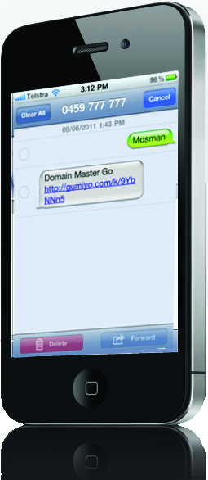
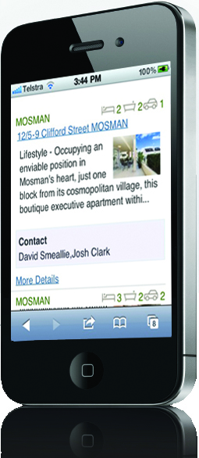

Slide 8



Use any media to promote Mobile
Extended Media Promotion
On Billboards and Magazines

Slide 9
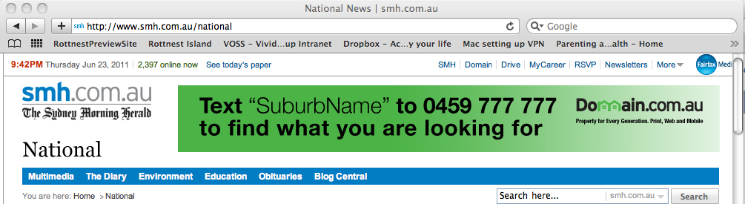
Website to mobile promotion
Example
On Domain website (plus third party sites)
Domain, Property for Every Generation – Text “Suburb” to 0459 777 777

Slide 10
Web to Mobile Product
Web Widget – drive leads from the web

Slide 11
ICMA Offer
Build Mobile classified Portal – no cost
€12,000 value
Host, Maintain and support Mobile classified Portal
No charges until June 30, 2012
Up to €6,000 value
Offer valid until November 30
Site guaranteed for delivery by January 31
Additional Advertiser solutions for mobile - $$$$$ for you

Slide 12
Thank you
If you are interested
Please contact
gavin@gumiyo.com.au
+61 409 999 339

