Slide 1
Developing Mobile Apps Market | Strategy | Marketing | Examples
Concentra
|MEDIA|
Koen Vandaele
Concentra Digital Media Services, Belgium
Sidharth Gupta
GETIT Infoservices Pvt. Ltd., India

Slide 2
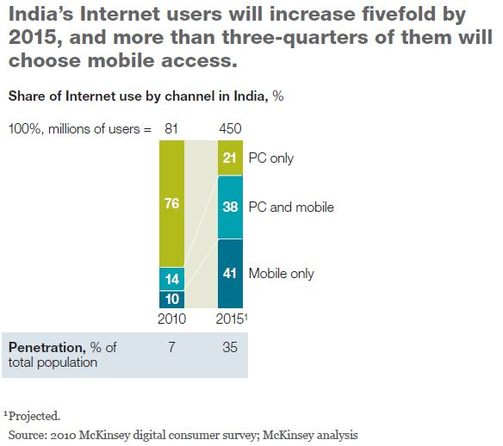
Which App/s to go for?
Ask Yourself:
Data Point
The current Mobile handset market-share
Proposed market-share in 12-18 months
Current competitors and their Wap site/apps
Concentra
|MEDIA|

Slide 3
Worldwide OS Market Share
Concentra
|MEDIA|

Slide 4





Choosing an OS/Mobile platform
Choosing a mobile platform depends on the market share by each OS
India is a huge & diverse market: app development on all major platforms except Windows
Belgium: app development on iOS, Android & Symbian
iOS
Best user experience
Android
The obvious choice – as it the fastest growing mobile platform across the world
BlackBerry
For entrepreneur/young user base
Symbian/Java
Windows
Comparatively easy and fast to develop
Internet use on iPhone is highest
Has few OS limitations compared to iOS/Android
Works on Java based phones which have mass market in India
Does not require a data plan – Standard SMS rates apply for each query
Requires more time to develop and test
Cost of development is high
Has the highest market share
Has a low market share and not many apps in the App store
SMS App
Unsure of how Windows/Nokia will turn
Concentra
|MEDIA|

Slide 5
App Development, Submission & Promotion Process
4
Initiate
Development
Submission
Scope & choose Mobile OS
Prepare an App Launch plan
Promotion
Paid stores
Develop webservice
Design wireframe
Free Stores
App World
iTunes
Android Market
GetJar
Project Plan
Testing
Vendor Selection
Development
Online PR
Blogger reviews
Mobile marketing
Social Media
Alliance with Handset manufacturers
3
2
1
Concentra
|MEDIA|

Slide 6
Initiate
1
Define Scope & choose Mobile OS. TIP: KISS
Vendor Selection
There are two ways to develop native apps:
With a Cross-Platform Mobile app development
Individually develop app for each platform
 | Benefits | Limitations | Costs & Time
 | Develop all apps from one single platform Easy & Quick | Majorly for smartphones All OSs are not compatible Many platforms don’t support BlackBerry (non touch) License Fees applicable in case of Patented Cross Platform | Euros 30,000-40,000 (includes iOS, Android, Symbian-touch) Timeline : 8-12 weeks
 | Cost effective when developing specific platforms Managed more appropriately One-time development cost | Takes comparatively more time to develop Designs need to be individually created for each platform | Each app costs between Euros 6,500-7,500 Timeline : 5- 7 weeks each
Cross-Platform
Apps
Specific Apps
Concentra
|MEDIA|

Slide 7
Develop
2
App Development Process
Deliver
Develop
Design
conceptualize
App design
Develop architecture
Testing
Review
Perform QA
Fix bugs
Design Wireframes
Integrate webservices
Coding
Deliver
A typical Project Tracker – Task List, Dependencies, Progress
Tasks List | Responsibility | Dependencies (if any) | W1 | W2 | W3 | W4 | W5 | W6 | W7 | W8 | W9
Design (Technical Design) | Vendor/Internal
Development | Vendor
Feedback/Review | Internal
User Acceptance Testing | Vendor/Internal
Testing/Fixes | Vendor
Deliver | Vendor
Concentra
|MEDIA|

Slide 8
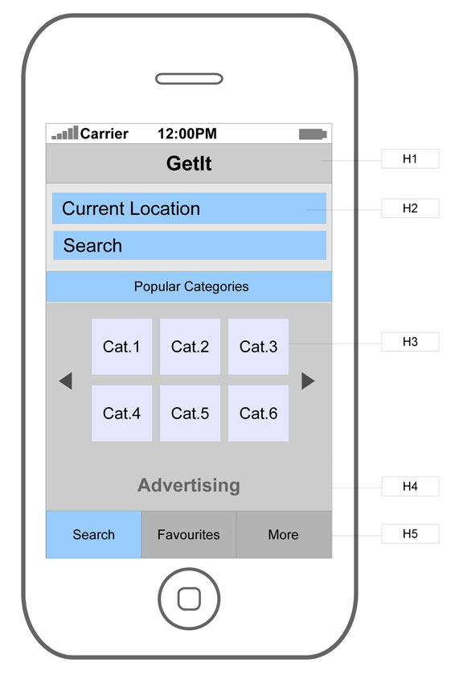
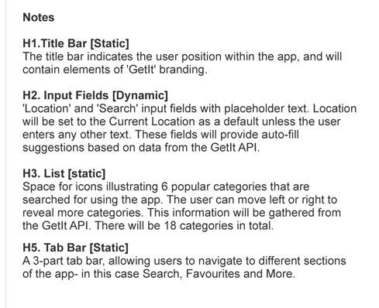
Design
Design is part of the total cost. However, screens may be designed internally seeing the resources and cost comparison.
Usability rules are different!
Before moving on to design, it is important to prepare a Wireframe of the Local Search app
Concentra
|MEDIA|

Slide 9
Submission
3
Account set-up
Account Verification
App Review
App Submission
App Approval
The standard process of an App Store
Online Store | Cost | TimeFrame
iTunes | $99 developer account fee per year | 2-3 weeks for complete process including review/approval
RIM App World | $99 developer account fee per year | 2-3 weeks for complete process including review/approval
Nokia OVI | $1 developer account fee | 1-2 weeks for complete process including review/approval
Android Market | Free
Others
GetJar | Free
Concentra
|MEDIA|

Slide 10
Promotion
4
After submission, prepare an App Launch plan to promote app
Your own media – print & online – integrate app downloads in your own online products
Online PR – Publishing story on leading online journals
Bloggers review – Specialized tech experts
Mobile marketing – Contextual/display advertising on Mobile Networks & interact between apps.
Social Media
Alliancing with handset manufacturers (eg. Nokia needs apps!)
Your own Media
&
Online PR
Bloggers Review
Result
Mobile marketing
Social Media
Inbuilt on mobile handsets
Better Visibility
Increase in Downloads
More usage
Concentra
|MEDIA|

Slide 11
Real live examples
Concentra
|MEDIA|

Slide 12
Concentra ‘App of Antwerp’ – About & Features
The ‘App of Antwerp’ app is a FourSquare-type app that lets you discover Antwerp, its local businesses, local services, including deals.
Features
Rich, interactive and graphical interface (only touch screen phones)
Auto detects your current location using GPS
Search for local information/businesses:
Shopping
Restaurants
Musea
‘Have a beer’
You can “check-in”
Collect deals
Earn points and become ‘major’
Find your closest friends
Mobile advertising
Concentra
|MEDIA|

Slide 13
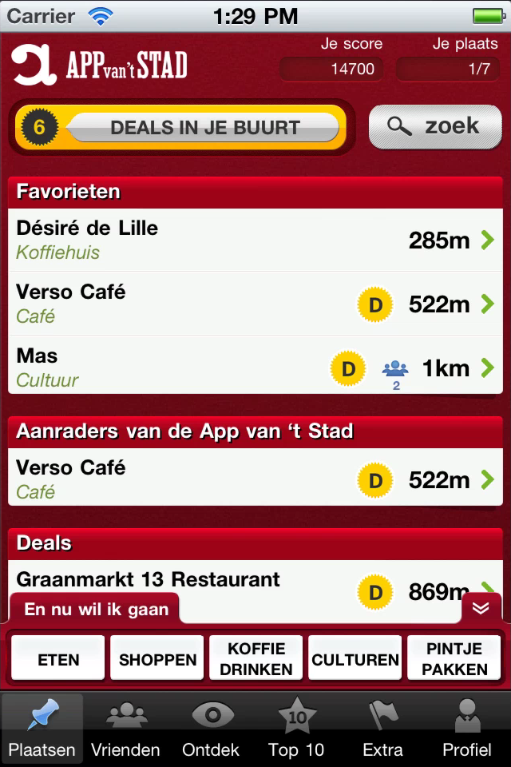
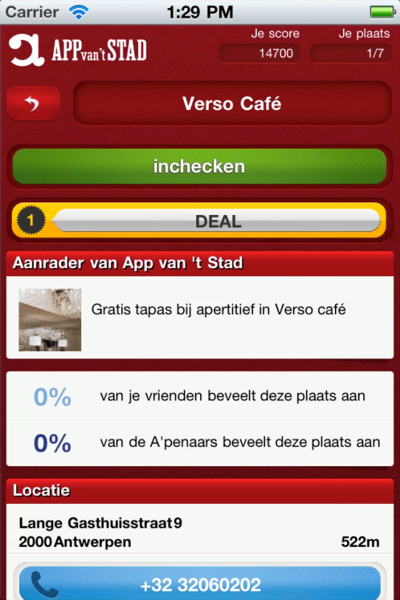
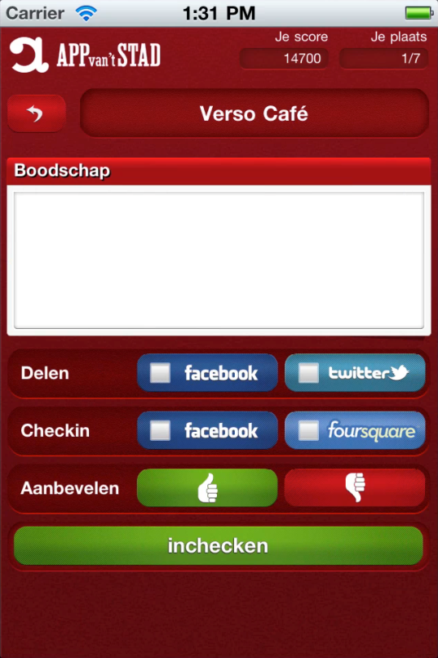
Concentra ‘App of Antwerp’ Screens/Flow
Home
Detail page
Check-in
Auto-detects location
Search by keyword or Popular categories
Check-in to a local business
Option to call, view on map and ‘take me there’
Earn points
Share
Recommend a place
Concentra
|MEDIA|

Slide 14
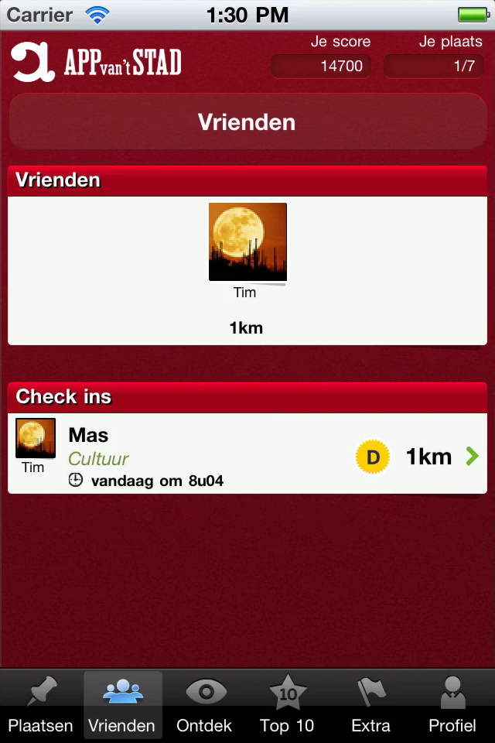
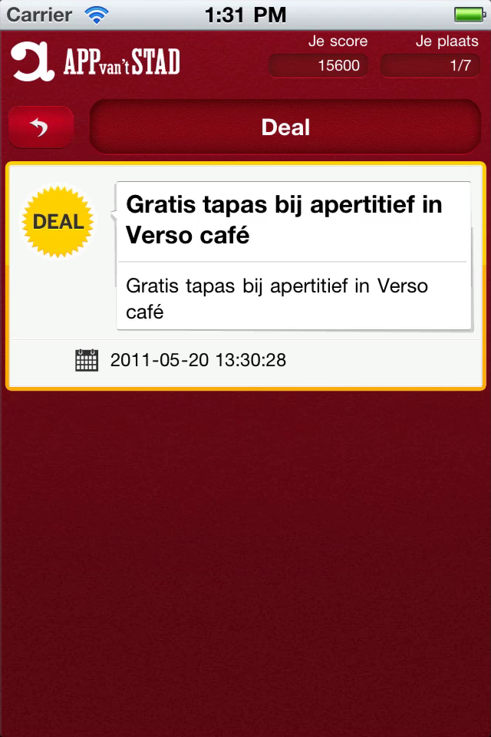
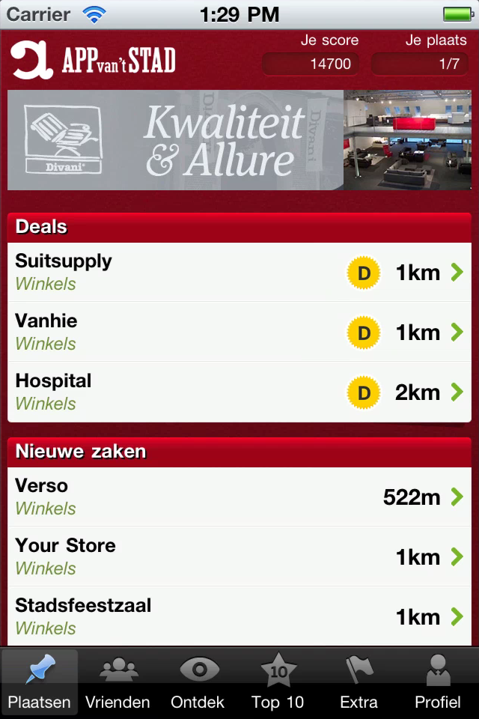
Concentra ‘App of Antwerp’ Screens/Flow
Friends
Collect a deal
Mobile advertising
Find your friends
Where did they go? And did they like it?
Check-in to a local business and collect a deal
Concentra
|MEDIA|

Slide 15
Getit Mobile App – About & Features
The Getit mobile app is your easy-to-use guide for local information. It provides a simple, convenient and intuitive solution to find local businesses and service providers from Getit's comprehensive India business listings.
Features
Rich, interactive and graphical interface
Search for local information/businesses in India with ease
Auto detects your current location using GPS
Quick links to top/popular categories let you find faster
Refine your search based on attributes and location
Interactive map with directions
Call any business with a single click/tap
Share businesses via email & SMS
Save favourite listings on your device
Concentra
|MEDIA|

Slide 16
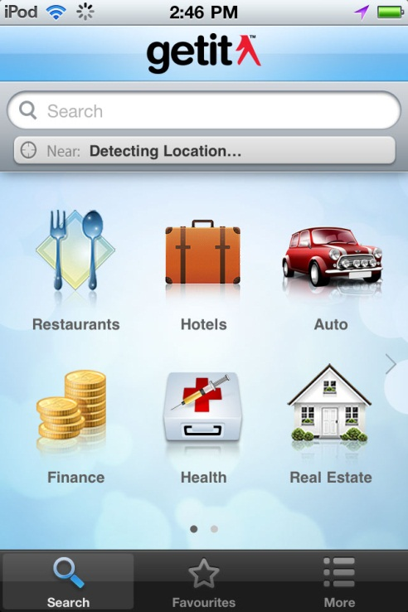
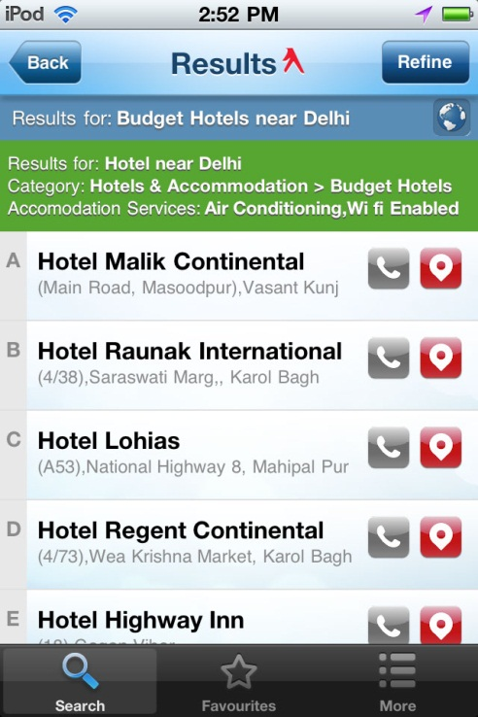
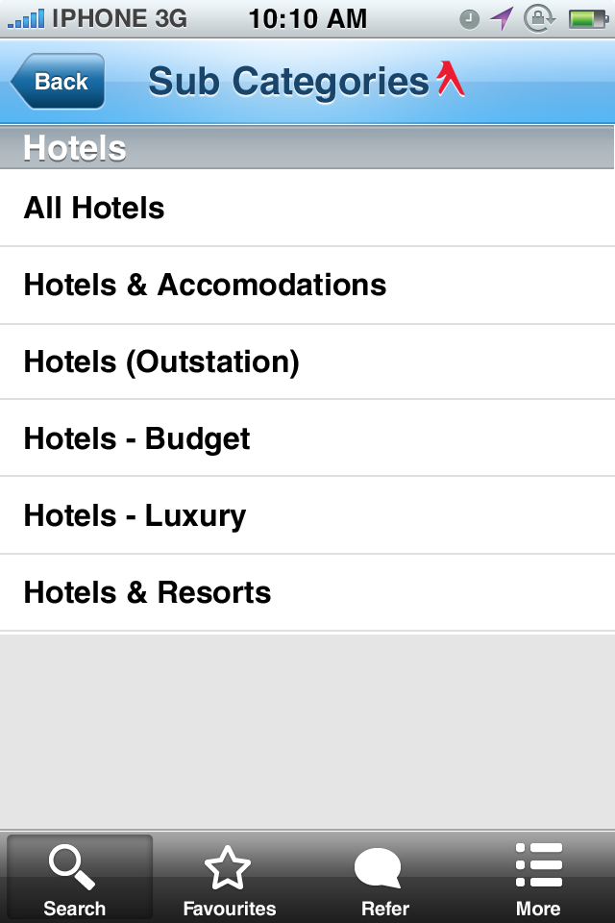
Getit Mobile App Screens/Flow
Home
Search Results
Sub-category
Auto-detects location
Search by keyword or Popular categories
Get direct results by keyword search
View Search results
Option to Call, View on map
Clicking/Tapping on Popular Categories takes user to Sub-category screen
Concentra
|MEDIA|

Slide 17
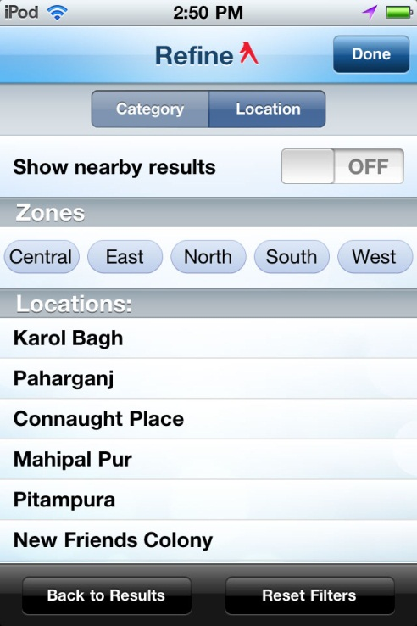
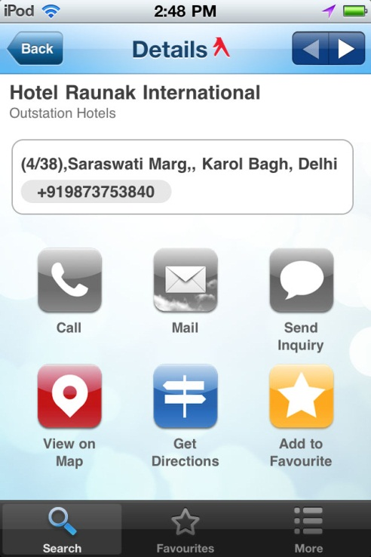
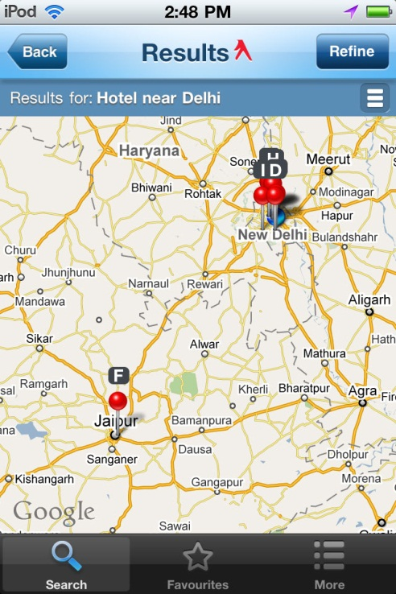
Getit Mobile App Screens/Flow
Refine option
Details
Maps
Refine allows user to get results based on Categories, attributes and Area
View complete contact details
Connect with advertiser via Call, Mail
View Map and Get Directions on maps
Concentra
|MEDIA|

Slide 18
Concentra Real Estate App – About & Features
Real-estate app that allows you to easely find property for sale or rent.
Features
Search result based upon your current location using GPS or by manually entering a city/region.
App adapts functionality depending on the quality of your mobile connection.
Display results on a map (default) or in a list
Refining your search based upon the most important real estate search criteria. (price, location, type, #bedrooms, …)
View detailed info including photo’s
Option to call or mail the seller
Save to your favorites & send to a friend features
Concentra
|MEDIA|

Slide 19
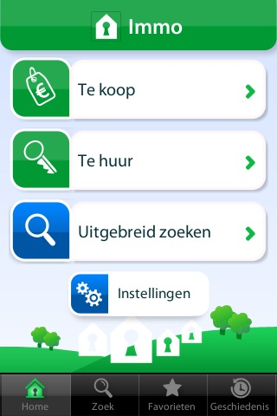
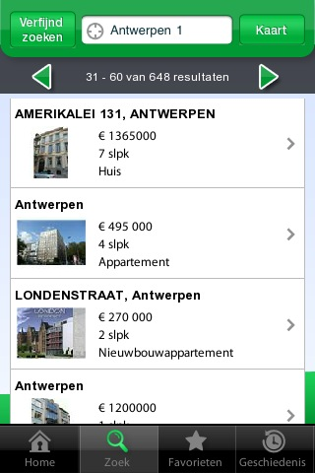
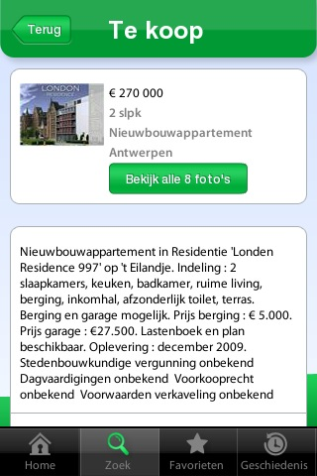
Concentra Real Estate App Screens/Flow
Home
Search result
Detail page
Sale or rent?
Refined search from the home screen
View your search history
Result with basic info
Navigate results
Map/List view
Detailed info
Contact details
Show more pictures
Save to your favorites
Concentra
|MEDIA|

Slide 20
FreeAds Mobile App – About & Features
The GetitFREEADS iPhone app allows users to buy, sell anything locally and nationally. It is a simple and reliable platform for buying & selling various products/services in various categories like Vehicles, Properties, Jobs, Education, Computers/mobile, Personal, etc.
Features
Search for ads in categories like Vehicles, Properties, Jobs etc.
Auto detects your current location using GPS
Quick links to top/popular categories let you find faster
Refine your search results based on location and attributes
Interactive map with directions
Share ads via email/SMS
Save your favourite ad on device
Save contact details of advertiser on device
Concentra
|MEDIA|

Slide 21
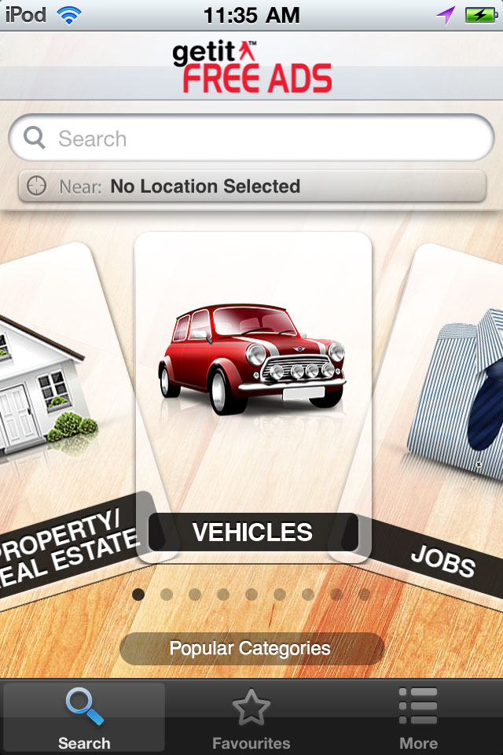
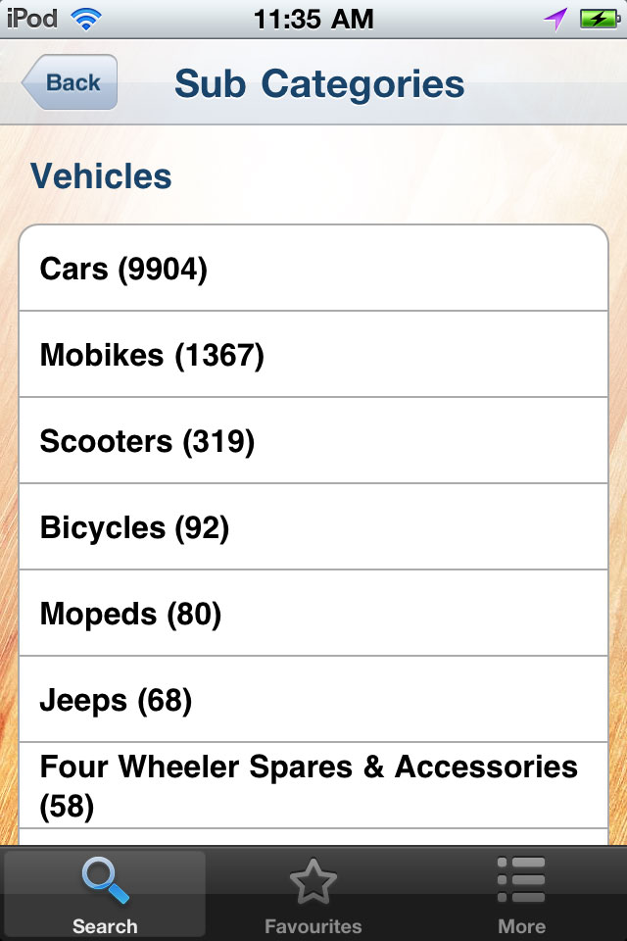
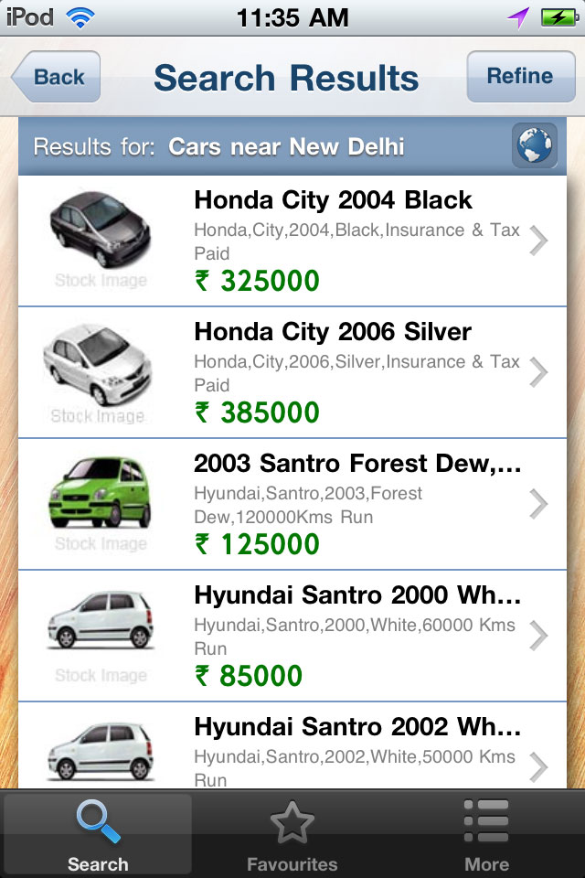
FreeAds Mobile App Screens/Flow
Home
Sub-Category
Search Results
Auto-detects location
Search by keyword or Popular categories
Sub-categories page gives number of listings in each sub-category
View product image, price, offerings in one singly screen
Concentra
|MEDIA|

Slide 22
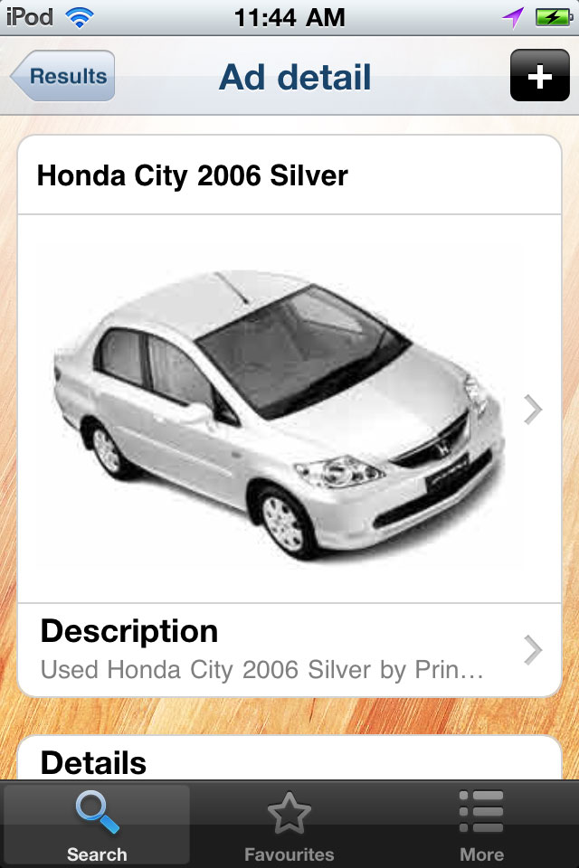
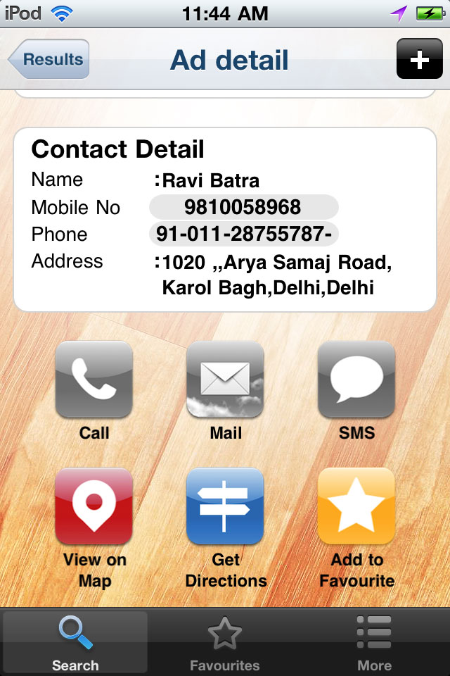
FreeAds Mobile App Screens/Flow
Ad Detail has a more detailed info about ad and advertiser
Option to Call, Mail Advertiser
Option to save Contact details of advertiser with one click
Ad Detail
Concentra
|MEDIA|

Slide 23
Thank You!
Concentra
|MEDIA|

