Slide 1
The new classifieds
4 Nov. 2011
ICMA

Slide 2
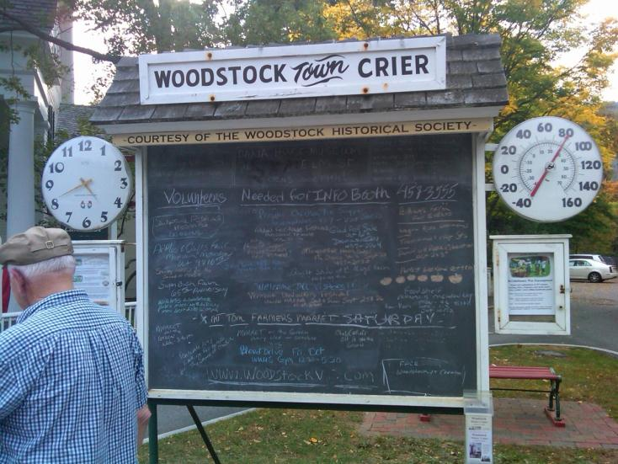
1 br, 1 ba, 600 sq ft cottage on Main St, no goats, $290/mth

Slide 3
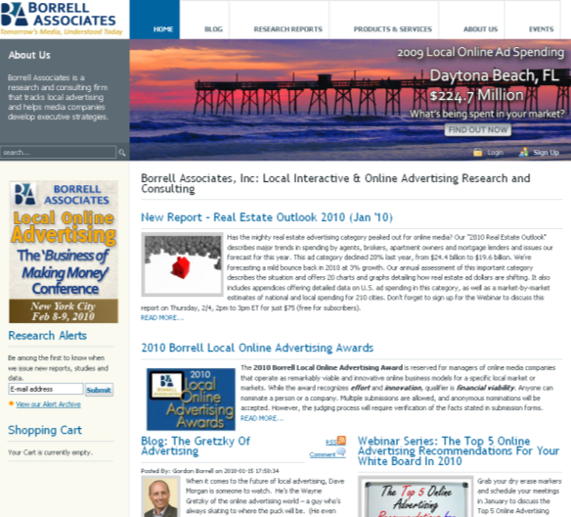
About Borrell Associates
Ad Spend Research
Publishing
Consulting
Conferences
Local
Notes:
3

Slide 4
Agenda
Online Classifieds Outlook
  Automotive
  Real Estate
  Jobs
Local Mobile Classifieds Examples
Stay a Step Ahead
Q&A

Slide 5
The Challenge
Get classified ads in front of a local audience in a creative way so that buyer and seller can find each other and complete the sale.

Slide 6

Online Classifieds Outlook

Slide 7
Automotive

Slide 8
Automotive 2010/2015
Source: Table A,10Q2

Slide 9
New Car Ad Spend, 2011-2016

Slide 10
Used Car Ad Spend, 2011-2016

Slide 11
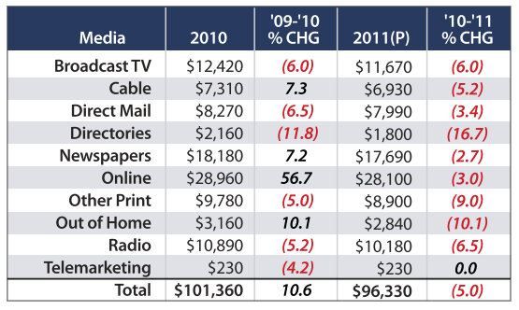
Average Ad Spending per Independent Auto Dealer, 2010 vs. 2011
Sources: NIADA, 2010; Borrell Associates Inc., 2011.

Slide 12
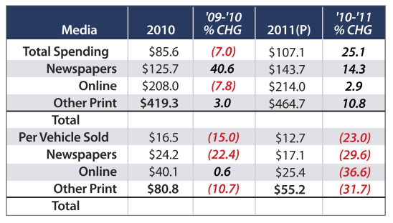
Private Party (Casual) Auto Sales Ad Spending, 2010 vs. 2011
Sources: Manheim Auctions, 2010; Borrell Associates Inc., 2010.

Slide 13
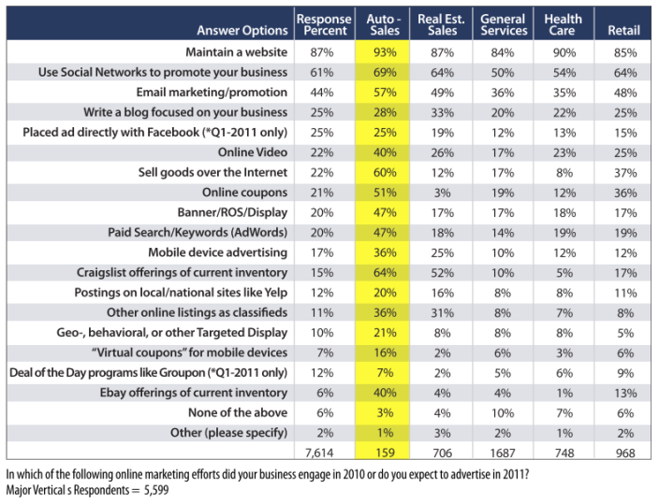
Borrell Survey: Auto Dealers Online Marketing Preferences
Sources: Borrell Associates Inc., 2011. SMB Advertiser Survey Wave 3, 2011 Q1

Slide 14
Real Estate

Slide 15
Local Residential Real Estate Agent/Broker Ad Spend 2010-2016

Slide 16
Local Residential Real Estate Developer Ad Spend 2010-2016

Slide 17
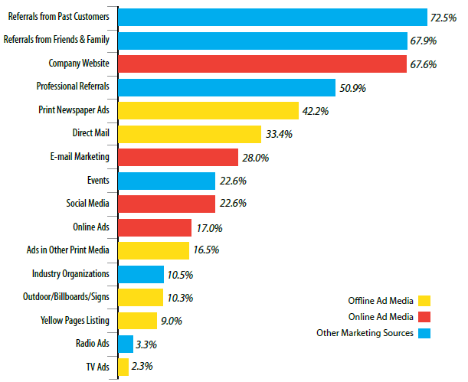
Q: Which of the following sources best provides you with new customers?
Question from The Borrell SMB Study — Real Estate responses only
Source: Borrell Associates Inc., 2011. 389 Respondents

Slide 18
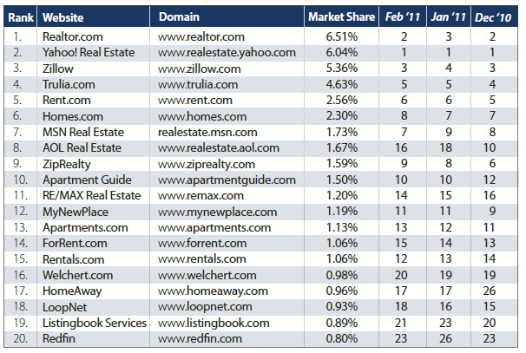
Top 20 Site Rankings & Change over 3 Months
Source: Experian Hitwise, February 2011

Slide 19
Local Apartment Rentals Ad Spend 2010-2016

Slide 20
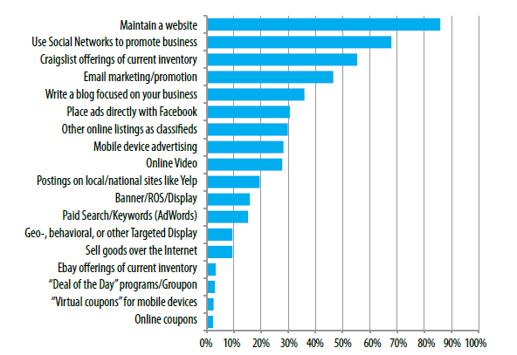
Realtors: On Which Types of Online Advertising Do You Expect To Spend in 2011?
Source: Borrell Associates Inc., 2011 N = 389

Slide 21
Recruitment

Slide 22
Recruitment by Media 2010-2016

Slide 23
Recruitment Turns Up In 2012

Slide 24
Local SMB Offline Marketing Efforts
Off-line Marketing List | Q4 2010 | Q1 2011 | Q2 2011
Sponsor events | 56% | 52% | 53%
In-Store promotions | 27% | 28% | 30%
Ads in programs for cultural events | 26% | 27% | 26%
Local sports teams | 30% | 28% | 29%
Printed coupon redemption | 28% | 26% | 31%
Place ads in church or organization bulletins | 24% | 25% | 26%
Advertised sales | 24% | 23% | 24%
Printed company newsletter(s) | 21% | 21% | 22%
Pre-prints /Inserts and Flyers | 19% | 20% | 19%
Classifieds listings of current inventory in print | 9% | 8% | 7%
Do not do off-line advertising, promotion, or marketing | 5% | 6% | 6%
None of the above | 10% | 11% | 9%
Answered question | 2,871 | 4,924 | 1,105
Which of the following offline marketing efforts do you expect to use in 2011?

Slide 25
SMBs Using Online Classifieds to Sell
Q1 2011 Call-Out Data
17%
12% have bought Groupon or Deal of the Day Ads

Slide 26
Expected Digital Spending Next Year
Q2 2011 Call-Out Data
Answer Options | Q2 2011
Company Web site | 68%
Email | 49%
Social Media | 41%
Search engine marketing | 23%
Banner/Display ads - Targeted Display | 21%
Business Directory listings | 21%
Banner/Display ads - Run of Sites (ROS) | 21%
Paid search/Keywords | 17%
Sponsorships | 15%
Mobile advertising | 15%
Online classifieds | 13%
Video | 11%
Streaming video ads | 10%
Display ads with audio | 9%
Other Online advertising and marketing | 11%
No online ad spend expected | 13%
 | 1,152
On which types of online advertising do you expect to spend money in 2011?
Q2 2011 Respondents = 1,081
Source: © Borrell Associates, Inc. SMB Survey Wave 4, Q2 2011

Slide 27
SMB Emerging Marketing Platforms & Tools
Q2 2011 Call-Out Data
 | Using | Considering | Neither | Count
Database Marketing | 33% | 18% | 49% | 1,040
Reputation management/monitoring | 15% | 19% | 67% | 973
Location-based advertising on mobile | 8% | 29% | 64% | 988
Near Field Communications (NFC) | 2% | 8% | 90% | 932
SMS-Text based messaging to customers, clients, etc. | 12% | 25% | 62% | 993
Which of these digital and electronic programs or services are you using, considering using, or unlikely to ever consider using? [Select all boxes that apply.]
Q2 2011 Respondents = 1,081
Source: © Borrell Associates, Inc. SMB Survey Wave 4, Q2 2011

Slide 28
What SMBs Want From Digital
Location-based ads on mobile –
8% using / 29% considering
SMS to customers –
        12% using / 25% considering
Which of these digital and electronic programs or services are you using, considering using, or unlikely to ever consider using? [Select all boxes that apply.]
Q2 2011 Respondents = 1,081
Source: © Borrell Associates, Inc. SMB Survey Wave 4, Q2 2011

Slide 29

Mobile Classifieds

Slide 30
Fragmentation of Digital Call Media Creates a Unique Challenge for Advertisers
Mobile search
Desktop search
Online directories
Voice search
Mobile directories

Slide 31
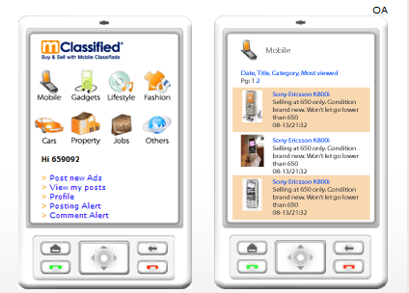
Everything Goes Mobile
garage sales
pets
fashion
gadgets
used and new cars
real estate

Slide 32
How Mobile Helps Classifieds
Get more info
  Mobile web
  Text “CODE123” to 99999
  Scan barcode
Maps
Payment

Slide 33
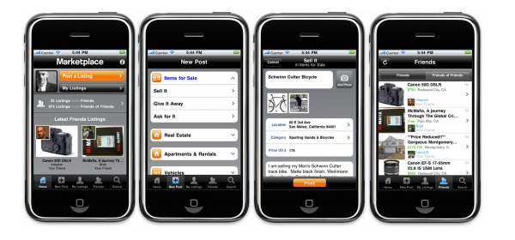
Facebook, Oodle, Craigslist

Slide 34
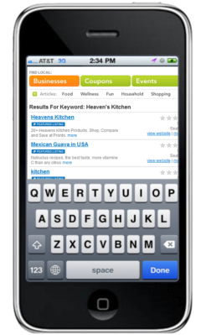

Digitally Driven Calls are Critical to Business Success in a Mobile-Centric World
Digital call advertising will grow to at least $6 billion by 2014¹
49% of marketers view calls as the most desirable result of their digital advertising efforts¹
Click-to-Call ads are generating millions of calls every month²
Forrester Report
Surojit Chatterjee from Google

Slide 35
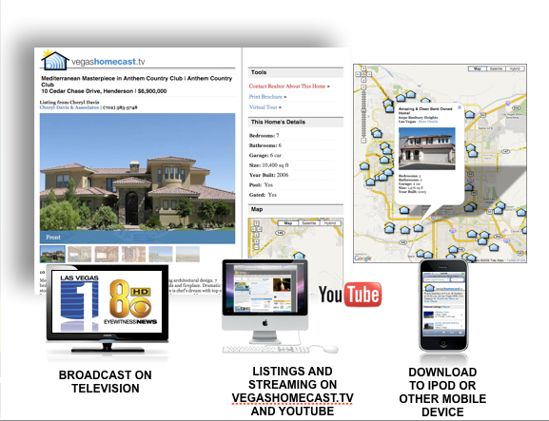
Vegas Home Cast Listings
Cross-Platform (Including TV), Client Uploads Content, System Automation Generates 30 Minute Show

Slide 36


VW Dealer Mobile Site
www.douglassvw.mobi
Promotes with e-mail
Offers prominent

Slide 37
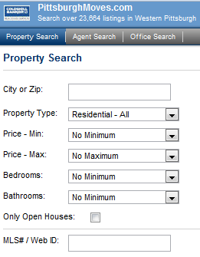
SMS for More Info
1st week of June:
  170 SMS leads
  500 people to mobile site
  8,000 page views to mobile site
  50 phone calls from mobile site
How it works:
  Sign Riders
  Text “CB12345” to 94253
  SMS call to action online is for branding
PittsburghMoves.com
Mobile Site

Slide 38
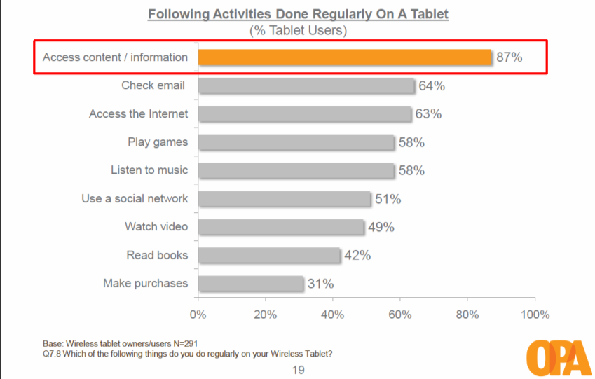
Content & Info on Tablets

Slide 39
Local Mobile Follows National
History Repeats Itself… Just Faster
Online
U.S. National vs. Local Mobile Marketing* Spending Forecast, 2006-2014
Source: Borrell Associates, The 2010 Local Mobile Ad Report, Part 1, 4/10

Slide 40


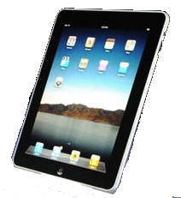
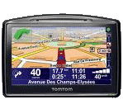


Mobile Marketing Universe
DEVICES
E-mail
Apps
CHANNELS
Cell Phone
Tablet
Image Ads
Static Banners
Flash Banners
Interstitial
FORMATS
Games
DIGITAL DATA
Audio/
Video Ads
Text
Ads
SMS/MMS
Mobile Portal
GPS
Portable Game Player
e-Reader
© 2010 Borrell Associates Inc.
www.borrellassociates.com

Slide 41
Mobile Advertising – US Totals
In $ Billions
Notes:
So, if local mobile advertising will be 3 times higher next year than it was this year, what does that mean for your business? If you made $50,000 in mobile revenue this year are you doomed to make only $150,000 next year? Depends on your strategy. If you’re satisfied with incremental growth and your current market share, then this is a likely path for you. If you want to be a leader in local mobile products and services, you can position your company to exceed these goals and capture market share from other players.

Slide 42

US Totals: Local Mobile Ad Spend
Source: Borrell Associates Q2 2010

Slide 43
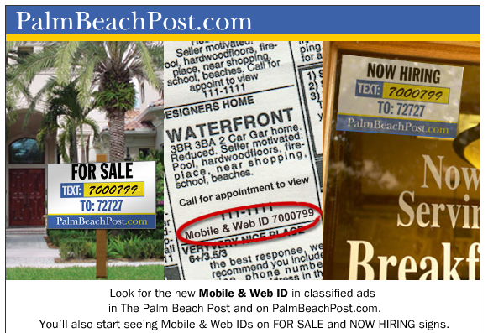
Mobile & Web ID
Notes:
Mobile & Web IDs appear at the end of most Classified ads in The Palm Beach Post and on PalmBeachPost.com. Using a Mobile & Web ID you can quickly go directly to an ad online without having to browse or search through other ads. You can also use the Mobile & Web ID to retrieve an ad via cell phone or PDA.

Slide 44
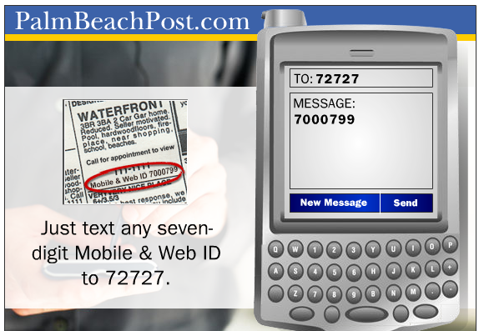
Text the ID

Slide 45
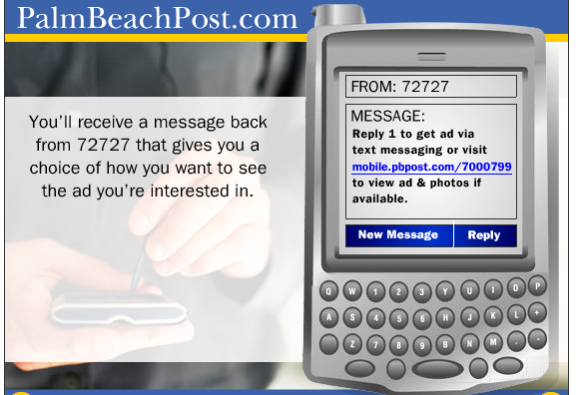
Ad in phone

Slide 46
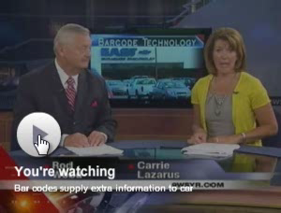
Using QR Codes in Classifieds
Place QR Codes
  On Cars
  In Ads
Deliver
  Info
  Offers

Slide 47
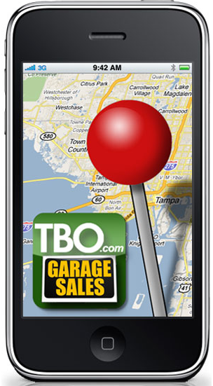
Integrating Maps
TBO.com Garage Sale App
  Plots garage sale locations
  Shows description on hover
Notes:
I don’t think a garage sale app should cost money. The target market is people that haggle over a nickel. I love this app, but I think it is best used to attract bargain hunters and to sell advertising to companies that try to reach out to garage-sale types. Good Will, Salvation Army, U Store It, etc.

Slide 48
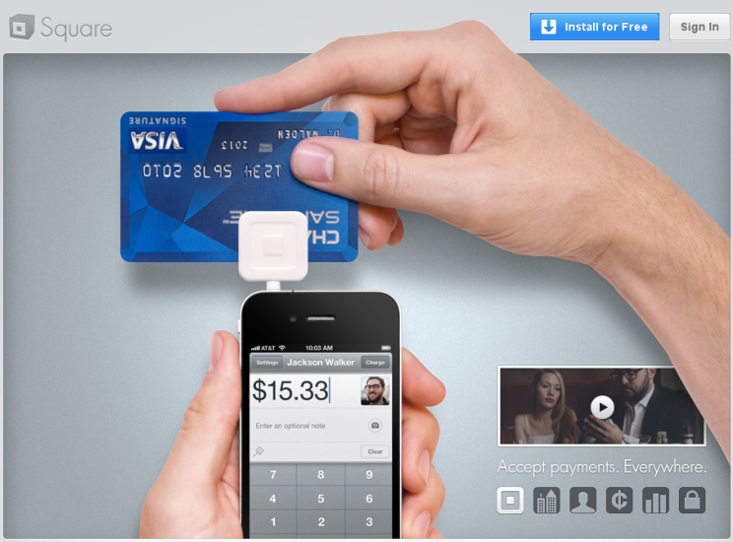
Mobile Payments

Slide 49
Stay a Step Ahead

Slide 50
Questions for SMS Providers
Can I have my own Short Code?
Can I give my clients direct access to the platform?
What is the monthly fee?
What is the per message fee?

Slide 51
Questions for App Developers
What platforms do you support?
  iPhone
  Android
  Blackberry
How do you price your service?
  Revenue Share
  Licensing Fee
What if I have a great idea… can we create it?

Slide 52
Questions for Mobile Site Developers
Do you support xhtml and html5?
Can you integrate with my domain name? (for SEO)
How are page names created?
  Random letters & Numbers www.domain.com/fi6lds
  Intuitive names for SEO www.domain.com/auto

Slide 53
Q&A

Slide 54

Thank You!
pconti@borrellassociates.com
phone 804.360.9434
www.borrellassociates.com

