Slide 1
Developing your Mobile Strategy
Why do you need a mobile strategy?
Know your audience
What is the business goal of your mobile initiative?
How will you measure it – quality, quantity, conversion or reach?
What is your budget?
Choose your development path and technology

Slide 2

But first – what else is happening now
2
2
Notes:
2

Slide 3

Who are we?
3
3
Notes:
3

Slide 4
Why Mobile?
Evolution of Media
Print
Web
Mobile
4
4
Notes:
4

Slide 5
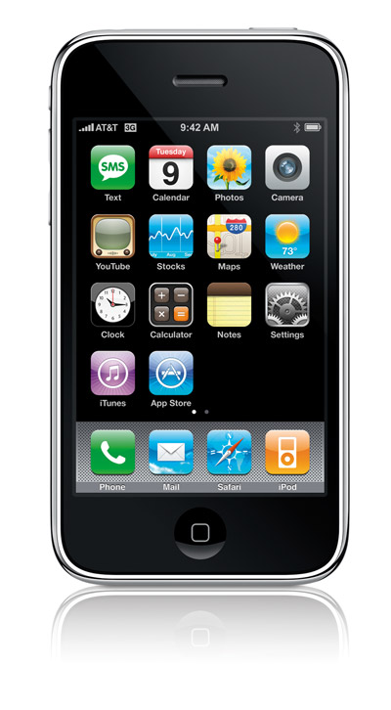

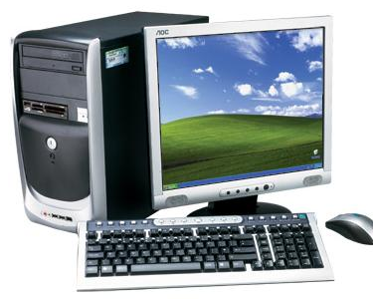
Why Mobile?
Smartphones outsold PCs for the first time in the December 10 quarter*
PC Vendors Shipped 92.1m PCs
Phones Vendors Shipped 100.9m smartphones
5
5
Notes:
5

Slide 6
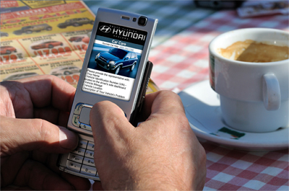
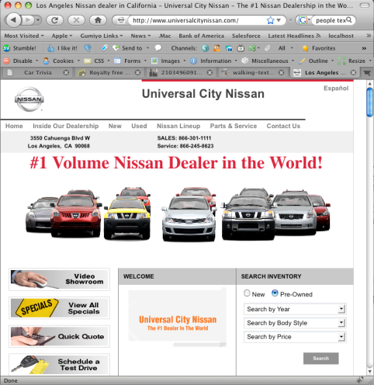

Why Mobile?
Drifting audience
Smart Phone users will surpass feature phone users within 12 months*
Mobile Web will surpass PC Web by 2013/14* *
**Nielsen
**Morgan Stanley
6
6
Notes:
6

Slide 7


Know Your Audience
The reason publishers need a mobile strategy is now obvious, however;
Before launching into panic mode understand your audience and your options
Different Regions have different mobile audiences.
Publishers with strong print and digital classifieds are well placed to capitalise on mobile
7
7
Notes:
7

Slide 8
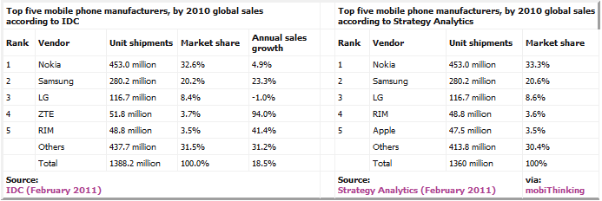
Know Your Audience
Globally:
Features phones are still 70% + of all phones
8
8
Notes:
8

Slide 9
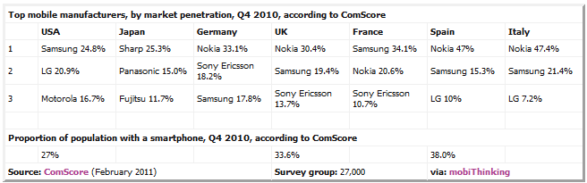
Know Your Audience
Globally:
But smartphones are catching up real fast
9
9
Notes:
9

Slide 10
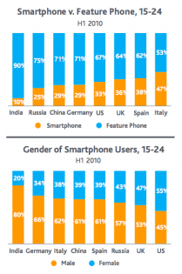
Know Your Audience
Globally:
Young people like smartphones
Each market is different
Men and women are different
..........Really different, but that is another presentation
10
10
Notes:
10

Slide 11

Know Your Audience
In Australia:
9.6 Million Active Internet Subscribers*
3.5 Million Mobile Broadband Subscribers*
Mobile Broadband Fastest Growing Internet Access Technology*
11
11
Notes:
11

Slide 12
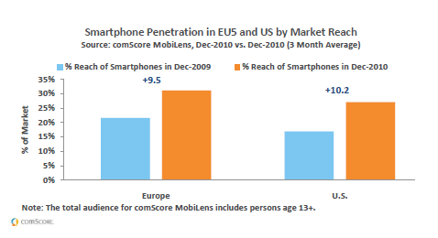
Know Your Audience
In Europe:
31% of consumers have smartphones, compared to 28% in US
8.7 Million Android Users
Apple grew OS market share 115% in 2010
RIM and Palm grew 65% and 34% respectively
Things seem to be going well!
12
12
Notes:
12

Slide 13
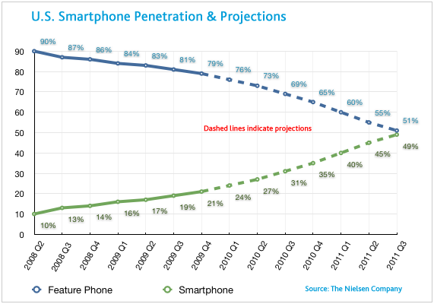
Know Your Audience
In US:
228 M Mobile Subscribers
83M Access Mobile Web
28% Smart Phone penetration
Smartphone users to equal feature phone users sometime in 2011
13
13
Notes:
13

Slide 14
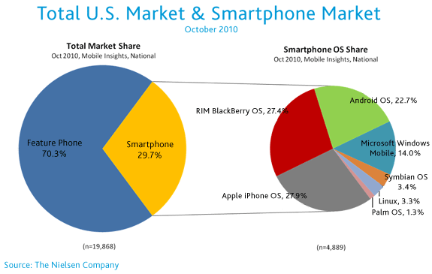
Know Your Audience
14
14
Notes:
14

Slide 15
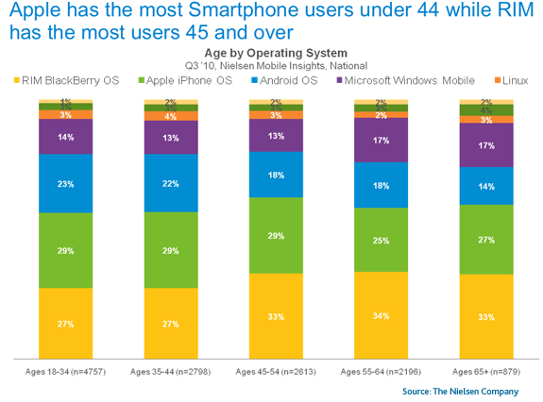
Know Your Audience
15
15
Notes:
15

Slide 16
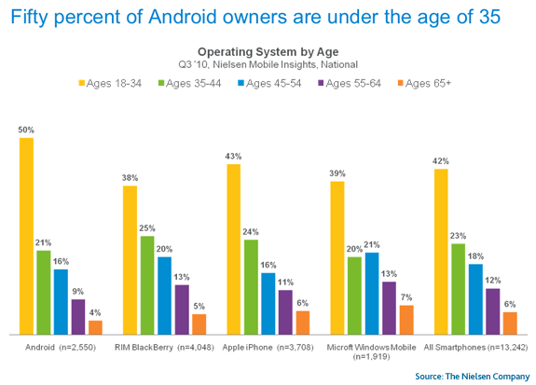
Know Your Audience

Slide 17

What are your Mobile Objectives?
OK, I am going mobile – but I’m confused. Do I need apps or mobile web – or both?
It comes back to your objectives and your budget (and of course your audience)
Let’s examine apps vs. web and see what they offer you.
17
17
Notes:
17

Slide 18

Apps vs Mobile Web
Key differences
Native Applications are;
Device specific (ie only iPhone or Android etc)
Feature rich
Sharper finish, superior UI
Require custom development
Can be costly to develop, deploy and maintain
Popular among smartphone owners
Mobile Web
Handset agnostic (depending on platform)
Not as feature rich as native applications
UI not as polished (must cater for 2,000 +)
Less development time
Easier to develop, deploy and maintain
Reaches feature phone and smartphone users
18
18
Notes:
18

Slide 19
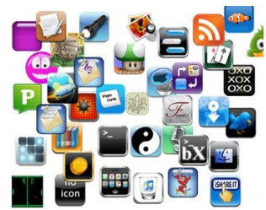
Apps vs Mobile Web
There are some core features that are only possible in “native app”
However contrary to common knowledge the following IS supported in BOTH modes:
GPS/ Location (requires HTML5)
Offline mode (requires HTML5)
Self adjusting UI
Still only possible in apps is:
Accelerometer, compass
Camera control/ scanning
Proximity API/ NFC/ Payment/ Address book integration
Be aware in apps you do not own the user profile
19
19
Notes:
19

Slide 20
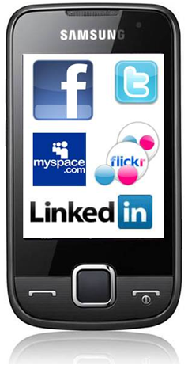
Apps vs Mobile Web
What do people use Apps for?
70% of Chart Topping Apps in terms of usage and revenue are games*
Average smartphone user spends 2.8 hours per day in apps (mostly social media)*
60% Smartphone users** turn to apps first before mobile web (ie one in five phone users)
* IDC
**MobClix
20
20
Notes:
20

Slide 21

Apps vs Mobile Web
What do people surf the Mobile Web for?
Consumers use the mobile web for much the same reasons as PC Web
More than half Mobile Internet browsing is Social Media
However, for general sites if the user experience is poor more than half will not return to the mobile site
Mobile internet traffic on classified sites that are mobile friendly enjoy strong natural growth – those that don’t are largely static.
21
21
Notes:
21

Slide 22
Case Study
REIWA – (www.reiwa.com)
Real Estate Institute of WA
Deployed Mobile site in September 2009
Installed code on home page to auto detect handset and redirect to mobile
No promotion at all to market – growth in traffic is purely organic
Represents more than 15% of overall traffic
More than a third of traffic referred from Google (mobile version)
But......look what happened when someone turned the lights off.....
22
22
Notes:
22

Slide 23
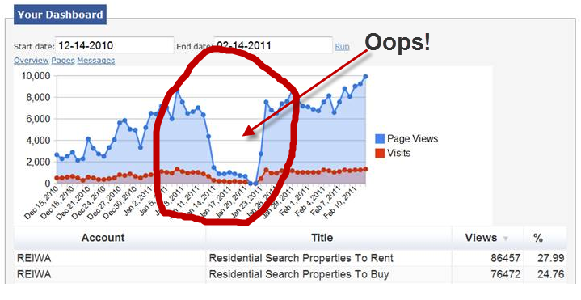
Case Study
REIWA
No mobile detection – lose 90% of audience
The guy responsible kept his job ☺
23
23
Notes:
23

Slide 24
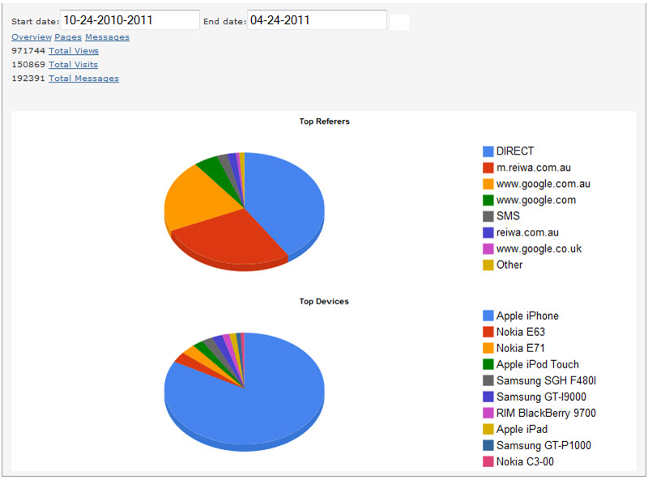
Case Study
REIWA
Do not have an iPhone App
But look at the audience
24
24
Notes:
24

Slide 25
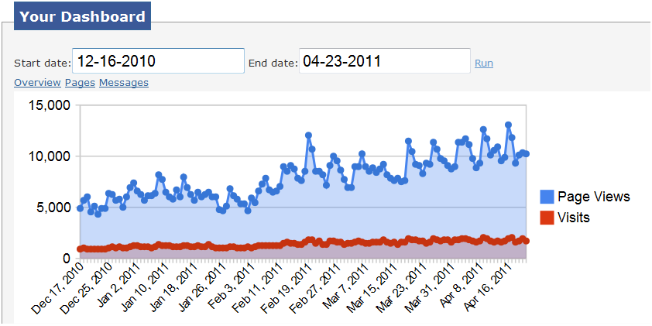
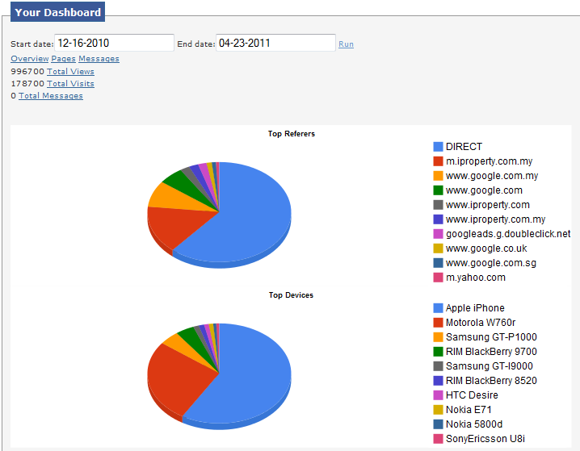
Case Study
iProperty (iproperty.com.my)
iProperty Malaysia
Deployed Mobile site in December 2010
Installed code on home page to auto detect handset and redirect to mobile
No promotion at all to market – growth in traffic is purely organic
Mobile site traffic has more than doubled in four months from a standing start.
Most traffic is either direct or bookmarked
25
25
Notes:
25

Slide 26
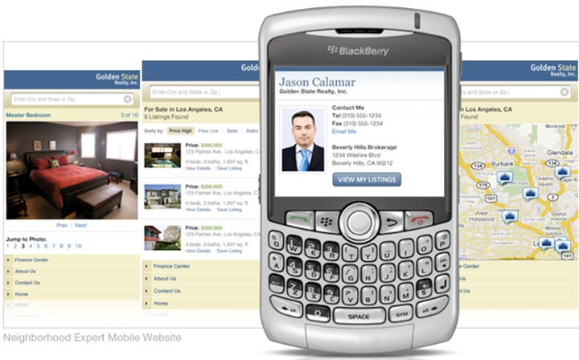
Case Study
Publisher X
Large National publisher
Successful in launching Property App
Mobile Web Traffic has been static for approx one year.
Mobile site only works on some phones, not user friendly and no auto handset detection and redirection.
Re-launching handset agnostic solution in coming weeks and months for all classifieds
Has introduced “Agent Mobile Solution” which will help deliver $2m plus in revenues in 12 months to September 2011.*
*Please note pictured agent solution is not the client depicted in case study
26
26
Notes:
26

Slide 27
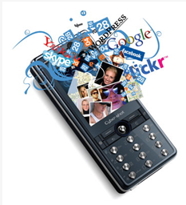
Budget considerations
Applications
Difficult to estimate time and cost – depends on functionality desired.
Prices can range from a few thousand to $500k plus for Native Applications
Time to deploy can be extensive
Which platform? There are probably three at least that need consideration if you are thinking Applications
Option to consider are “Browser Apps” – lower cost and uses existing Mobile Web Site.
27
27
Notes:
27

Slide 28

Budget considerations
Mobile Web
Can be implemented fairly quickly ( in weeks not months)
Much lower cost compared to building bespoke applications
Easily maintained (comparatively)
Solution is handset agnostic and works across all browsers
Rapidly deploy a basic solution and build on it.
Re-use existing digital assets
Supports existing consumer behaviour
28
28
Notes:
28

Slide 29

What does it do for my business?
Show me the money
Leverage existing digital content
Where possible use same data feeds/APIs for mobile web and Applications.
Little or no revenue in mobile sponsorship/banner advertising (not enough audience to gain media buyer’s attention)
Little or no money in classified apps at this point in time – at best sponsorship may cover development costs.
Can be substantial revenue in “bundling mobile web solutions” with existing digital products and services.
29
29
Notes:
29

Slide 30
Development Path Suggestion
Step 1
Your are a successful classified publisher
Step 2
Create agnostic Mobile Web solution
Create client branded mobile web solutions (own the market space)
Step 3
Develop multiple browser apps
Lock in clients to your service and generate incremental revenue
Utilise your existing digital content for mobile
30
30
Notes:
30

Slide 31
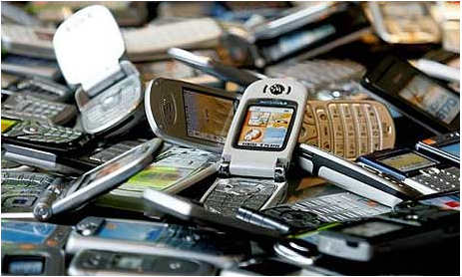
Thank You
31
31
Notes:
31

