Slide 1
Making Money From Free
Konstantin Kalabin, Top Internet Projects
ICMA Conference, Nice, April 2011

Slide 2


How it all started…
How?
Why?
Why not?
Quality of your business (and life) is defined
only by the quality of the questions you ask

Slide 3

Contents
Media business model disruption
Freemium model in classifieds
The Magic Formula
Applying the Magic Formula
Customer segmentation

Slide 4
Media Business Models Disruption
Print Media
Online Media
Pay for Access
Profits $$$
Multi-Sided Markets
Multi-Sided Markets
Freemium
Profits ?
Technology
step-change
Digital access costs -> 0
Digital production costs reduced, but ≠ 0

Slide 5
What is a Multi-Sided Market?
“Multi-Sided Market” is a business model in which several different types of users exchange goods, services or information.
Network effects are an integral characteristic
Cross-side (buyers/sellers) is most common, must be +
Same side (users/users), can be + or -
Tend to be “winner takes all” markets
Usually one side is subsidized by others to achieve wide adoption
Multi-sided markets examples
Telephone Networks, All Newspapers, Visa, Game Consoles, Google

Slide 6
Classifieds as a Multi-Sided Market: Print
Prod & CS
Fees
Display Ads
Sellers
(Free | Paying )
Buyers (Readers)
Advertisers
(Display)
Sales Force
Strongly Negative
Negative
Negative
Very Strong
Very Strong
Legend:
Copy Sales
Revenues
Circ & Mark
Costs
Neutral
Network Effects
Notes:
In print classifieds non-paying sellers are subsidized by display advertising and copy sales

Slide 7
Classifieds as a Multi-Sided Market: Online
Freemium principles
Prod & CS
Display Ads
Sellers
(Free | Paying )
Buyers (Visitors)
Fees
Advertisers
(Display)
Prod & CS
Fees
Sales Force
Online Ads
Sales
Strongly Negative
Negative
Negative
Very Strong
Very Strong
Legend:
Copy Sales
Revenues
Circ & Mark
Mark
Costs
Neutral
Network Effects
Notes:
In online classifieds there is no revenue from visitors (no payment for access)
Reduced revenue from online ads is needed to subsidize marketing costs
Costs are reduced in all 3 aspects, but mostly in sales force
Costs of servicing non-paying sellers are need to be covered by paying sellers

Slide 8
What is Freemium?
“Freemium” is a business model in which one segment of users can receive service for free permanently, while other customer segments subsidize the cost of providing the service to free users
Demand is maximum at the point of “Free”. The difference between 1p vs free is the difference between having to make a decision vs just do it
Usually free and paying customers have same needs, but of different importance and/or scale
Subsidy happens within the same type of customers – key difference to multi-sided markets
Free samples, shareware are not freemium models
Freemium examples
Skype, Evernote, LinkedIn, Google Apps, Zynga etc

Slide 9

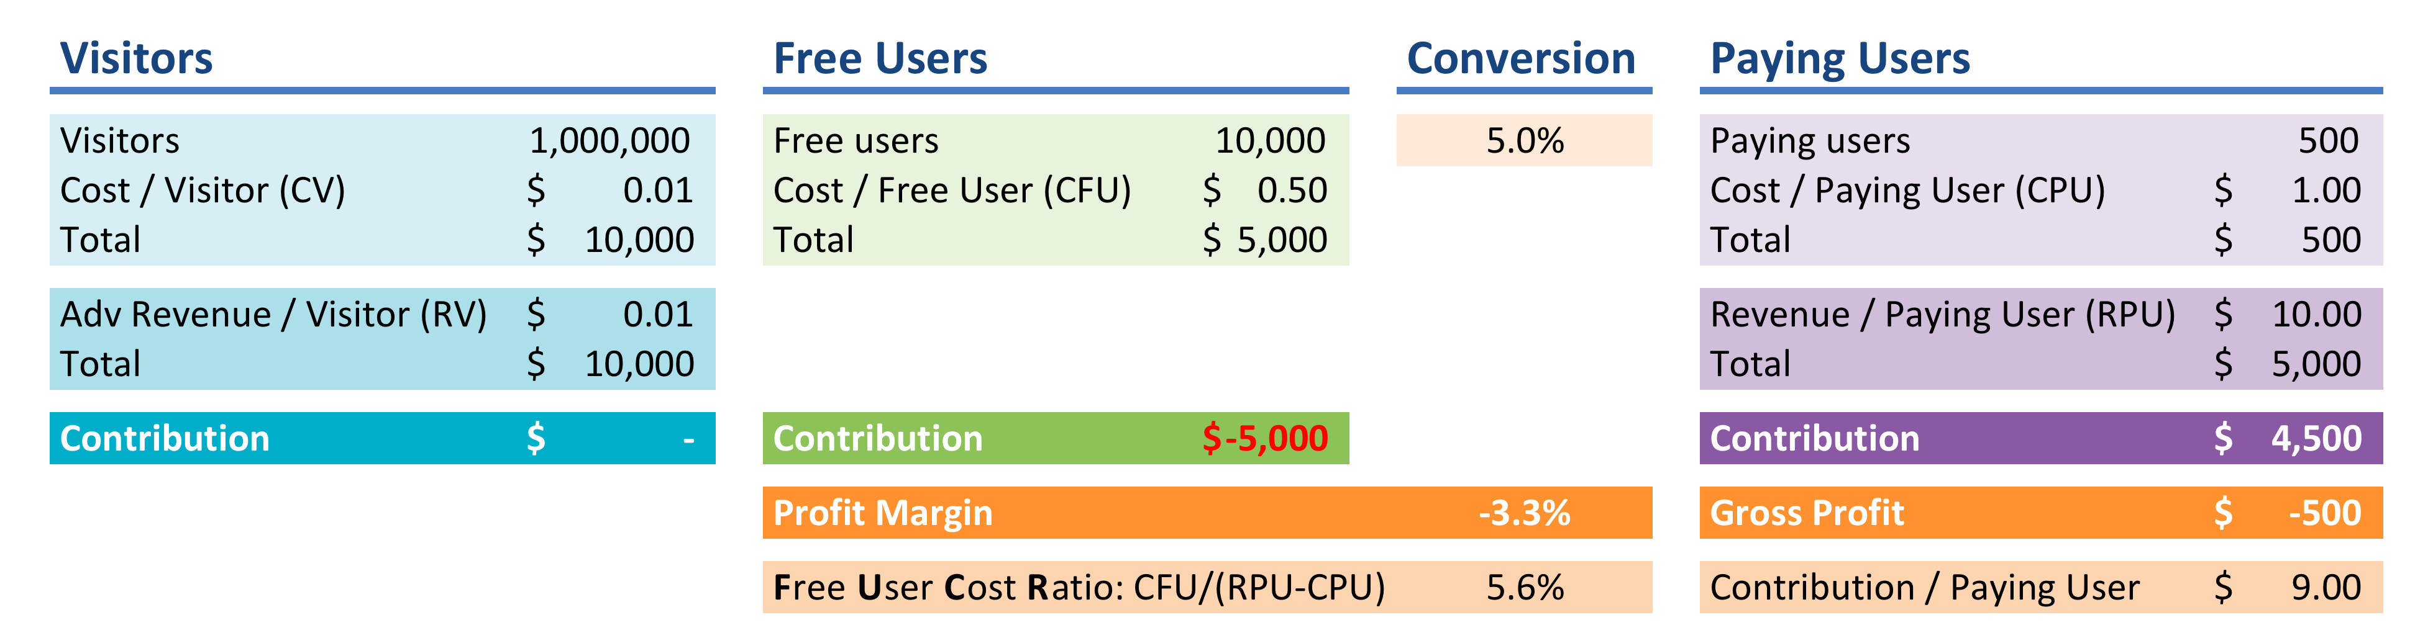
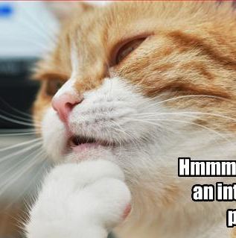
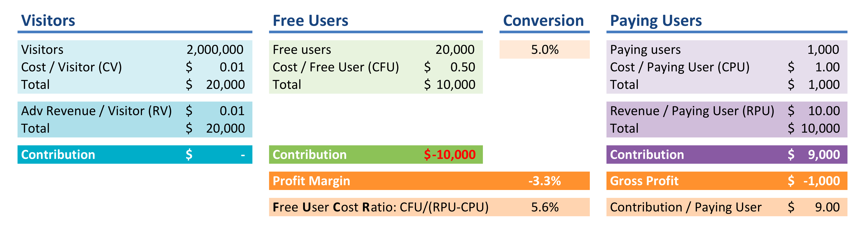
Freemium in Classifieds Business
We need to get scale to improve profits! Invest in marketing and drive traffic!
Hmmm…,
you make an interesting point…

Slide 10
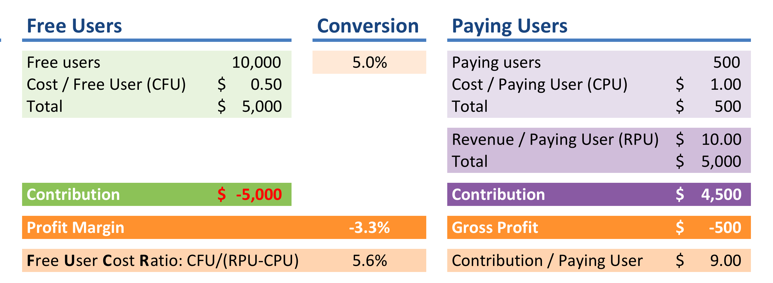
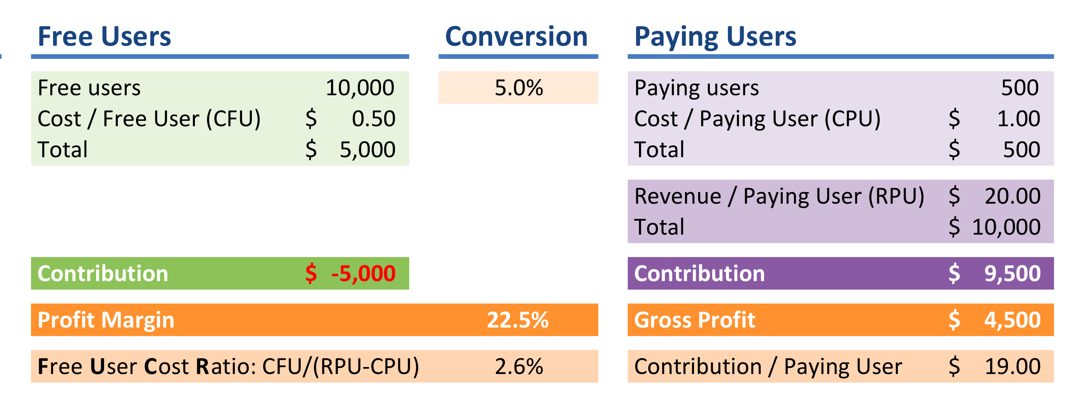


Little Experiment
Original situation
Double revenue per paying user
Negative Correlation
Double conversion rate
Halve costs per free user

Slide 11
The Magic Formula
CFU
CR
RPU
CPU
Cost per Free User
Conversion Rate, %
Contribution ( Revenue – Cost) per Paying User

Slide 12
The 3 Levers of Freemium Model
Cost per free user (CFU)
Revenue per paying user (RPU)
Conversion rate (CR)
CFU
RPU
CR

Slide 13
Cost / Free User: Minimize
Most of freemium businesses fail because of prohibitively high costs of free users
User Acquisition Costs
User Servicing Costs
Total Cost / Free User

Slide 14

Cost / Free User: Acquisition
Will I use this service again?
Do I recommend it to my friends?
TV
Expensive (CPA = $0.5-1.2)
Fast
SEO
Very Cheap (CPA = $0.01)
ROI grows over time
Slow
ROI constant
Repeat Visitors (Core) x WoM
Free (CPA = 0)
Greatest asset
Organic growth
SEM
Can be cheaper than SEM
Super fast
Good for very large scale
Partnerships
Ideally no cash involved
Time & effort to establish and manage

Slide 15

Cost / Free User: Servicing
Will they enjoy using our service again?
Do they still recommend us to their friends?
Out-
source
Sharp focus on 80/20
Automate
Digitize all processes
Balance performance, complexity, reliability
Pass costs onto users
Eliminate
Outsource all non-critical functions
Leverage specialist technologies
Use open-source & free technology
Self-service everywhere

Slide 16
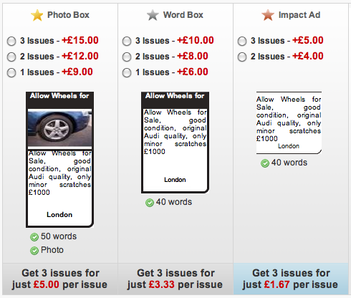
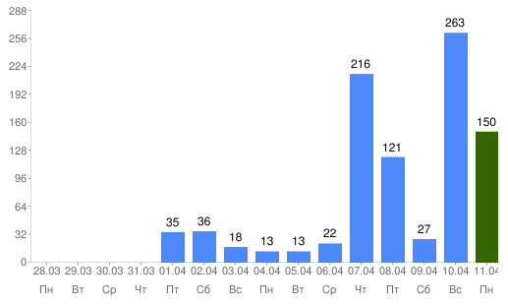
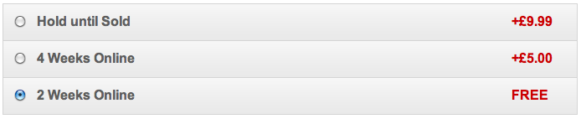
Conversion Rate: Maximize
Dominate niche demand
Charge for really important features
Be Reasonable
Demonstrate Value
Make It Easy
Conversion
Typically 2 to 8%
Page views go up after paying
Ouch!
Hmmm?…
Analyze response from each upsell
Communicate the effects to user in their terms (“sell twice faster”)
Easy
Never more than 3 options at a time
Provide all popular payment methods
Know which option you want the user to choose and make it clear why
10 mins of time vs £5?
Charge for things that have obvious costs (print ads, private numbers, larger photos)
Price proportionate to value to customer
Notes:
Demonstrate value
Be reasonable
Charge for things that have obvious costs to you AND user
Price proportionate to value to customer, not your costs
Make it easy
No more than 3 options at a time
Payment options

Slide 17
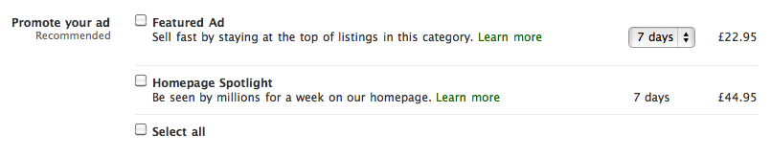
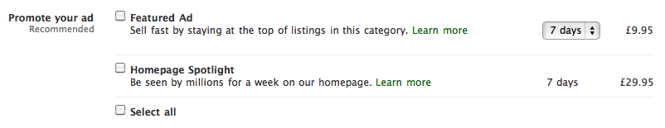

Revenue / Paying User: Increase
Sell benefits not features
Sell benefits not features
Manage limited capacity – charge per time period
Manage limited capacity – charge per time period
Cars for Sale - Audi
Vary prices by category based on avg item price or category demand
Vary prices by category based on avg item price or category demand
Car Accessories
Increased reach
Increased reach
Play on urgency
Notes:
Item value
Segment customers
Manage limited capacity
Clear difference in value vs free
Priority process
Save time/effort
Greater reach
More information about buyers
Increased security

Slide 18
Cost / Paying User: Optimize
CPU can be several times CFU, but usually 2x-3x
Acquisition Costs
SEM optimized based on lifetime value just like in eCommerce
Servicing Costs
Hosting costs much higher due to volumes
Support includes higher human involvement
Payment processing costs (incl. fraud)
Refunds

Slide 19
User Segments & Strategies
Max
Likelihood of paying
Convenience- & Time-Savvy Sellers
Cost-Sensitive Occasional Sellers
Spammers
Trade & Professional Sellers
5% of customers
2% of ads
10% of customers
40% of ads
75% of customers
18% of ads
10% of users
40% of ads
Delight:
Win trust
Support
Beat expectations
Harvest & Learn
Analyze
Segment
Optimize
Service
80% of Revenue
Volume or Frequency
Min
Max
Impress:
Fast
Simple
It works!
Minimize impact: Delete at source
No refunds
Block access
Min
80% of Costs

Slide 20

Making money from free is not rocket science!
But it’s not far off…

Slide 21
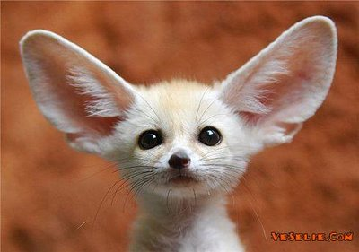
Your Questions
konstantin@topinternetprojects.com
www.linkedin.com/in/kalabin
Skype: konstantin.kalabin

