Slide 1


USING AI & IMAGES TO grow your business
by Dominik Pogorzelski
Head of Product Management

Slide 2
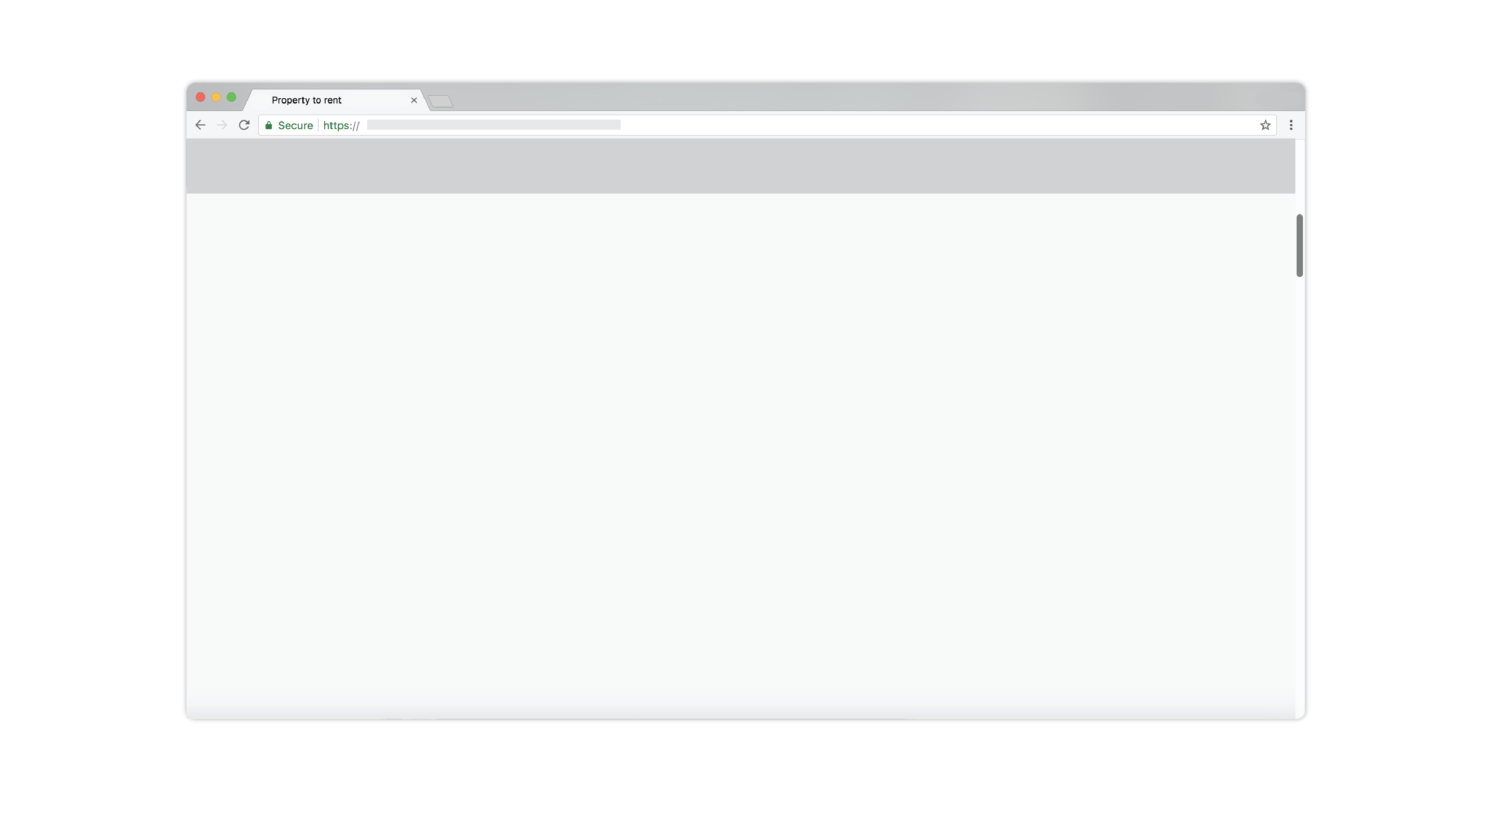
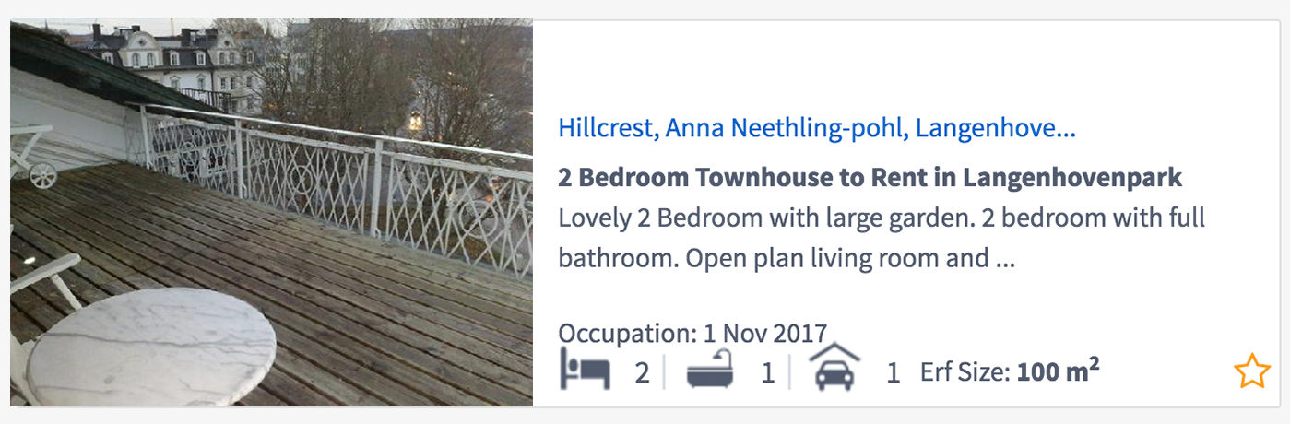
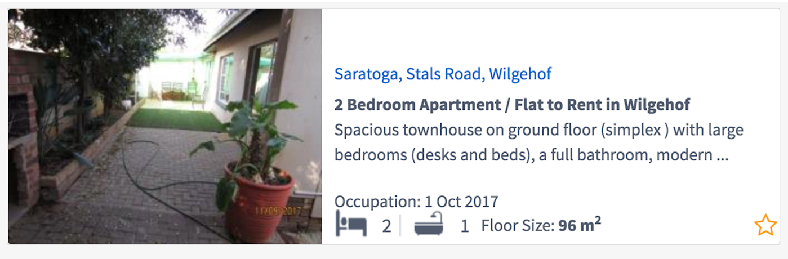
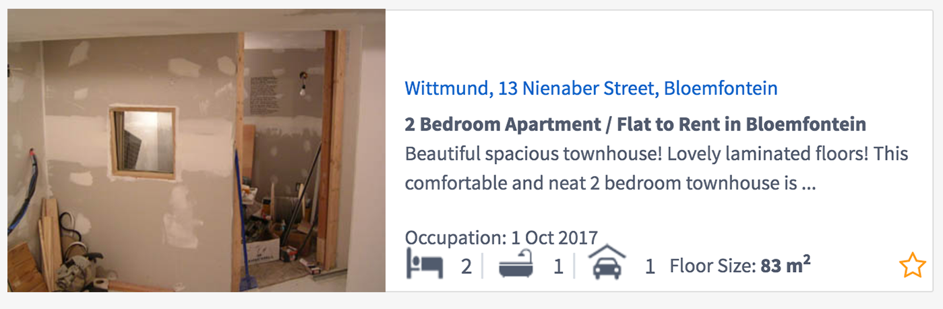
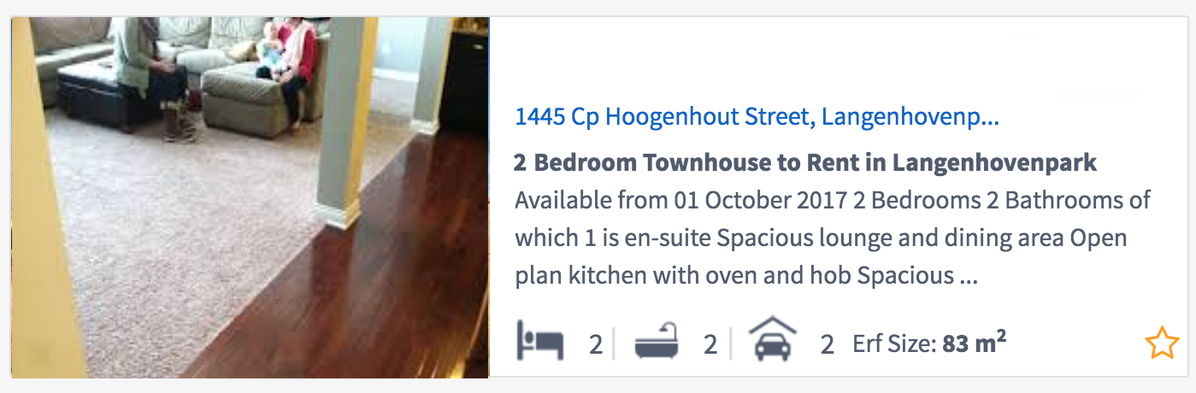
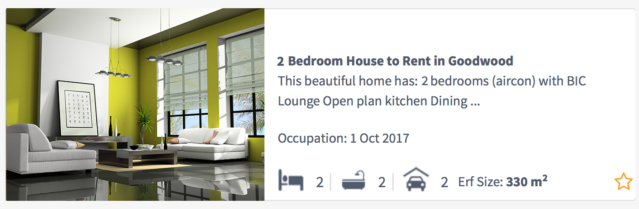

“Oh that one’s nice!”

Slide 3
USING AI & IMAGES TO grow your business
by Dominik Pogorzelski
Head of Product Management

Slide 4



How your images can work for you
GENERATE
MORE TRAFFIC
INCREASE TIME
ON SITE
CONVERT
MORE LEADS

Slide 5
Generate More Organic Traffic
SEO

Slide 7
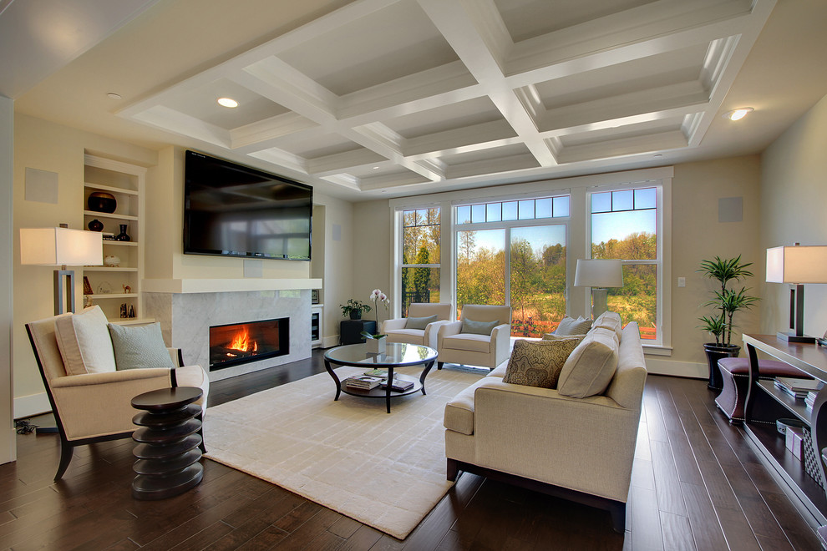
Add relevant tags to Alt Text
Title
Caption
Alt Text
Living room with coffered ceiling, hardwood floor, natural light and fireplace
Description

Slide 8

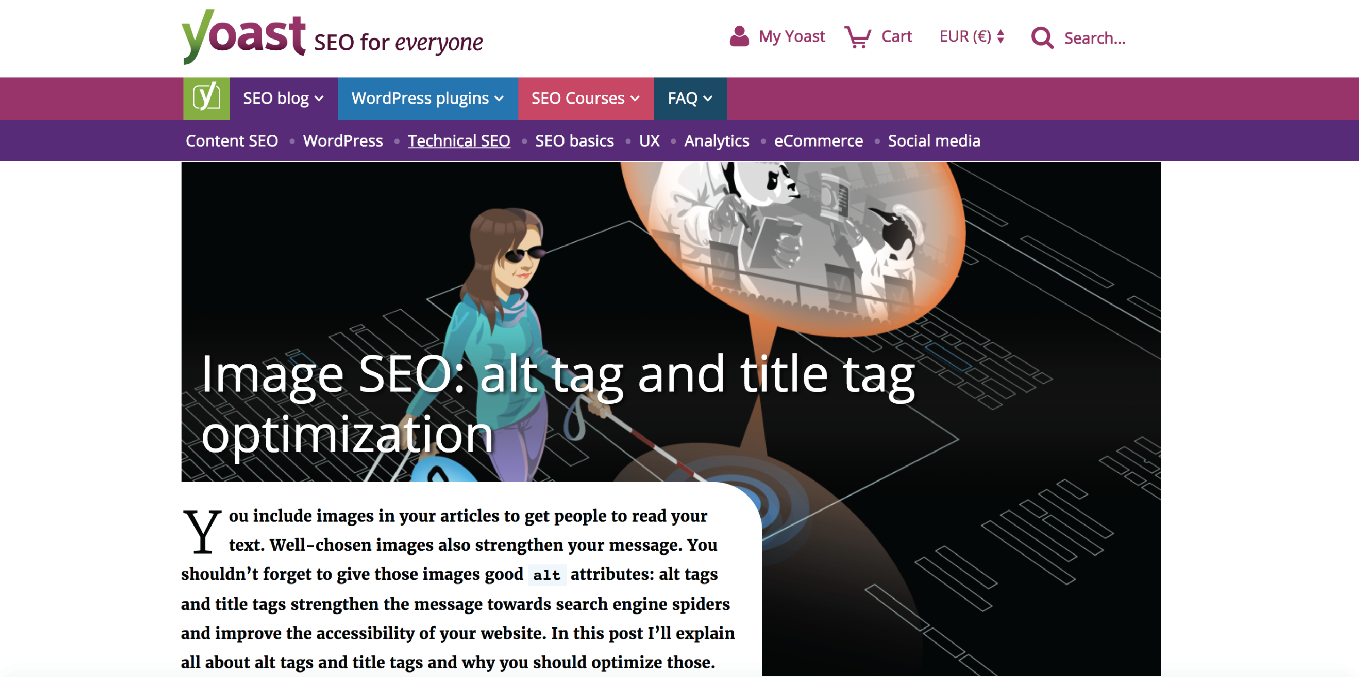

Slide 9
Increase the Time That Leads Spend on Site
UX

Slide 10
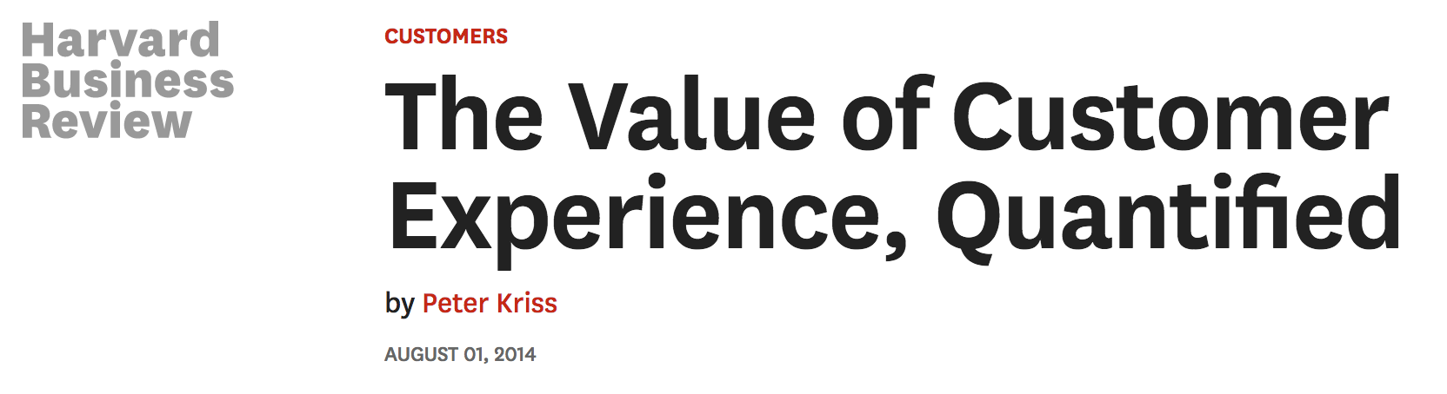
“customers who had the best past experiences spend 140% more compared to those who had the poorest past experience”

Slide 11
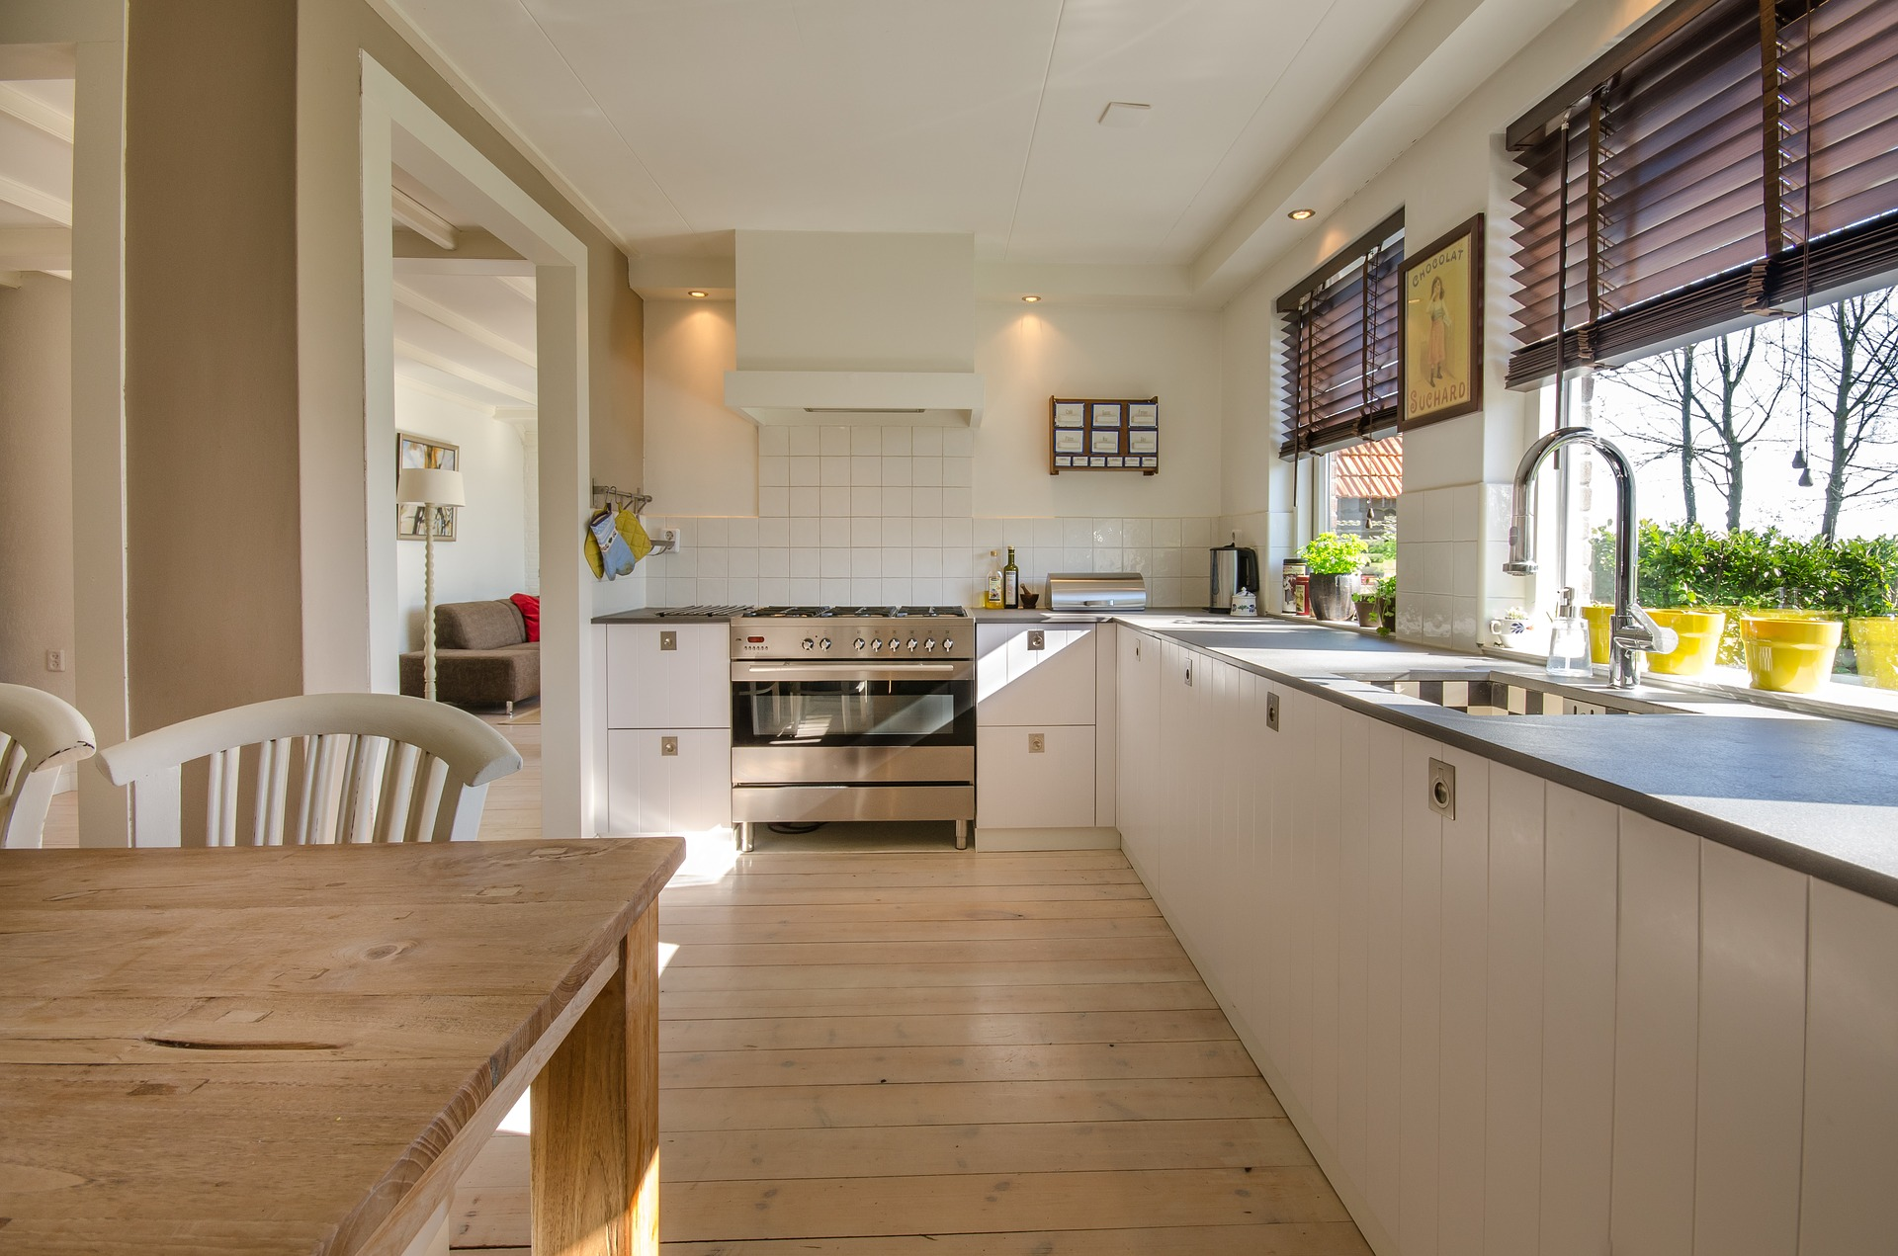
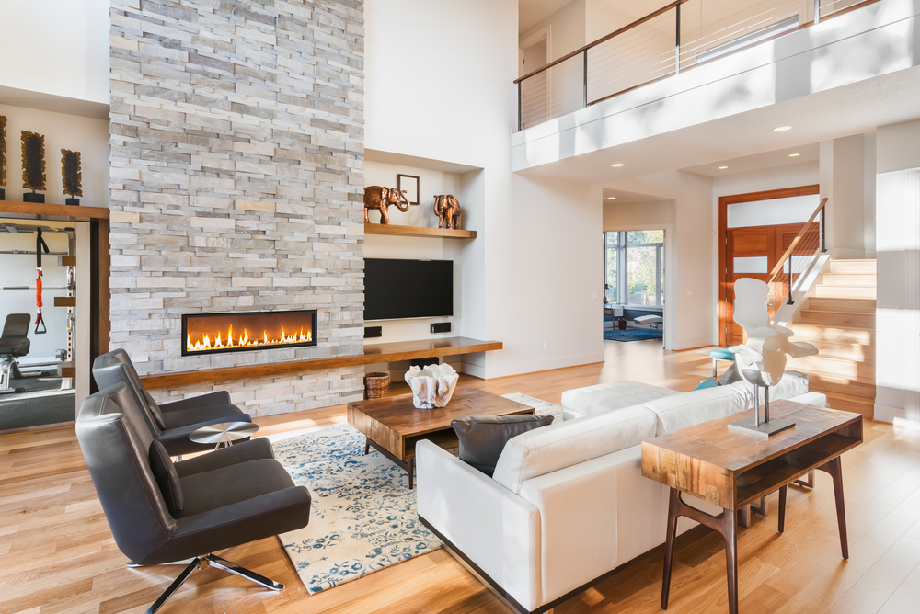
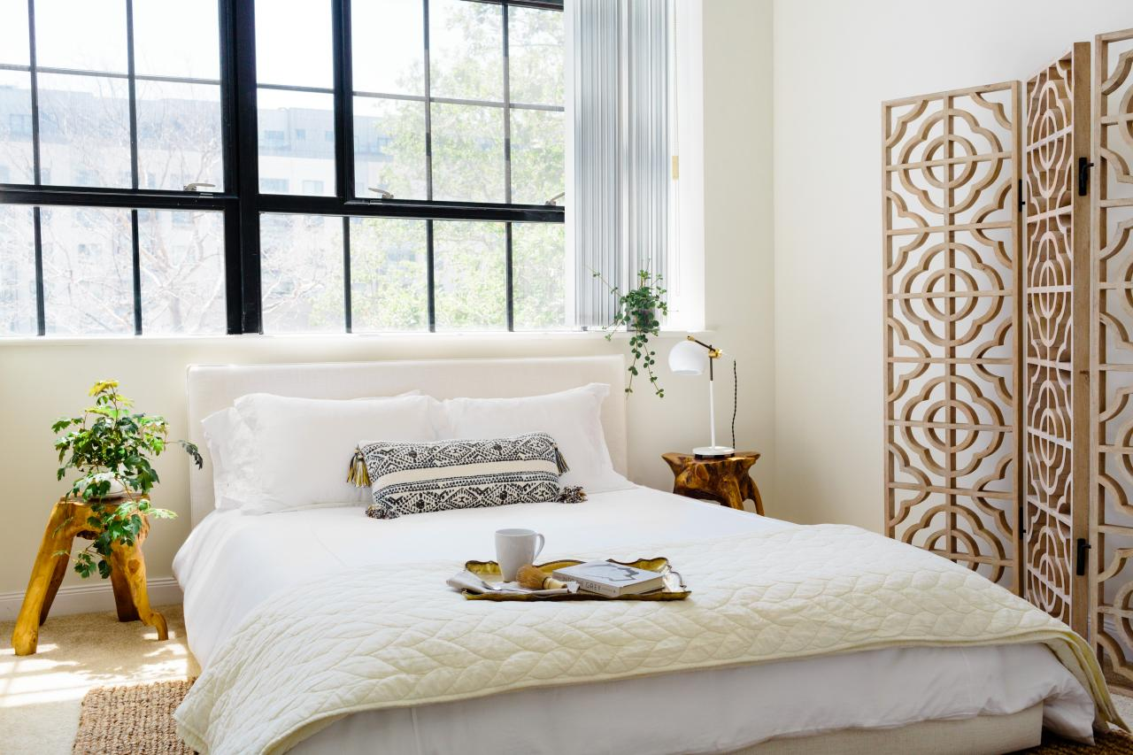
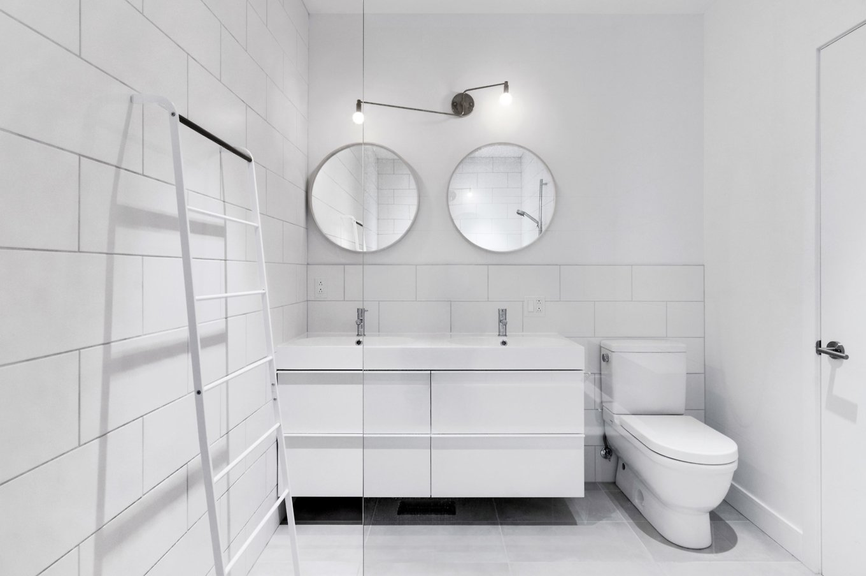
Tag and organize your images
Kitchen
Living room
Bedroom
Bathroom

Slide 12
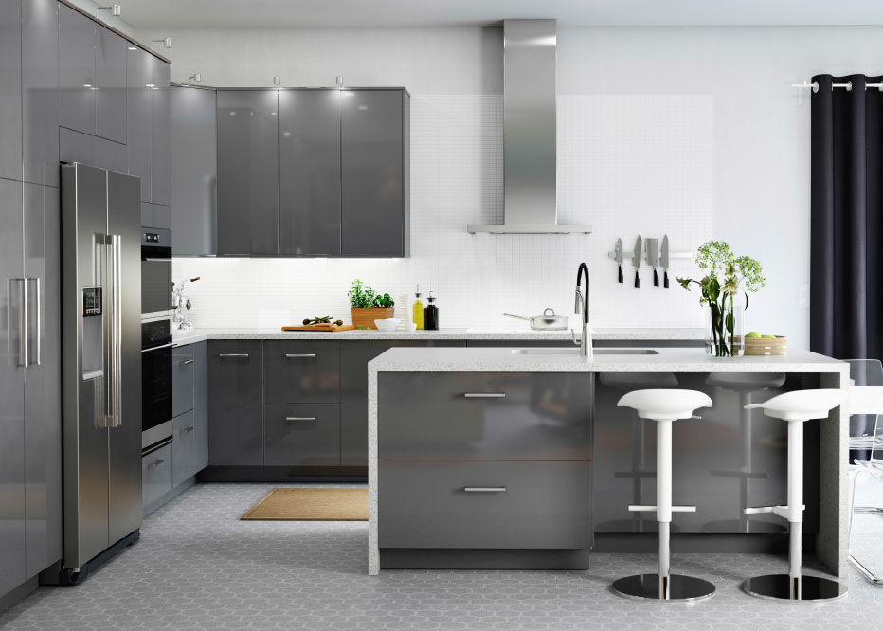
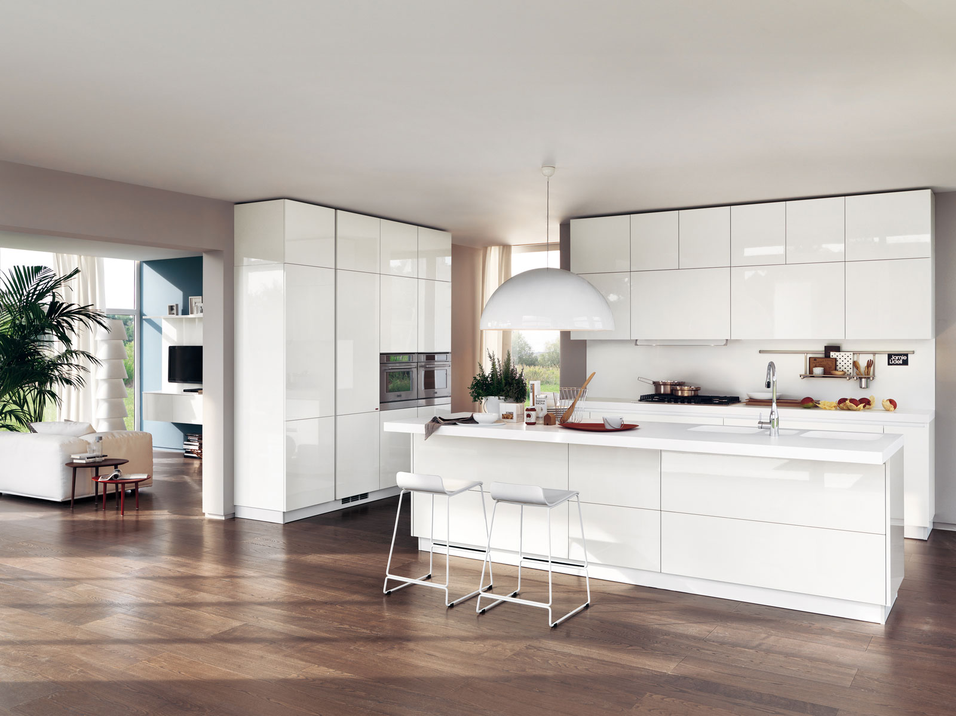

Compare property rooms side-by-side
Kitchen
123 SellMore St, Uxville, CA
456 SellMore St, Uxville, CA
789 SellMore St, Uxville, CA

Slide 13
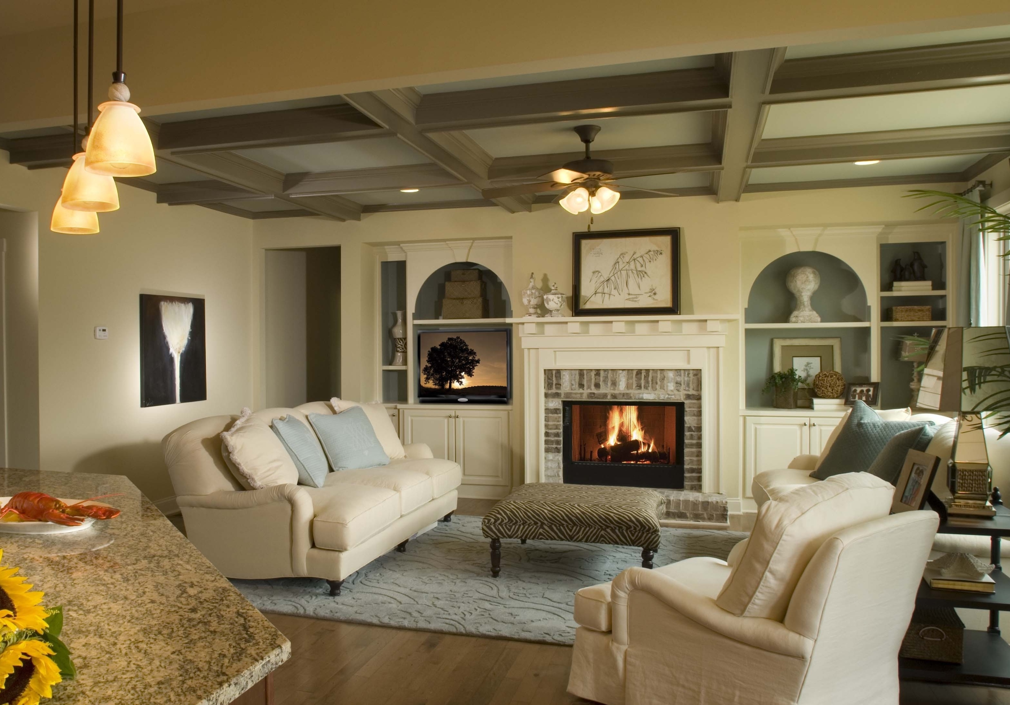

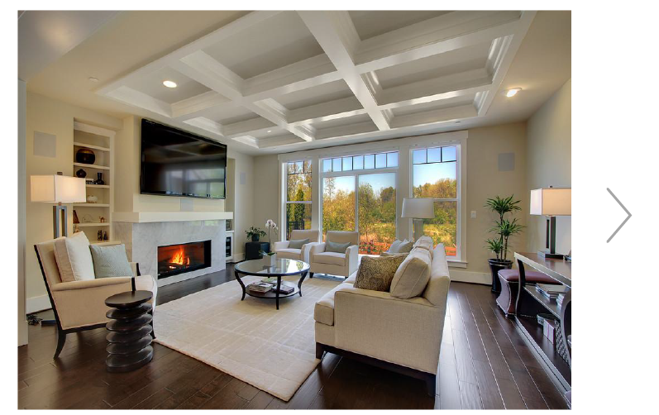


Preview listings by buyer’s interests
22 HOMES FOUND
UXville, CA
High ceiling
Carpet
Natural light
Fireplace

Slide 14

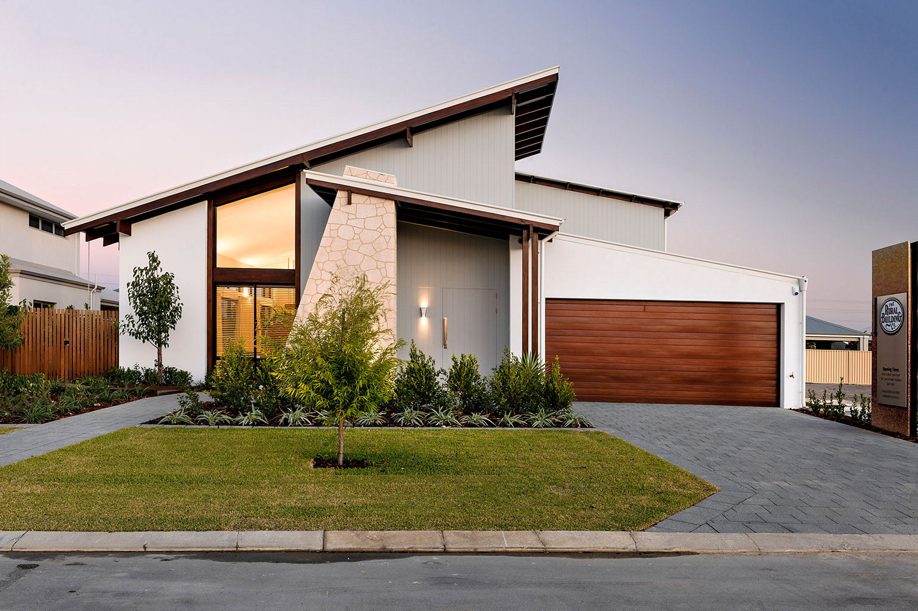



Improve the quality of your visual content
call 555.546.7245

Slide 15
Convert More Leads
CRO

Slide 16
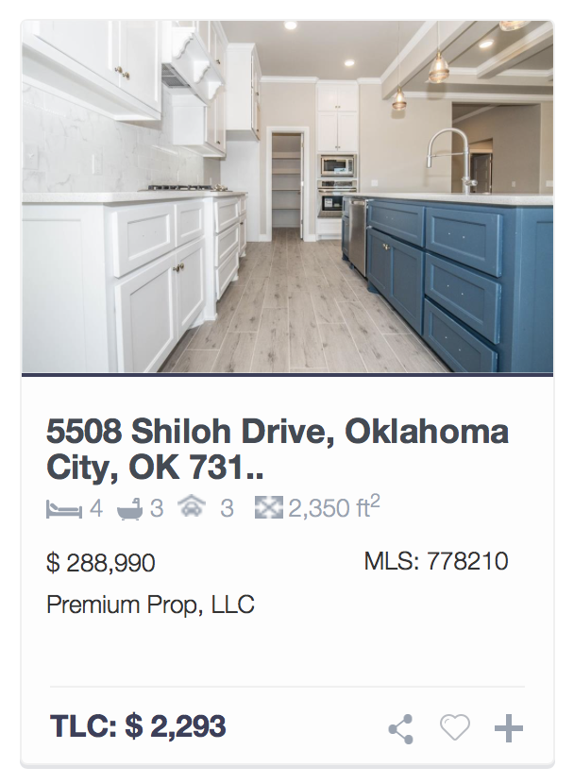


Avoid poor thumbnails

Slide 17
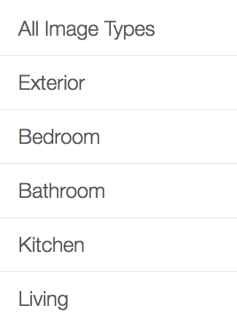
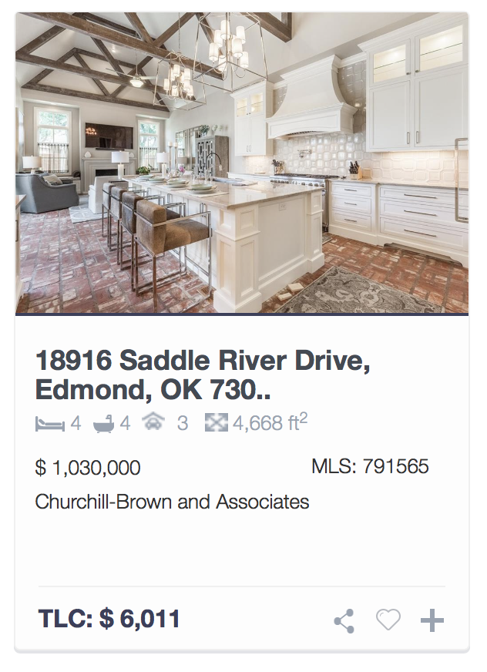
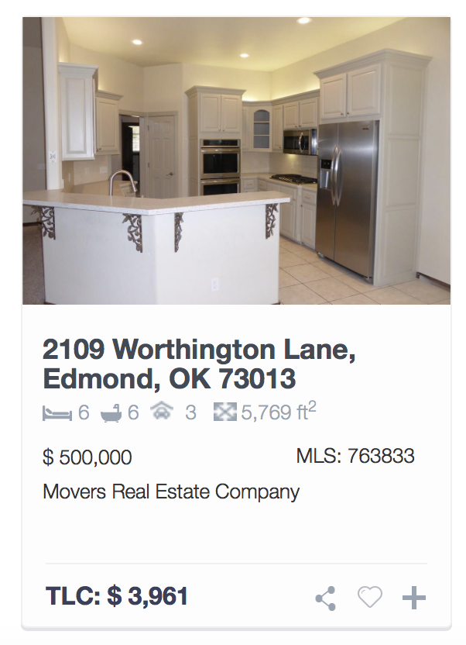
Let user filter by desired thumbnail
All image types
Kitchen

Slide 18
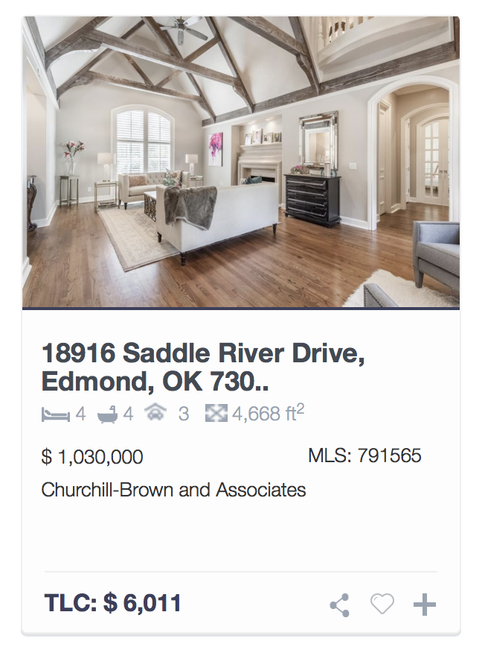
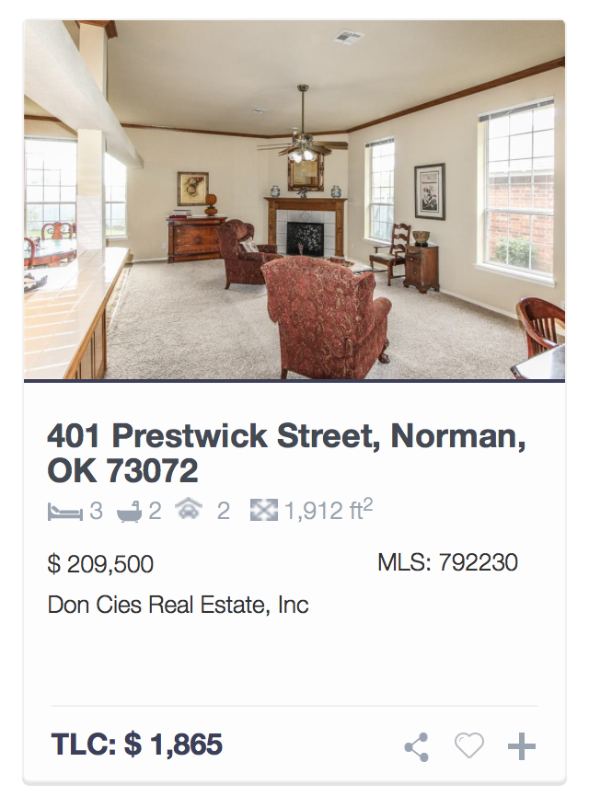
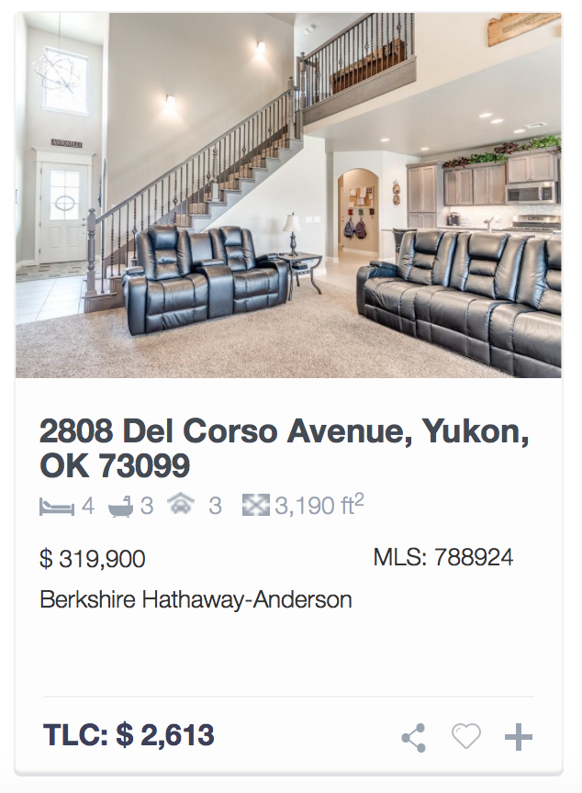
Bedroom
Optimize default thumbnail
Test A
Test B
Kitchen
Living room

Slide 19

Generate
More traffic
Increase time
on site
Convert more
leads

Slide 20
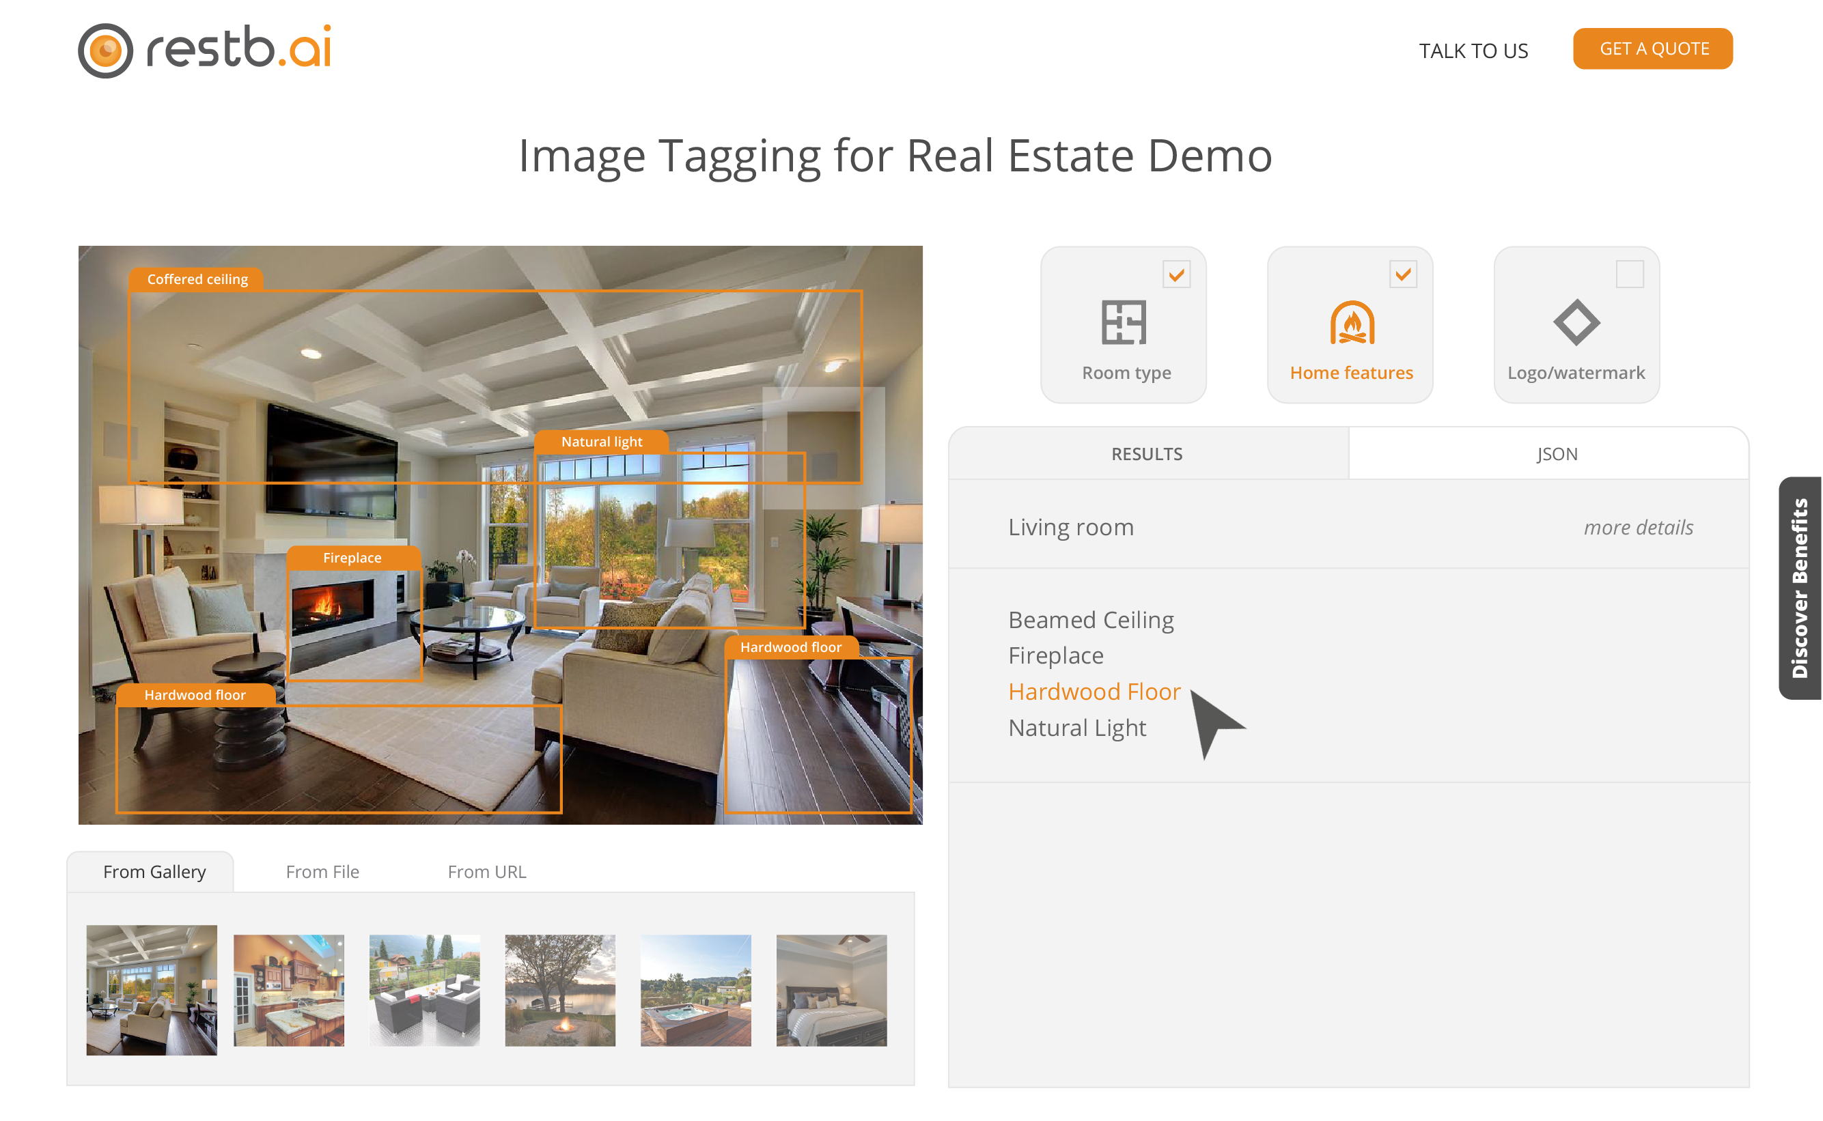

Slide 21
Thank you
Dominik Pogorzelski
dominik@restb.ai
http://restb.ai

