Slide 1
Making Money From Free “Güncelim” Case ICMA Meeting – April 2011 Burak Ertaş CEO, sahibinden.com

Slide 2
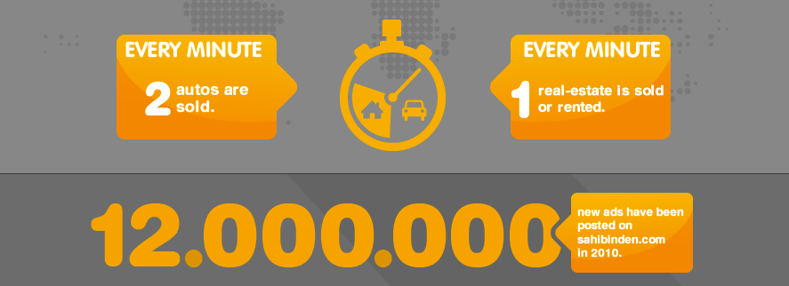
sahibinden.com in a (tiny) nutshell
Largest classifieds & marketplace website in Turkey
#1 in Turkey* with over 2 bio monthly pageviews
20+ mio unique visitors making 60+ mio visits monthly
18 minutes average time per session
* IAB Turkey – March 2011

Slide 3
Checklist to make money from free…
Traffic is a must… and we all know it ☺
Use touch points…
and provide a compelling offer…
with a convenient method of payment
for conversion

Slide 4
Traffic!
2 bio pageviews monthly, 50K new ads daily!
Free
Traffic
Conversion

Slide 5
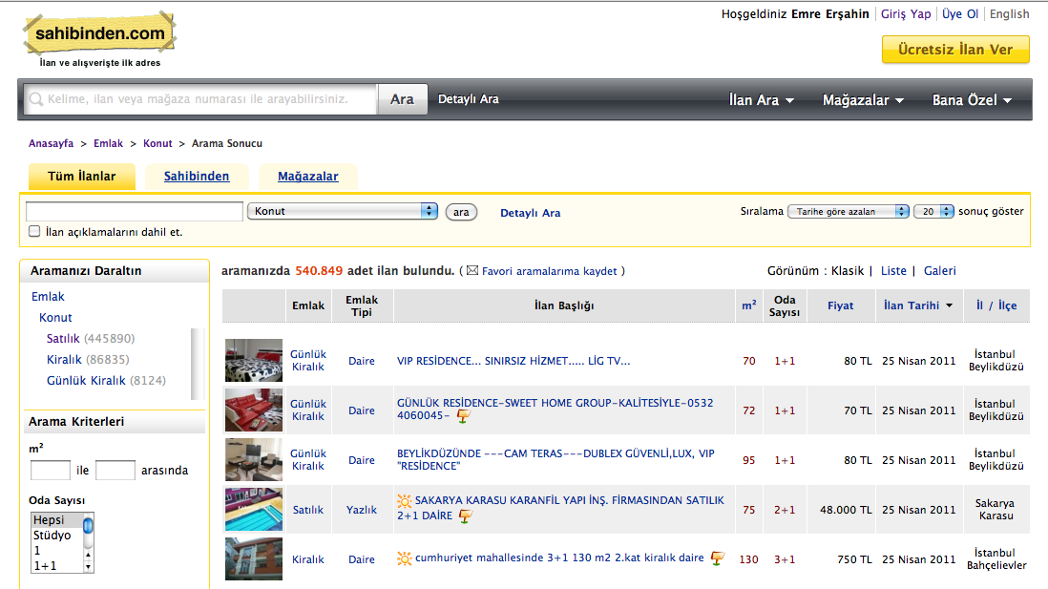
Traffic!
Search heavily used
Results sorted according to posting date by default

Slide 6
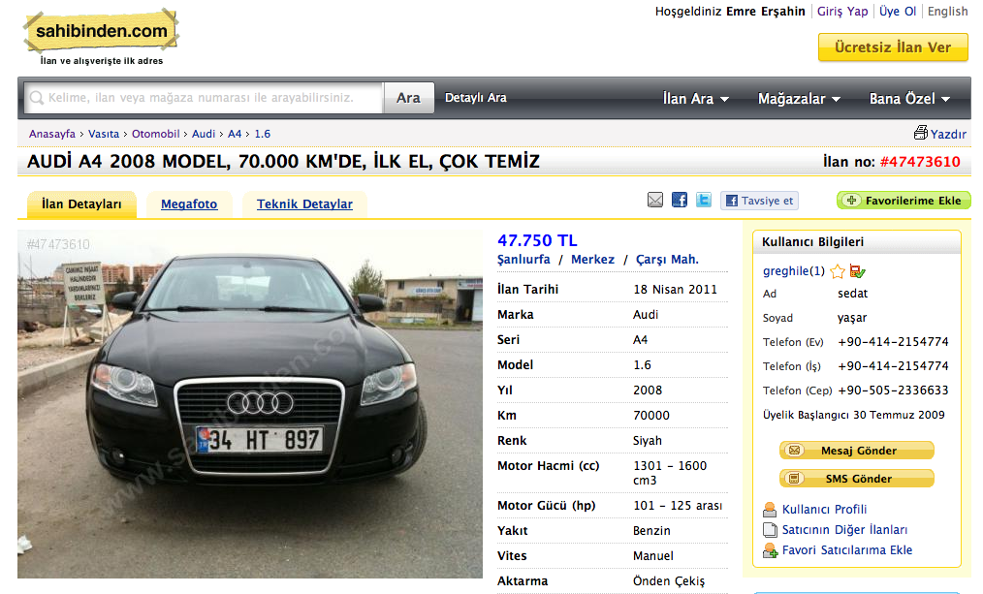
Buyers are after new ads...

Slide 7
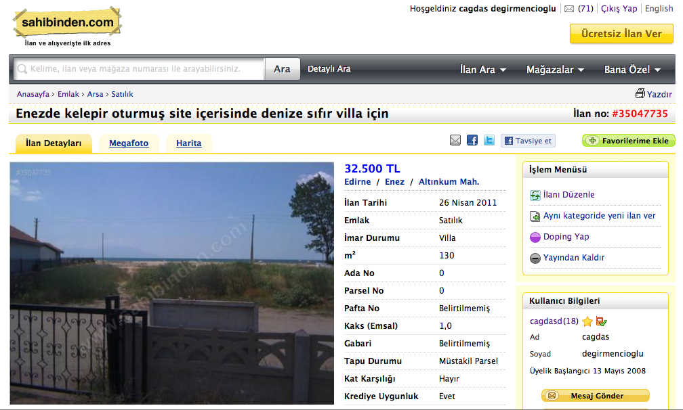
Touch point: Ad Update
20K ads updated daily

Slide 8
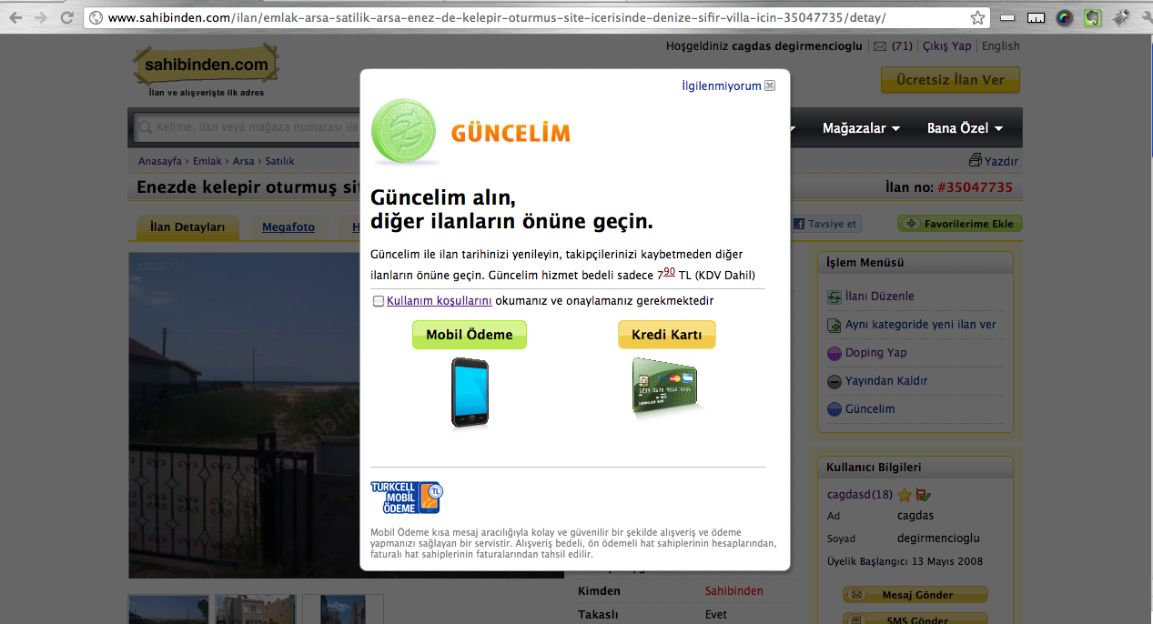
Targeted Offer
Compelling offer
While updating the ad, we offer the possibility to renew the posting date
The original posting date is reset
Still remains in respective favorites lists
view count is protected

Slide 9
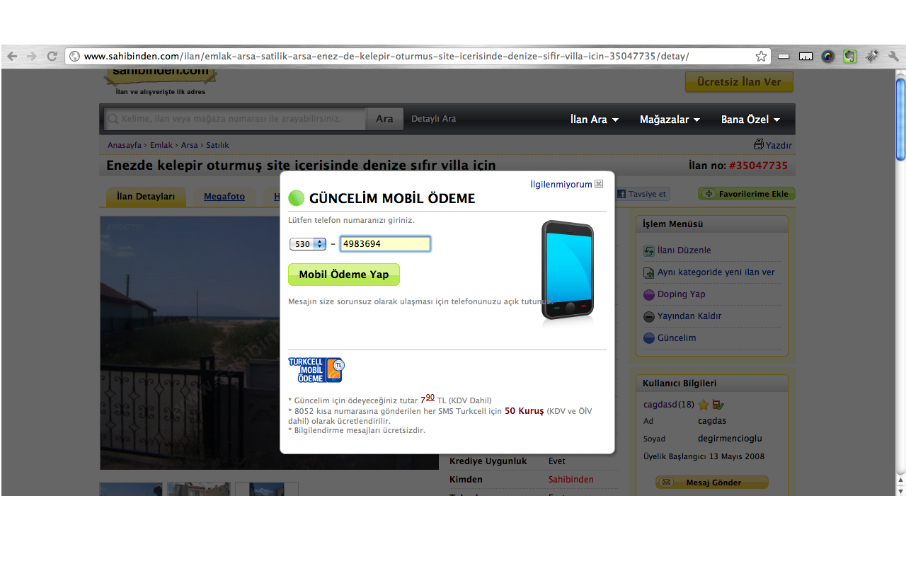
Convenience: Mobile Payment
We offer the convenient option of mobile payment for increased conversion

Slide 10
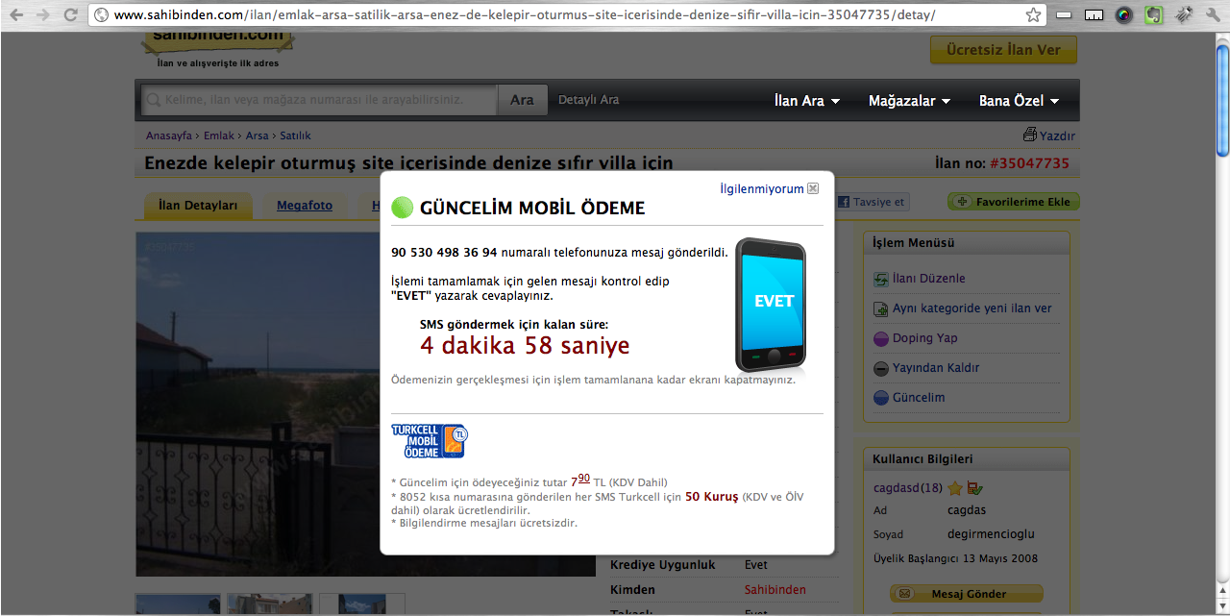
Mobile Payment Option
User enters his/her mobile phone number online
Responds “YES" to the authentication SMS within 5 minutes.

Slide 11
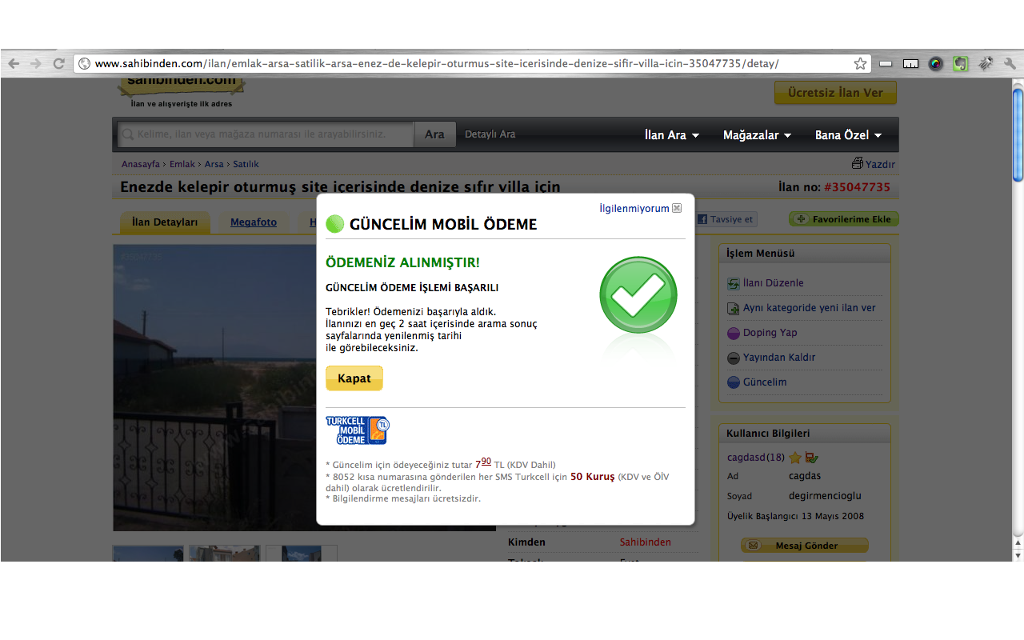
Mobile Payment Option
Sees “Payment received’ message on the same page and that’s it !

Slide 12
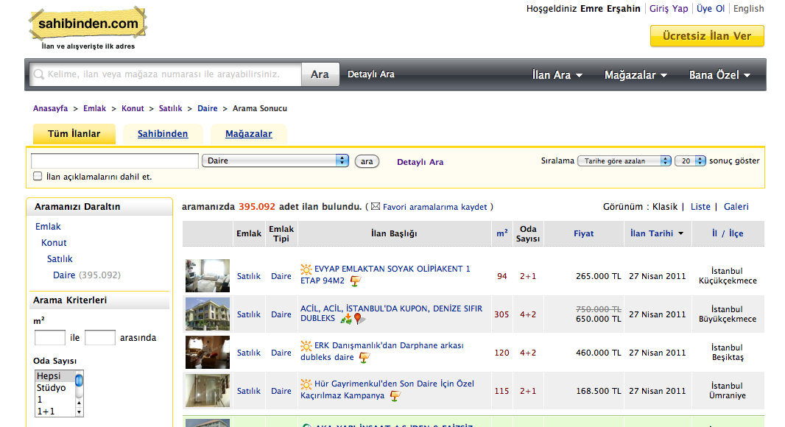
Results. Delivered.

Slide 13
Rule Based Marketing is Key
Rule based offer renewal at upcoming touch points.
Automatic rules calculated on time, price, category and view count
Lifetime of a Classifieds Ad
1st offer appears after 48 hours
Offer reset every 24 hours at each update
Final obligatory offer 2 years after posting date

Slide 14
Results
400K EUR annual incremental revenue in the first year
Half of the revenue comes from mobile payment
Conversion rate increasing due to repeat purchase
August 2010 March 2011

Slide 15
Checklist to make money from free…
Use touch points…
and provide a compelling offer…
with a convenient method of payment
for conversion

Slide 16
“Güncelim” Shortlisted: 2011 ICMA Classified Media Innovation Award Category: “Show me the money”

Slide 17
Thank you ! Q & A burak.ertas@sahibinden.com

