Slide 1

THE
PROGRAMMATIC
PLAYBOOK*
*MOSTLY BUZZWORD-FREE!
MADE WITH ♥ BY FREDERIC HANSEN

Slide 2

PROGRAMMATIC DEFINED
Programmatic Advertising is machine-to-machine automation of advertising transactions. This typically involves machine-learning decisioning and both biddable and non-biddable inventory, but currently relies on human input to create rules for both the buy and sell side.
1

Slide 3
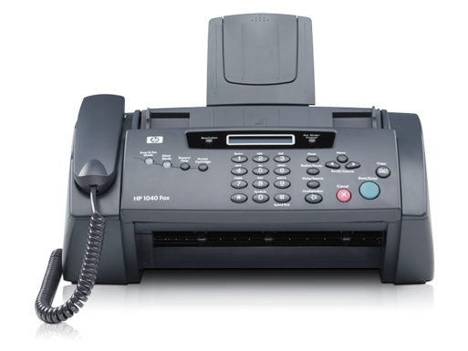
HOW WE USED TO TRADE MEDIA
2

Slide 4
THE EXTENDED PLAYING FIELD
DIRECT
OPEN
AUCTION
AUCTION
FIRST LOOK
PREFERRED
DEALS
FIRST
LOOK
CPM
PRICING
PREFERRED DEALS
AUTOMATED
GUARANTEED
FIXED
OPEN AUCTION
TRADITIONAL
REMNANT
RESERVED
DEAL TYPE
UNRESERVED
VOLUME
3

Slide 5
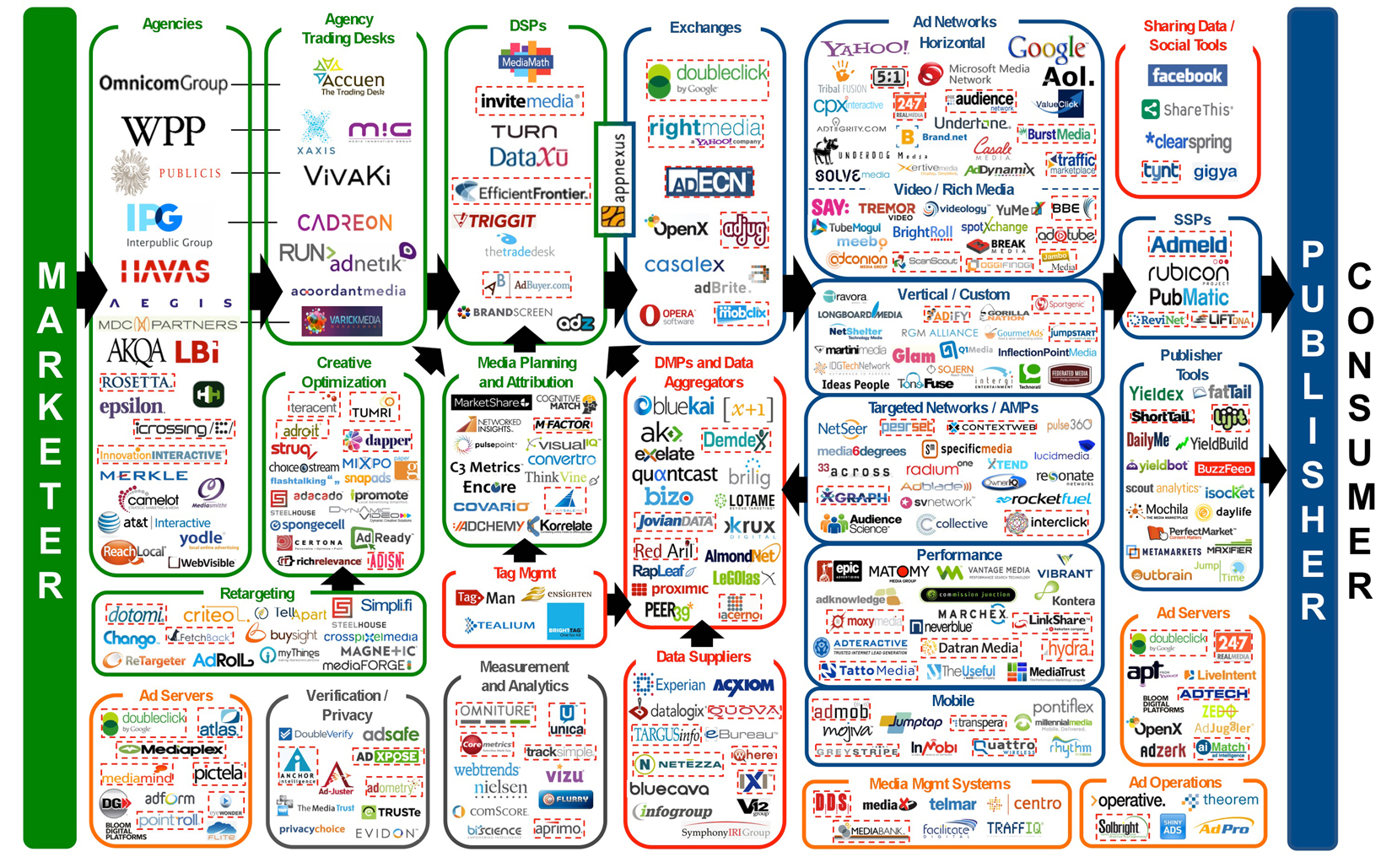
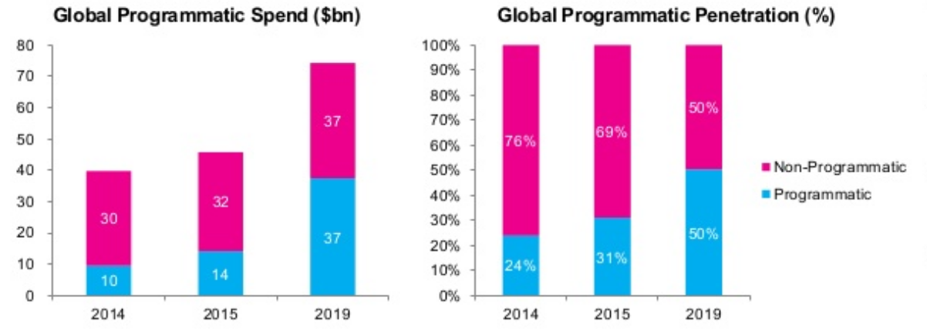
KNOW THE PLAYERS
Source: LUMAscape by LUMA Partners
Source: Magna Global Programmatic Intelligence Report 2015
ADVERTISER
AGENCY
TRADING
DESK
DSP
DATA
SSP
NETWORK
TOOLS & AD
SERVER
PUBLISHER
100%
=$10.00
-10%
=$9.00
-15%
=$7.65
-15%
=$6.50
-$1.00
=$5.50
-15%
=$4.68
-20%
=$3.74
-$0.10
=$3.64
36%
=$3.64
4

Slide 6

LET‘S GET READY
FOR THE GAME...

Slide 7
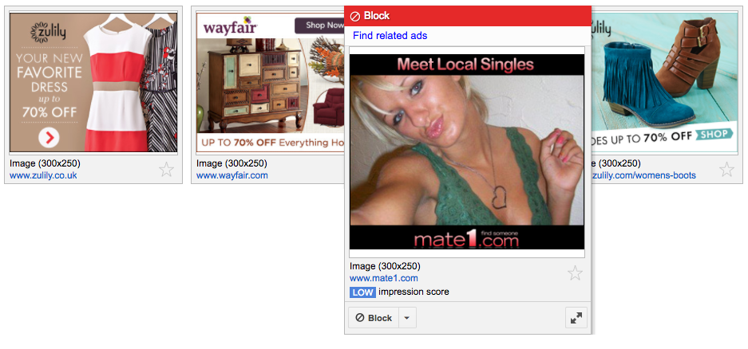




PLAY #1 STAY IN CONTROL
AD NETWORK
KEY TAKEAWAYS
Have control over all revenue sources
Monitor closely who is buying your inventory and at which price
Establish relationships with agencies and advertisers already buying your inventory
6

Slide 8
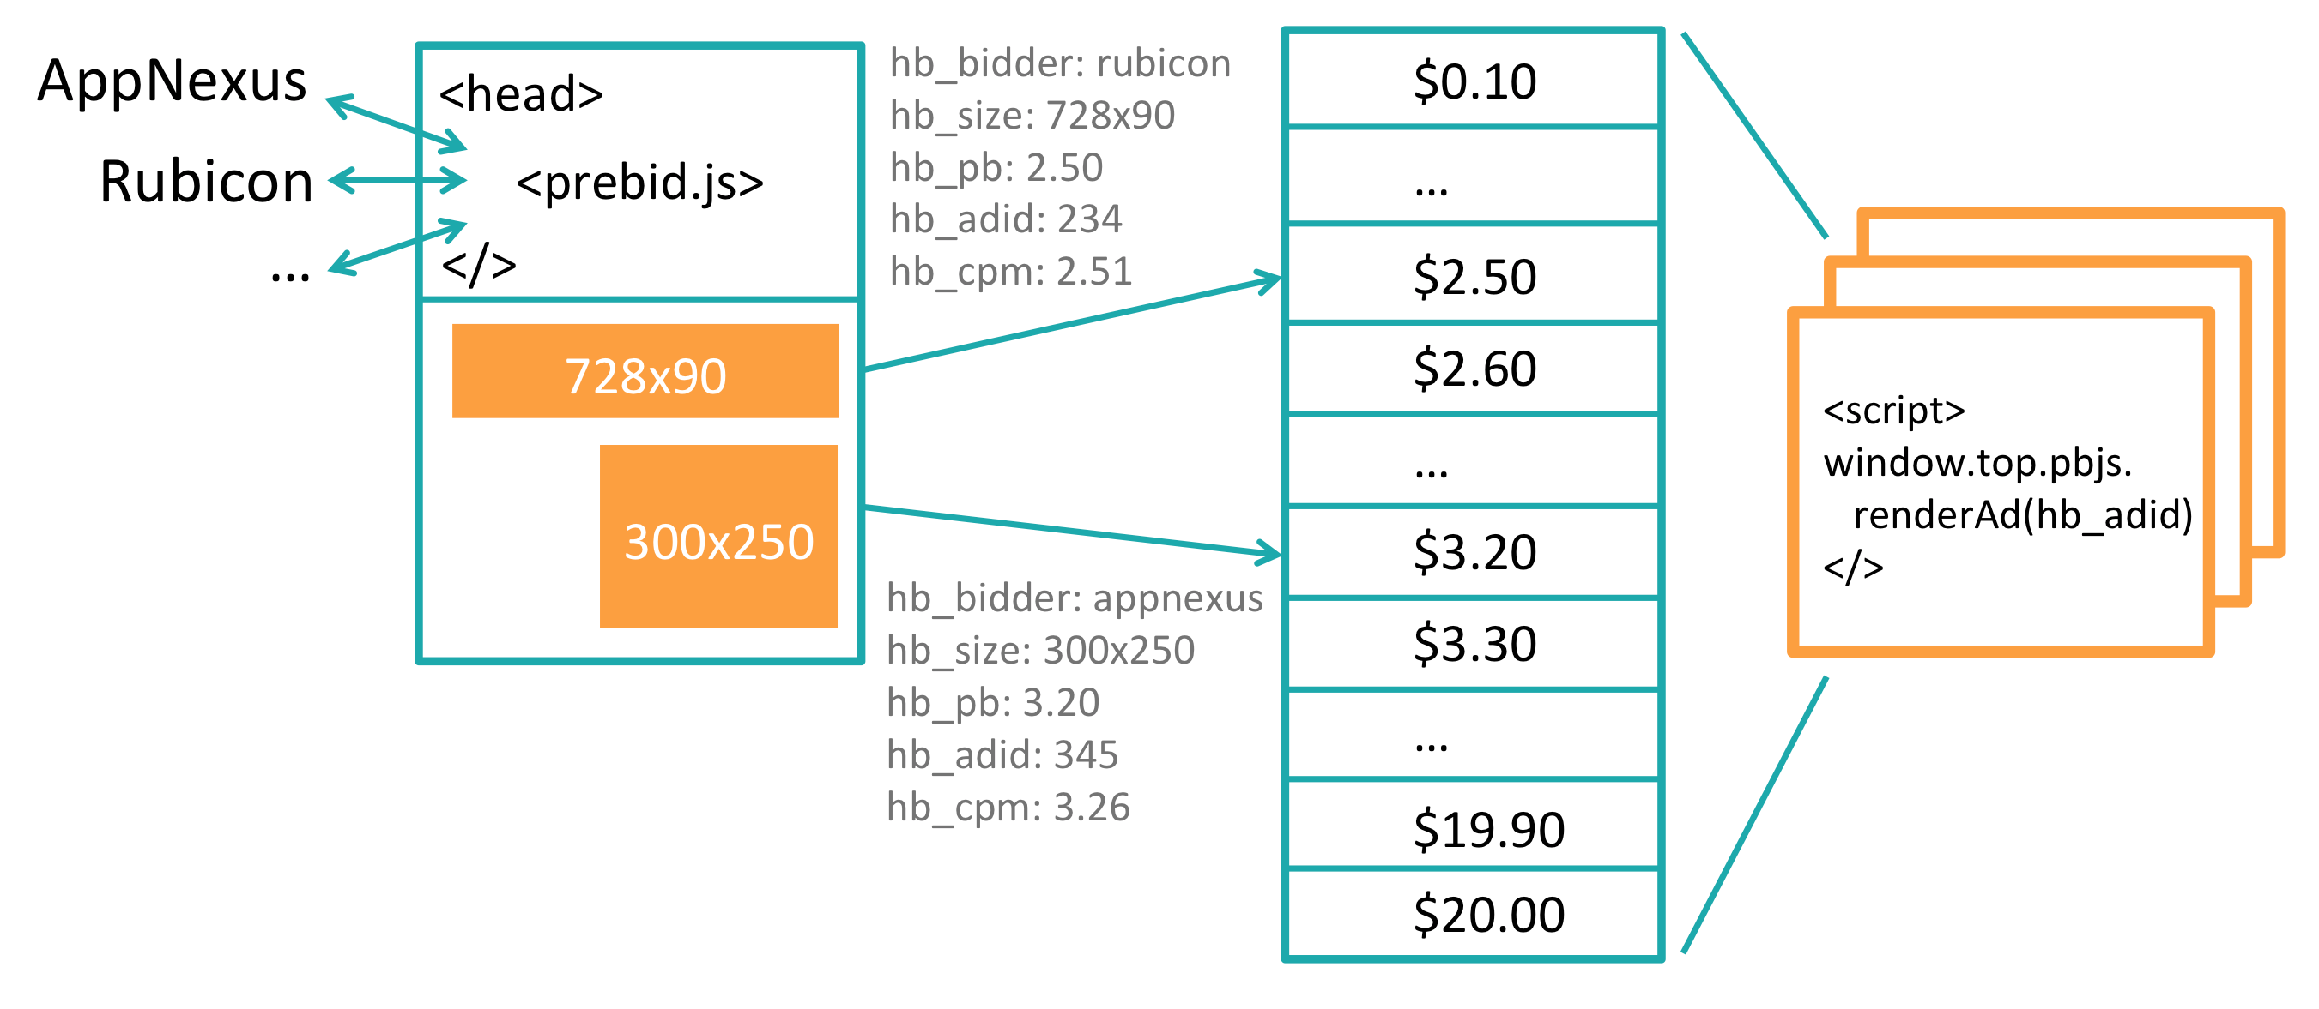
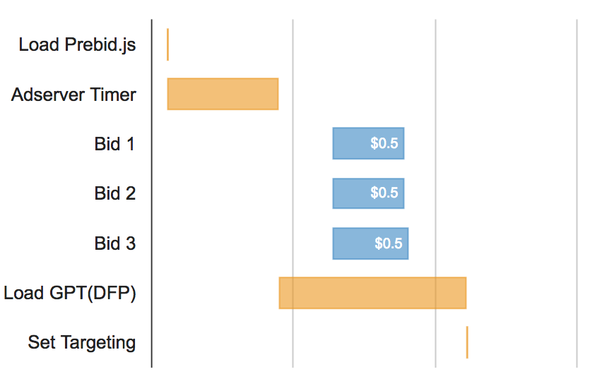
PLAY #2 UTILIZE HEADER BIDDING
KEY TAKEAWAYS
Source: Prebid.org
Avoid proprietary wrappers, use open-source frameworks like Prebid.js instead
Do not use more than 4 or 5 header bidding partners simultaneously
Become a part of the open-source community and share with others, it will pay off
7

Slide 9

PLAY #3 FOCUS ON VIEWABILITY
A
Variation A:
Viewability = 23.92%
CPM = $0.32
Variation B:
Viewability = 76.14%
CPM = $0.87
B
KEY TAKEAWAYS
The most viewable position is right above the fold, not at the very top
If you increase viewability by 10%, CPMs will increase by about 8%
Making the banner outside your content sticky can increase CPMs by 15-20%
8

Slide 10
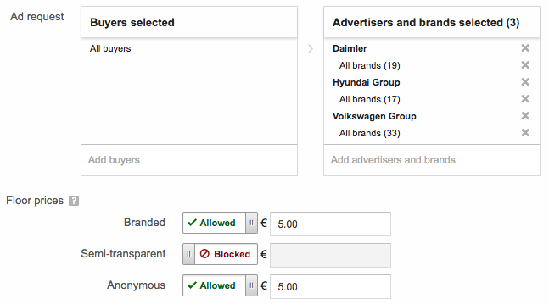
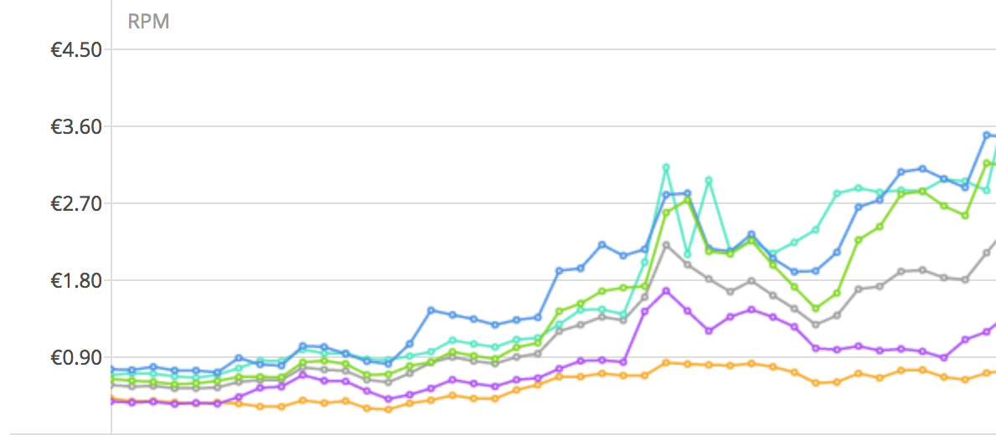
PLAY #4 SEGMENT YOUR INVENTORY
Cars_Top
Viewability: 72.21%
CTR: 1.21%
Cars_Bottom
Viewability: 21.29%
CTR: 0.04%
KEY TAKEAWAYS
Segment your inventory by performance (Viewability & CTR)
Set individual floor prices for your top buyers per category
Block your top buyers from non-converting ad placements such as a footer integration
9

Slide 11
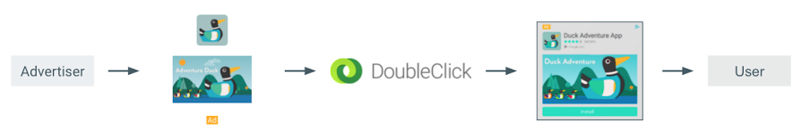
PLAY #5 UTILIZE NATIVE ADS
Source: Google
KEY TAKEAWAYS
While banner ads are pre-rendered, native ads are rendered in your ad server
Advertisers allocate more budgets to native ads which increases demand and CPMs
Native ads are performing better for advertisers. As a result, prices will increase
10

Slide 12
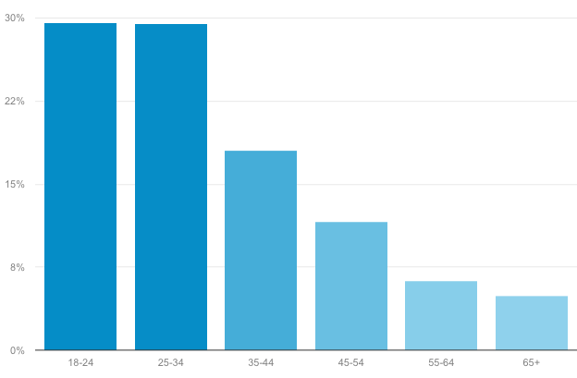
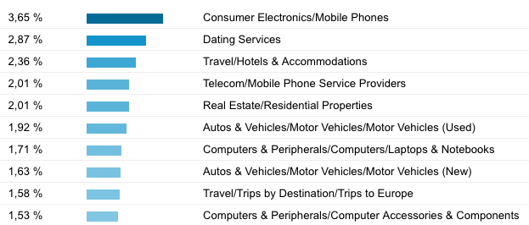
PLAY #6 LEVERAGE AUDIENCE DATA
KEY TAKEAWAYS
DMPs are fairly expensive and difficult to implement
If you‘re using DFP, ask your account manager to get whitelisted for DFP Audience
Data is not for free! Add $1.00 (or more) if your clients want to make use of your data
11

Slide 13
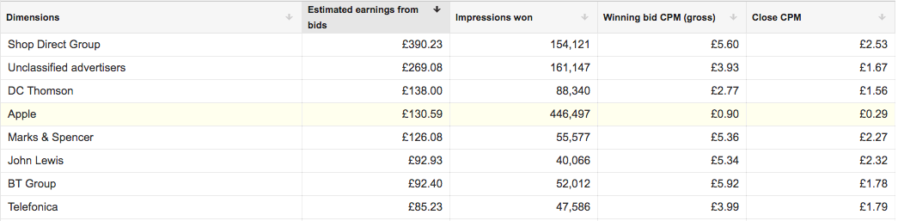
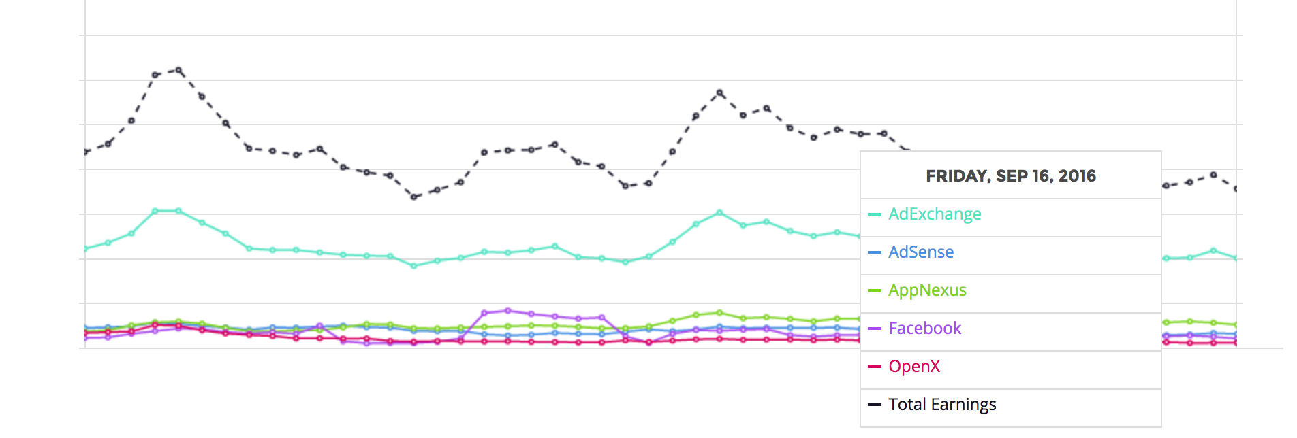
PLAY #7 STAY INFORMED
KEY TAKEAWAYS
Do not put all your eggs in one basket – diversification is key
Some buyers and sources are extremely volatile, monitor them frequently
Experiment! If one does not work, try another
12

Slide 14

TOUCHDOWN!
THANK YOU!
SEND QUESTIONS AND FEEDBACK TO:
FREDERIC@CLICK-PERFORMANCE.COM

