Slide 1
Publi24.ro
The 10 year old startup

Slide 2
Hello!
I’m Lucian Luncan
Working with digital classifieds since 2007.
You can find me at lucian.luncan@russmmedia.ro

Slide 3
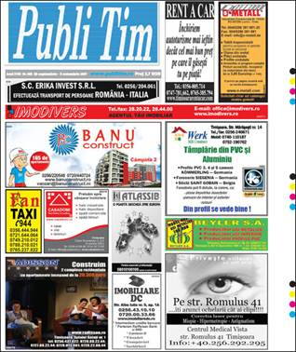
Where did we start?
1
Publitim classiffieds weekly newspaper launched in 1990.
Russmedia aquired it in 2006.

Slide 4
Publitim.ro
We relaunched the site in 2007.

Slide 5
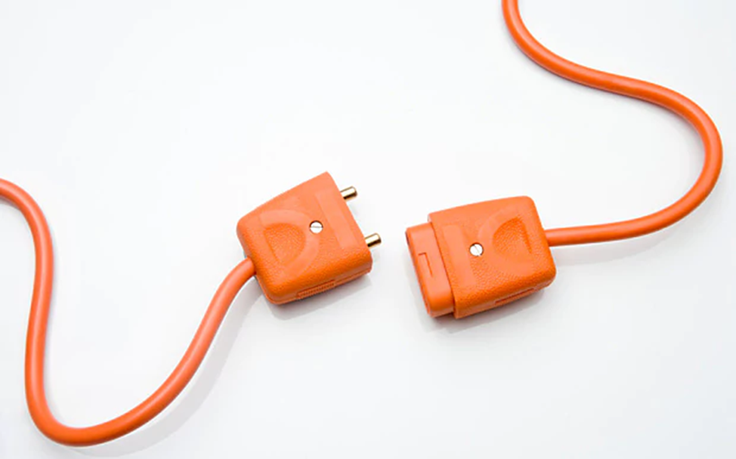
In 2009 we completeley separated print and digital.

Slide 6
2009: Publi24.ro rebrand
We decided to rebrand and move focus from local to national market.

Slide 7
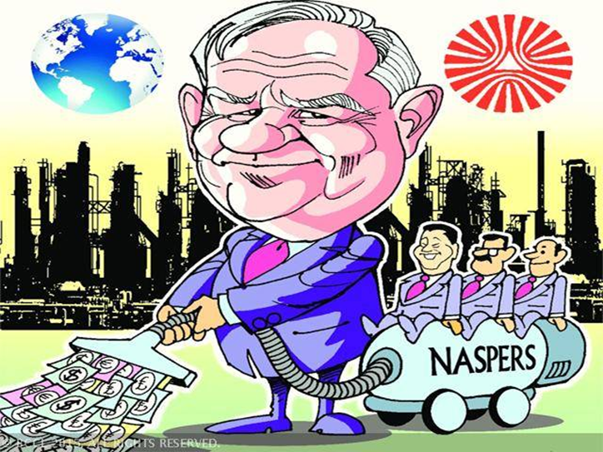
2010: attack of the giants

Slide 8
40.000.000€
Naspers & Schibsted spent in Romania form 2010 to 2015.

Slide 9

Fighting for survival

Slide 10

Move to free(mium)

Slide 11

Keep it small!

Slide 12
3 integrated brands
Publi24
Horizontal.
All ads pusblised on all classifieds appear on Publi24.
Bestauto
Auto classifieds.
All auto ads published here.
Romimo
Real estate.
All real estate ads publised here.

Slide 13
10 people
3 developers
1 designer/frontend
2 project managers
1 support
2 content editors
1 manager

Slide 14
Focus on 3 main pillars
Tech
Brand
UX

Slide 15

Tech: speed & responsive site

Slide 16
Speed: hybrid apps
We build our android & ios apps internally using cordova/phonegap and HTML5.

Slide 17

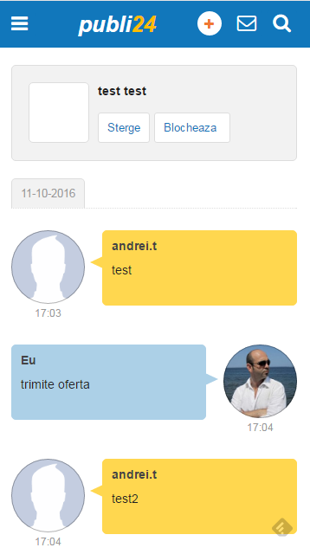
Real time messaging
We implemented real-time messaging in the website and apps.

Slide 18
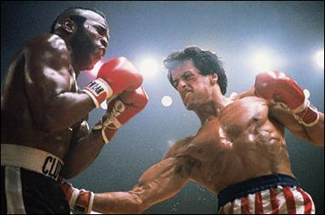
Fighting back

Slide 19
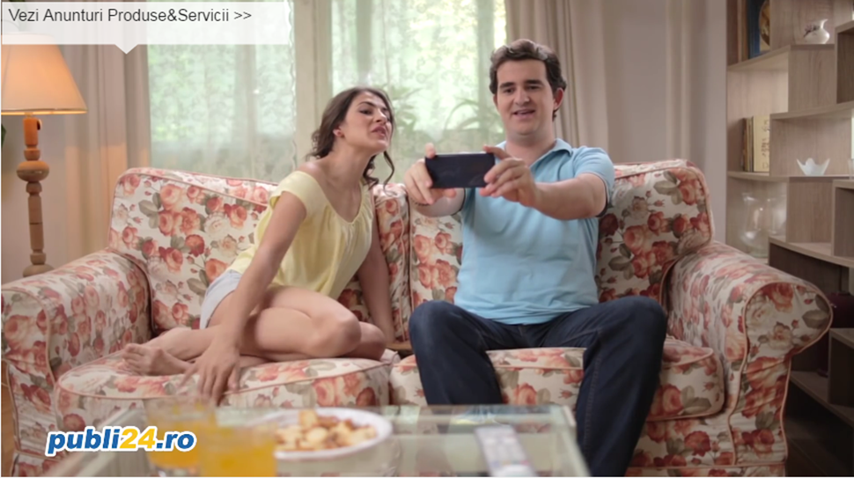
Branding: started TV campaigns in 2016

Slide 20
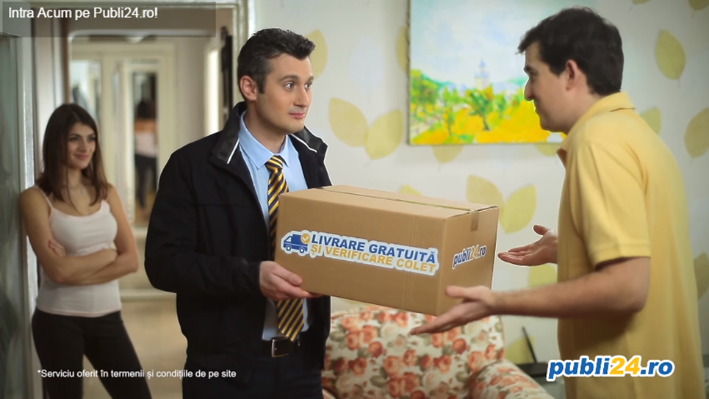
Add value: Verified delivery

Slide 21

UX: Building trust

Slide 22
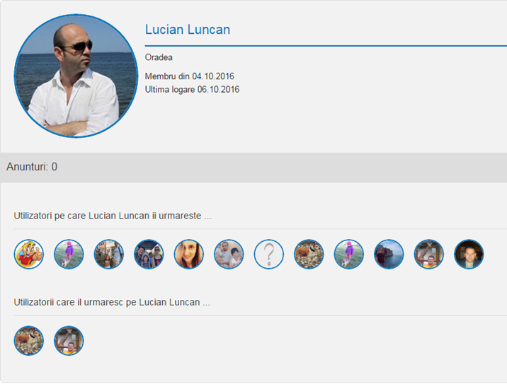
User identity & social features

Slide 23
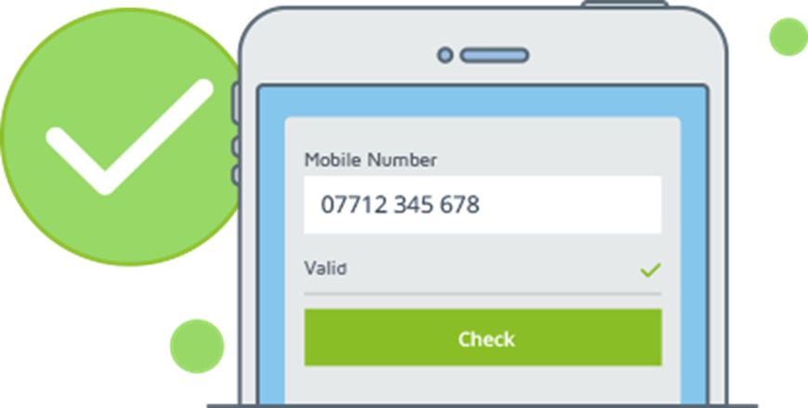
Security: phone validation

Slide 24

make/accept offer & user ratings

Slide 25

Where are we now?

Slide 26
Player nr. 3 in market.
Napsers is market leader with OLX.

Slide 27
7.000.000
Monthly visits in September 2016.

Slide 28
80%
Visits growth compared to 2015.

Slide 29
300%
Visits growth compared to 2013.

Slide 30
160%
Revenue growth compared last year.

Slide 31

70%
Traffic on mobile.

Slide 32
70%
Payments on mobile.

Slide 33
35%
Ads posted on mobile.

Slide 34

What’s next?

