Slide 1


Top 5 Considerations for Deploying DMP
Sebastian Fleischmann
Sales Director
Oracle Marketing Cloud
Notes:
Hat einen MBA mit dem Schwerpunkt Marketing

Slide 2




Core Challenges
1
DATA SILOES
Only
18%
1
2
Marketers have centralised view of customer interactions
3
Copyright © 2016 Oracle and/or its affiliates. All rights reserved. | Oracle Confidential – Internal/Restricted/Highly Restricted
Notes:
1 – 82% of Marketers lack a centralized view of customer interactions (Accenture) through an inability to unify and make actionable their valuable first party and second party data that remains trapped across different siloes across your business. First party data consists of known audience insights including Website analytics, call centre data, transactional data, CRM & loyalty data, website behavior and more…
Second party data is data shared with your trusted and value sponsorship/commercial partners.
3rd party data is then bought in isolation to power your media campaigns and fails to provide a complete view of your existing and ideal Prospect audiences. Of marketers and
advertisers say they’re highly confident in the audience they’re targeting (Nielsen), which shows that it’s failing when bought in isolation.
2 – Did you know that the digital eco system consists of over 2,000 technology vendors?! With each vendor offering you the opportunity to drive improved engagement, higher CTRs, increased conversions, and improved ROI’s, how can you make an objective, informed decision as to which partners are going to deliver the best results for your business? For every new marketing technology application you add, that means another piece of tracking script implemented on your web pages, giving these vendors the ability to track your valuables audiences as they engage with your site.
Did you know that an average B2C brand marketer sees an average of 20-30 tracking scripts spawning from their sites, with the average b2b company seeing an average of 15 or so trackers, while media owners on the other hand who are keen to commercialise their digital inventory and as a consequence see seeing anything from 30 – 70 trackers across their webpages at any given time.
Why does this matter? Well the more tech vendors you have tracking audiences from your site, the harder it is to control your data, and the harder it is to understand how your audiences are engaging with your assets as data insights differ from one technology vendor to the next… Not to mention the negative impact that multiple trackers can have on your web pages that can slow down the load times of your pages and cause audience drop-off in the process… If you could reduce the percentage of people who fail to complete an on-site purchase or complete business enquiry form by just 0.5% over the course of the next 12 months, how many more conversions could you achieve to positively grow your business?
3. Within most organisations, Marketing Departments are set-up to have specialists focused on different channels, such as Search, Display, Mobile, CRM, Personalisation, Loyalty, Commerce, and Social… With each team focused on delivering against their channel-specific objectives, more clicks, more conversions, more video completes, more social engagement, your audiencies inevitably get bombarded with duplicate and often irrelevant messaging…

Slide 3
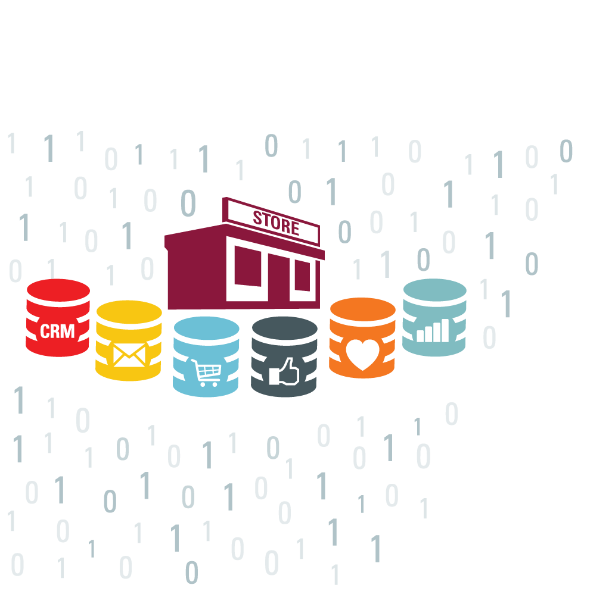

Valuable 1st Party Data Fails to Inform Marketing Campaigns
CRM
Web Analytics
Email
Loyalty
Commerce
Social
85%
CMOs that say data spread across different sources prevents cross-channel relevance
-CMO Club
Notes:
Now, assuming we could become more efficient with our third-party data, it’s still data that a lot of competitors could get access to
What’s truly unique for many retailers is the gold mine of proprietary data they have at their disposal
If this isn’t connected to the audience data you have in place to run campaigns, you might be missing out on a huge opportunity

Slide 4
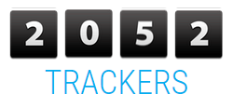

Core Challenges
2
TECH SILOS
SSPs
DSPs
CRM
Analytics
Retargeters
Optimisers
Contextual
Data Modellers
Data Aggregators
Ad Exchanges
Ad Networks
Native
Bidders
DMPs
Copyright © 2016 Oracle and/or its affiliates. All rights reserved. | Oracle Confidential – Internal/Restricted/Highly Restricted

Slide 5
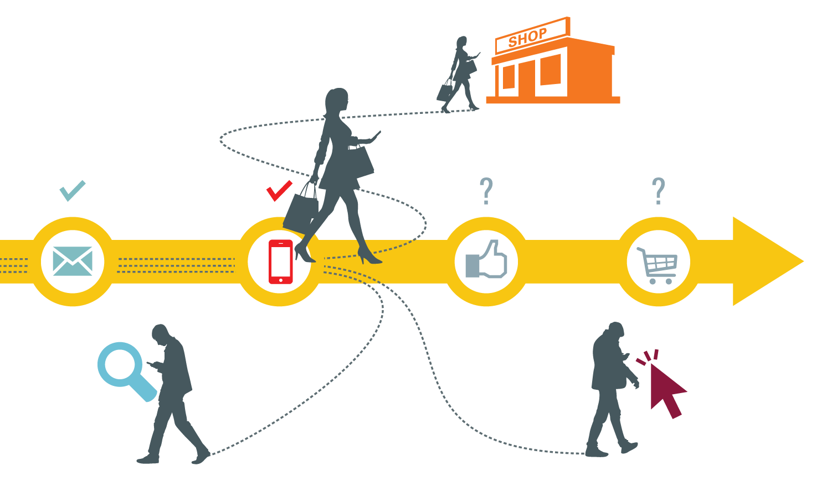

Pre-Determined “Journeys” Fail to Adapt Fast Enough
12%
believe their marketing is real-time enough to drive adequate business results
Copyright © 2016 Oracle and/or its affiliates. All rights reserved. | Oracle Confidential – Internal/Restricted/Highly Restricted

Slide 6
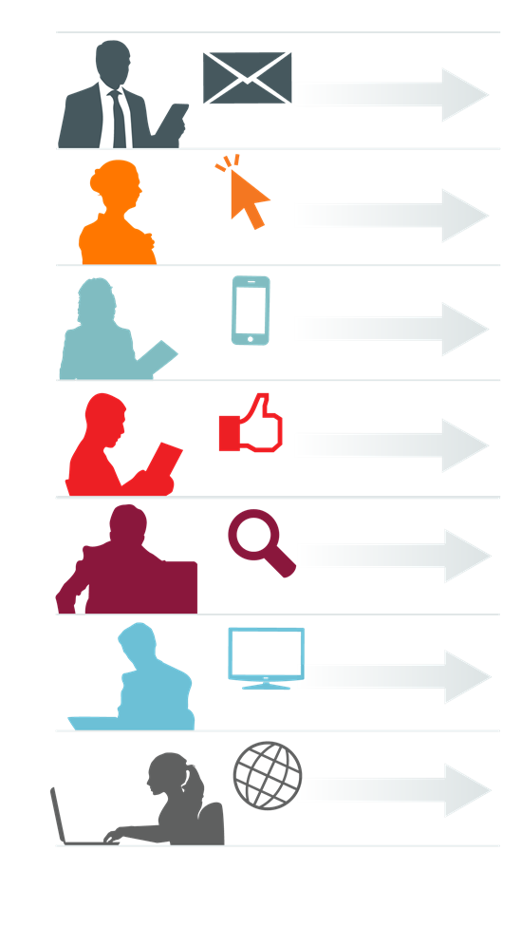

Core Challenges
3
PEOPLE SILOS
89%
marketing team divisions between channels
Copyright © 2016 Oracle and/or its affiliates. All rights reserved. | Oracle Confidential – Internal/Restricted/Highly Restricted

Slide 7
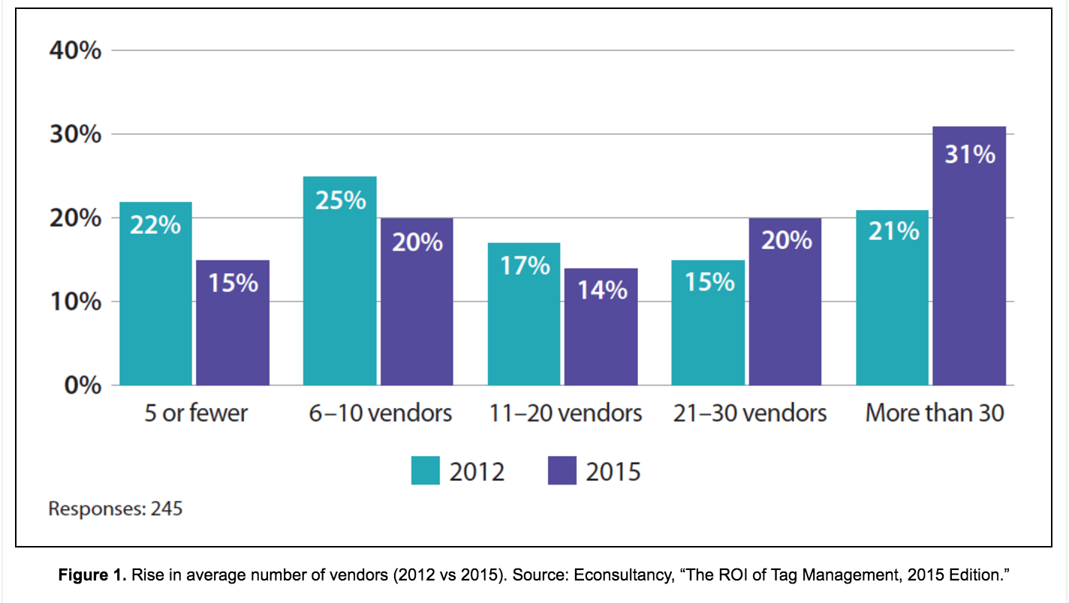
The Average # of MarTech Solutions Per Business Is Growing
51% of organizations are now using 21 or more digital marketing solutions (eConsultancy)
Notes:
While we’re focusing on the importance of Marketing Clouds, point solutions are still leveraged widely
This something to consider as you go into some of these companies: they’re still using many tools that do something very specific or niche, and you need to think about those as you go into position us more holistically at that marketing cloud level.
The market is starting to see the need to consolidate

Slide 8
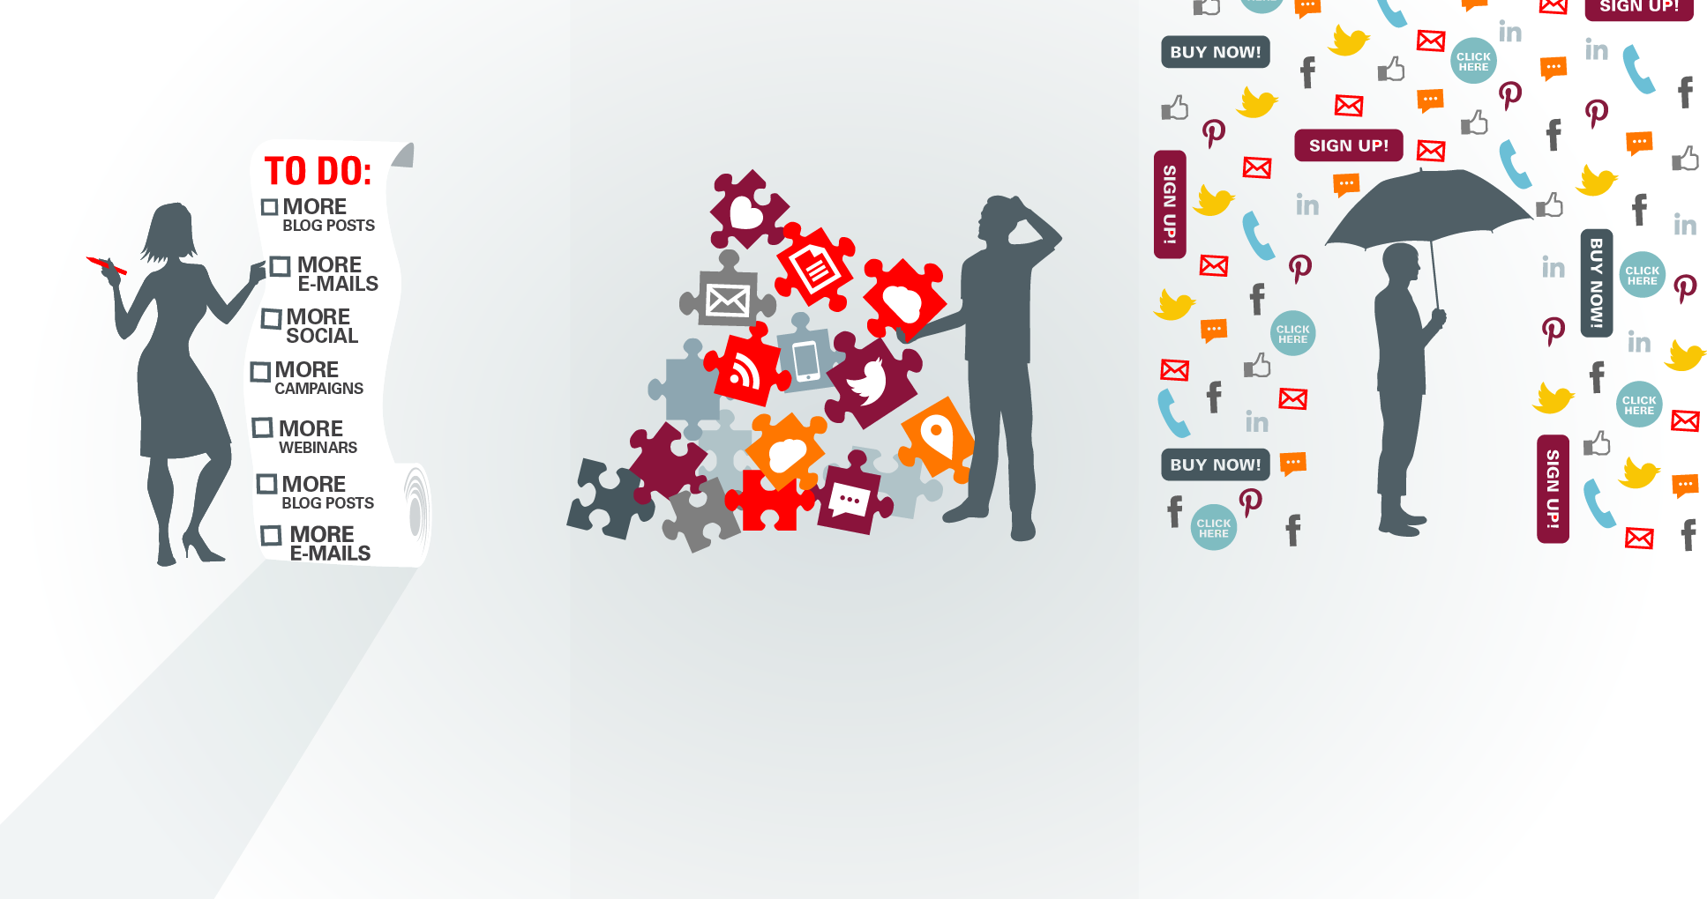
The Result: A Broken Customer Experience
Marketers Lean Heavily
on Fragmented Tools
Pass Fragmentation
Onto Customer
Bombarded, Customers Don’t Convert or They Leave
Notes:
78% of customers don’t receive consistent experience across channels. — Accenture
94% of customers have discontinued communication with a company because of irrelevant messages. — Blue Research
The result of a broken marketer experience is, unfortunately, a broken customer experience
With marketing teams fragmented approach to data, content, social and cross-channel engagement is plain to see – we pass our dysfunction onto our customers.
Because Marketers still have that short-term revenue goal, they lean on these fragmented systems and apps. That means more content. More disorganized social interactions. More e-mails. More lists. More content. More Campaigns.
More. More. More.
As customers get bombarded with irrelevant content, ads and promotions, one of two things happen: At best, they simply don’t buy, helping contribute to stagnant conversion rate. At worst, they get annoyed, and decide to discontinue communication with you altogether.

Slide 9


Effects Of Disparate Data: Broken Customer Experience
94%
frustrated due to irrelevant messaging!
Notes:
So, what’s at stake?
Easily broken customer experiences and missed opportunities. This is very simple and we see this lack of cross-channel, intelligent, programmatic thinking everyday. Just take a look at your Facebook feed right now and see how disconnected the retargeting ads are on the right-hand side of your screen are. Or, the fact that your local retailer never reconnects after purchase or upon re-entry. These basic opportunities to deliver value require at least 2-3 different data systems to sync and be activated.

Slide 10
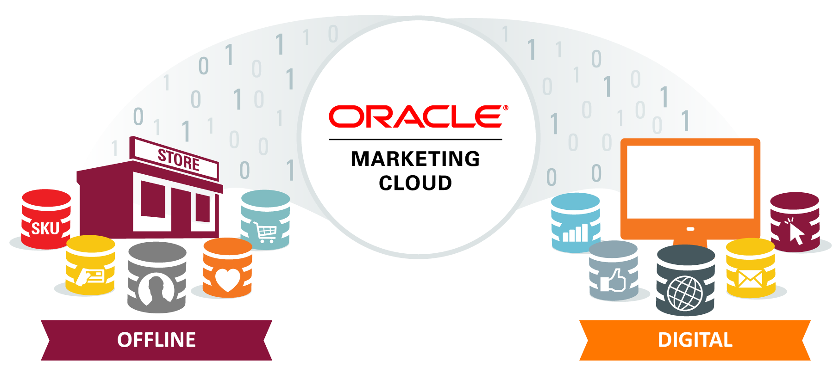
DMP Can Connect These Disparate Data Sources
Copyright © 2016 Oracle and/or its affiliates. All rights reserved.

Slide 11
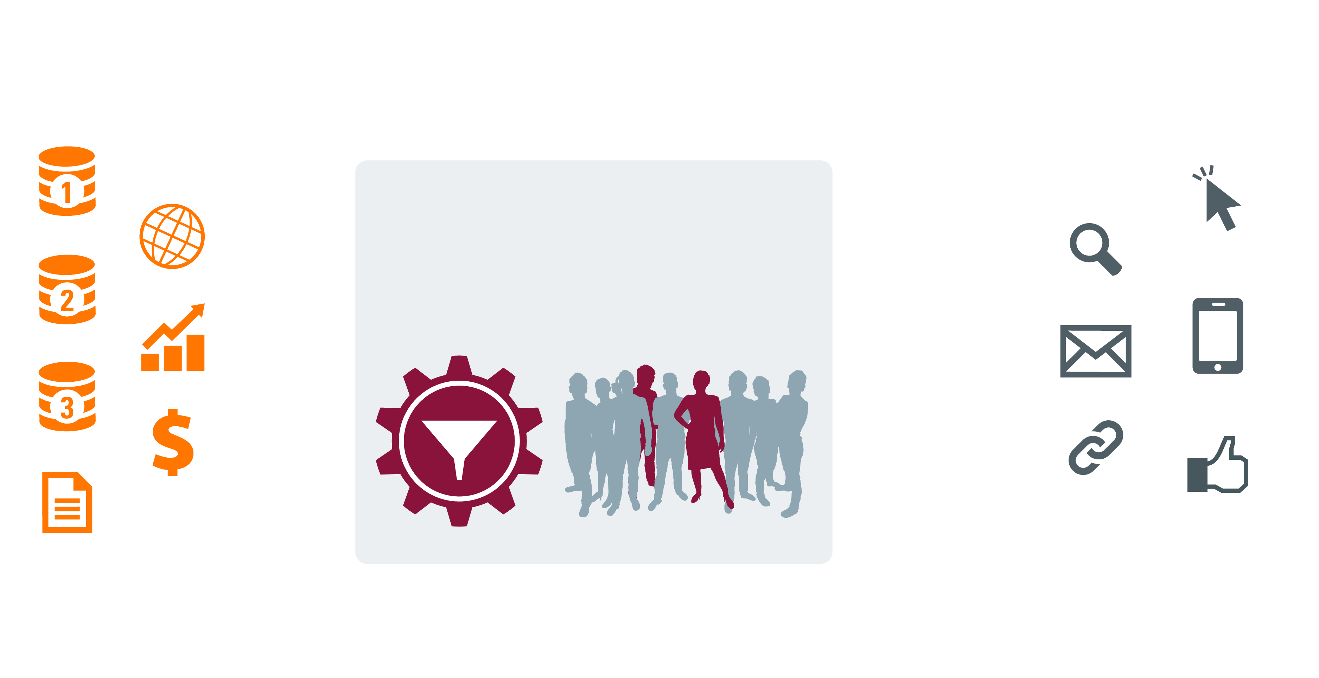
DMP For Data Activation
Oracle Marketing Cloud’s
DMP
1st Party
Display
Online
Unify Your
Data
Build the
Right Audience
Search
Data In
Data Out: Execute Across Ecosystem
2nd Party
Sales Data
E-mail
Mobile
3rd Party
CRM
Websites
Social
Offline
Notes:
Aggregate marketing data of all kinds to improve marketing execution

Slide 12





Why Do I Need a DMP?
Manage
Control
Enhance
Improve
Control
multiple online campaigns across different
ad networks, exchanges, and publishers
over data assets, maximize segmentation, prevent leakage,
and monitor
partner usage
niche-targeting, messaging capabilities, and
scalability
response rates, conversion, and brand recognition
advertising costs and improve overall ROI
Notes:
You need a DMP if...
• You manage multiple online campaigns across different ad networks, exchanges, and publishers
• You want to ensure you have control over your data assets, maximize segmentation, prevent leakage and monitor partner usage
• You currently run retargeting and would like to enhance your scalability, niche-targeting and messaging capabilities
• You want to better target campaigns to improve response rates, conversion, and brand recognition
• You want to control advertising costs and improve overall ROI

Slide 13
5 Best Practice Tips

Slide 14
Plan Big Start Small
70%+ start with Display as the main activation channel
55% of media sellers & 33% of media buyers stated the DMP was a central tool across their business
Notes:
Effectiveness and efficiencies in display advertising tend to be the main drives for DMP RFPs today.
Given the majority of respondents had less than 12 months of platform execution under their belt they are at early stages of understanding how to create value from integrated customer data and its common that companies will to launch with one channel/set of use cases.
Over time as their experience and capabilities grow we see broader adoption not just across paid channels like search & mobile but also into personalisation and optimisation.
At Oracle our most sophisticated clients with 2 years+ DMP usage are active across an average 5 channels.
And usage goes beyond the media team. As the DMP becomes a centralised point of access for all customer data businesses leverage the insights across other functions such as product development and servicing.
Already 55% of media sellers & 33% of media buyers stated the DMP was a central tool for business data.

Slide 15





























































































Future Proof Your Investment
Native and Search
Partners
Ad Serving Partners
Media Partners (Mobile)
Media Partners
Data App Partners (Modeling)
Ad Customization/Website Site Optimization
Attribution
Notes:
Over 400 connections across all channels
Server to Server integrations
We’ve been building these partnerships for more than 7 years – more than anyone else in the market
Mobile: Cookies not available in mobile browsers/apps → BK developed a way to identify users:
Statistical ID User Agent | IP Address | App Footprint → Correlate to develop a Stat ID (digital fingerprint)

Slide 16
Consider Your Data Dream Team
IT Teams
  Gatekeepers | Tag implementation
Audience Insight Analytics
  Segmentation| Propensity Models
Digital Operations Executive
  Day-2-Day Management of DMP & Vendor Integrations
Performance Media Managers
  Run campaigns fed by audience data into Paid Digital: Search, Display etc
Notes:
Org structure
CTO responsible for IT teams – there are IT sub teams split by product vertical i.e. Travel, Mortgages, Car Insurance, Package Holidays, etc. They’re the gate keepers with each sub team managing a respective CMS system for their product vertical. They’re responsible for adding any physical code.
The Customer Insight Analytics Team report into a Chief Data Scientist who reports into the MD of MSM. They’re responsible for feeding offline data in DMP including any propensity models
The Day-2-Day management of the DMP and integrations that include selecting and creating the exclusive audience segments to be pushed out to their marketing schedule is headed-up by a Head of Digital Operations. The Senior Digital Operations Executive handles the day-2-day activity such as Categorisation, Segmentation, Pushing Data Out and ensuring that any site tagging is in the right place.
For both MSM and Travel Supermarket (TSM), it is the role of the Performance Media Managers split by Product vertical (Insurance, Money, Home Services and Travel) to run the digital campaigns fed by audience data into Paid Digital inc. Search & Display.

Slide 17

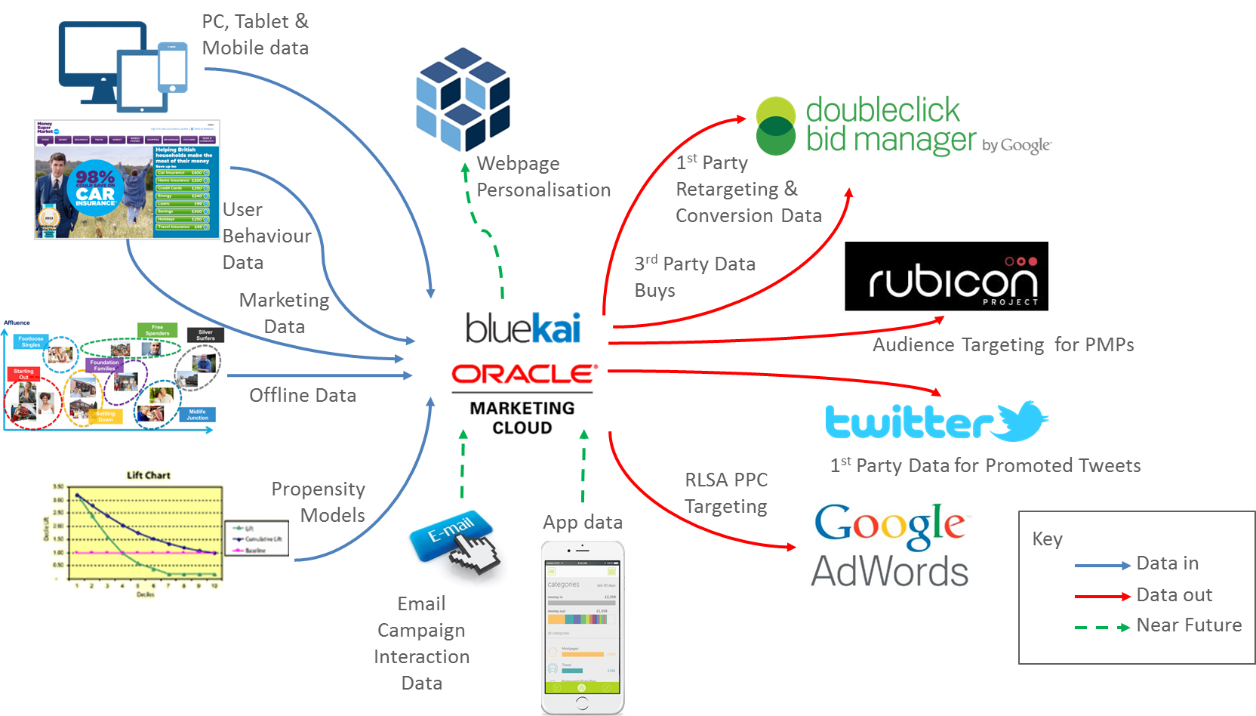
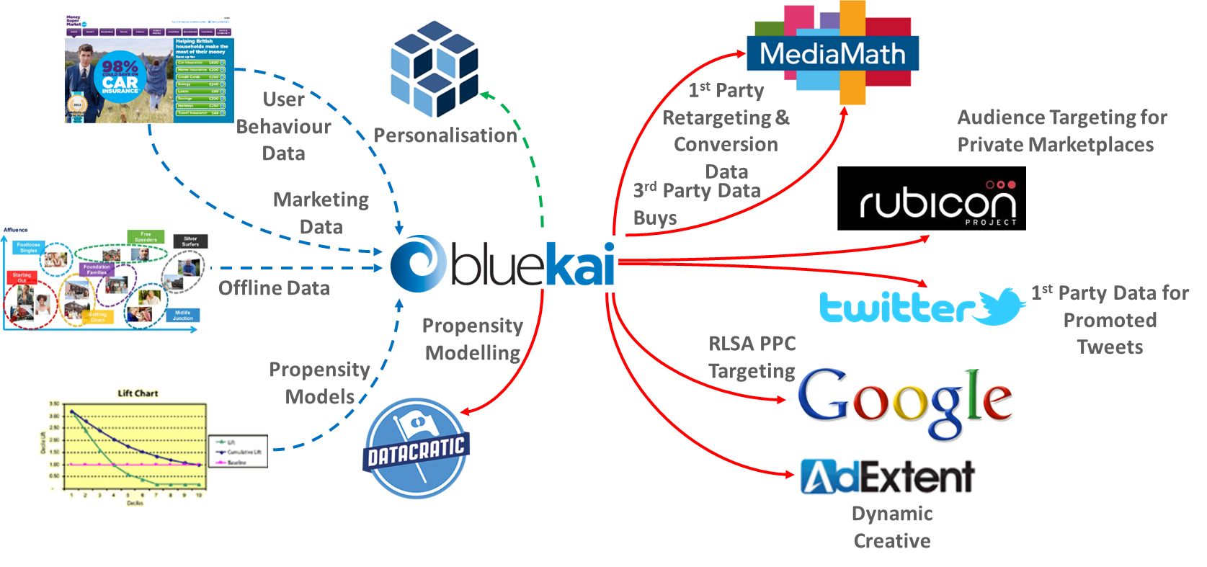
Test And Learn
Notes:
Over the last 3 years, MSM have been through multiple iterations of tech vendor partnerships on the data activation side of their business.
Oracle DMP gives clients the ease to test from a multitude of pre-integrated tech vendors, using our A/B testing segmentation functionality within their DMP seat, which allows clients to not only A/B test up to 12 different sets of creative against a controlled audience groups but also also allows them to use this functionality to test up to 12 different adtech vendors in the same way, so that they can identify which vendors deliver in-line with their business/marketing objectives and continue to work only with those that perform.
Typically, advertisers without a DMP will have multiple implementations with technology vendors, each with their own walled-gardens of audience data that restricts an advertiser’s ability to gain a synchronised view of their audiences, where these insights are not easily passed back to the advertiser. Furthermore, time and resource is required for a new partnership to be established with each tech vendor, tags to be integrated, testing to be done, only to find that many of these vendors fail on delivering on what they promised. The pre-integrated nature of data activation partners with Oracle DMP reduces time to market, freeing up marketing resource to focus on other important areas of their business that enable business growth.
Using Oracle DMP, the advertisers valuable audience data remains separated from each point of marketing execution, serving as the audience brain behind their business. This means that as they switch from one adtech vendor to the next as their needs change over time, or in favour of one adtech vendor who performs better than another, the audience behaviour continues to be captured via the Oracle DMP.
This empowers our clients to understand what stage of the lifecycle an audiences are with their brand, so they can continue to deliver the right message to the right user at the right time, whichever partners they choose to work with to fulfil on their marketing schedule.
Oracle will continue to innovate and integrated with new adtech/martech vendors as new technologies, advertising mechanisms and ways of targeting audiences evolve, which means that not only do our clients have the ability to easily test and learn, they are also future-proofed with Oracle Marketing Cloud to keep ahead of the technology curve.

Slide 18

Be Brave
Early Adopters See Success
90% Report their DMP implementation to have been a success
91% report seeing positive ROI at 12+ months

Slide 19



A Day in the Life of your Customer: Jaxon’s
Notes:
We start with the ideal customer for Vmware SMB: Patrick is the Director of IT Infrastructure at Zionsville Community Schools and we have some demographic and firmagraphic information about him. We also know something about Patrick’s presence on social media and that he is a big fan of jazz which as you will see later comes into play during an important part of the digital strategy.
As we will soon see Patrick is in the market for a virtualization solution for his school. He needs an alternative to an expensive replacement of aging computer systems. Zionsville wants to provide all students the same access to learning resources and programs from anywhere but many of the schools computers are old and for students who bring their own devices to school there is a huge range in their modernity and capabilities.

Slide 20

Meet The Customer:
35-years-old
Lives in Bern
€40-60 CHF annual income
In market for running jackets
Trains for Marathon
User XYZ
Persona Group:
Running Enthusiasts
Sabine
Notes:
We start with the ideal customer for Vmware SMB: Patrick is the Director of IT Infrastructure at Zionsville Community Schools and we have some demographic and firmagraphic information about him. We also know something about Patrick’s presence on social media and that he is a big fan of jazz which as you will see later comes into play during an important part of the digital strategy.
As we will soon see Patrick is in the market for a virtualization solution for his school. He needs an alternative to an expensive replacement of aging computer systems. Zionsville wants to provide all students the same access to learning resources and programs from anywhere but many of the schools computers are old and for students who bring their own devices to school there is a huge range in their modernity and capabilities.

Slide 21
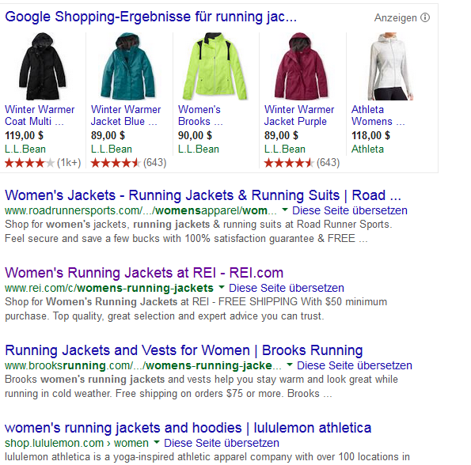

Slide 22

Notes:
Patrick visits the Vmware Education Solutions page and starts reading.

Slide 23
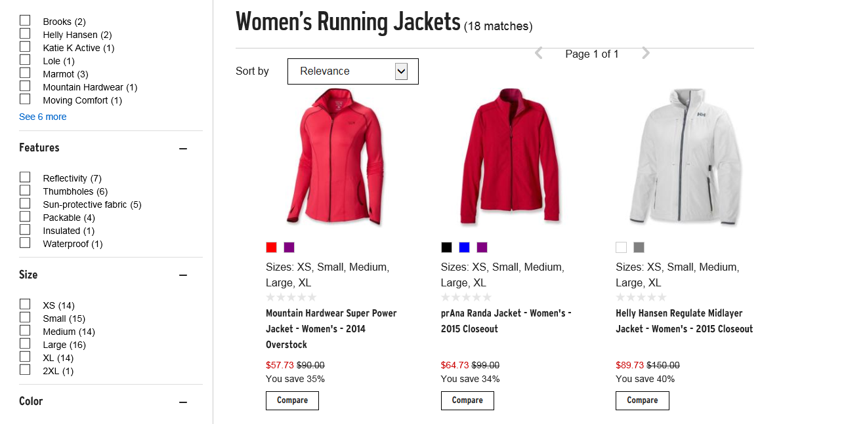
Notes:
Patrick visits the Vmware Education Solutions page and starts reading.

Slide 24
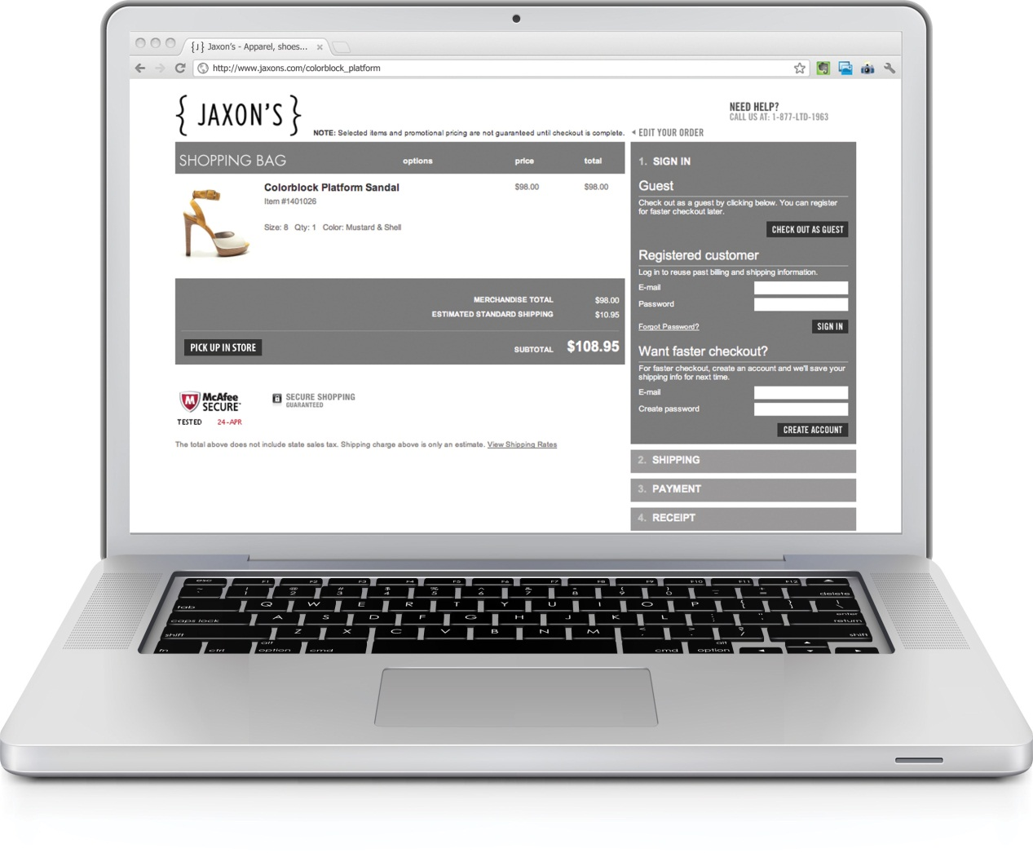


Notes:
Patrick visits the Vmware Education Solutions page and starts reading.

Slide 25
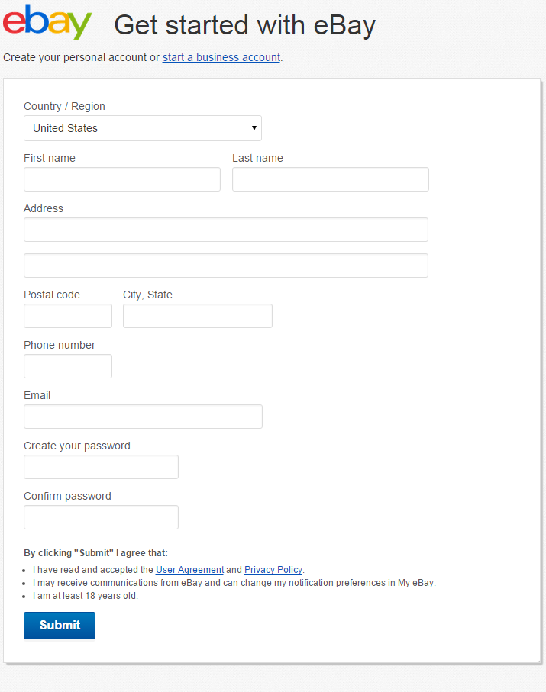
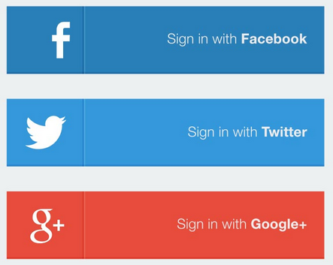
Notes:
Clicking the link Patrick is taken to a landing page for some progressive profiling. You’ll notice in addition to the traditional form fill we present an option for social login

Slide 26

Notes:
Clicking the link Patrick is taken to a landing page for some progressive profiling. You’ll notice in addition to the traditional form fill we present an option for social login

Slide 27
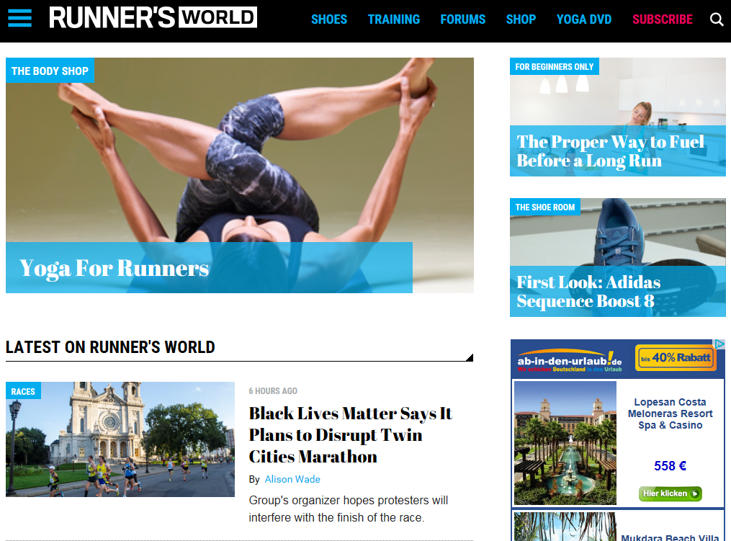



Slide 28
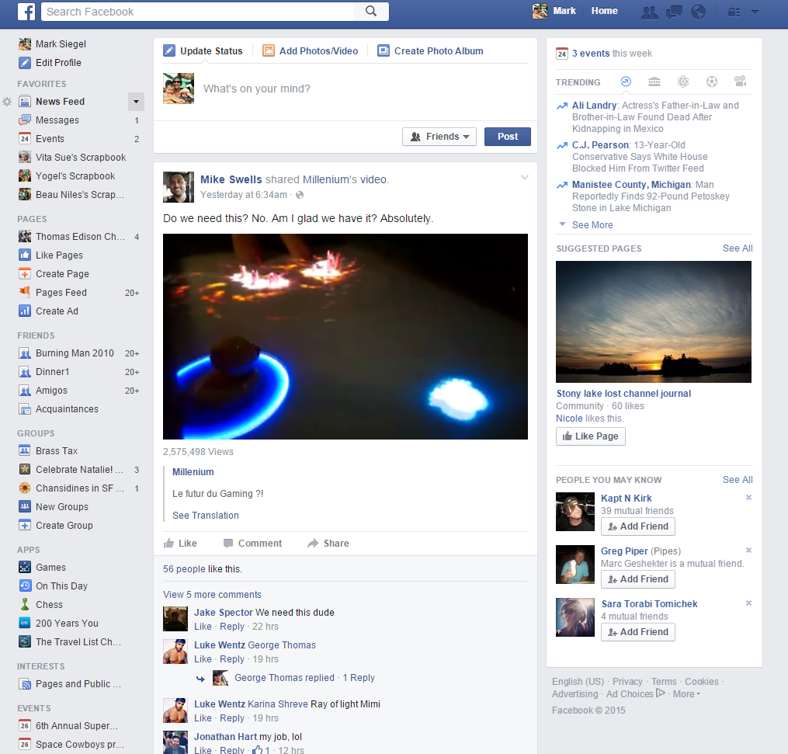

Notes:
Later that evening Mark is browsing Facebook on his tablet and continues to be nurtured by the eBay campaign

Slide 29

Notes:
The ad captures Mark’s attention and he decides to download the app and logs in. At that point we finally identify him as a known user and all that past browsing data gets added to Mark’s Universal Customer Profile (UCP).

Slide 30
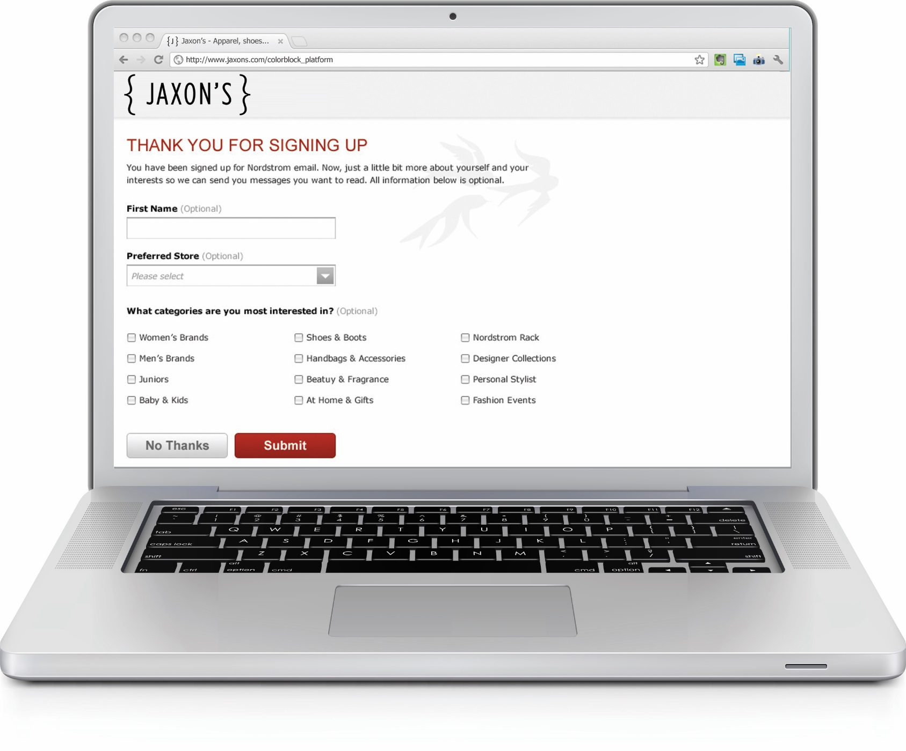
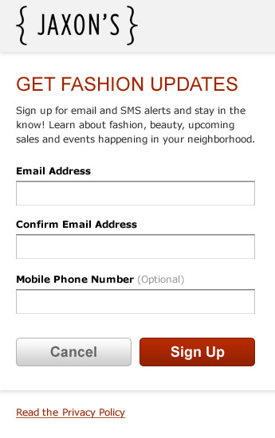

Notes:
Clicking the link Patrick is taken to a landing page for some progressive profiling. You’ll notice in addition to the traditional form fill we present an option for social login

Slide 31



Consumer Identity Graph
Authors/
Posts
Household
Level
CRM
Offline
Sources
Unstructured Social
Reviews
Forums
Contacts
Registration
ID
2nd Party
Cookie Data
Blogs
Customer
Data
Brick
&
Mortar
Cookies
Mobile
Web
Email
3rd-Party
Cookie
Data
1st-Party
Cookie
Data
Other
Emerging
Channels
Matched
Statistical
IDs
Mobile
App
ID
Mapping
Over the
Top
Boxes
Mobile
Web
Addressable
TV
Google
Ad ID
Online
Sources
Microsoft
ID
Set Top
Boxes
Notes:
Up to this point we have collected quite a lot of anonymous data on Patrick adding to his UCP in the ID Graph

Slide 32


Notes:
A few days later, back on the VMware site, Patrick’s experience is being personalized based on his profile information and regardless of whether he visits on his laptop, tablet or phone the experience is the equally relevant and personalized.

Slide 33
