Slide 1


SEM strategies for the classified sector
How to gain maximum profits out of search?
Maciej Gałecki
bluerank
Miami, Nov 7th, 2008
Your way to be no.1 in search engines worldwide…
Miami General Meeting 2008, November 5-9th, 2008
1

Slide 2
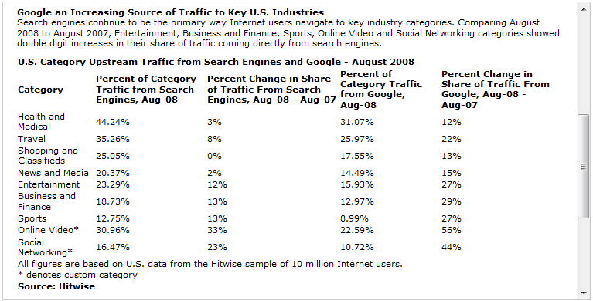
Importance of search
Potential of search engines cannot be ignored by the industry
25% of „Shopping and Classified” traffic comes from search engines’ organic results:
Your way to be no.1 in search engines worldwide…
Miami General Meeting 2008, November 5-9th, 2008
2

Slide 3





Importance of search
Potential of search engines cannot be ignored by the industry
ALL of bluerank’s classified clients gain majority of traffic from both organic & paid listings:
30 – 90% of traffic from SEO / PPC
Your way to be no.1 in search engines worldwide…
Miami General Meeting 2008, November 5-9th, 2008
3

Slide 4
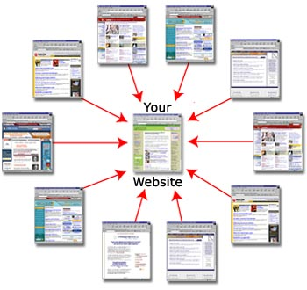


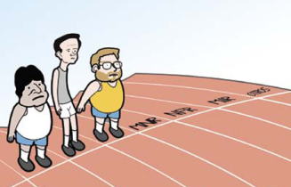
Question: SEO or PPC?
It’s all about competition
SEO
PPC
Links Content
Quality
To improve content, build links (SEO) or work on campaign quality (PPC)?
Yes? No? All?
Your way to be no.1 in search engines worldwide…
Miami General Meeting 2008, November 5-9th, 2008
4

Slide 5
Question: SEO or PPC?
Specifics of SEO and PPC
SEO
„Discreet marketing” – users believe in search results
Long term benefits
PPC
Advert – 40% users do not know it!
Quick results
Unique algorithm of each search engine
Cheap
Common approach
„Affordable” rather than cheap
Limited to the „website potential”
Budget is the only limit
Your way to be no.1 in search engines worldwide…
Miami General Meeting 2008, November 5-9th, 2008
5

Slide 6
SEM strategy
Why to plan Search Engine Marketing in the long term?
SEM strategy is about combining SEO & PPC (as the main channels) in order to:
Emphasize benefits
Reduce disadvantages
Your way to be no.1 in search engines worldwide…
Miami General Meeting 2008, November 5-9th, 2008
6

Slide 7

Planning SEM strategy
SEM is not a standalone activity
It should also be a part of Marketing Mix:
Coherent communication
Claims and slogans
Brands
Communicated values
SEM
Media convergency
Marketing MIX
Your way to be no.1 in search engines worldwide…
Miami General Meeting 2008, November 5-9th, 2008
7

Slide 8

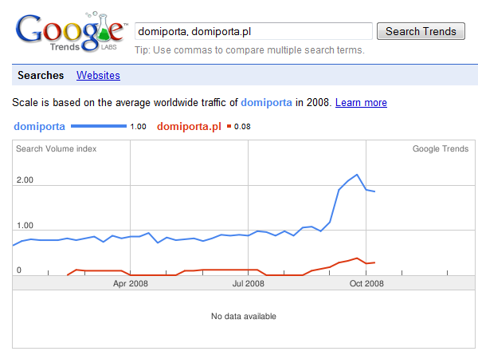
Media convergency
How does offline influence on online?
Domiporta.pl, TV spot
Your way to be no.1 in search engines worldwide…
Miami General Meeting 2008, November 5-9th, 2008
8

Slide 9
Question:
What is YOUR experience with combining offline and online (SEM) e-marketing activities?
Does it really work?
Your way to be no.1 in search engines worldwide…
Miami General Meeting 2008, November 5-9th, 2008
9

Slide 10
SEO or PPC? Or both?
Pros and cons of different approaches
SEO
PPC
Do you have time to wait for results…?
Is it really cheap…?
SEO & PPC =
= maximum exposure in search listings
Your way to be no.1 in search engines worldwide…
Miami General Meeting 2008, November 5-9th, 2008
10

Slide 11
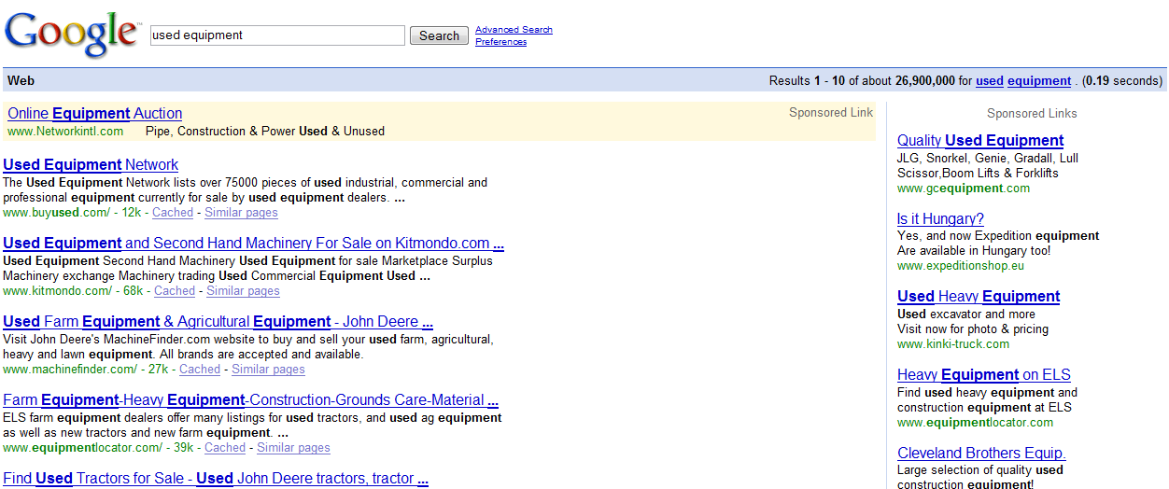
A simple way of combining SEO with PPC
Possible scenarios
Switching on / off PPC gives new possibilities = a constant exposure in listings:
SEO – NO / PPC - YES
SEO – YES / PPC - NO
Your way to be no.1 in search engines worldwide…
Miami General Meeting 2008, November 5-9th, 2008
11

Slide 12
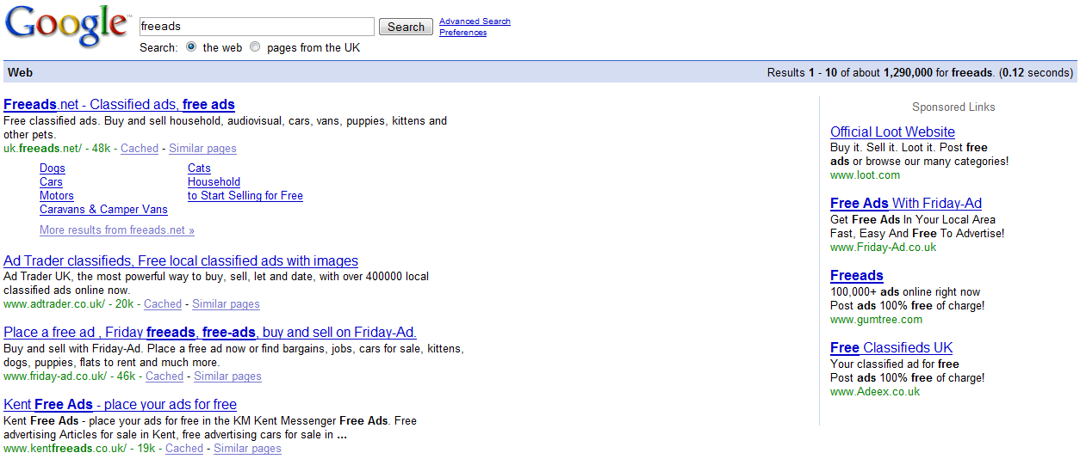
SEO or PPC – not a question anymore
It’s WORTH combining both channels
What if we switch on PPC when successful in SEO?
„Surround effect” – double exposure in search engine listings (paid & organic) at the same time
Your way to be no.1 in search engines worldwide…
Miami General Meeting 2008, November 5-9th, 2008
12

Slide 13
SEO or PPC – not a question anymore
It’s WORTH combining both channels
+50%
(60% queries attracted a click)
(92% queries attracted a click)
Source: Nielsen ReelResearch
Your way to be no.1 in search engines worldwide…
Miami General Meeting 2008, November 5-9th, 2008
13

Slide 14
SEO or PPC – not a question anymore
It’s WORTH combining both channels
+92%
Source: iCrossing.com
Your way to be no.1 in search engines worldwide…
Miami General Meeting 2008, November 5-9th, 2008
14

Slide 15
SEO or PPC – not a question anymore
It’s WORTH combining both channels
SEO
PPC
The Synergy Effect
1 + 1 = 3
Your way to be no.1 in search engines worldwide…
Miami General Meeting 2008, November 5-9th, 2008
15

Slide 16
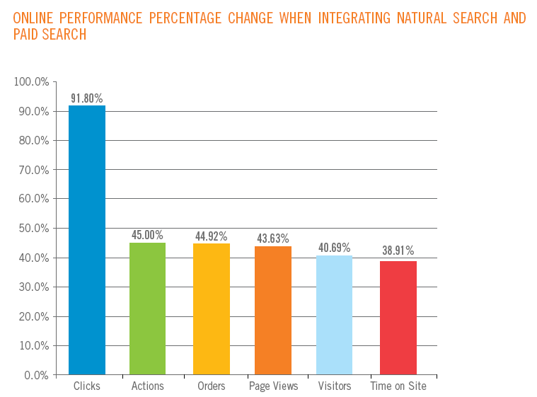
SEO & PPC in SEM strategy
It’s WORTH combining both channels
2 x 2 = 8 ☺
Source: iCrossing.com
Your way to be no.1 in search engines worldwide…
Miami General Meeting 2008, November 5-9th, 2008
16

Slide 17
Question:
What is YOUR experience with combining SEO and PPC?
Does it really work?
Your way to be no.1 in search engines worldwide…
Miami General Meeting 2008, November 5-9th, 2008
17

Slide 18
What do Clients tell us?
As the service provider we face different needs…
„The cheaper the better”
Minimum user acquisition cost is the most important;
SEO preferred to PPC;
The Client is patient… which „costs” time…
BUT:
It takes time – and the competitors are active!
You cannot be 100% sure with results in the future? ☹
Your way to be no.1 in search engines worldwide…
Miami General Meeting 2008, November 5-9th, 2008
18

Slide 19
What do Clients tell us?
As the service provider we face different needs…
„We don’t / can’t wait”
Results have to be RIGHT NOW;
PPC only;
The Client is impatient – which „costs” money…
BUT:
Good for short-term activity – why to pay too much in long term?
Unstable results – they are as long as you spend money;
Your way to be no.1 in search engines worldwide…
Miami General Meeting 2008, November 5-9th, 2008
19

Slide 20
What do Clients tell us?
As the service provider we face different needs…
„We can’t do SEO”
Oh yes, there are still SEO-unfriendly applications;
Critical problems and restrictions limit any SEO opportunities;
The result:
There is nothing left but PPC;
…so we turn to „We can’t wait” model ☹
Your way to be no.1 in search engines worldwide…
Miami General Meeting 2008, November 5-9th, 2008
20

Slide 21
What do Clients tell us?
As the service provider we face different needs
„We want to be present… for a cheap money”
The „Surround effect” doesn’t really convince;
One channel: SEO or PPC at a time;
Tracking rankings allows to switch on / off PPC activities;
The Result:
Constant exposure – well, yes.
BUT:
Maximum traffic – not really ☹
Your way to be no.1 in search engines worldwide…
Miami General Meeting 2008, November 5-9th, 2008
21

Slide 22
What do Clients tell us?
As the service provider we face different needs
„Maximum traffic – this is important to us”
„Surround effect” – Yes, please!
Aggresive exposure – really eye-catching;
Branding effect in long term;
The result:
Constant exposure - certainly;
Maximum traffic – certainly;
Brand recognition and awareness – certainly! ☺
Your way to be no.1 in search engines worldwide…
Miami General Meeting 2008, November 5-9th, 2008
22

Slide 23
What do Clients tell us?
As the service provider we face different needs
„Maximize my ROI”
The channel is not important – it’s all about the keywords / ad placement;
If the keyword converts – „Maximum traffic – this is important to us”;
If the keyword does not bring profits – let’s cut costs;
The result:
Positive ROI – that’s the goal;
BUT:
Sales effect only (nothing in common with the branding);
Your way to be no.1 in search engines worldwide…
Miami General Meeting 2008, November 5-9th, 2008
23

Slide 24
What do Clients tell us?
As the service provider we face different needs
„PPC test – for the purposes of SEO”
Close to „Maximize my ROI” – goal is to choose keywords to gain natural rankings for;
Keyword profitability is the most important factor;
The result:
Proven figures = NO risk of inefficient SEO;
BUT:
We again focus on sales only;
Test different approaches – also the bad ones.
Your way to be no.1 in search engines worldwide…
Miami General Meeting 2008, November 5-9th, 2008
24

Slide 25


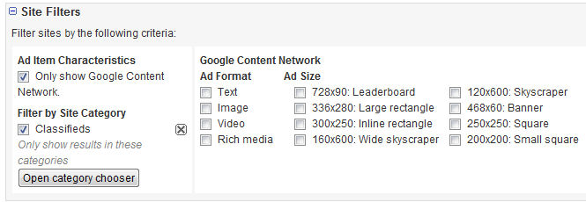
SEM is not only about search results pages
Don’t forget contextual advertising
A succesful SEM strategy incorporates other opportunities delivered by search engines – like content targetting.
Your way to be no.1 in search engines worldwide…
Miami General Meeting 2008, November 5-9th, 2008
25

Slide 26
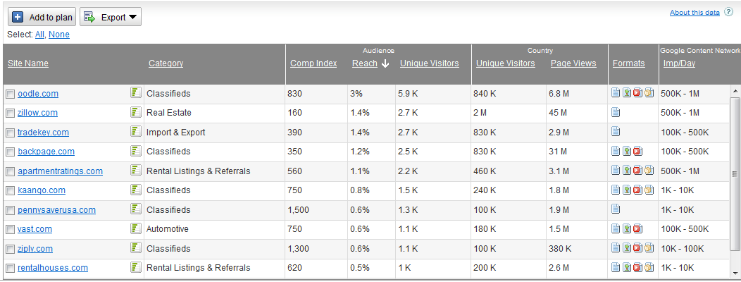
SEM is not only about search results pages
Don’t forget contextual advertising
Result: Wide reach in a short time with multiple ad formats bringing cheap traffic.
Your way to be no.1 in search engines worldwide…
Miami General Meeting 2008, November 5-9th, 2008
26

Slide 27
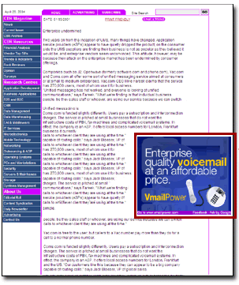

SEM is not only about search results pages
Don’t forget contextual advertising
Thousands of websites match with your content:
Branding effect;
A coherent communication;
Making use of media convergency;
Example: an article mentioning your brand / website – are you sure there is always a link available for the interested people?
Your way to be no.1 in search engines worldwide…
Miami General Meeting 2008, November 5-9th, 2008
27

Slide 28
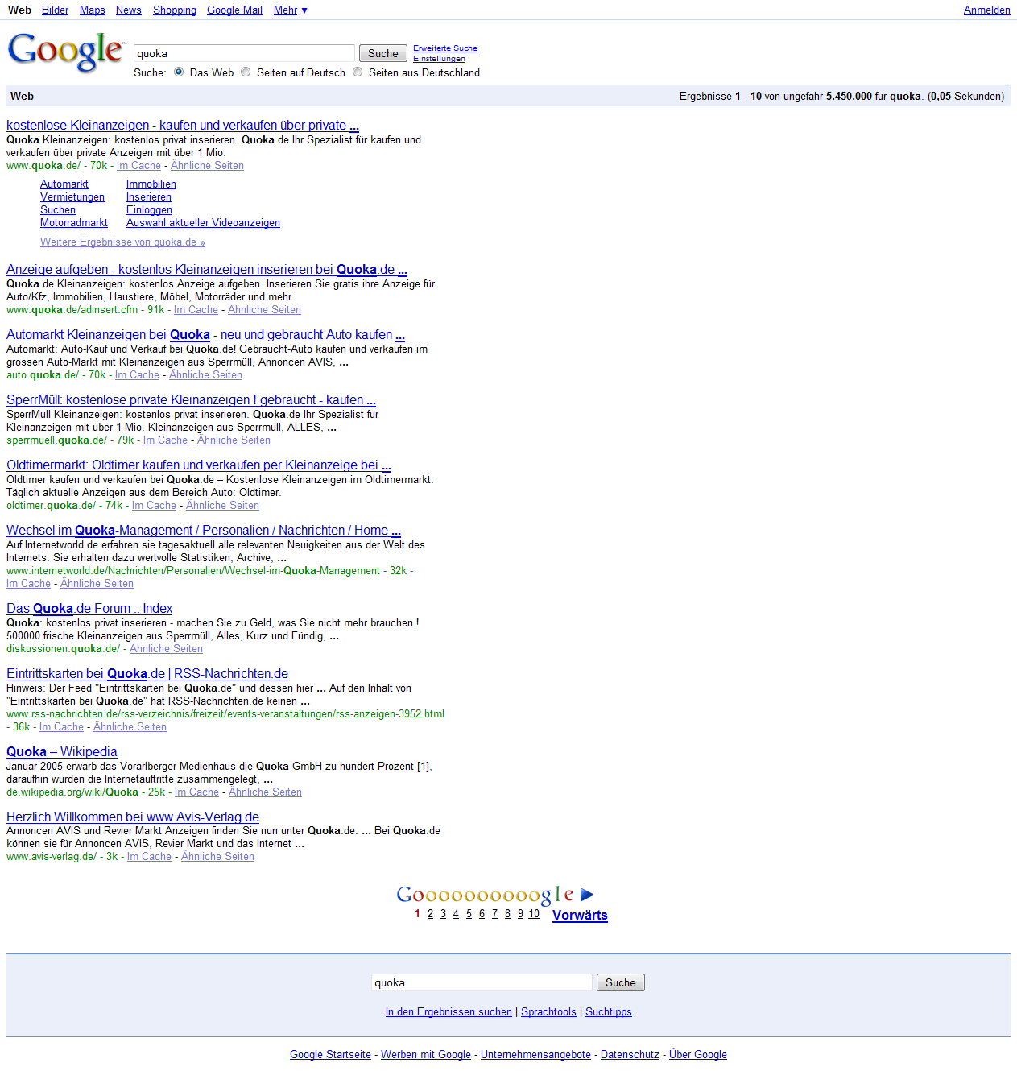
SEM strategy – things to remember
Sometimes you HAVE TO be present in search listings
SEO:
Brands, branded keywords – what appears in Top10?
Homepage (1);
„Place an ad” (2);
Important sections, e.g. „cars” (3, 5);
PR news (6);
Web 2.0 – forum, RSS (7, 8);
2 other brands of the company (4, 10);
Wikipedia (9);
NO negative entries!
Your way to be no.1 in search engines worldwide…
Miami General Meeting 2008, November 5-9th, 2008
28

Slide 29
SEM strategy – things to remember
Sometimes you HAVE TO be present in search listings
PPC:
Temporary promotions, e.g. „Premium Ad with XX% discount NOW”;
When you cannot do SEO with your application;
Or when the keywords are too competitive in SEO;
Finally, when your competitors are too good in SEO ☹
Your way to be no.1 in search engines worldwide…
Miami General Meeting 2008, November 5-9th, 2008
29

Slide 30
Conclusions
What does SEM strategy mean to me – the classified site owner?
A wide range of approaches allows to define a SEM strategy relevant to particular project’s needs and targets;
SEM strategy is something to plan in the long term;
SEM is always a part of Marketing Mix – and has to be included in the general marketing strategy of the company;
OR…
„If you are listed nowhere in Google, you don’t exist”
Your way to be no.1 in search engines worldwide…
Miami General Meeting 2008, November 5-9th, 2008
30

Slide 31
The Final Question:
Which SEM approach is the most relevant one for you?
Your way to be no.1 in search engines worldwide…
Miami General Meeting 2008, November 5-9th, 2008
31

Slide 32

Thank you,
Maciej Gałecki,
CEO, Bluerank
80 Gdańska street
90613 Łódź, Poland
P: 004842 632 33 21
M: 0048 0502 224 467
m.galecki@bluerank.pl
www.bluerank.pl | bluerank.blogspot.com
Your way to be no.1 in search engines worldwide…
Miami General Meeting 2008, November 5-9th, 2008
32

